Slide 1
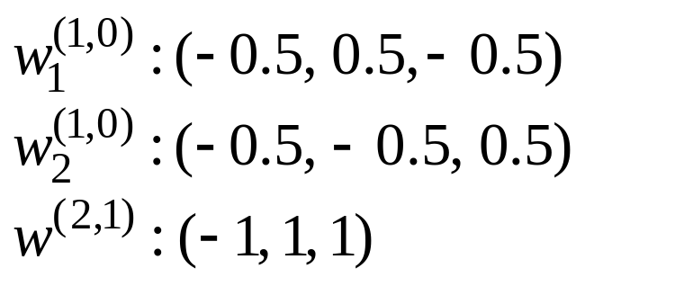
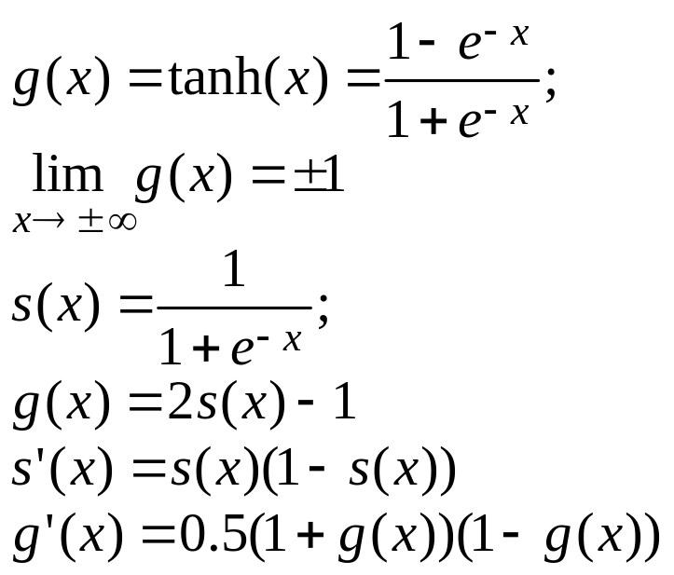


Example, BP learning function XOR
Training samples (bipolar)
Network: 2-2-1 with thresholds (fixed output 1)
Initial weights W(0)
Learning rate = 0.2
Node function: hyperbolic tangent
 | in_1 | in_2 | d
P0 | -1 | -1 | -1
P1 | -1 | 1 | 1
P2 | 1 | -1 | 1
P3 | 1 | 1 | 1
0
0
p_{j}
1
1
o
2
2
W^{(1,0)}
W^{(2,1)}

Slide 2
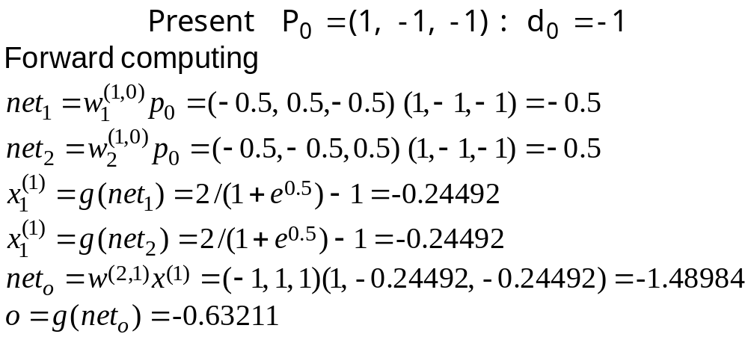
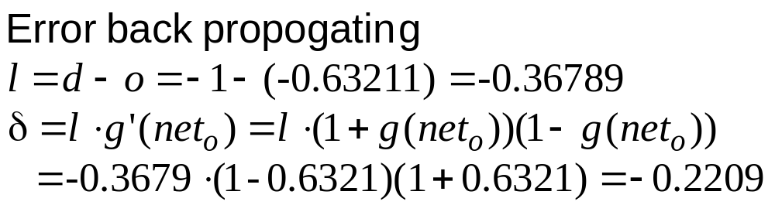
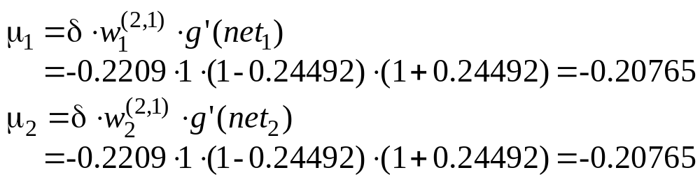

Slide 3
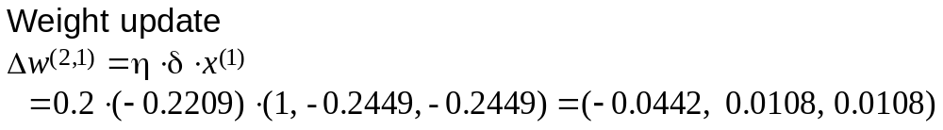
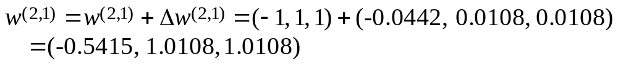
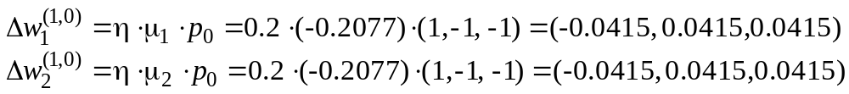
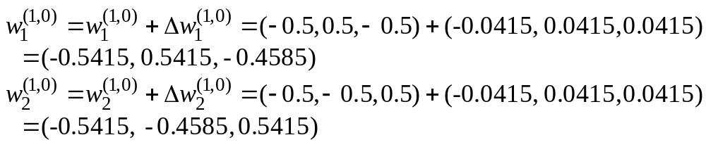

Slide 4
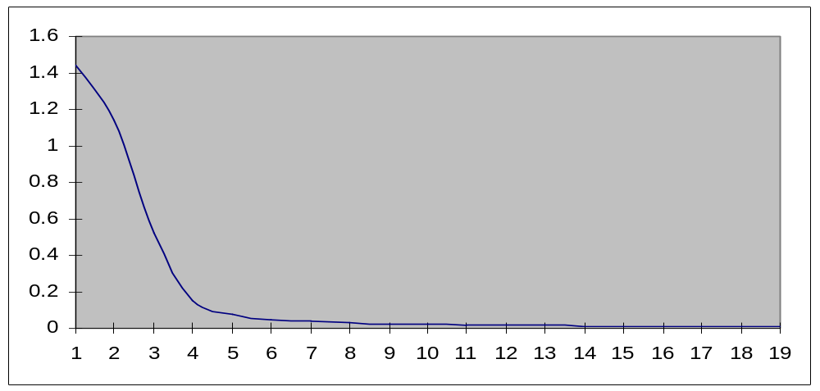
MSE reduction:
every 10 epochs
Output: every 10 epochs
epoch | 1 | 10 | 20 | 40 | 90 | 140 | 190 | d
P0 | -0.63 | -0.05 | -0.38 | -0.77 | -0.89 | -0.92 | -0.93 | -1
P1 | -0.63 | -0.08 | 0.23 | 0.68 | 0.85 | 0.89 | 0.90 | 1
P2 | -0.62 | -0.16 | 0.15 | 0.68 | 0.85 | 0.89 | 0.90 | 1
p3 | -0.38 | 0.03 | -0.37 | -0.77 | -0.89 | -0.92 | -0.93 | -1
MSE | 1.44 | 1.12 | 0.52 | 0.074 | 0.019 | 0.010 | 0.007

Slide 5
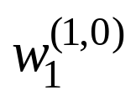
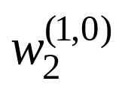

After epoch 1
init | (-0.5, 0.5, -0.5) | (-0.5, -0.5, 0.5) | (-1, 1, 1)
p0 | -0.5415, 0.5415, -0.4585 | -0.5415, -0.45845, 0.5415 | -1.0442, 1.0108, 1.0108
p1 | -0.5732, 0.5732, -0.4266 | -0.5732, -0.4268, 0.5732 | -1.0787, 1.0213, 1.0213
p2 | -0.3858, 0.7607, -0.6142 | -0.4617, -0.3152, 0.4617 | -0.8867, 1.0616, 0.8952
p3 | -0.4591, 0.6874, -0.6875 | -0.5228, -0.3763, 0.4005 | -0.9567, 1.0699, 0.9061
# epoch
13 | -1.4018, 1.4177, -1.6290 | -1.5219, -1.8368, 1.6367 | 0.6917, 1.1440, 1.1693
40 | -2.2827, 2.5563, -2.5987 | -2.3627, -2.6817, 2.6417 | 1.9870, 2.4841, 2.4580
90 | -2.6416, 2.9562, -2.9679 | -2.7002, -3.0275, 3.0159 | 2.7061, 3.1776, 3.1667
190 | -2.8594, 3.18739, -3.1921 | -2.9080, -3.2403, 3.2356 | 3.1995, 3.6531, 3.6468

