Slide 1
Prediction Networks
Prediction
  Predict f(t) based on values of f(t – 1), f(t – 2),…
  Two NN models: feedforward and recurrent
A simple example (section 3.7.3)
  Forecasting gold price at a month based on its prices at previous months
  Using a BP net with a single hidden layer
    1 output node: forecasted price for month t
    k input nodes (using price of previous k months for prediction)
    k hidden nodes
    Training sample: for k = 2: {(x_{t-2}, x_{t-1}) x_{t}}
    Raw data: gold prices for 100 consecutive months, 90 for training, 10 for cross validation testing
    one-lag forecasting: predict x_{t} based on x_{t-2} and x_{t-1}
    multilag: using predicted values for further forecasting

Slide 2
Prediction Networks
Training:
  Three attempts:
  k = 2, 4, 6
  Learning rate = 0.3, momentum = 0.6
  25,000 – 50,000 epochs
  2-2-2 net with good prediction
  Two larger nets over-trained
  Results
  Network MSE
  2-2-1 Training 0.0034
  one-lag 0.0044
  multilag 0.0045
  4-4-1 Training 0.0034
  one-lag 0.0098
  multilag 0.0100
  6-6-1 Training 0.0028
  one-lag 0.0121
  multilag 0.0176

Slide 3


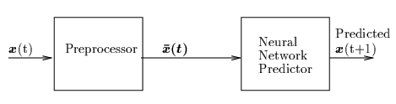

Prediction Networks
Generic NN model for prediction
  Preprocessor prepares training samples from time series data
  Train predictor using samples (e.g., by BP learning)
Preprocessor
  In the previous example,
    Let k = d + 1 (using previous d + 1data points to predict)
  More general:
    c_{i} is called a kernel function for different memory model (how previous data are remembered)
    Examples: exponential trace memory; gamma memory (see p.141)

Slide 4
Prediction Networks
Recurrent NN architecture
  Cycles in the net
    Output nodes with connections to hidden/input nodes
    Connections between nodes at the same layer
    Node may connect to itself
  Each node receives external input as well as input from other nodes
  Each node may be affected by output of every other node
  With a given external input vector, the net often converges to an equilibrium state after a number of iterations (output of every node stops to change)
An alternative NN model for function approximation
  Fewer nodes, more flexible/complicated connections
  Learning is often more complicated

Slide 5
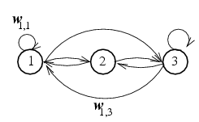
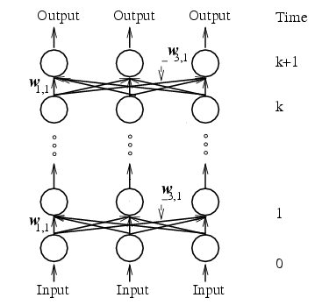

Prediction Networks
Approach I: unfolding to a feedforward net
  Each layer represents a time delay of the network evolution
  Weights in different layers are identical
  Cannot directly apply BP learning (because weights in different layers are constrained to be identical)
  How many layers to unfold to? Hard to determine
A fully connected net of 3 nodes
Equivalent FF net of k layers

Slide 6
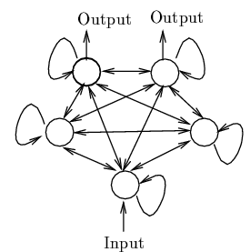
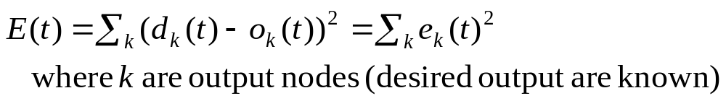
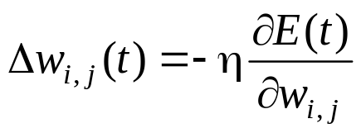
Prediction Networks
Approach II: gradient descent
  A more general approach
  Error driven: for a given external input
  Weight update

Slide 7
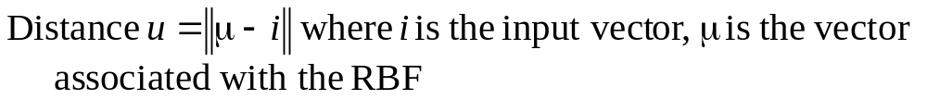

NN of Radial Basis Functions
Motivations: better performance than Sigmoid function
  Some classification problems
  Function interpolation
Definition
  A function is radial symmetric (or is RBF) if its output depends on the distance between the input vector and a stored vector to that function
    Output
  NN with RBF node function are called RBF-nets

Slide 8
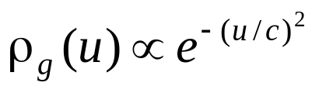
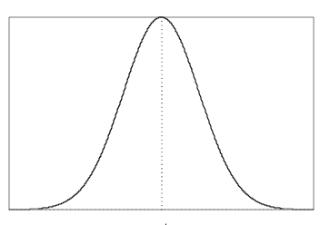
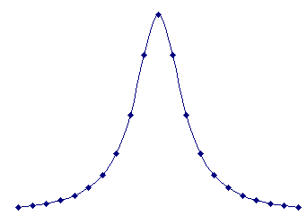
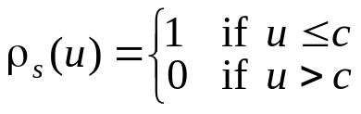

NN of Radial Basis Functions
Gaussian function is the most widely used RBF
  a bell-shaped function centered at u = 0.
  Continuous and differentiable
  Other RBF
    Inverse quadratic function, hypersh]pheric function, etc
μ
μ
μ
Inverse quadratic function
hyperspheric function
Gaussian function

Slide 9
NN of Radial Basis Functions
Pattern classification
  4 or 5 sigmoid hidden nodes are required for a good classification
  Only 1 RBF node is required if the function can approximate the circle
x
x
x
x
x
x
x
x
x
x
x

Slide 10
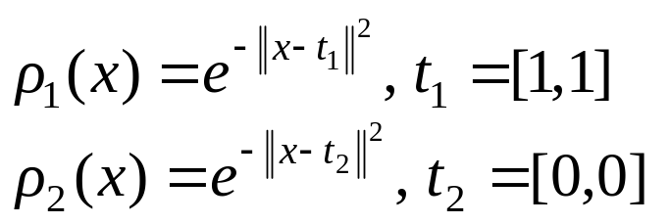


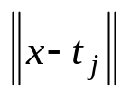
NN of Radial Basis Functions
XOR problem
  2-2-1 network
    2 hidden nodes are RBF:
    Output node can be step or sigmoid
  When input x is applied
    Hidden node calculates distance then its output
    All weights to hidden nodes set to 1
    Weights to output node trained by LMS
    t₁ and t₂ can also been trained
x
(1,1) 1 0.1353
(0,1) 0.3678 0.3678
(0,0) 0.1353 1
(1,0) 0.3678 0.3678
(0, 0)
(0, 1) (1, 0)
(1, 1)

Slide 11








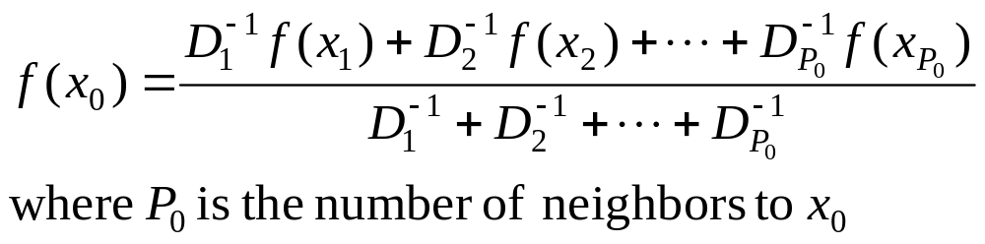

NN of Radial Basis Functions
Function interpolation
  Suppose you know and , to approximate ( ) by linear interpolation:
  Let be the distances of from and then
  i.e., sum of function values, weighted and normalized by distances
  Generalized to interpolating by more than 2 known f values
    Only those with small distance to are useful

Slide 12
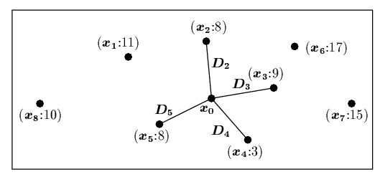

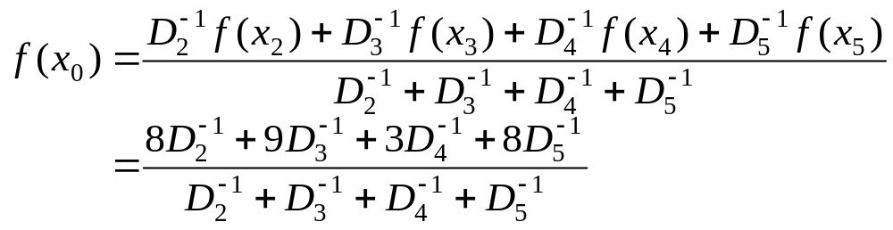


NN of Radial Basis Functions
Example:
  8 samples with known function values
  can be interpolated using only 4 nearest neighbors
Using RBF node to achieve neighborhood effect
  One hidden node per sample:
  Network output for approximating is proportional to

Slide 13



NN of Radial Basis Functions
Clustering samples
  Too many hidden nodes when # of samples is large
  Grouping similar samples together into N clusters, each with
    The center: vector
    Desired mean output:
    Network output:
    Suppose we know how to determine N and how to cluster all P samples (not a easy task itself), and can be determined by learning

Slide 14


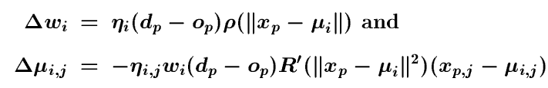
NN of Radial Basis Functions
Learning in RBF net
  Objective:
  learning
  to minimize
  Gradient descent approach
  One can also obtain by other clustering techniques, then use GD learning for only

Slide 15

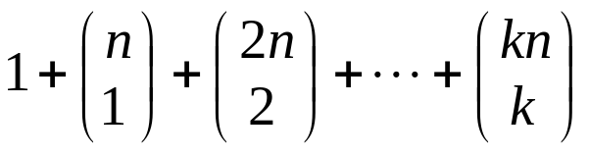
Polynomial Networks
Polynomial networks
  Node functions allow direct computing of polynomials of inputs
  Approximating higher order functions with fewer nodes (even without hidden nodes)
  Each node has more connection weights
Higher-order networks
  # of weights per node:
  Can be trained by LMS

Slide 16

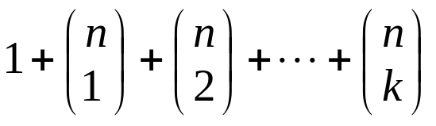



Polynomial Networks
Sigma-pi networks
  Does not allow terms with higher powers of inputs, so they are not a general function approximater
  # of weights per node:
  Can be trained by LMS
Pi-sigma networks
  One hidden layer with Sigma function:
  Output nodes with Pi function:
Product units:
    Node computes product:
    Integer power P_{j,i} can be learned
    Often mix with other units (e.g., sigmoid)

