Slide 1
Chapter 4
Supervised learning:
Multilayer Networks II

Slide 2
Other Feedforward Networks
Madaline
  Multiple adalines (of a sort) as hidden nodes
  Weight change follows minimum disturbance principle
Adaptive multi-layer networks
  Dynamically change the network size (# of hidden nodes)
Prediction networks
  BP nets for prediction
  Recurrent nets
Networks of radial basis function (RBF)
  e.g., Gaussian function
  Perform better than sigmoid function (e.g., interpolation) in function approximation
Some other selected types of layered NN

Slide 3
Madaline
Architectures
  Hidden layers of adaline nodes
  Output nodes differ
Learning
  Error driven, but not by gradient descent
  Minimum disturbance: smaller change of weights is preferred, provided it can reduce the error
Three Madaline models
  Different node functions
  Different learning rules (MR I, II, and III)
  MR I and II developed in 60’s, MR III much later (88)

Slide 4
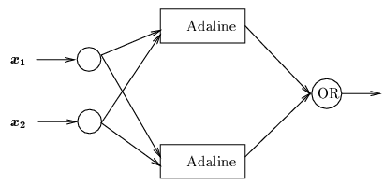
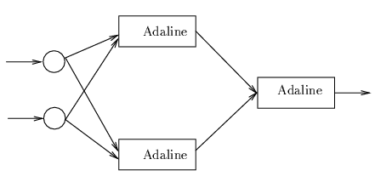
Madaline
MRI net:
  Output nodes with logic function
MRII net:
  Output nodes are adalines
MRIII net:
  Same as MRII, except the nodes with sigmoid function

Slide 5
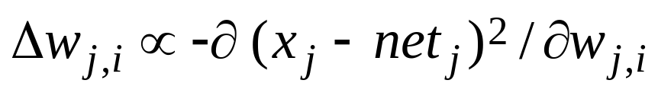
Madaline
MR II rule
  Only change weights associated with nodes which have small |net_{j} |
  Bottom up, layer by layer
Outline of algorithm
  At layer h: sort all nodes in order of increasing net values, remove those with net <θ, put them in S
  For each A_{j} in S
  if reversing its output (change x_{j} to -x_{j}) improves the output error, then change the weight vector leading into A_{j} by LMS of Adaline (or other ways)

Slide 6


Madaline
MR III rule
  Even though node function is sigmoid, do not use gradient descent (do not assume its derivative is known)
  Use trial adaptation
  E: total square error at output nodes
  E_{k}: total square error at output nodes if net_{k} at node k is increased by ε (> 0)
  Change weight leading to node k according to
or
  Update weight to one node at a time
  It can be shown to be equivalent to BP
  Since it is not explicitly dependent on derivatives, this method can be used for hardware devices that inaccurately implement sigmoid function

Slide 7
Adaptive Multilayer Networks
Smaller nets are often preferred
  Computing is faster
  Generalize better
  Training is faster
    Fewer weights to be trained
    Smaller # of training samples needed
Heuristics for “optimal” net size
  Pruning: start with a large net, then prune it by removing unimportant nodes and associated connections/weights
  Growing: start with a very small net, then continuously increase its size with small increments until the performance becomes satisfactory
  Combining the above two: a cycle of pruning and growing until performance is satisfied and no more pruning is possible

Slide 8

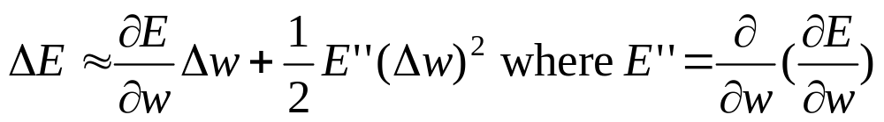
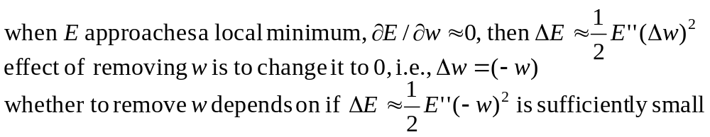

Adaptive Multilayer Networks
Pruning a network by removing
  Weights with small magnitude (e.g., ≈ 0)
  Nodes with small incoming weights
  Weights whose existence does not significantly affect network output
    If is negligible
  By examining the second derivative
  Input nodes can also be pruned if the resulting change of is negligible

Slide 9
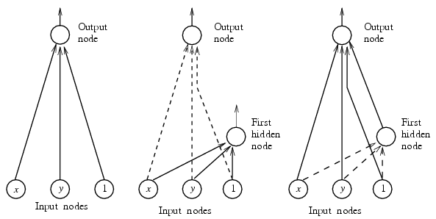
Adaptive Multilayer Networks
Cascade correlation (example of growing net size)
  Cascade architecture development
    Start with a net without hidden nodes
    Each time one hidden node is added between the output nodes and all other nodes
    The new node is connected TO output nodes, and FROM all other nodes (input and all existing hidden nodes)
    Not strictly feedforward

Slide 10
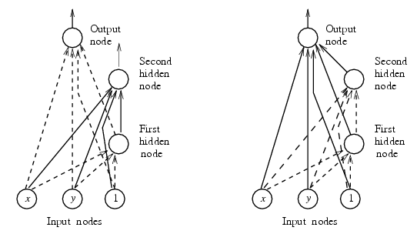
Adaptive Multilayer Networks
  Correlation learning: when a new node n is added
    first train all input weights to node n from all nodes below (maximize covariance with current error of output nodes E)
    then train all weight to output nodes (minimize E)
    quickprop is used
    all other weights to lower hidden nodes are not changes (so it trains fast)

Slide 11
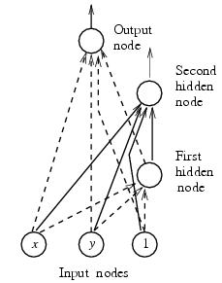
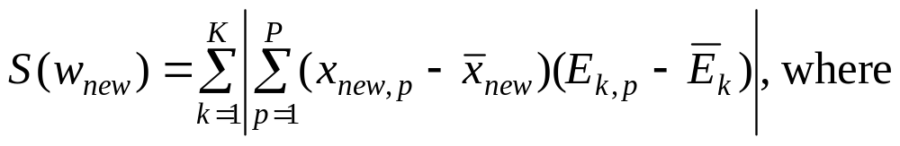
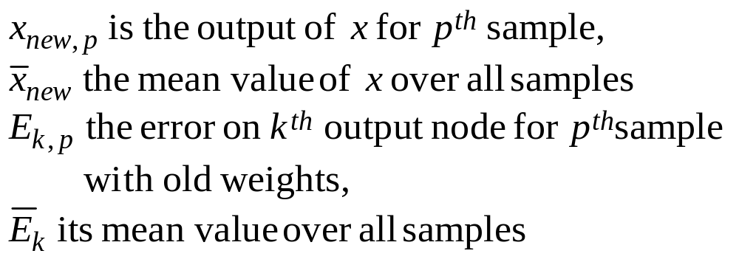




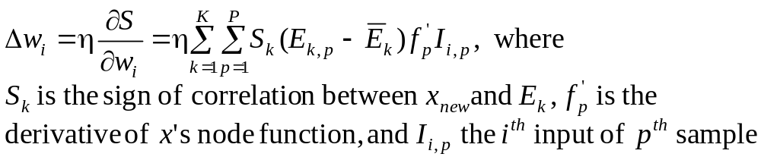
Adaptive Multilayer Networks
x_{new}
  Train w_{new} to maximize covariance
    covariance between x and E_{old}
w_{new}
    when S(w_{new}) is maximized, variance of from mirrors that of error from ,
    S(w_{new}) is maximized by gradient ascent

Slide 12
Adaptive Multilayer Networks
  Example: corner isolation problem
    Hidden nodes are with sigmoid function ([-0.5, 0.5])
    When trained without hidden node: 4 out of 12 patterns are misclassified
    After adding 1 hidden node, only 2 patterns are misclassified
    After adding the second hidden node, all 12 patterns are correctly classified
    At least 4 hidden nodes are required with BP learning
X
X
X
X

Slide 13
Prediction Networks
Prediction
  Predict f(t) based on values of f(t – 1), f(t – 2),…
  Two NN models: feedforward and recurrent
A simple example (section 3.7.3)
  Forecasting commodity price at month t based on its prices at previous months
  Using a BP net with a single hidden layer
    1 output node: forecasted price for month t
    k input nodes (using price of previous k months for prediction)
    k hidden nodes
    Training sample: for k = 2: {(x_{t-2}, x_{t-1}) x_{t}}
    Raw data: flour prices for 100 consecutive months, 90 for training, 10 for cross validation testing
    one-lag forecasting: predict x_{t} based on x_{t-2} and x_{t-1}
    multilag: using predicted values for further forecasting

Slide 14
Prediction Networks
Training:
  90 input data values
  Last 10 prices for validation test
  Three attempts:
  k = 2, 4, 6
  Learning rate = 0.3, momentum = 0.6
  25,000 – 50,000 epochs
  2-2-2 net with good prediction
  Two larger nets over-trained (with larger prediction errors for validation data)
  Results
  Network MSE
  2-2-1 Training 0.0034
  one-lag 0.0044
  multilag 0.0045
  4-4-1 Training 0.0034
  one-lag 0.0098
  multilag 0.0100
  6-6-1 Training 0.0028
  one-lag 0.0121
  multilag 0.0176

Slide 15


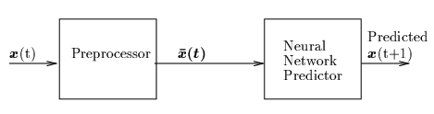
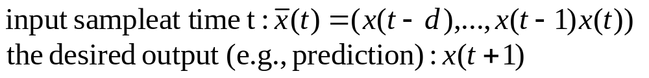

Prediction Networks
Generic NN model for prediction
  Preprocessor prepares training samples from time series data
  Train predictor using samples (e.g., by BP learning)
Preprocessor
  In the previous example,
    Let k = d + 1 (using previous d + 1data points to predict)
  More general:
    c_{i} is called a kernel function for different memory model (how previous data are remembered)
    Examples: exponential trace memory; gamma memory (see p.141)

Slide 16
Prediction Networks
Recurrent NN architecture
  Cycles in the net
    Output nodes with connections to hidden/input nodes
    Connections between nodes at the same layer
    Node may connect to itself
  Each node receives external input as well as input from other nodes
  Each node may be affected by output of every other node
  With a given external input vector, the net often converges to an equilibrium state after a number of iterations (output of every node stops to change)
An alternative NN model for function approximation
  Fewer nodes, more flexible/complicated connections
  Learning procedure is often more complicated

Slide 17
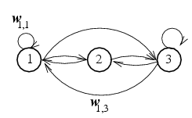
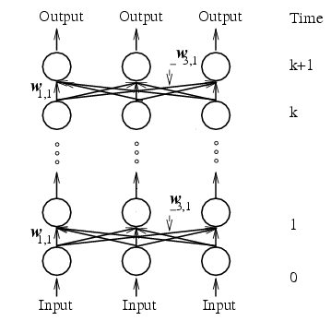

Prediction Networks
Approach I: unfolding to a feedforward net
  Each layer represents a time delay of the network evolution
  Weights in different layers are identical
  Cannot directly apply BP learning (because weights in different layers are constrained to be identical)
  How many layers to unfold to? Hard to determine
A fully connected net of 3 nodes
Equivalent FF net of k layers

Slide 18
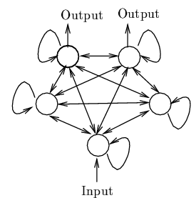
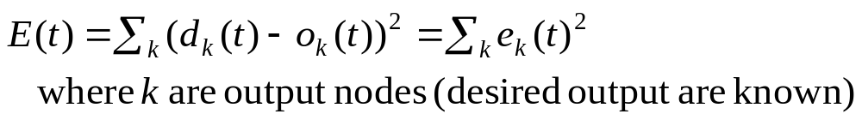
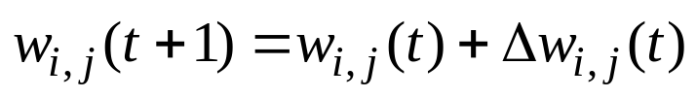
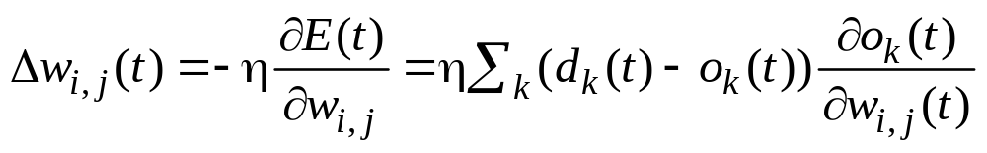
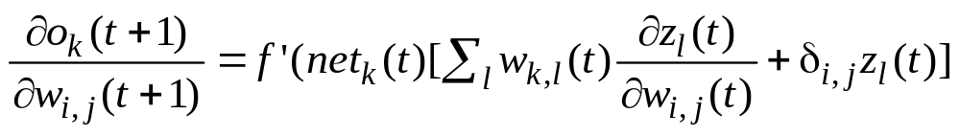
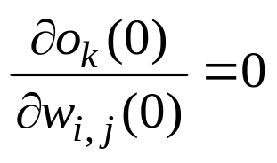
Prediction Networks
Approach II: gradient descent
  A more general approach
  Error driven: for a given external input
  Weight update

Slide 19
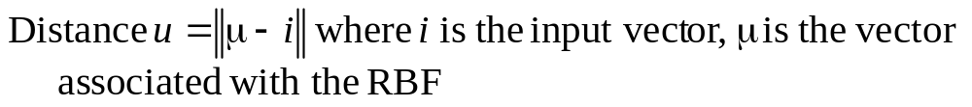

NN of Radial Basis Functions
Motivations: better performance than sigmoid functions
  Some classification problems
  Function interpolation
Definition
  A function is radial symmetric (or is RBF) if its output depends on the distance between the input vector and a stored vector related to that function
    Output
  NN with RBF node function are called RBF-nets

Slide 20
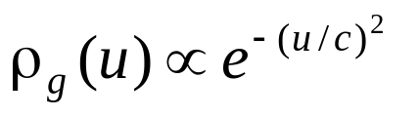
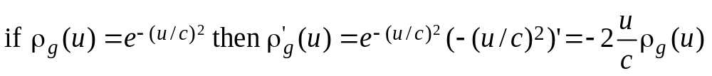
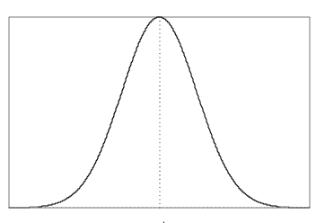
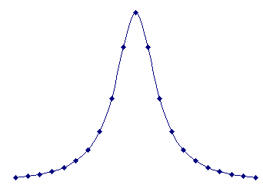
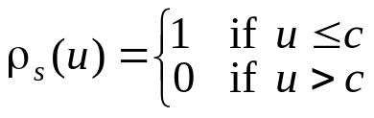

NN of Radial Basis Functions
Gaussian function is the most widely used RBF
  a bell-shaped function centered at u = 0.
  Continuous and differentiable
  Other RBF
    Inverse quadratic function, hypersh]pheric function, etc
μ
μ
μ
Inverse quadratic function
hyperspheric function
Gaussian function

Slide 21
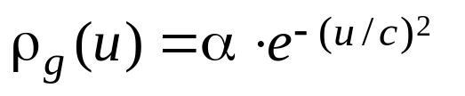
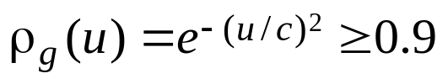
Consider Gaussian function again
  μ gives the center of the region for activating this unit
  α gives the max output
  c determines the size of the region
  ex: for
  c = 0.1 u = 0.03246
  c = 1.0 u = 0.3246
  c = 10. u = 3.246
Small c
Large c

Slide 22
NN of Radial Basis Functions
Pattern classification
  4 or 5 sigmoid hidden nodes are required for a good classification
  Only 1 RBF node is required if the function can approximate the circle
x
x
x
x
x
x
x
x
x
x
x

Slide 23
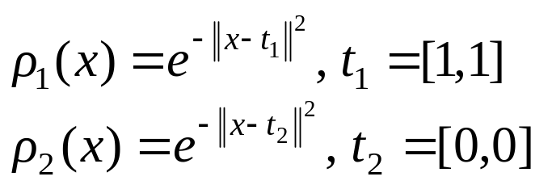


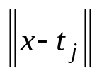
NN of Radial Basis Functions
XOR problem
  2-2-1 network
    2 hidden nodes are RBF:
    Output node can be step or sigmoid
  When input x is applied
    Hidden node calculates distance then its output
    All weights to hidden nodes set to 1
    Weights to output node trained by LMS
    t₁ and t₂ can also been trained
x
(1,1) 1 0.1353
(0,1) 0.3678 0.3678
(1,0) 0.3678 0.3678
(0,0) 0.1353 1
(0, 0)
(0, 1) (1, 0)
(1, 1)

Slide 24








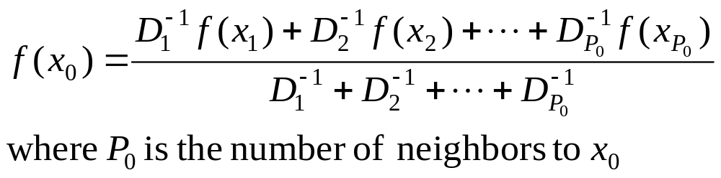

NN of Radial Basis Functions
Function interpolation
  Suppose you know and , to approximate ( ) by linear interpolation:
  Let be the distances of from and then
  i.e., sum of function values, weighted and normalized by distances
  Generalized to interpolating by more than 2 known f values
    Only those with small distance to are useful

Slide 25
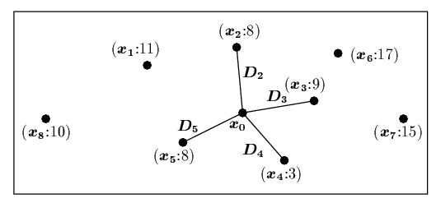

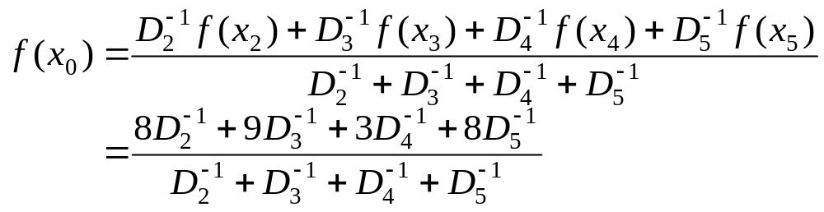
NN of Radial Basis Functions
Example:
  8 samples with known function values
  can be interpolated using only 4 nearest neighbors

Slide 26




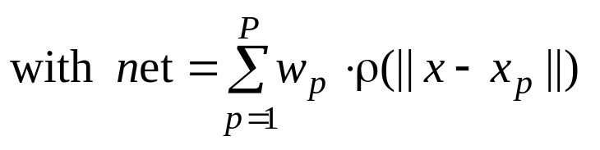

NN of Radial Basis Functions
Using RBF node to achieve neighborhood
  One hidden node per sample x_{p}: μ = x_{p}, and
  Network output for approximating is proportional to
weights
w_{p} = d_{p}/P
output node
hidden RBF nodes:
Output ρ(||x – x_{p}||)
x

Slide 27



NN of Radial Basis Functions
Clustering samples
  Too many hidden nodes when # of samples is large
  Grouping similar samples (having similar input and similar desired output) together into N clusters, each with
    The center: vector
    Mean desired output:
    Network output:
    Suppose we know how to determine N and how to cluster all P samples (not a easy task itself), and can be determined by learning

Slide 28


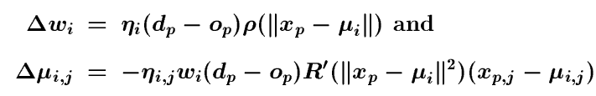
NN of Radial Basis Functions
Learning in RBF net
  Objective:
  learning
  to minimize
  Gradient descent approach
  One can also obtain by other clustering techniques, then use GD learning for only

Slide 29
NN of Radial Basis Functions
A strategy for learning RBF net
  Start with a single RBF hidden node for a single cluster containing only the first training sample.
  For each of the new training samples x
    If it is close to any of the existing clusters, do the gradient descent based updates of the w and φ for all clusters/hidden nodes
    Otherwise, adding a new hidden node for a cluster containing only x
RBF networks are universal approximators
  same representational power as BP networks

Slide 30

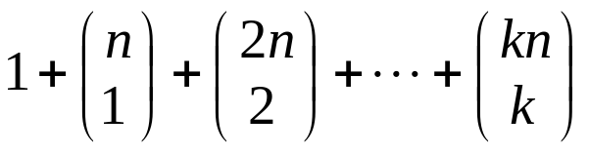
Polynomial Networks
Polynomial networks
  Node functions allow direct computing of polynomials of inputs
  Approximating higher order functions with fewer nodes (even without hidden nodes)
  Each node has more connection weights
Higher-order networks
  # of weights per node:
  Can be trained by LMS
  General function approximator

Slide 31

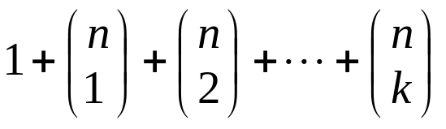



Polynomial Networks
Sigma-pi networks
  Does not allow terms with higher powers of inputs, so they are not a general function approximator
  # of weights per node:
  Can be trained by LMS
Pi-sigma networks
  One hidden layer with Sigma function:
  Output nodes with Pi function:
Product units:
    Node computes product:
    Integer power P_{j,i} can be learned
    Often mix with other units (e.g., sigmoid)

