Slide 1
Self-Organizing Maps (SOM) (§ 5.5)
Competitive learning (Kohonen 1982) is a special case of SOM (Kohonen 1989)
In competitive learning,
  the network is trained to organize input vector space into subspaces/classes/clusters
  each output node corresponds to one class
  the output nodes are not ordered: random map
cluster_1
The topological order of the three clusters is 1, 2, 3
The order of their maps at output nodes are 2, 3, 1
The map does not preserve the topological order of the training vectors
cluster_2
w_2
w_3
cluster_3
w_1

Slide 2



Topographic map
  a mapping that preserves neighborhood relations between input vectors, (topology preserving or feature preserving).
  if are two neighboring input vectors ( by some distance metrics),
    their corresponding winning output nodes (classes), i and j must also be close to each other in some fashion
  one dimensional: line or ring, node i has neighbors or
  two dimensional: grid.
  rectangular: node(i, j) has neighbors:
  hexagonal: 6 neighbors

Slide 3
Biological motivation
  Mapping two dimensional continuous inputs from sensory organ (eyes, ears, skin, etc) to two dimensional discrete outputs in the nerve system.
    Retinotopic map: from eye (retina) to the visual cortex.
    Tonotopic map: from the ear to the auditory cortex
  These maps preserve topographic orders of input.
  Biological evidence shows that the connections in these maps are not entirely “pre-programmed” or “pre-wired” at birth. Learning must occur after the birth to create the necessary connections for appropriate topographic mapping.

Slide 4
SOM Architecture
Two layer network:
  Output layer:
    Each node represents a class (of inputs)
    Neighborhood relation is defined over these nodes
      N_{j}(t): set of nodes within distance D(t) to node j.
    Each node cooperates with all its neighbors and competes with all other output nodes.
    Cooperation and competition of these nodes can be realized by Mexican Hat model
D = 0: all nodes are competitors (no cooperative) → random map
D > 0: → topology preserving map

Slide 5
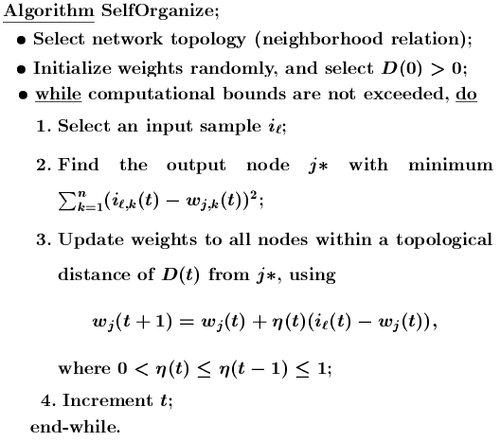

Slide 6





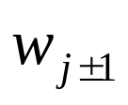
Notes
Initial weights: small random value from (-e, e)
Reduction of :
  Linear:
  Geometric:
Reduction of D:
  should be much slower than reduction.
  D can be a constant through out the learning.
Effect of learning
  For each input i, not only the weight vector of winner
  is pulled closer to i, but also the weights of ’s close neighbors (within the radius of D).
Eventually, becomes close (similar) to . The classes they represent are also similar.
May need large initial D in order to establish topological order of all nodes

Slide 7
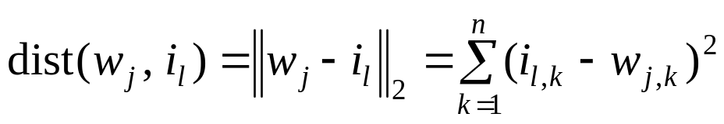
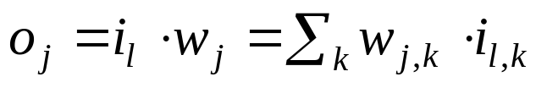
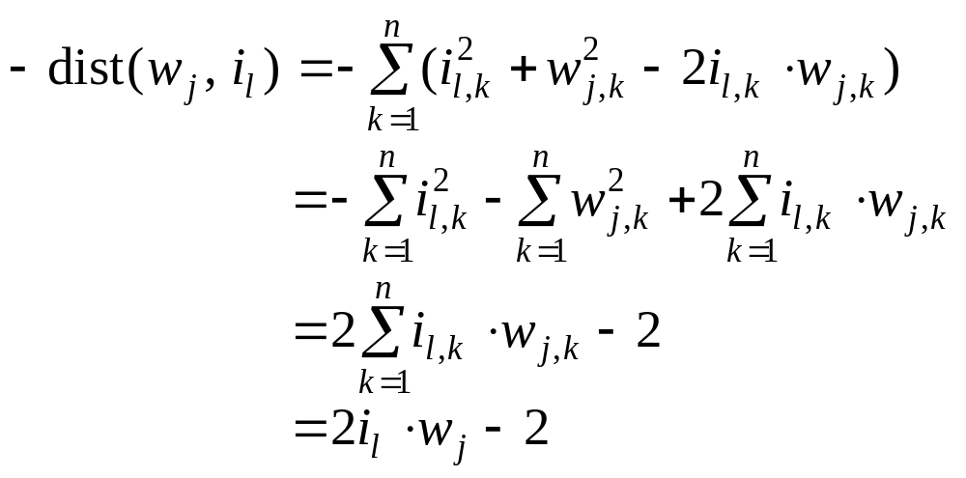
Notes
Find j* for a given input i_{l}:
  With minimum distance between w_{j} and i_{l}.
  Distance:
  Minimizing dist(w_{j}, i_{l}) can be realized by maximizing

Slide 8
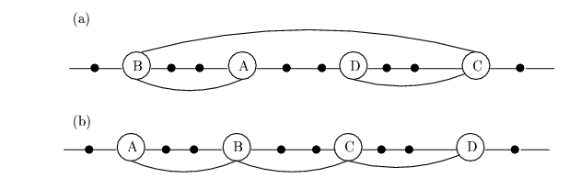
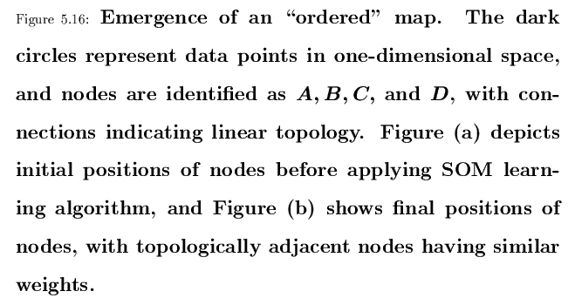

Slide 9






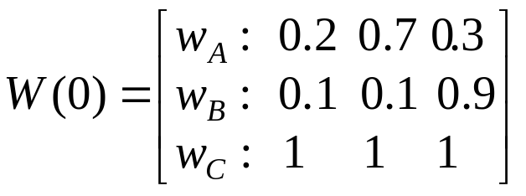




Examples
A simple example of competitive learning (pp. 172-175)
  6 vectors of dimension 3 in 3 classes, node ordering: B – A – C
  Initialization: , weight matrix:
  D(t) = 1 for the first epoch, = 0 afterwards
  Training with
  determine winner: squared Euclidean distance between
  C wins, since D(t) = 1, weights of node C and its neighbor A are updated, bit not w_{B}

Slide 10
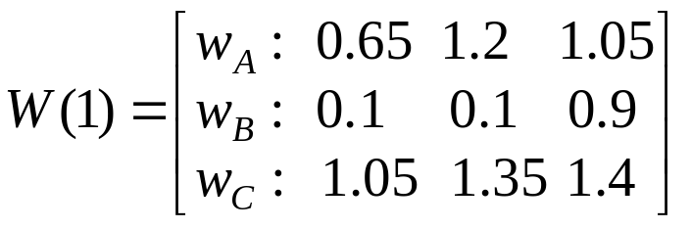
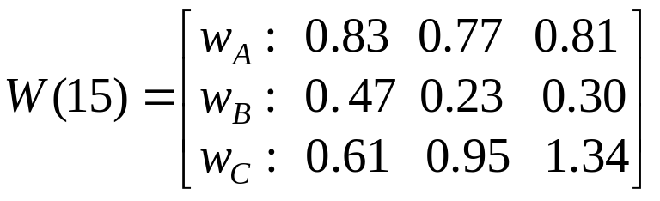
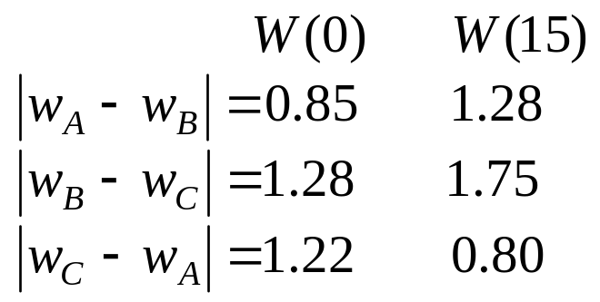
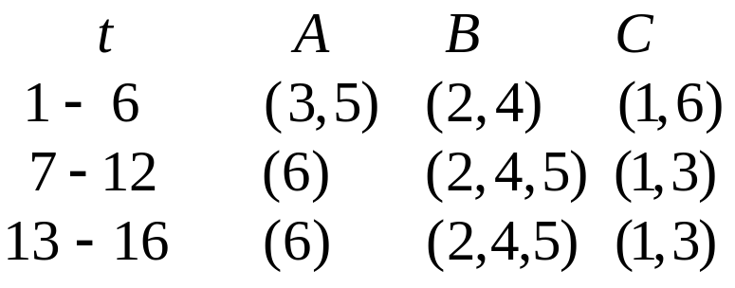
Examples
  Observations:
    Distance between weights of non-neighboring nodes (B, C) increase
    Input vectors switch allegiance between nodes, especially in the early stage of training

Slide 11
How to illustrate Kohonen map (for 2 dimensional patterns)
  Input vector: 2 dimensional
  Output vector: 1 dimensional line/ring or 2 dimensional grid.
  Weight vector is also 2 dimensional
  Represent the topology of output nodes by points on a 2 dimensional plane. Plotting each output node on the plane with its weight vector as its coordinates.
  Connecting neighboring output nodes by a line
  output nodes: (1, 1) (2, 1) (1, 2)
  weight vectors: (0.5, 0.5) (0.7, 0.2) (0.9, 0.9)
C(1, 2)
C(1, 1)
C(2, 1)

Slide 12
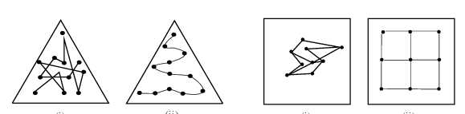
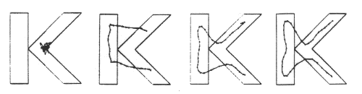
Illustration examples
Input vectors are uniformly distributed in the region, and randomly drawn from the region
Weight vectors are initially drawn from the same region randomly (not necessarily uniformly)
Weight vectors become ordered according to the given topology (neighborhood), at the end of training

Slide 13
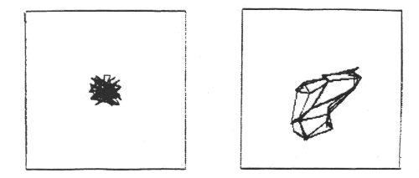
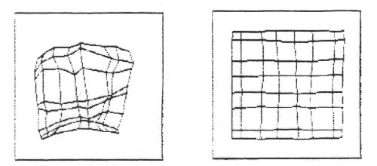

Slide 14
Traveling Salesman Problem (TSP)
Given a road map of n cities, find the shortest tour which visits every city on the map exactly once and then return to the original city (Hamiltonian circuit)
(Geometric version):
  A complete graph of n vertices on a unit square.
  Each city is represented by its coordinates (x_i, y_i)
  n!/2n legal tours
  Find one legal tour that is shortest

Slide 15
Approximating TSP by SOM
Each city is represented as a 2 dimensional input vector (its coordinates (x, y)),
Output nodes C_j, form a SOM of one dimensional ring, (C_1, C_2, …, C_n, C_1).
Initially, C_1, ... , C_n have random weight vectors, so we don’t know how these nodes correspond to individual cities.
During learning, a winner C_j on an input (x_I, y_I) of city i, not only moves its w_j toward (x_I, y_I), but also that of of its neighbors (w_(j+1), w_(j-1)).
As the result, C_(j-1) and C_(j+1) will later be more likely to win with input vectors similar to (x_I, y_I), i.e, those cities closer to I
At the end, if a node j represents city I, it would end up to have its neighbors j+1 or j-1 to represent cities similar to city I (i,e., cities close to city I).
This can be viewed as a concurrent greedy algorithm

Slide 16
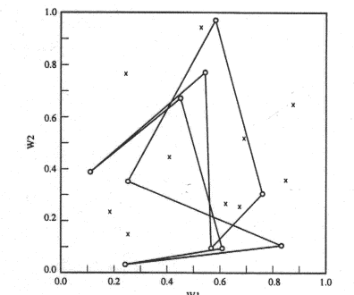
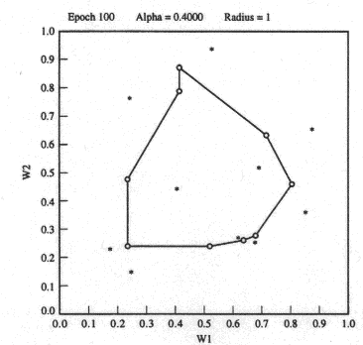
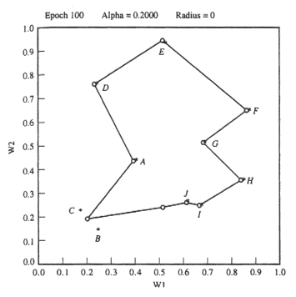
Initial position
Two candidate solutions:
  ADFGHIJBC
  ADFGHIJCB

Slide 17
Convergence of SOM Learning
Objective of SOM: converge to an ordered map
  Nodes are ordered if for all nodes r, s, q
One-dimensional SOP
  If neighborhood relation satisfies certain properties, then there exists a sequence of input patterns that will lead the learn to converge to an ordered map
  When other sequence is used, it may converge, but not necessarily to an ordered map
SOM learning can be viewed as of two phases
  Volatile phase: search for niches to move into
  Sober phase: nodes converge to centroids of its class of inputs
  Whether a “right” order can be established depends on “volatile phase,

Slide 18
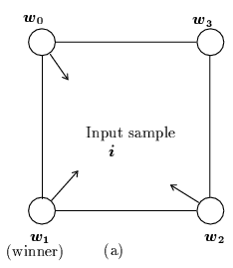
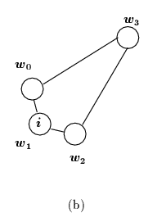
Convergence of SOM Learning
For multi-dimensional SOM
  More complicated
  No theoretical results
Example
  4 nodes located at 4 corners
  Inputs are drawn from the region that is near the center of the square but slightly closer to w₁
  Node 1 will always win, w₁, w₀, and w₂ will be pulled toward inputs, but w₃ will remain at the far corner
  Nodes 0 and 2 are adjacent to node 3, but not to each other. However, this is not reflected in the distances of the weight vectors:
  |w₀ – w₂| < |w₃ – w₂|

Slide 19
Extensions to SOM
Hierarchical maps:
  Hierarchical clustering algorithm
    Tree of clusters:
    Each node corresponds to a cluster
    Children of a node correspond to subclusters
    Bottom-up: smaller clusters merged to higher level clusters
  Simple SOM not adequate
    When clusters have arbitrary shapes
    It treats every dimension equally (spherical shape clusters)
  Hierarchical maps
    First layer clusters similar training inputs
    Second level combine these clusters into arbitrary shape

Slide 20
Growing Cell Structure (GCS):
  Dynamically changing the size of the network
    Insert/delete nodes according to the “signal count” τ (# of inputs associated with a node)
  Node insertion
    Let l be the node with the largest τ.
    Add new node l_{new} when τ_{l} > upper bound
    Place l_{new} in between l and l_{far}, where l_{far} is the farthest neighbor of l,
    Neighbors of l_{new} include both l and l_{far} (and possibly other existing neighbors of l and l_{far} ).
  Node deletion
    Delete a node (and its incident edges) if its τ < lower bound
    Node with no other neighbors are also deleted.

Slide 21
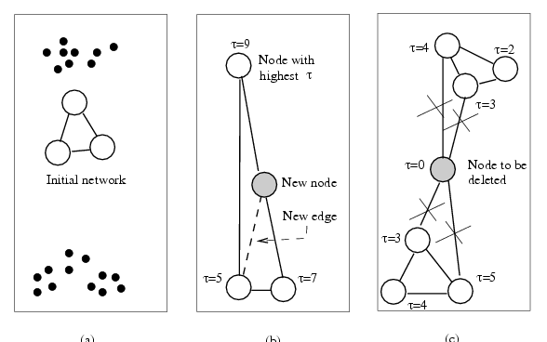
  Example

Slide 22
Distance-Based Learning (§ 5.6)
Which nodes will have the weights updated when an input i is applied
  Simple competitive learning: winner node only
  SOM: winner and its neighbors
  Distance-based learning: all nodes within a given distance to i
Maximum entropy procedure
  Depending on Euclidean distance |i – w_{j}|
Neural gas algorithm
  Depending on distance rank

Slide 23





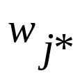
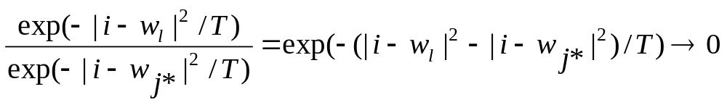
Maximum entropy procedure
T: artificial temperature, monotonically decreasing
Every node may have its weight vector updated
Learning rate for each depends on the distance
where is normalization factor
When , only the winner’s weight vectored is updated, because, for any other node l

Slide 24


Neural gas algorithm
Rank k_{j}(i, W): # of nodes have their weight vectors closer to input vector i than
Weight update depends on rank
where h(x) is a monotonically decreasing function
  for the highest ranking node: k_{j*}(i, W) = 0: h(0) = 1.
  for others: k_{j}(i, W) > 0: h < 1
  e.g: decay function
  when λ ≈ 0, winner takes all!!!
Better clustering results than many others (e.g., SOM, k-mean, max entropy)

Slide 25
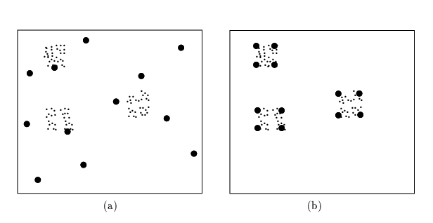
  Example

