Slide 1



Counter propagation network (CPN) (§ 5.3)
Basic idea of CPN
  Purpose: fast and coarse approximation of vector mapping
    not to map any given x to its with given precision,
    input vectors x are divided into clusters/classes.
    each cluster of x has one output y, which is (hopefully) the average of for all x in that class.
  Architecture: Simple case: FORWARD ONLY CPN,
x
z
y
1
1
1
x
w
z
v
y
i
k,i
k
j,k
j
x
z
y
n
p
m
from input to hidden (class)
from hidden (class) to output

Slide 2









Learning in two phases:
  training sample (x, d ) where is the desired precise mapping
  Phase1: weights coming into hidden nodes are trained by competitive learning to become the representative vector of a cluster of input vectors x: (use only x, the input part of (x, d ))
  1. For a chosen x, feedforward to determined the winning
  2.
  3. Reduce , then repeat steps 1 and 2 until stop condition is met
  Phase 2: weights going out of hidden nodes are trained by delta rule to be an average output of where x is an input vector that causes to win (use both x and d).
  1. For a chosen x, feedforward to determined the winning
  2. (optional)
  3.
  4. Repeat steps 1 – 3 until stop condition is met

Slide 3


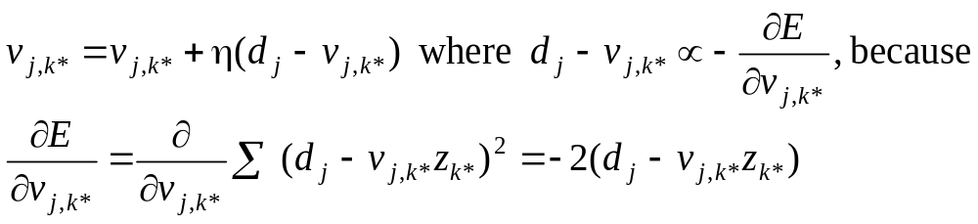
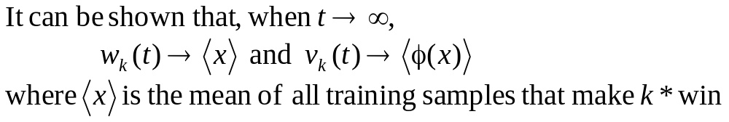
Notes
A combination of both unsupervised learning (for in phase 1) and supervised learning (for in phase 2).
After phase 1, clusters are formed among sample input x , each is a representative of a cluster (average).
After phase 2, each cluster k maps to an output vector y, which is the average of
View phase 2 learning as following delta rule

Slide 4
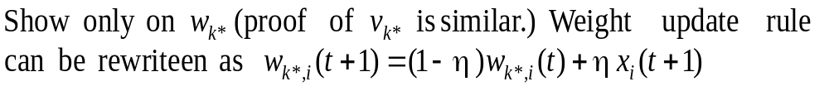
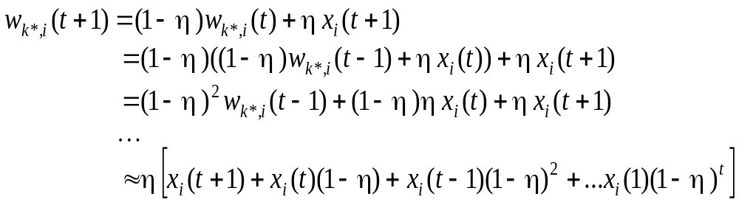
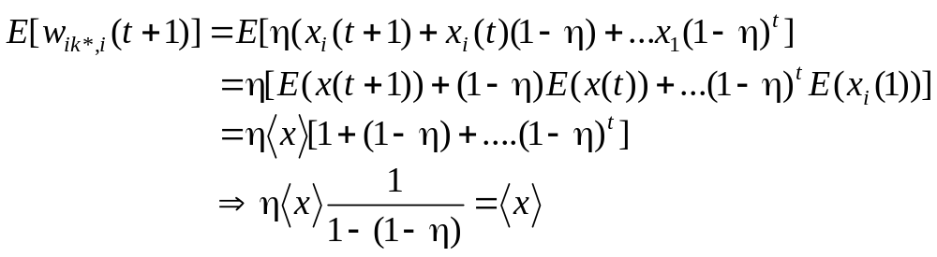

Slide 5
After training, the network works like a look-up of math table.
  For any input x, find a region where x falls (represented by the wining z node);
  use the region as the index to look-up the table for the function value.
  CPN works in multi-dimensional input space
  More cluster nodes (z), more accurate mapping.
  Training is much faster than BP
  May have linear separability problem

Slide 6



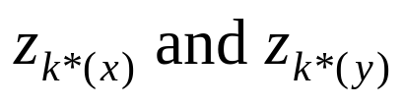
Full CPN
If both
we can establish bi-directional approximation
Two pairs of weights matrices:
W(x to z) and V(z to y) for approx. map x to
U(y to z) and T(z to x) for approx. map y to
When training sample (x, y) is applied ( ), they can jointly determine the winner z_{k*} or separately for

Slide 7
Adaptive Resonance Theory (ART) (§ 5.4)
ART1: for binary patterns; ART2: for continuous patterns
Motivations: Previous methods have the following problems:
  Number of class nodes is pre-determined and fixed.
    Under- and over- classification may result from training
    Some nodes may have empty classes.
    no control of the degree of similarity of inputs grouped in one class.
  Training is non-incremental:
    with a fixed set of samples,
    adding new samples often requires re-train the network with the enlarged training set until a new stable state is reached.

Slide 8

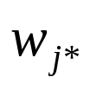

Ideas of ART model:
  suppose the input samples have been appropriately classified into k clusters (say by some fashion of competitive learning).
  each weight vector is a representative (average) of all samples in that cluster.
  when a new input vector x arrives
    Find the winner j* among all k cluster nodes
    Compare with x
if they are sufficiently similar (x resonates with class j*),
then update based on
else, find/create a free class node and make x as its
first member.

Slide 9

To achieve these, we need:
  a mechanism for testing and determining (dis)similarity between x and .
  a control for finding/creating new class nodes.
  need to have all operations implemented by units of local computation.
Only the basic ideas are presented
  Simplified from the original ART model
  Some of the control mechanisms realized by various specialized neurons are done by logic statements of the algorithm

Slide 10
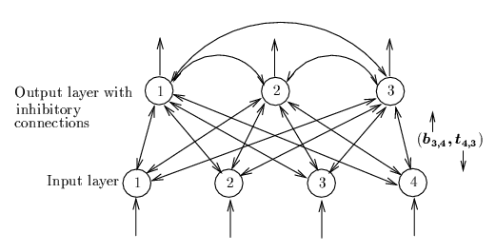
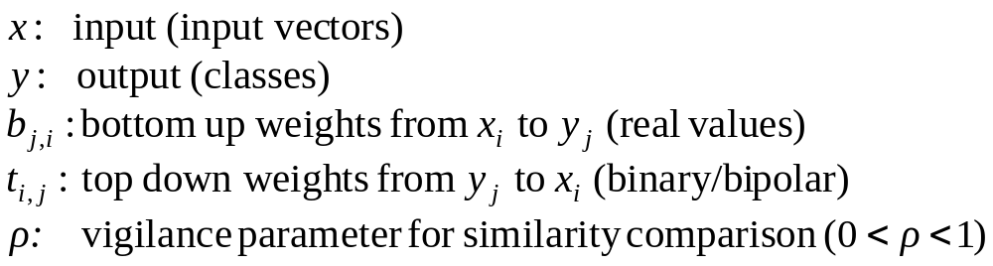
ART1 Architecture

Slide 11
Working of ART1
3 phases after each input vector x is applied
Recognition phase: determine the winner cluster for x
  Using bottom-up weights b
  Winner j* with max y_{j*} = b_{j*} ּx
  x is tentatively classified to cluster j*
  the winner may be far away from x (e.g., |t_{j*} - x| is unacceptably large)

Slide 12
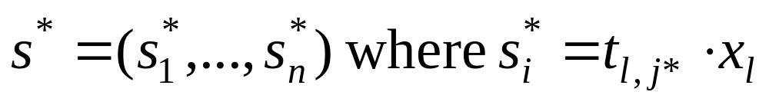
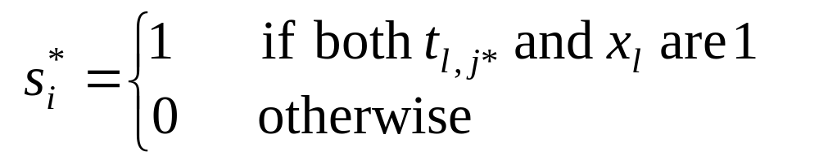
Working of ART1 (3 phases)
Comparison phase:
  Compute similarity using top-down weights t:
  vector:
  If (# of 1’s in s)|/(# of 1’s in x) > ρ, accept the classification, update b_{j*} and t_{j*}
  else: remove j* from further consideration, look for other potential winner or create a new node with x as its first patter.

Slide 13


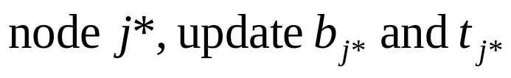
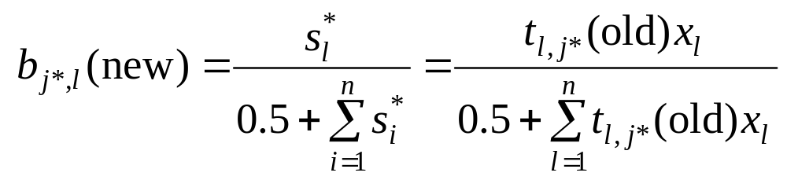
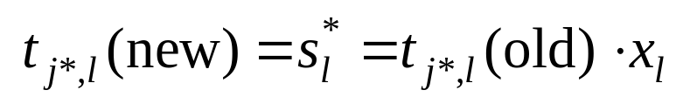

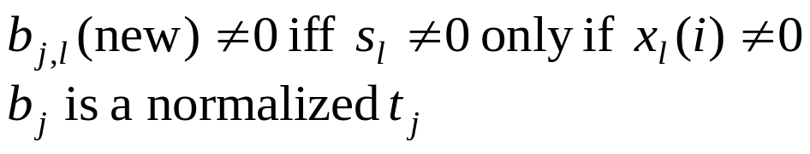
Weight update/adaptive phase
  Initial weight: (no bias)
  bottom up: top down:
  When a resonance occurs with
  If k sample patterns are clustered to node j then
= pattern whose 1’s are common to all these k samples

Slide 14




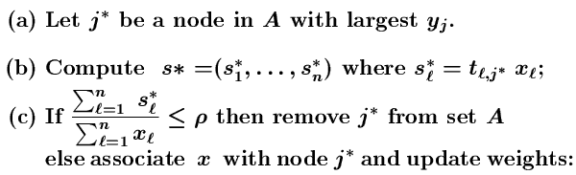
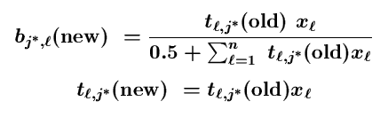

Slide 15
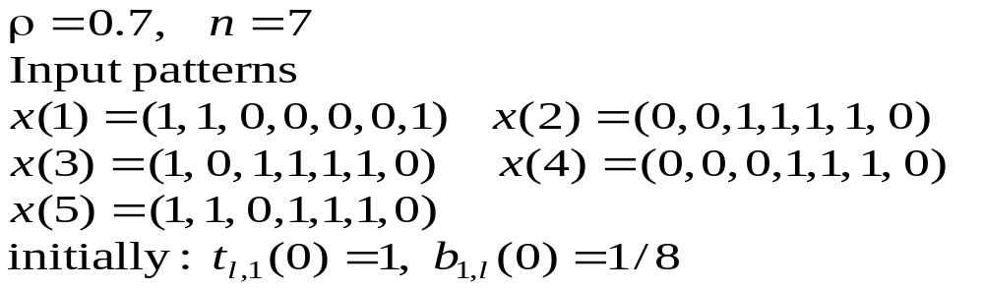


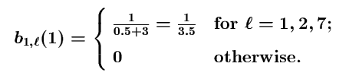



Example
for input x(1)
Node 1 wins

Slide 16
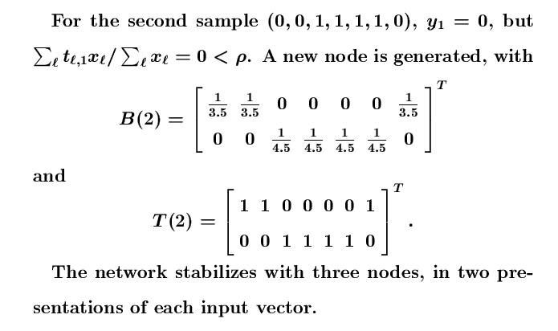

Slide 17
Notes
Classification as a search process
No two classes have the same b and t
Outliers that do not belong to any cluster will be assigned separate nodes
Different ordering of sample input presentations may result in different classification.
Increase of ρ increases # of classes learned, and decreases the average class size.
Classification may shift during search, will reach stability eventually.
There are different versions of ART1 with minor variations
ART2 is the same in spirit but different in details.

Slide 18

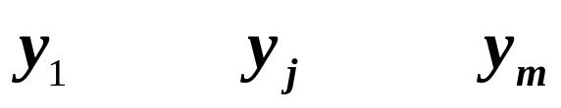



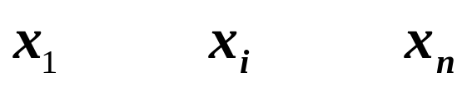
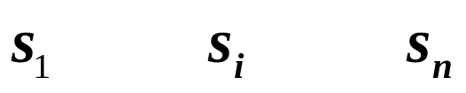

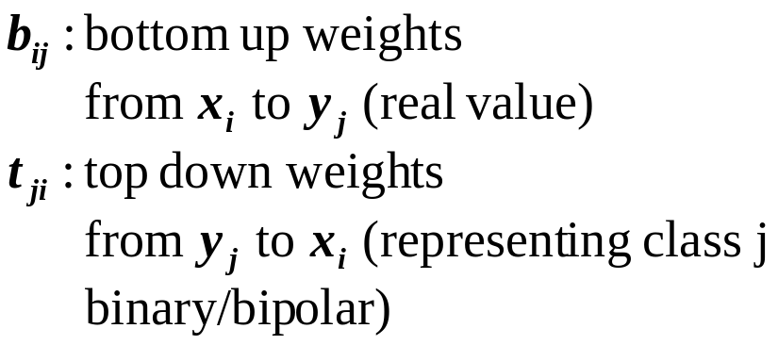
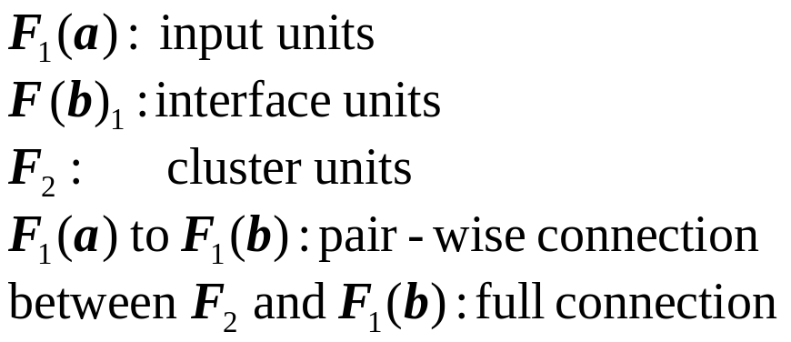

ART1 Architecture
+
+
R
-
G2
-
+
G1
+
+
+

Slide 19



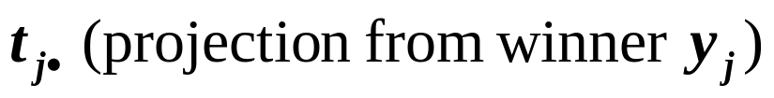
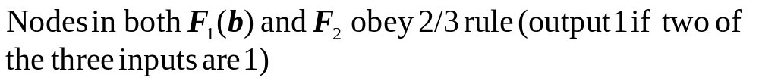

cluster units: competitive, receive input vector x through weights b: to determine winner j.
input units: placeholder or external inputs
interface units:
  pass s to x as input vector for classification by
  compare x and
  controlled by gain control unit G1
Needs to sequence the three phases (by control units G1, G2, and R)

Slide 20
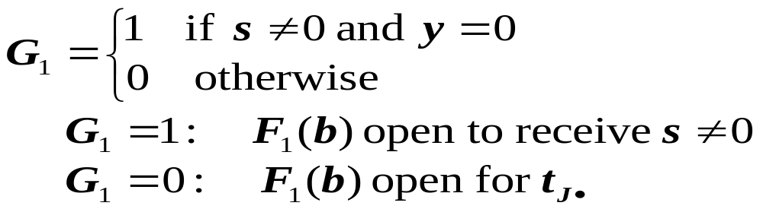
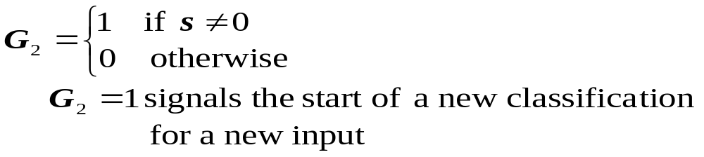
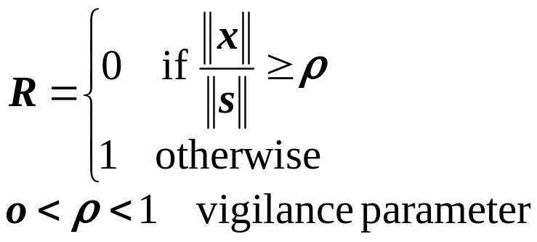


R = 0: resonance occurs, update and
R = 1: fails similarity test, inhibits J from further computation

