Slide 1
Principle Component Analysis (PCA) Networks (§ 5.8)
PCA: a statistical procedure
  Reduce dimensionality of input vectors
    Too many features, some of them are dependent of others
    Extract important (new) features of data which are functions of original features
    Minimize information loss in the process
  This is done by forming new interesting features
    As linear combinations of original features (first order of approximation)
    New features are required to be linearly independent (to avoid redundancy)
    New features are desired to be different from each other as much as possible (maximum variability)

Slide 2
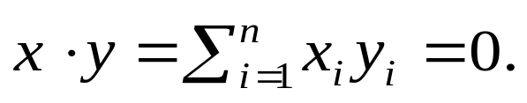
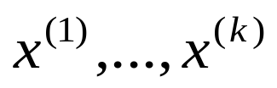

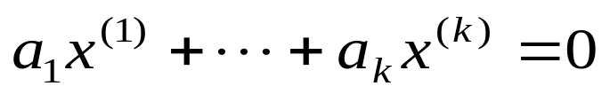
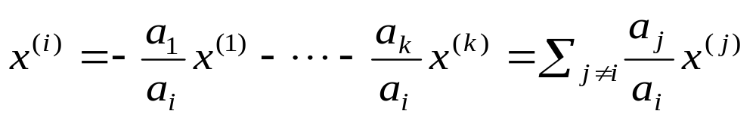
Linear Algebra
Two vectors
are said to be orthogonal to each other if
A set of vectors of dimension n are said to be linearly independent of each other if there does not exist a set of real numbers which are not all zero such that
otherwise, these vectors are linearly dependent and each one can be expressed as a linear combination of the others

Slide 3
Vector x is an eigenvector of matrix A if there exists a constant γ != 0 such that Ax = γx
  γ is called a eigenvalue of A (wrt x)
  A matrix A may have more than one eigenvectors, each with its own eigenvalue
  Eigenvectors of a matrix corresponding to distinct eigenvalues are linearly independent of each other
Matrix B is called the inverse matrix of matrix A if AB = 1
  1 is the identity matrix
  Denote B as A⁻¹
  Not every matrix has inverse (e.g., when one of the row/column can be expressed as a linear combination of other rows/columns)
Every matrix A has a unique pseudo-inverse A*, which satisfies the following properties
  AA*A = A; A*AA* = A*; A*A = (A*A)^{T}; AA* = (AA*)^{T}

Slide 4
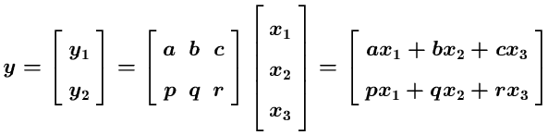
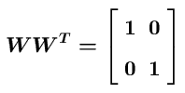
Example of PCA: 3-dim x is transformed to 2-dem y
2-d feature vector
Transformation matrix W
3-d feature vector
If rows of W have unit length and are ortho-gonal (e.g., w₁ • w₂ = ap + bq + cr = 0), then
W^{T} is a pseudo-inverse of W

Slide 5
Generalization
  Transform n-dim x to m-dem y (m < n) , the pseudo-inverse matrix W is a m x n matrix
  Transformation: y = Wx
  Opposite transformation: x’ = W^{T}y = W^{T}Wx
  If W minimizes “information loss” in the transformation, then
  ||x – x’|| = ||x – W^{T}Wx|| should also be minimized
  If W^{T} is the pseudo-inverse of W, then x’ = x: perfect transformation (no information loss)
How to find such a W for a given set of input vectors
  Let T = {x₁, …, x_{k}} be a set of input vectors
  Making them zero-mean vectors by subtracting the mean vector (∑ x_{i}) / k from each x_{i}.
  Compute the correlation matrix S(T) of these zero-mean vectors, which is a n x n matrix (book calls covariance-variance matrix)

Slide 6
  Find the m eigenvectors of S(T): w₁, …, w_{m} corresponding to m largest eigenvalues γ₁, …, γ_{m}
  w₁, …, w_{m} are the first m principal components of T
  W = (w1, …, w_{m}) is the transformation matrix we are looking for
  m new features extract from transformation with W would be linearly independent and have maximum variability
  This is based on the following mathematical result:

Slide 7


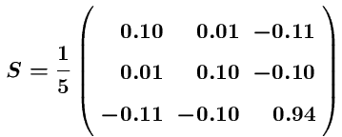





Example

Slide 8


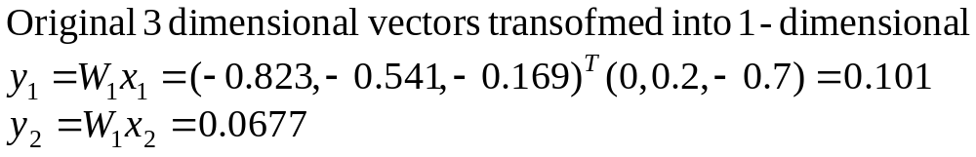
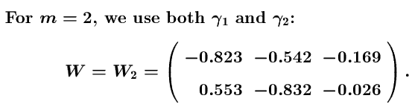
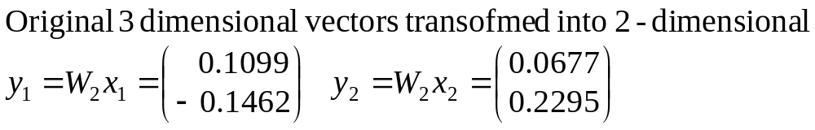

Slide 9
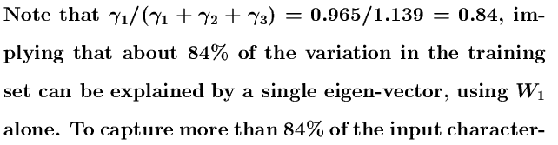


Slide 10
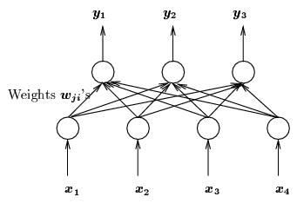
PCA network architecture
Output: vector y of m-dim
W: transformation matrix
y = Wx
x = W^{T}y
Input: vector x of n-dim
  Train W so that it can transform sample input vector x_{l} from n-dim to m-dim output vector y_{l}.
  Transformation should minimize information loss:
  Find W which minimizes
  ∑_{l}||x_{l} – x_{l}’|| = ∑_{l}||x_{l} – W^{T}Wx_{l}|| = ∑_{l}||x_{l} – W^{T}y_{l}||
  where x_{l}’ is the “opposite” transformation of y_{l} = Wx_{l} via W^{T}

Slide 11


Training W for PCA net
  Unsupervised learning:
  only depends on input samples x_{l}
  Error driven: ΔW depends on ||x_{l} – x_{l}’|| = ||x_{l} – W^{T}Wx_{l}||
  Start with randomly selected weight, change W according to
  This is only one of a number of suggestions for K_{l}, (Williams)
  Weight update rule becomes
(
)
column vector
row vector
transf. error

Slide 12






Example (sample sample inputs as in previous example)
-
After x₃
After x₄
After x₅
After second epoch
After second epoch
eventually converging to 1st PC (-0.823 -0.542 -0.169)

Slide 13

Notes
  PCA net approximates principal components (error may exist)
  It obtains PC by learning, without using statistical methods
  Forced stabilization by gradually reducing η
  Some suggestions to improve learning results.
    instead of using identity function for output y = Wx, using non-linear function S, then try to minimize
    If S is differentiable, use gradient descent approach
    For example: S be monotonically increasing odd function
    S(-x) = -S(x) (e.g., S(x) = x³

