Slide 1
Chapter 6
Associative Models

Slide 2
Introduction
Associating patterns which are
  similar,
  contrary,
  in close proximity (spatial),
  in close succession (temporal)
  or in other relations
Associative recall/retrieve
  evoke associated patterns
  recall a pattern by part of it: pattern completion
  evoke/recall with noisy patterns: pattern correction
Two types of associations. For two patterns s and t
  hetero-association (s != t) : relating two different patterns
  auto-association (s = t): relating parts of a pattern with other parts

Slide 3
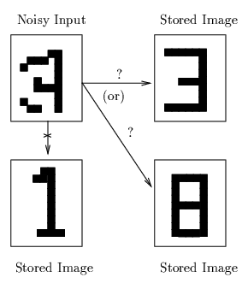
Example
  Recall a stored pattern by a noisy input pattern
  Using the weights that capture the association
  Stored patterns are viewed as “attractors”, each has its “attraction basin”
  Often call this type of NN “associative memory” (recall by association, not explicit indexing/addressing)

Slide 4
Architectures of NN associative memory
  single layer: for auto (and some hetero) associations
  two layers: for bidirectional associations
Learning algorithms for AM
  Hebbian learning rule and its variations
  gradient descent
  Non-iterative: one-shot learning for simple associations
  Iterative: for better recalls
Analysis
  storage capacity (how many patterns can be remembered correctly in AM, each is called a memory)
  learning convergence

Slide 5

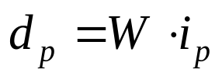
Training Algorithms for Simple AM
Network structure: single layer
  one output layer of non-linear units and one input layer
i_{p,1}
x₁
w₁₁
y₁
d_{p,1}
w_{m,1}
w_{1,n}
i_{p,n}
x_{n}
y_{m}
d_{p,n}
w_{m,n}
Goal of learning:
  to obtain a set of weights W = {w_{j,i}}
  from a set of training pattern pairs
  such that when i_{p} is applied to the input layer, d_{p} is computed at the output layer, e.g.,
  for all training pairs (i_{p}, d_{p}):

Slide 6

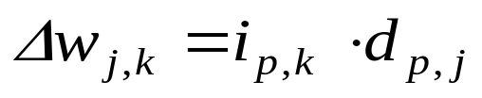
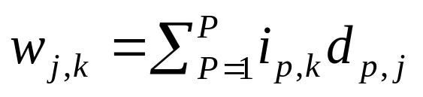
Hebbian rule
Algorithm: (bipolar patterns)
  Sign function for output nodes:
  For each training samples (i_{p}, d_{p}):
  # of training pairs in which i_{p} and d_{p} have the same sign.
  Instead of obtaining W by iterative updates, it can be computed from the training set by summing the outer product of i_{p} and d_{p} over all P samples.

Slide 7
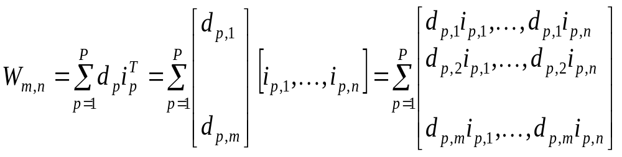
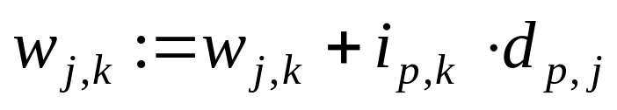
Associative Memories
Compute W as the sum of outer products of all training pairs (i_{p}, d_{p})
  note: outer product of two vectors is a matrix
It involves 3 nested loops p, k, j, (order of p is irrelevant)
  p = 1 to P /* for every training pair */
j = 1 to m /* for every row in W */
k = 1 to n /* for every element j in row k */

Slide 8

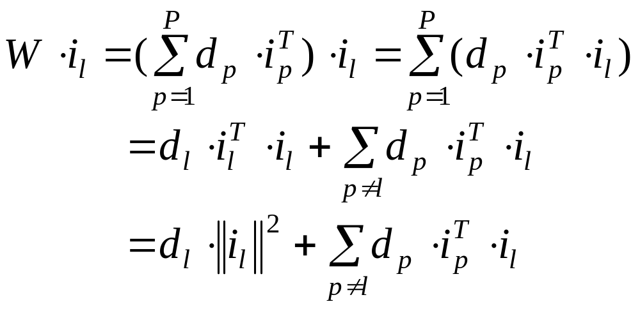
Does this method provide a good association?
  Recall with training samples (after the weights are learned or computed)
  Apply i_{l} to one layer, hope d_{l} appears on the other, e.g.
  May not always succeed (each weight contains some information from all samples)
principal term
cross-talk term

Slide 9
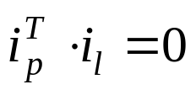
Principal term gives the association between i_{l} and d_{l} .
Cross-talk represents correlation between (i_{l}, d_{l}) and other training pairs. When cross-talk is large, i_{l} will recall something other than d_{l}.
If all sample input i are orthogonal to each other, then we have , no sample other than (i_{l}, d_{l}) contribute to the result (cross-talk = 0).
There are at most n orthogonal vectors in an n-dimensional space.
Cross-talk increases when P increases.
How many arbitrary training pairs can be stored in an AM?
  Can it be more than n (allowing some non-orthogonal patterns while keeping cross-talk terms small)?
  Storage capacity (more later)

Slide 10
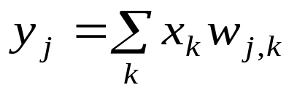
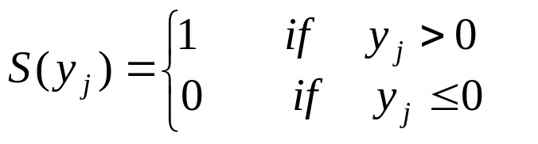
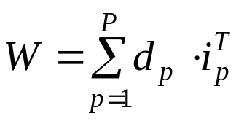
Example of hetero-associative memory
Binary pattern pairs i:d with |i| = 4 and |d| = 2.
Total weighted input to output units:
Activation function: threshold
Weights are computed by Hebbian rule (sum of outer products of all training pairs)
4 training samples:

Slide 11
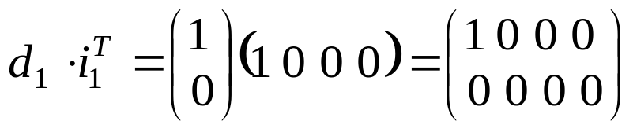
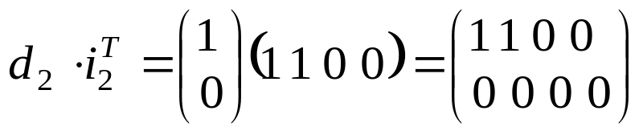
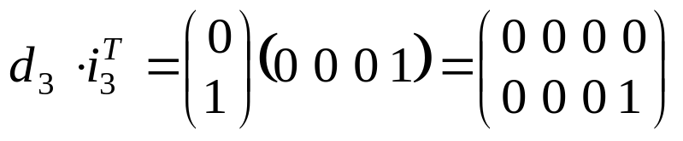
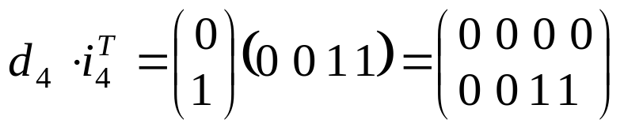
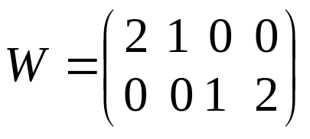
Training Samples
i_{p} d_{p}
p=1 (1 0 0 0) (1, 0)
p=2 (1 1 0 0) (1, 0)
p=3 (0 0 0 1) (0, 1)
p=4 (0 0 1 1) (0, 1)
Computing the weights

Slide 12
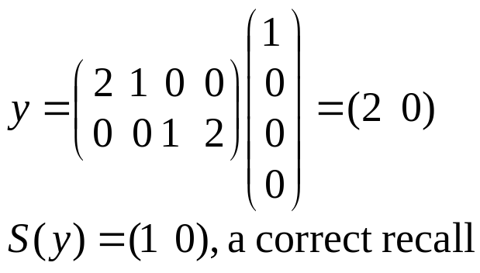
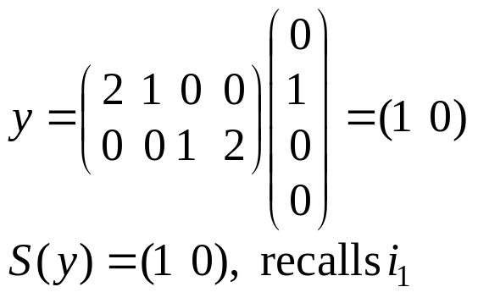
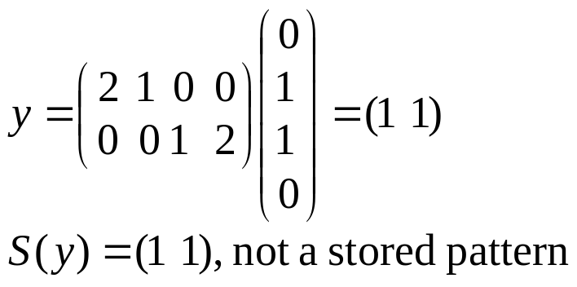
recall
4 training inputs have correct recall
For example: x = (1 0 0 0)
x=(0 1 0 0)
(similar to i₁ and i₂ )
x=(0 1 1 0)
(not sufficiently similar to any training input)

Slide 13
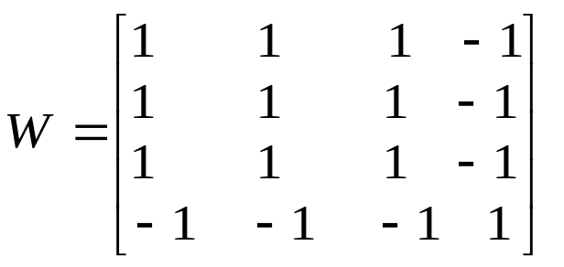
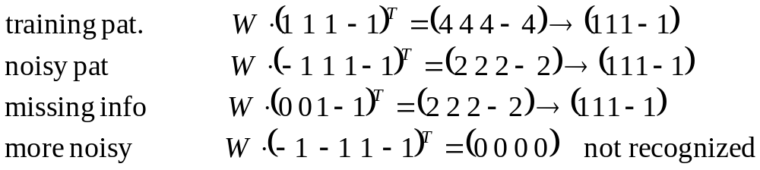
Example of auto-associative memory
Same as hetero-assoc nets, except d_{p} = i_{p} for all p = 1,…, P
Used to recall a pattern by a its noisy or incomplete version.
(pattern completion/pattern recovery)
A single pattern i = (1, 1, 1, -1) is stored (weights computed by Hebbian rule – outer product)

Slide 14
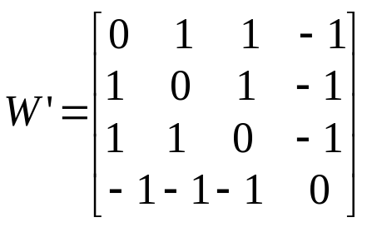
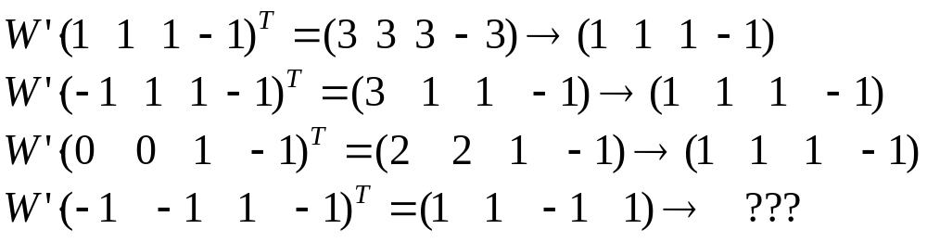
Always a symmetric matrix
Diagonal elements (∑_{p}(i_{p,k})² will dominate the computation when large number of patterns are stored .
When P is large, W is close to an identity matrix. This causes recall output = recall input, which may not be any stoned pattern. The pattern correction power is lost.
Replace diagonal elements by zero.

Slide 15
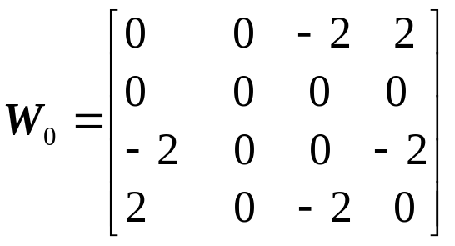
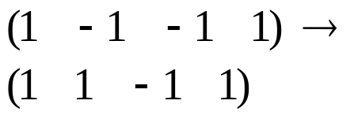
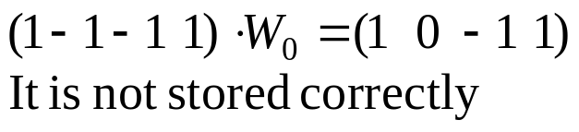
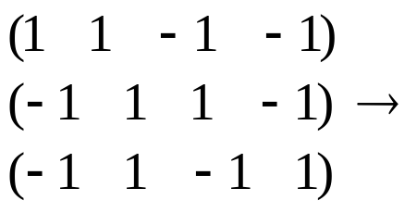
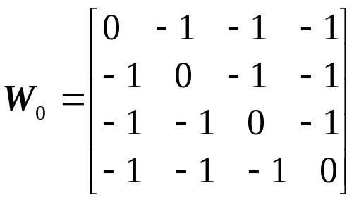
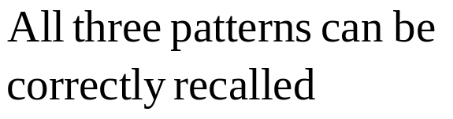
Storage Capacity
# of patterns that can be correctly stored & recalled by a network.
More patterns can be stored if they are not similar to each other (e.g., orthogonal)
non-orthogonal
orthogonal

Slide 16
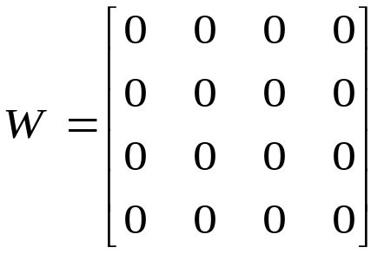


Adding one more orthogonal pattern (1 1 1 1), the weight matrix becomes:
Theorem: an n by n network is able to store up to n-1 mutually orthogonal (M.O.) bipolar vectors of n-dimension, but not n such vectors.
How many mutually orthogonal bipolar vectors with given dimension n?
n can be written as , where m is an odd integer.
Then maximally: M.O. vector
The memory is completely destroyed!!!

Slide 17
Follow up questions:
  What would be the capacity of AM if stored patterns are not mutually orthogonal (say random)
  Ability of pattern recovery and completion.
  How far off a pattern can be from a stored pattern that is still able to recall a correct/stored pattern
  Suppose x is a stored pattern, input x’ is close to x, and x”= S(Wx’) is even closer to x than x’. What should we do?
    Feed back x” , and hope iterations of feedback will lead to x?

Slide 18
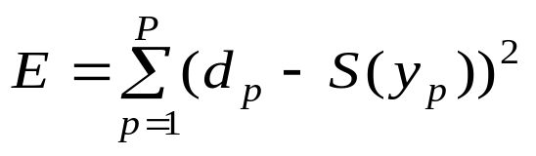
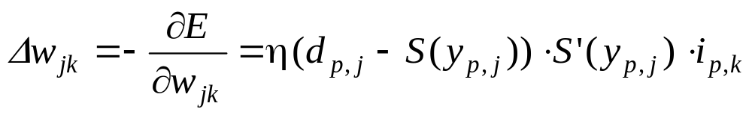
Delta Rule
Suppose output node function S is differentiable
Minimize square error
Derive weight update rule by gradient descent approach
This works for arbitrary pattern mapping,
  Similar to Adaline
  May have better performance than Hebbian rule

Slide 19
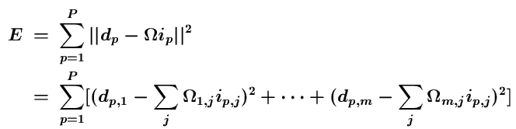

Least Square (Widrow-Hoff) Rule
Also minimizes square error with step/sign node functions
Directly computes the weight matrix Ω from
  I : matrix whose columns are input patterns i_{p}
  D : matrix whose columns are desired output patterns d_{p}
Since E is a quadratic function, it can be minimized by Ω that is the solution to the following systems of equations

Slide 20




This leads to
When is invertible, E will be minimized
If is not invertible, it always has a unique pseudo inverse, the weight matrix can then be computed as
When all sample input patterns are orthogonal, it reduces to
W =

Slide 21
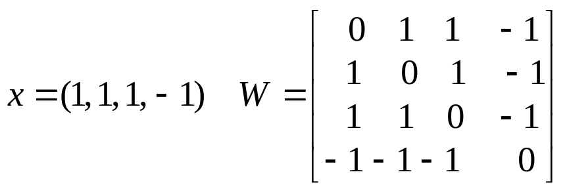
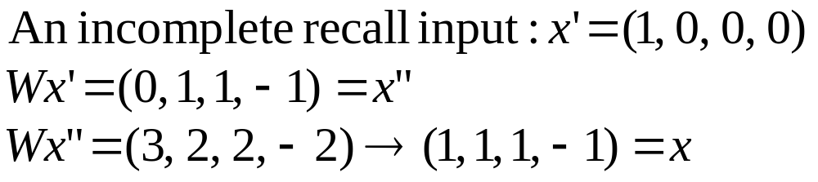
Iterative Autoassociative Networks
Example:
In general: using current output as input of the next iteration
  x(0) = initial recall input
  x(I) = S(Wx(I-1)), I = 1, 2, ……
  until x(N) = x(K) for some K < N
Output units are threshold units

Slide 22
Dynamic System: state vector x(I)
  If K = N-1, x(N) is a stable state (fixed point)
  f(Wx(N)) = f(Wx(N-1)) = x(N)
    If x(K) is one of the stored pattern, then x(K) is called a genuine memory
    Otherwise, x(K) is a spurious memory (caused by cross-talk/interference between genuine memories)
    Each fixed point (genuine or spurious memory) is an attractor (with different attraction basin)
  If K != N-1, limit-circle,
    The network will repeat
    x(K), x(K+1), …..x(N)=x(K) when iteration continues.
    Iteration will eventually stop because the total number of distinct state is finite (3^n) if threshold units are used.
  If patterns are continuous, the system may continue evolve forever (chaos) if no such K exists.

Slide 23
Hopfield Models
A single layer network with full connection
  each node as both input and output units
  node values are iteratively updated, based on the weighted inputs from all other nodes, until stabilized
More than an AM
  Other applications e.g., combinatorial optimization
Different forms: discrete & continuous
Major contribution of John Hopfield to NN
  Treating a network as a dynamic system
  Introduced the notion of energy function and attractors into NN research

Slide 24
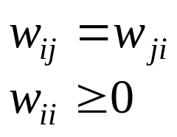
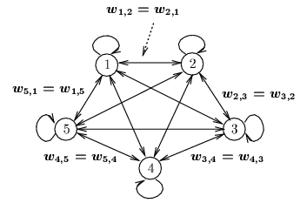
Discrete Hopfield Model (DHM) as AM
Architecture:
  single layer (units serve as both input and output)
  nodes are threshold units (binary or bipolar)
  weights: fully connected, symmetric, and zero diagonal
  External inputs
  may be transient
  or permanent

Slide 25
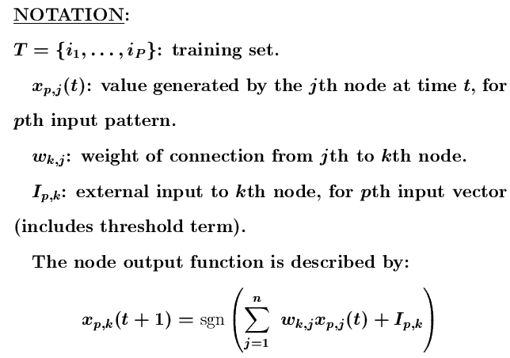

Slide 26
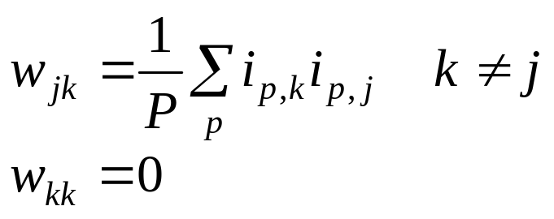
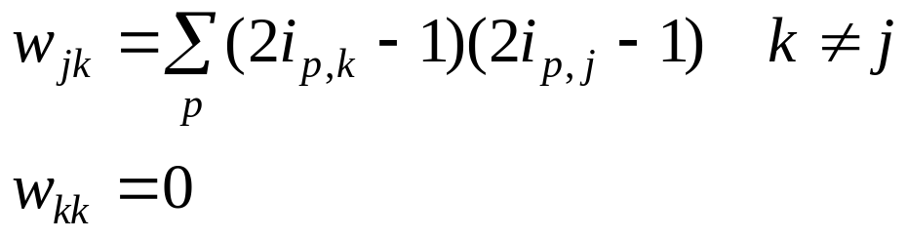
Weights:
  To store patterns i_{p}, p = 1,2,…P
  bipolar:
same as Hebbian rule (with zero diagonal)
  binary:
  converting i_{p} to bipolar when constructing W.
Recall
  Use an input vector to recall a stored vector
  Each time, randomly select a unit for update
  Periodically check for convergence

Slide 27

Notes:
  Theoretically, to guarantee convergence of the recall process (avoid oscillation), only one unit is allowed to update its activation at a time during the computation (asynchronous model).
  However, the system may converge faster if all units are allowed to update their activations at the same time (synchronous model).
  Each unit should have equal probability to be selected at
  Convergence test:

Slide 28


Example:
  A 4 node network, stores 2 patterns (1 1 1 1) and (-1 -1 -1 -1)
  Weights:
Corrupted input pattern: (1 1 1 -1)
Node output
selection pattern
node 2: (1 1 1 -1)
node 4: (1 1 1 1)
No more change of state will occur, the correct pattern is recovered
Equaldistance: (1 1 -1 -1)
node 2: net = 0, no change (1 1 -1 -1)
node 3: net = 0, change state from -1 to 1 (1 1 1 -1)
node 4: net = 0, change state from -1 to 1 (1 1 1 1)
No more change of state will occur, the correct pattern is recovered
If a different node selection order is used, the stored pattern (-1 -1 -1 -1) may be recalled

Slide 29
Missing input element: (1 0 -1 -1)
Node output
selection pattern
node 2: (1 -1 -1 -1)
node 1: net = -3, change state to -1 (-1 -1 -1 -1)
No more change of state will occur, the correct pattern is recovered
Missing input element: (0 0 0 -1)
the correct pattern (-1 -1 -1 -1) is recovered
This is because the AM has only 2 attractors
(1 1 1 1) and (-1 -1 -1 -1)
When spurious attractors exist (with more memories), pattern completion may be incorrect

Slide 30
Convergence Analysis of DHM
Two questions:
  1.Will Hopfield AM converge (stop) with any given recall input?
  2.Will Hopfield AM converge to the stored pattern that is closest to the recall input ?
Hopfield provides answer to the first question
  By introducing an energy function to this model,
  No satisfactory answer to the second question so far.
Energy function:
  Notion in thermo-dynamic physical systems. The system has a tendency to move toward lower energy state.
  Also known as Lyapunov function. After Lyapunov theorem for the stability of a system of differential equations.

Slide 31




In general, the energy function is the state of the system at step (time) t, must satisfy two conditions
1. is bounded from below
2. is monotonically non-increasing.
  Therefore, if the system’s state change is associated with such an energy function, its energy will continuously be reduced until it reaches a state with a (locally) minimum energy
  Each (locally) minimum energy states are attractors
  Hopfield shows his model has such an energy function, the memories (patterns) stored in DHM are attractors (other attractors are spurious)

Slide 32
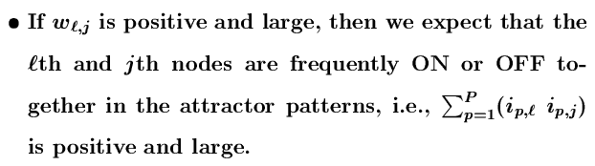
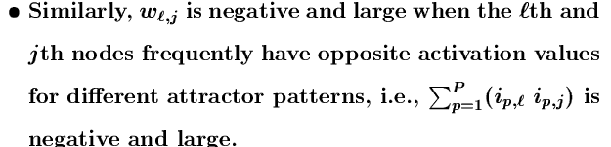
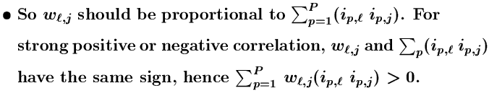
The energy function for DHM:
  Assume the input vector is close to one of the attractors

Slide 33
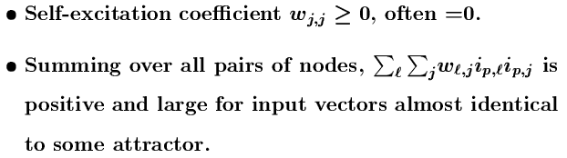
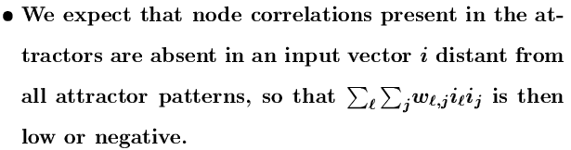
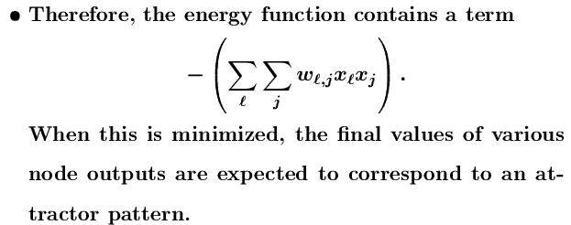

Slide 34

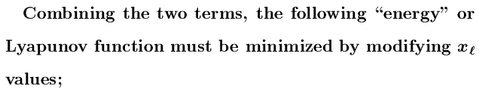


often with a = ½, b = 1

Slide 35
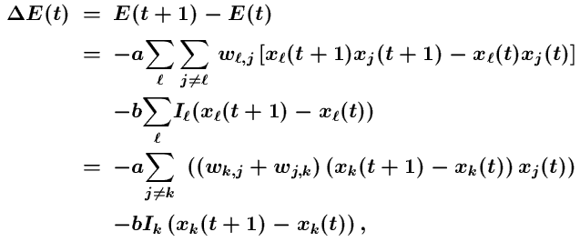
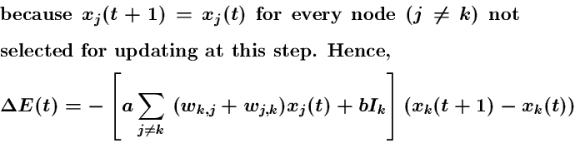
Convergence
  let k^{th} node is updated at time t, the system energy change is

Slide 36
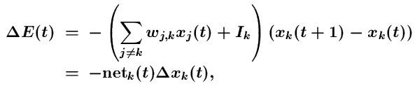

  When choosing a = ½, b = 1
  Since state change (from -1 to +1 or +1 to -1) depends on if net_{k} >= 0 or < 0, we have
  And therefore, < 0

Slide 37

Example:
  A 4 node network, stores 3 patterns
  (1 1 -1 -1), (1 1 1 1) and (-1 -1 1 1)
  Weights:
Corrupted input pattern: (-1 -1 -1 -1)
  If node 4 is selected:
  (-1/3 -1/3 1 0) (-1 -1 -1 -1) + (-1) = 1/3 + 1/3 –1 –1 = -4/3,
  No change of state for node 4
  Same for all other nodes, net stabilized at (-1 -1 -1 -1)
  A spurious state/attractor is recalled

Slide 38


For input pattern (-1 -1 -1 0)
  If node 4 is selected first,
  (-1/3 -1/3 1 0) (-1 -1 -1 0) + (0) = 1/3 + 1/3 – 1 – 0 – 0 = –1/3,
  change state to -1, then same as in the previous example,
  network stabilized at (-1 -1 -1 -1)
  However, if the node selection sequence is 1, 2, 3, 4, the net will stabilized at state (-1 -1 1 1), a genuine attractor

Slide 39
Comments:
  Why converge.
    Each time, E is either unchanged or decreases an amount.
    E is bounded from below.
    There is a limit E may decrease. After finite number of steps, E will stop decrease no matter what unit is selected for update
  The state the system converges is a stable state.
  Will return to this state after some small perturbation. It is called an attractor (with different attraction basin)
  Error function of BP learning is another example of energy/Lyapunov function. Because
    It is bounded from below (E>0)
    It is monotonically non-increasing (W updates along gradient descent of E)

Slide 40


Capacity Analysis of DHM
P: maximum number of random patterns of dimension n can be stored in a DHM of n nodes
Hopfield’s observation:
Theoretical analysis:
  P/n decreases because larger n leads to more interference between stored patterns (stronger cross-talks).
Some work to modify HM to increase its capacity to close to n, W is trained (not computed by Hebbian rule).
Another limitation: full connectivity leads to excessive connections for patterns with large dimensions

Slide 41




Continuous Hopfield Model (CHM)
Different (the original) formulation than the text
Architecture:
  Continuous node output, and continuous time
  Fully connected with symmetric weights
  Internal activation
  Output (state)
  where f is a sigmoid function to ensure binary/bipolar output. E.g. for bipolar, use hyperbolic tangent function

Slide 42



Continuous Hopfield Model (CHM)
Computation: all units change their output (states) at the same time, based on states of all others.
  Compute net:
  Compute internal activation by first-order Taylor expansion
  Compute output

Slide 43



Convergence:
  define an energy function,
  show that if the state update rule is followed, the system’s energy always decreasing by showing derivative

Slide 44



  asymptotically approaches zero when approaches 1 or 0 (-1 for bipolar) for all i.
  The system reaches a local minimum energy state
  Gradient descent:
  Instead of jumping from corner to corner in a hypercube as the discrete HM does, the system of continuous HM moves in the interior of the hypercube along the gradient descent trajectory of the energy function to a local minimum energy state.

Slide 45



Bidirectional AM(BAM)
Architecture:
  Two layers of non-linear units: X⁽¹⁾-layer, X⁽²⁾-layer of different dimensions
  Units: discrete threshold, continuing sigmoid (can be either binary or bipolar).
Weights:
  Hebbian rule:
Recall: bidirectional

Slide 46


Analysis (discrete case)
  Energy function: (also a Lyapunov function)
    The proof is similar to DHM
    Holds for both synchronous and asynchronous update (holds for DHM only with asynchronous update, due to lateral connections.)
  Storage capacity:

Slide 47
My Own Work: Turning BP net for Auto AM
One possible reason for the small capacity of HM is that it does not have hidden nodes.
Train feed forward network (with hidden layers) by BP to establish pattern auto-associative.
Recall: feedback the output to input layer, making it a dynamic system.
Shown 1) it will converge, and 2) stored patterns become genuine attractors.
It can store many more patterns (seems O(2^n))
Its pattern complete/recovery capability decreases when n increases (# of spurious attractors seems to increase exponentially)
output
hidden
input
Auto-association
output1
output2
hidden1
hidden2
input1
input2
Hetero-association

Slide 48
Example
  n = 10, network is (10, 20, 10)
  Varying # of stored memories ( 8 – 128)
  Using all 1024 patterns for recall, correct if one of the stored memories is recalled
  Two versions in preparing training samples
    (X, X), where X is one of the stored memory
    Supplemented with (X’, X) where X’ is a noisy version of X
# stored memories | correct recall w/o relaxation | correct recall with relaxation | # spurious attractors
8 | (835) | (1024) | 6 (0)
16 | 49 (454) | (980) | 60 (5)
32 | 39 (371) | (928) | (17)
64 | 65 (314) | (662) | (144)
128 | (351) | (561) | (254)
Numbers in parentheses are for learning with supplementary samples (X’, X)

