Slide 1
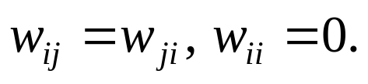
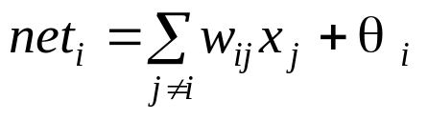
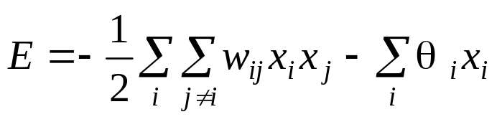
Boltzmann Machine (BM) (§6.4)
Hopfield model + hidden nodes + simulated annealing
BM Architecture
  a set of visible nodes: nodes can be accessed from outside
  a set of hidden nodes:
    adding hidden nodes to increase the computing power
    Increase the capacity when used as associative memory (increase distance between patterns)
  connection between nodes
    Fully connected between any two nodes (not layered)
    Symmetric connection:
  nodes are the same as in discrete HM:
  energy function:

Slide 2
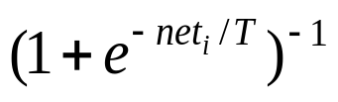
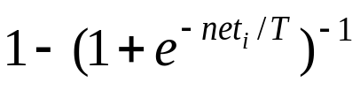
BM computing (SA), with a given set of weights
1. Apply an input pattern to the visible nodes.
  some components may be missing or corrupted ---pattern completion/correction;
  some components may be permanently clamped to the input values (as recall key or problem input parameters).
2. Assign randomly 0/1 to all unknown nodes
( including all hidden nodes and visible nodes with
missing input values).
3. Perform SA process according to a given cooling
schedule. Specifically, at any given temperature T.
a random picked non-clamped node i is assigned
value of 1 with probability ,
and 0 with probability

Slide 3
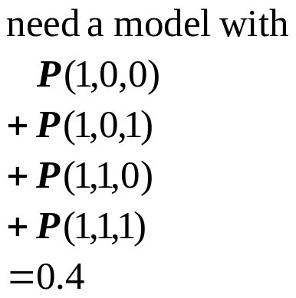

BM learning ( obtaining weights from exemplars)
  what is to be learned?
    probability distribution of visible vectors in the environment.
    exemplars: assuming randomly drawn from the entire population of possible visible vectors.
    construct a model of the environment that has the same prob. distri. of visible nodes as the one in the exemplar set.
  There may be many models satisfying this condition
    because the model involves hidden nodes.
hidden
2
3
Infinite ways to assign prob. to individual states
visible
1
let the model have equal probability of theses states (max. entropy);
let these states obey B-G distribution (prob. proportional to energy).

Slide 4





  BM Learning rule:
: the set of exemplars ( visible vectors)
: the set of vectors appearing on the hidden nodes
two phases:
    clamping phase: each exemplar is clamped to visible nodes. (associate a state H_{b} to V_{a})
    free-run phase: none of the visible node is clamped (make (H_{b} , V_{a}) pair a min. energy state)
: probability that exemplar is applied in
clamping phase (determined by the training set)
: probability that the system is stabilized with
at visible nodes in free-run (determined by the
model)

Slide 5

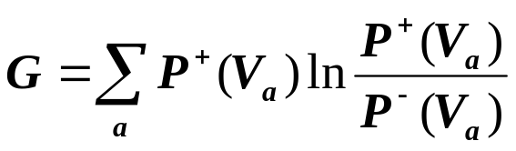
learning is to construct the weight matrix such that
is as close to as possible.
A measure of the closeness of two probability distributions (called maximum likelihood, asymmetric divergence, or cross-entropy):
It can be shown
BM learning takes the gradient descent approach to minimal G

Slide 6
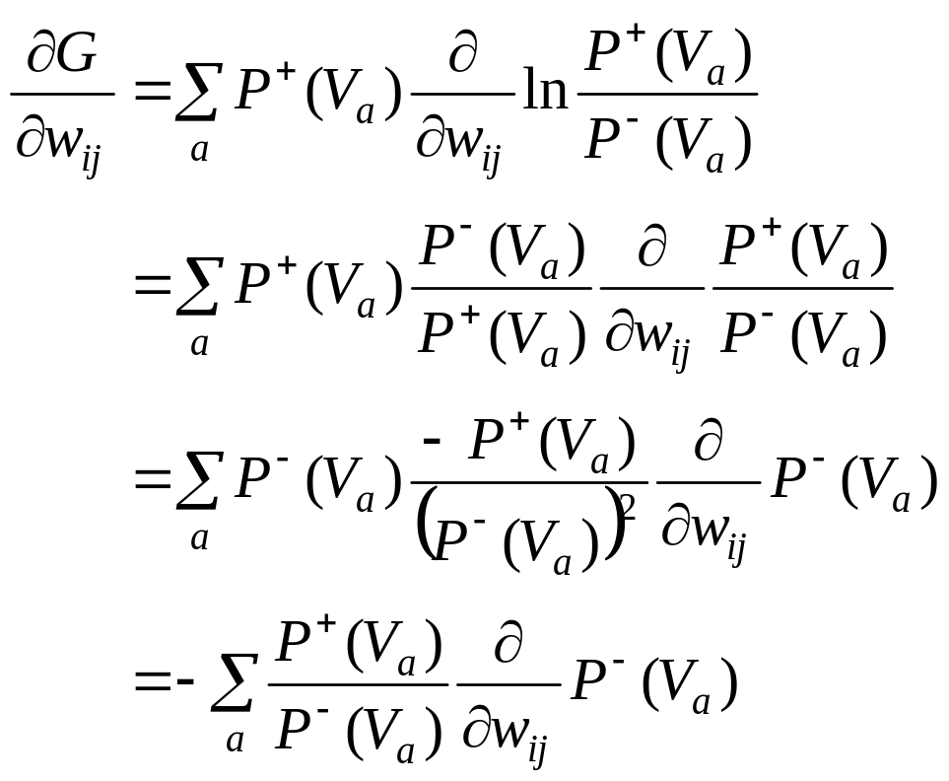

Slide 7
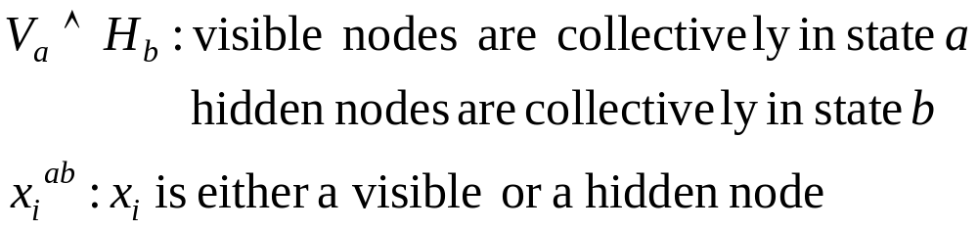
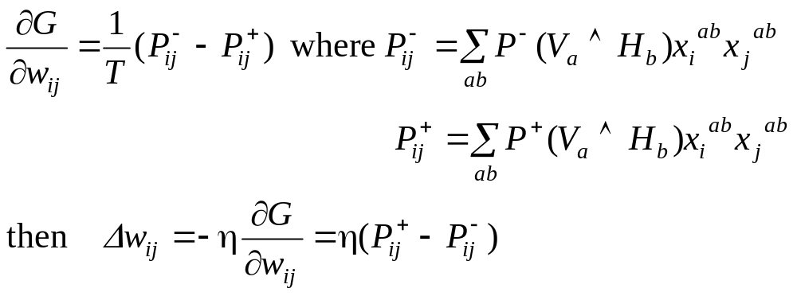
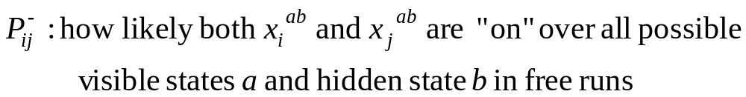
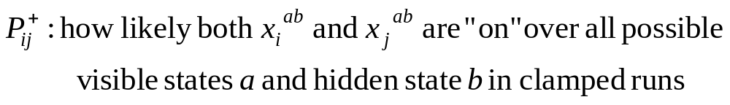

Slide 8

BM Learning algorithm
1. compute
1.1. clamp one training vector to the visible nodes of the
network
1.2. anneal the network according to the annealing
schedule until equilibrium is reached at a pre-set low
temperature T1 (close to 0).
1.3. continue to run the network for many cycles at T1.
After each cycle, determine which pairs of connected
node are “on” simultaneously.
1.4. average the co-occurrence results from 1.3
1.5. repeat steps 1.1 to 1.4 for all training vectors and
average the co-occurrence results to estimate
for each pair of connected nodes.

Slide 9

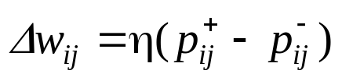
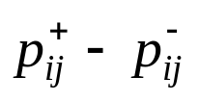
2. Compute
the same steps as 1.1 to 1.5 except no visible node is clamped.
3. Calculate and apply weight change
4. Repeat steps 1 to 3 until is sufficiently small.

Slide 10
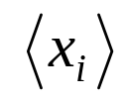
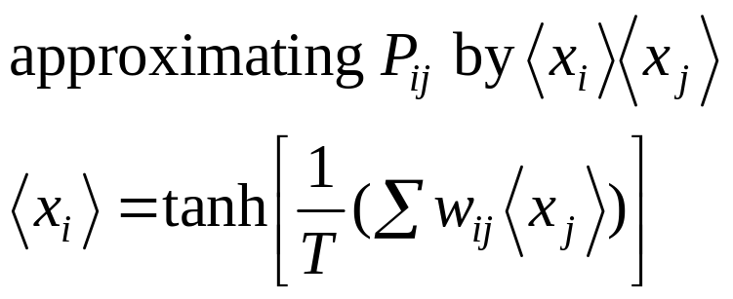
Comments on BM learning
BM is a stochastic machine not a deterministic one.
It has higher representative/computation power than HM+SA (due to the existence of hidden nodes).
Since learning takes gradient descent approach, only local optimal result is guaranteed (G may not be reduced to 0).
Learning can be extremely slow, due to repeated SA involved
Speed up:
  Hardware implementation
  Mean field theory: turning BM to deterministic by replacing random variables x_{i} by its expected values

Slide 11
Evolutionary Computing (§7.5)
Another expensive method for global optimization
Stochastic state-space search emulating biological evolutionary mechanisms
  Biological reproduction
    Most properties of offspring are inherited from parents, some are resulted from random perturbation of gene structures (mutation)
    Each parent contributes different part of the offspring’s chromosome structure (cross-over)
  Biological evolution: survival of the fittest
    Individuals of greater fitness have more offspring
    Genes that contribute to greater fitness are more predominant in the population

Slide 12
Overview
population
selection of parents for reproduction
(based on a fitness function)
parents
reproduction (cross-over + mutation)
next generation of population
Variations of evolutionary computing:
  Genetic algorithm (relying more on cross-over)
  Genetic programming
  Evolutionary programming (mutation is the primary operation)
  Evolutionary strategies (using real-value vectors and self-adapting variables (e.g., covariance))

Slide 13
Basics
Individual:
  corresponding to a state
  represented as a string of symbols (genes and chromosomes), similar to a feature vector.
Population of individuals (at current generation)
Fitness function f: estimates the goodness of individuals
Selection for reproduction:
  randomly select a pair of parents from the current population
  individuals with higher fitness function values have higher probabilities to be selected
Reproduction:
  crossover allows offspring to inherit and combine good features from their parents
  mutation (randomly altering genes) may produce new (hopefully good) features
Bad individuals are throw away when the limit of population size is reached

Slide 14
Comments
Initialization:
  Random,
  Plus sub-optimal states generated from fast heuristic methods
Termination:
  All individual in the population are almost identical (converged)
  Fitness values stop to improve over many generations
  Pre-set max # of iterations exceeded
To ensure good results
  Population size must be large (but how large?)
  Allow it to run for a long time (but how long?)

