Slide 1
Chapter 7
Optimization Methods

Slide 2
Introduction
Examples of optimization problems
  IC design (placement, wiring)
  Graph theoretic problems (partitioning, coloring, vertex covering)
  Planning
  Scheduling
  Other combinatorial optimization problems (knapsack, TSP)
Approaches
  AI: state space search
  NN
  Genetic algorithms
  Mathematical programming

Slide 3
Introduction
NN models to cover
  Continuous Hopfield mode
    Combinatorial optimization
  Simulated annealing
    Escape from local minimum
  Boltzmann machine (§6.4)
  Evolutionary computing (genetic algorithms)

Slide 4
Introduction
Formulating optimization problems in NN
  System state: S(t) = (x₁(t), …, x_{n}(t)) where x_{i}(t) is the current value of node i at time/step t
    State space: the set of all possible states
  State changes as any node may change its value based on
    Inputs from other nodes; Inter-node weights; Node function
  A state is feasible if it satisfies all constraints without further modification (e.g., a legal tour in TSP)
  A solution state is a feasible state that optimizes some given objective function (e.g., a legal with minimum tour length)
    Global optimum: the best in the entire state space
    Local optimum: the best in a subspace of the state space
    (e.g., cannot be better by changing value of any SINGLE node)

Slide 5
Introduction
Energy minimization
  A popular way for NN-based optimization methods
  Sum-up problem constraints and cost functions and other considerations into an energy function E:
    E is a function of system state
    Lower energy states correspond to better solutions
    Penalty for constraint violation (with big energy increase)
  Work out the node function and weights so that
    The energy can only be reduced when the system moves
  The hard part is to ensure that
    Every solution state corresponds to a (local) minimum energy state
    Optimal solution corresponds to a globally minimum energy state

Slide 6
Hopfield Model for Optimization
Constraint satisfaction combinational optimization.
A solution must satisfy
  a set of given constraints (strong) and
  be optimal w.r.t. a cost or utility function (weak)
Using node functions defined in Hopfield model
What we need:
  Energy function derived from the cost function
    Must be quadratic
  Representing the constraints,
    Relative importance between constraints
    Penalty for constraint violation
  Extract weights

Slide 7
Hopfield Model for TSP
Constraints:
  Each city can be visited no more than once
  Every city must be visited
  TS can only visit cities one at a time
  Tour should be the shortest
  Constraints 1 – 3 are hard constraints (they must be satisfied to be qualified as a legal tour or a Hamiltonian circuit)
  Constraint 4 is soft, it is the objective function for optimization, suboptimal but good results may be acceptable
Design the network structure:
Different possible ways to represent TSP by NN:
  node - city: hard to represent the order of cities in forming a circuit (SOM solution)
  node - edge: n out of n(n-1)/2 nodes must become activated and they must form a circuit.

Slide 8
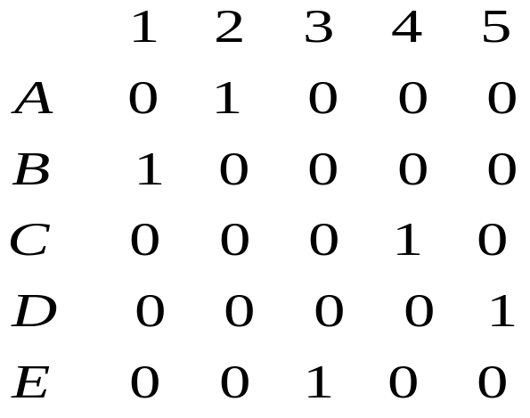
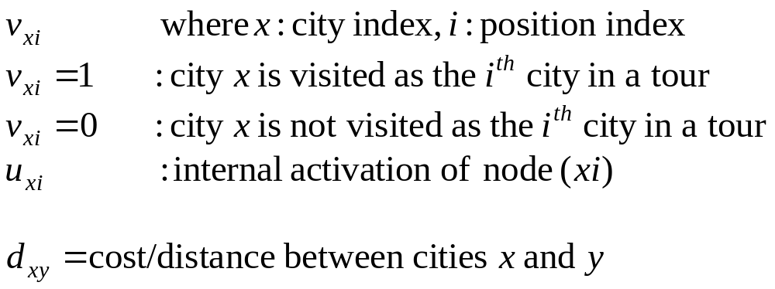
Hopfield’s solution:
  n by n network, each node is
  connected to every other node.
    Node output approach 0 or 1
    row: city
    column: position in the tour:
    Tour: B-A-E-C-D-B
  Output (state) of each node is denoted:

Slide 9
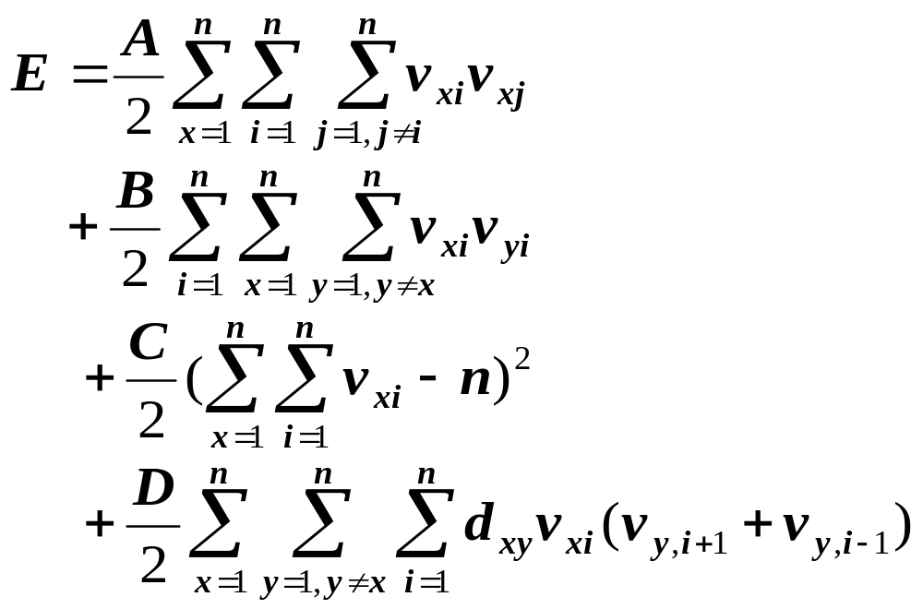
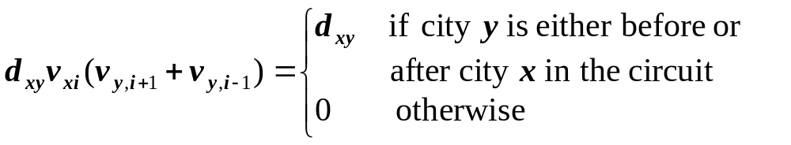
Energy function
(penalty for the row constraint: no city shall be visited more than once)
(penalty for the column constraint: cities can be visited one at a time)
(penalty for the tour legs: it must have exactly n cities)
(penalty for the tour length)
A, B, C, D are constants, to be determined by trial-and-error.
a legal where the first three terms in E become zero, and the last term gives the tour length. This is because

Slide 10
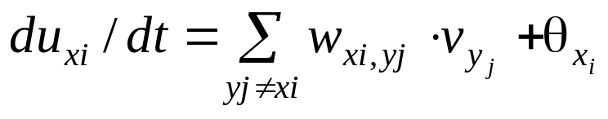
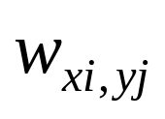
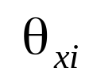



Obtaining weight matrix
Note
  In CHM,
  We want u to change in the way to always reduce E.
  Try to extract and from
Determine from E so that with
(gradient descent approach again)

Slide 11
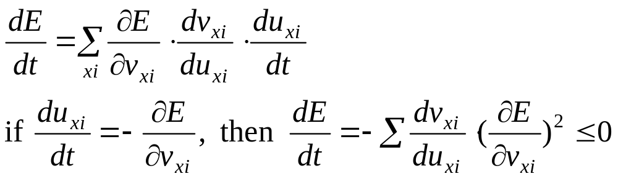
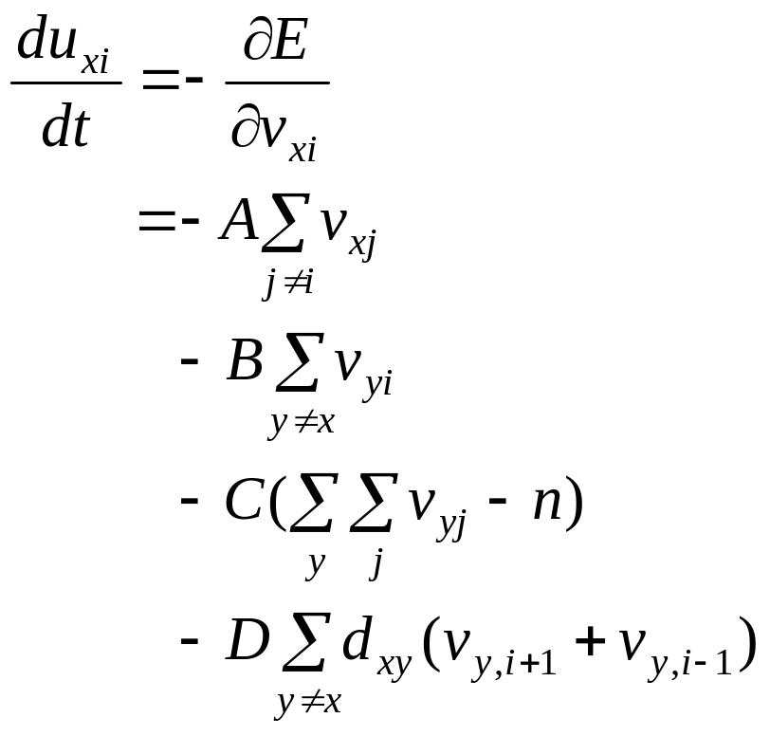
(row inhibition: x = y, i != j)
(column inhibition: x != y, i = j)
(global inhibition: xi != yj)
(tour length)

Slide 12
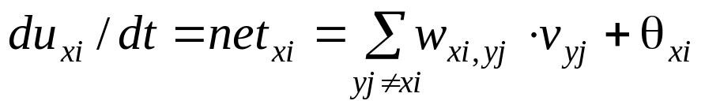
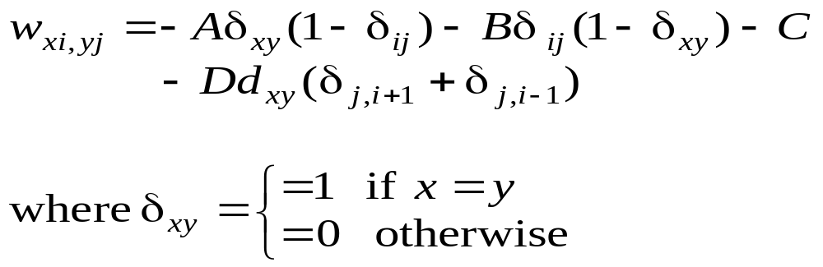

(2) Since , weights thus should include the following
  A: between nodes in the same row
  B: between nodes in the same column
  C: between any two nodes
  D: dxy between nodes in different row but adjacent column
  each node also has a positive bias

Slide 13
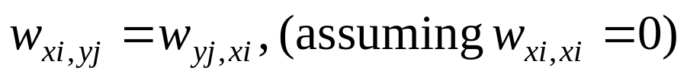

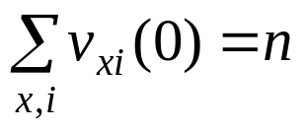
Notes
Since , W can also be used for discrete model.
Initialization: randomly assign between 0 and 1 such that
No need to store explicit weight matrix, weights can be computed when needed
Hopfield’s own experiments
A = B = D = 500, C = 200, n = 15
20 trials (with different distance matrices): all trials converged:
16 to legal tours, 8 to shortest tours, 2 to second shortest tours.
Termination: when output of every node is
  either close to 0 and decreasing
  or close to 1 and increasing

Slide 14
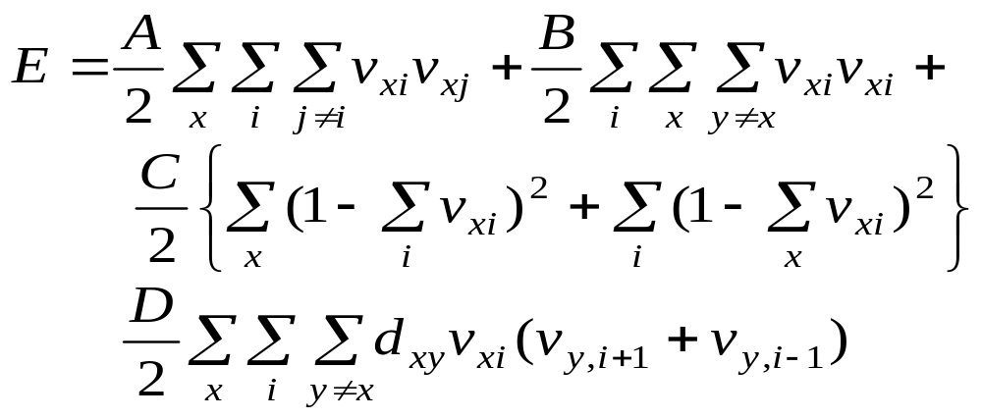
Problems of continuous HM for optimization
  Only guarantees local minimum state (E always decreasing)
  No general guiding principles for determining parameters (e.g., A, B, C, D in TSP)
  Energy functions are hard to come up and different functions may result in different solution qualities
another energy function for TSP

Slide 15

Simulated Annealing
A general purpose global optimization technique
Motivation
BP/HM:
  Gradient descent to minimal error/energy function E.
  Iterative improvement: each step improves the solution.
  As optimization: stops when no improvement is possible without making it worse first.
  Problem: trapped to local minimal .
  key:
  Possible solution to escaping from local minimal:
  allow E to increase occasionally (by adding random noise).

Slide 16
Annealing Process in Metallurgy
To improve quality of metal works.
Energy of a state (a config. of atoms in a metal piece)
  depends on the relative locations between atoms.
  minimum energy state: crystal lattice, durable, less fragile/crisp
  many atoms are dislocated from crystal lattice, causing higher (internal) energy.
Each atom is able to randomly move
  How easy and how far an atom moves depends on the temperature (T), and if the atom is in right place
  Dislocation and other disruptions from min. energy state can be eliminated by the atom’s random moves: thermal agitation.
  Takes too long if done at room temperature
Annealing: (to shorten the agitation time)
  starting at a very high T, gradually reduce T
SA: apply the idea of annealing to NN optimization

Slide 17



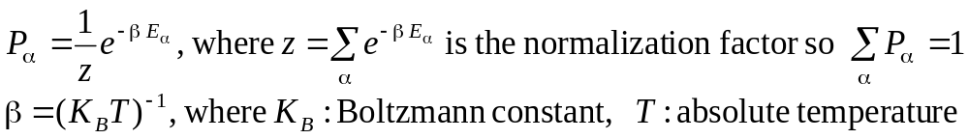
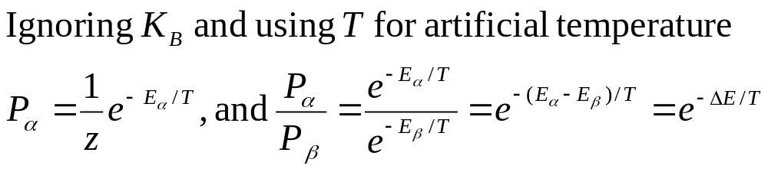
Statistical Mechanics
System of multi-particles,
  Each particle can change its state
  Hard to know the system’s exact state/config. , and its energy.
  Statistical approach: probability of the system is at a given state.
  assume all possible states obey Boltzmann-Gibbs distribution:
  : the energy when the system is at state
  : the probability the system is at state

Slide 18
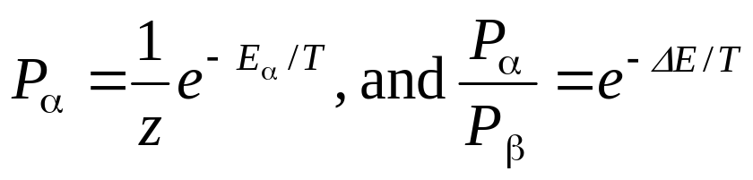




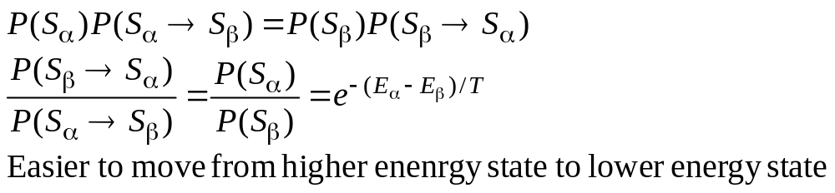
Let
(1)
differ little with high T, more opportunity to change state in the beginning of annealing.
differ a lot with low T, help to keep the system at low E state at the end of annealing.
when T→0, (system is infinitely more likely to be in the global minimum energy state than in any other state).
(3) Based on B-G distribution

Slide 19



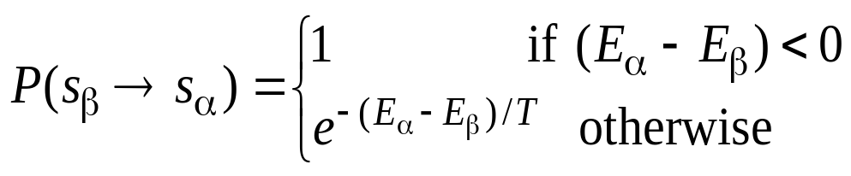
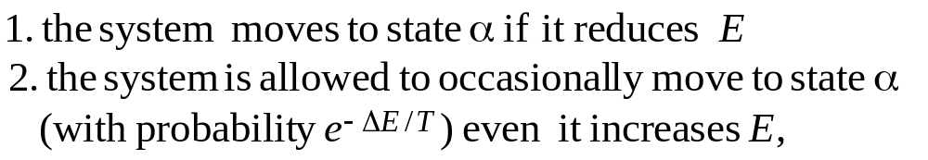
Metropolis algorithm for optimization(1953)
: current state
a new state differs from by a small random displacement, then will be accepted with the probability
Random noise introduced here

Slide 20


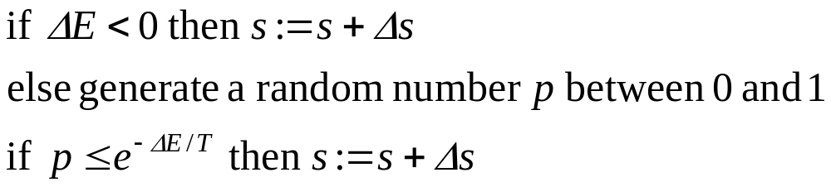
Simulated Annealing in NN
Algorithm (very close to Metropolis algorithm)
  set the network to an initial state S
set the initial temperature T >> 1
  do the following steps many times until quasi thermal equilibrium is reached at the current T
2.1. randomly select a state displacement
2.2. compute
2.3.
  3. reduce T according to the cooling schedule
  4. if T > T-lower-bound, then go to 2 else stop

Slide 21


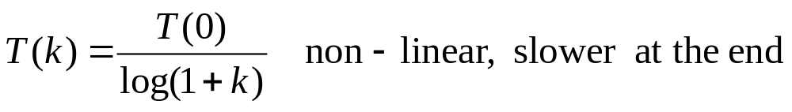
Comments
  thermal equilibrium (step 2) is hard to test, usually with a pre-set iteration number/time
  displacement may be randomly generated
    choose one component of S to change or
    changes to all components of the entire state vector
    should be small
  cooling schedule
    Initial T: 1/T ~ 0 (so any state change can be accepted)
    Simple example:
    Another example:
  you may store the state with the lowest energy among all states generated so far

Slide 22
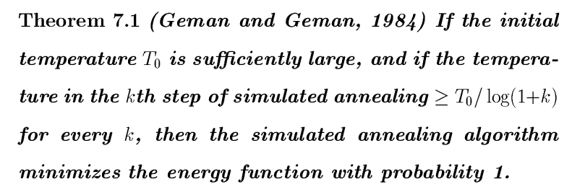

Slide 23
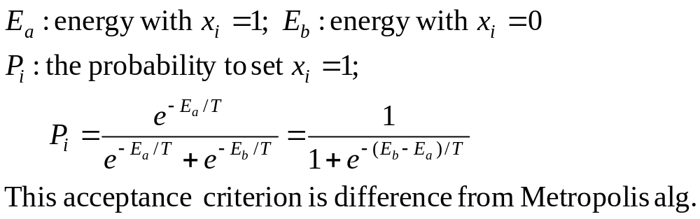
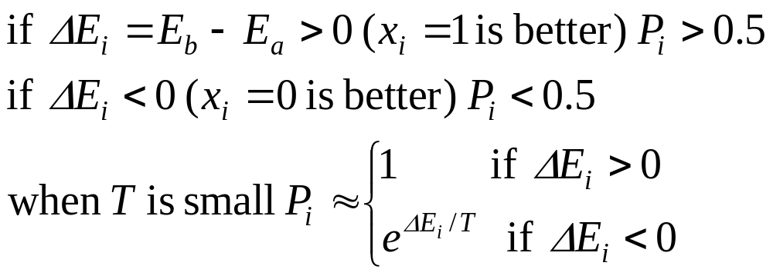
SA for discrete Hopfield Model
In step 2, each time only one node say x_{i} is selected for possible update, all other nodes are fixed.

Slide 24
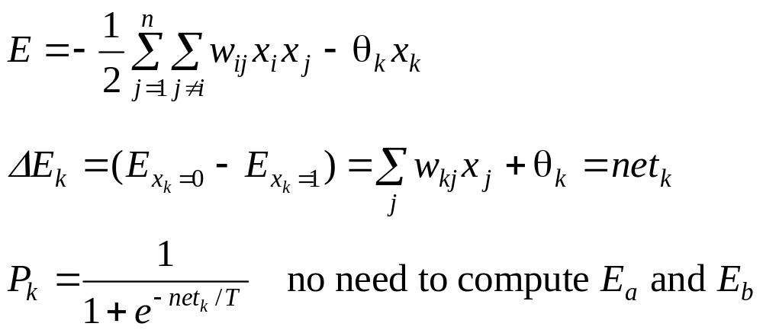
Localize the computation
It can be shown that both acceptance criterion guarantees the B-G distribution if a thermal equilibrium is reached.
When applying to TSP, using the energy function designed for continuous HM

Slide 25
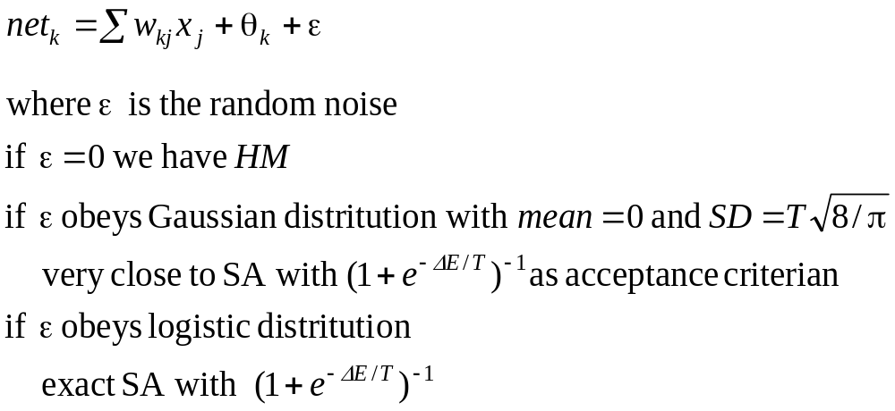
Variations of SA
Gauss machine: a more general framework

Slide 26

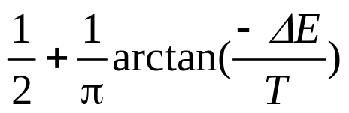
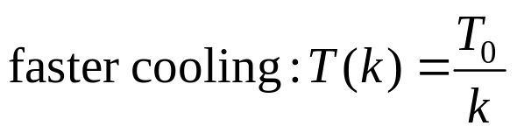
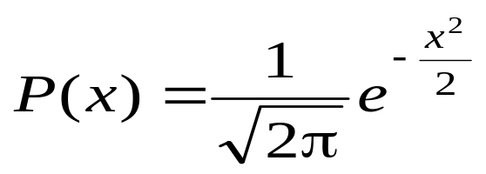
Cauchy machine
obeys Cauchy distribution
acceptance criteria:
Need special random number generator for a particular
distribution
Gauss: density function

Slide 27
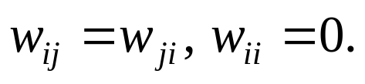
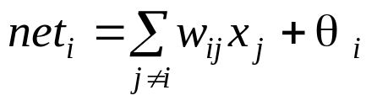
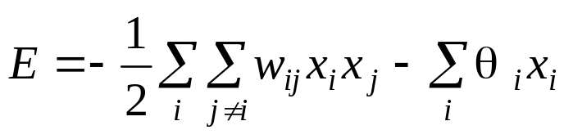
Boltzmann Machine (BM) (§6.4)
Hopfield model + hidden nodes + simulated annealing
BM Architecture
  a set of visible nodes: nodes can be accessed from outside
  a set of hidden nodes:
    adding hidden nodes to increase the computing power
    Increase the capacity when used as associative memory (increase distance between patterns)
  connection between nodes
    Fully connected between any two nodes (not layered)
    Symmetric connection:
  nodes are the same as in discrete HM:
  energy function:

Slide 28


BM computing (SA), with a given set of weights
1. Apply an input pattern to the visible nodes.
  some components may be missing or corrupted ---pattern completion/correction;
  some components may be permanently clamped to the input values (as recall key or problem input parameters).
2. Assign randomly 0/1 to all unknown nodes
( including all hidden nodes and visible nodes with
missing input values).
3. Perform SA process according to a given cooling
schedule.
  randomly picked non-clamped node i is assigned value of
  1 with probability ,
  0 with probability
  Boltzmann distribution for states

Slide 29
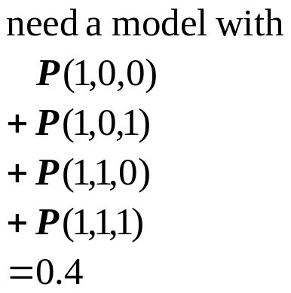

BM learning ( obtaining weights from exemplars)
  what is to be learned?
    probability distribution of visible vectors in the environment.
    exemplars: assuming randomly drawn from the entire population of possible visible vectors.
    construct a model of the environment that has the same prob. distri. of visible nodes as the one in the exemplar set.
  There may be many models satisfying this condition
    because the model involves hidden nodes.
hidden
2
3
Infinite ways to assign prob. to individual states
visible
1
let the model have equal probability of theses states (max. entropy);
let these states obey B-G distribution (prob. proportional to energy).

Slide 30





  BM Learning rule:
: the set of exemplars ( visible vectors)
: the set of vectors appearing on the hidden nodes
two phases:
    clamping phase: each exemplar is clamped to visible nodes. (associate a state H_{b} to V_{a})
    free-run phase: none of the visible node is clamped (make (H_{b} , V_{a}) pair a min. energy state)
: probability that exemplar is applied in
clamping phase (determined by the training set)
: probability that the system is stabilized with
at visible nodes in free-run (determined by the
model)

Slide 31

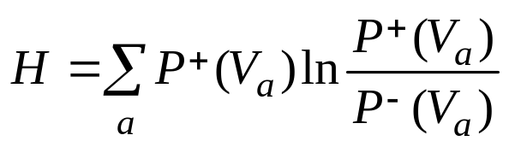
learning is to construct the weight matrix such that
is as close to as possible.
A measure of the closeness of two probability distributions (called maximum likelihood, asymmetric divergence, Kullback-Leibler distance, or cross-entropy):
It can be shown
BM learning takes the gradient descent approach to minimal H

Slide 32
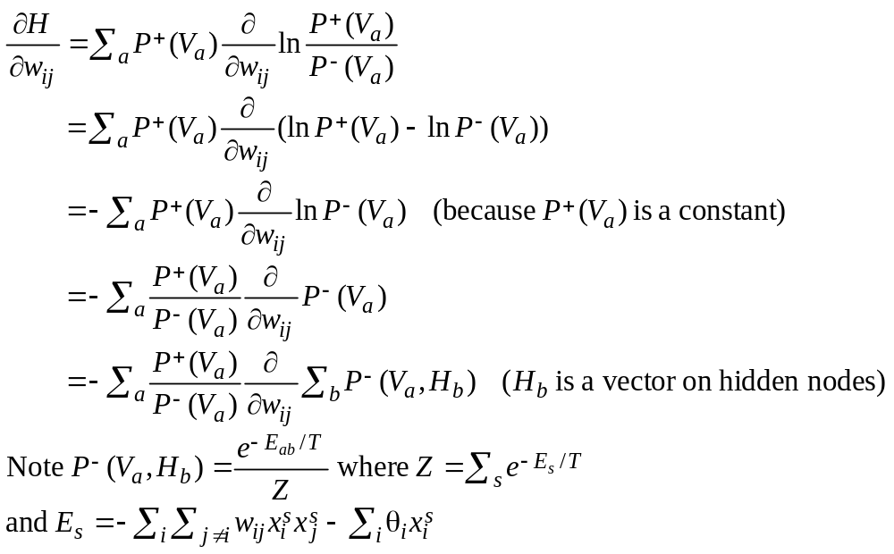

Slide 33
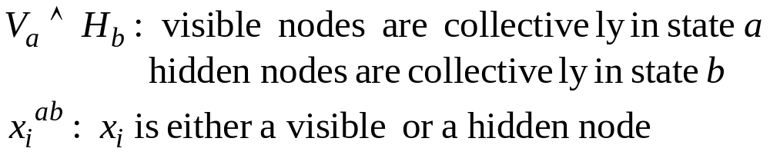
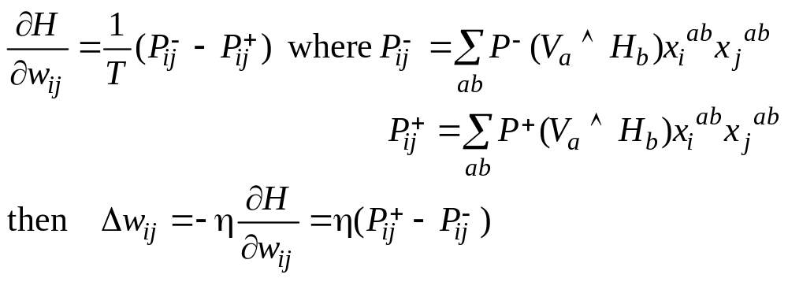
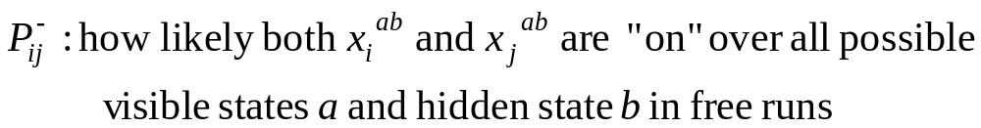
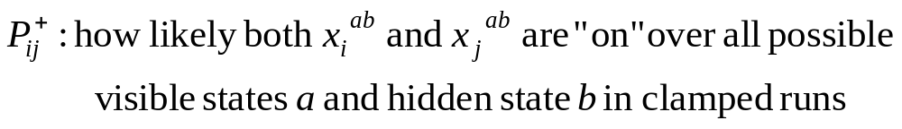

Slide 34

BM Learning algorithm (for auto-association)
1. compute
1.1. clamp one training vector to the visible nodes of the
network
1.2. anneal the network according to the annealing
schedule until equilibrium is reached at a pre-set low
temperature T1 (close to 0).
1.3. continue to run the network for many cycles at T1.
After each cycle, determine which pairs of connected
node are “on” simultaneously.
1.4. average the co-occurrence results from 1.3
1.5. repeat steps 1.1 to 1.4 for all training vectors and
average the co-occurrence results to estimate
for each pair of connected nodes.

Slide 35

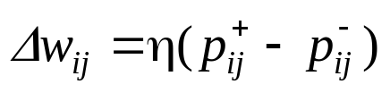
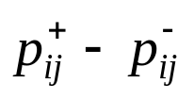
2. Compute
the same steps as 1.2 to 1.4 (no visible node is clamped).
3. Calculate and apply weight change
4. Repeat steps 1 to 3 until is sufficiently small.

Slide 36
Comments on BM learning
BM is a stochastic machine not a deterministic one.
  Solution is obtained at the end of annealing process
It has higher representative/computation power than HM+SA (due to the existence of hidden nodes).
Since learning takes gradient descent approach, only local optimal result is guaranteed (H may not be reduced to 0).
Learning can be extremely slow, due to repeated SA involved
There are a number of variations of BM learning
  The one in text is for hetero-association
  Alternatively, let p_{ij} be prob. of i and j both “on” or both “off”
There are a number of variations of BM computing
  Clamp input vector (it may contain noise)
  Transient input (resulting min. energy state may be irrelevant to input)
  Clamp input to an intermediate temperature

Slide 37
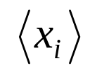
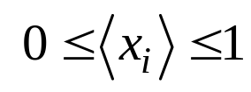
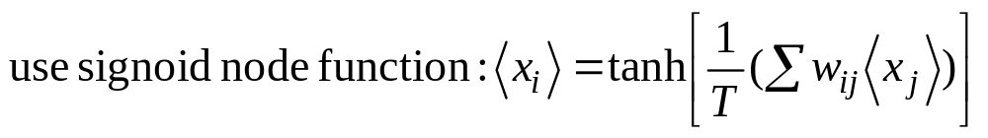
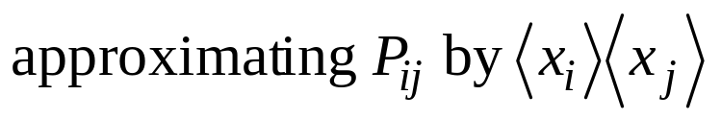
Comments on BM learning
Speed up:
  Hardware implementation
  Mean field theory: turning BM to deterministic by replacing random variables x_{i} by its expected (mean) values
    no annealing takes place

Slide 38
Evolutionary Computing (§7.5)
Another expensive method for global optimization
Stochastic state-space search emulating biological evolutionary mechanisms
  Biological reproduction
    Most properties of offspring are inherited from parents, some are resulted from random perturbation of gene structures (mutation)
    Each parent contributes different part of the offspring’s chromosome structure (cross-over)
  Biological evolution: survival of the fittest
    Individuals of greater fitness have more offspring
    Genes that contribute to greater fitness are more predominant in the population

Slide 39
Overview
population
selection of parents for reproduction
(based on a fitness function)
parents
reproduction (cross-over + mutation)
next generation of population
Variations of evolutionary computing:
  Genetic algorithm (relying more on cross-over)
  Genetic programming
  Evolutionary programming (mutation is the primary operation)
  Evolutionary strategies (using real-value vectors and self-adapting variables (e.g., covariance))

Slide 40
Basics
Individual:
  corresponding to a state
  represented as a string of symbols (genes and chromosomes), similar to a feature vector.
Population of individuals (at current generation) P (t)
Fitness function f: estimates the goodness of individuals
Selection for reproduction:
  randomly select a pair of parents from the current population
  individuals with higher fitness function values have higher probabilities to be selected
Reproduction:
  crossover allows offspring to inherit and combine good features from their parents
  mutation (randomly altering genes) may produce new (hopefully good) features
Bad individuals are throw away when the limit of population size is reached

Slide 41
Comments
Initialization:
  Random,
  Plus sub-optimal states generated from fast heuristic methods
Termination:
  All individual in the population are almost identical (converged)
  Fitness values stop to improve over many generations
  Pre-set max # of iterations exceeded
To ensure good results
  Population size must be large (but how large?)
  Allow it to run for a long time (but how long?)

Slide 42
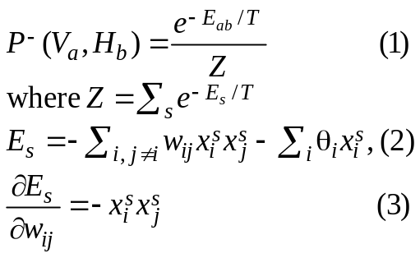
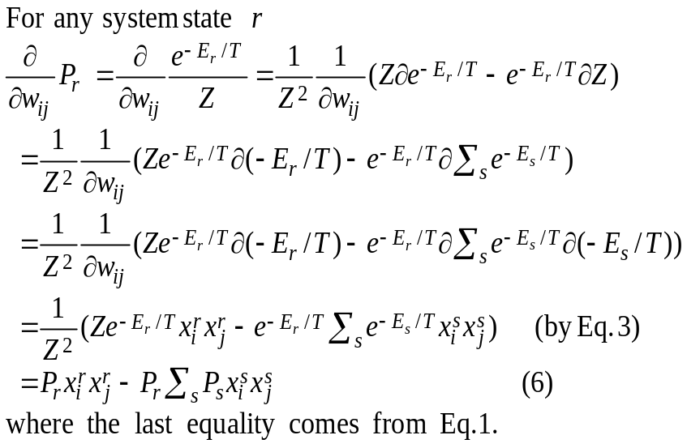

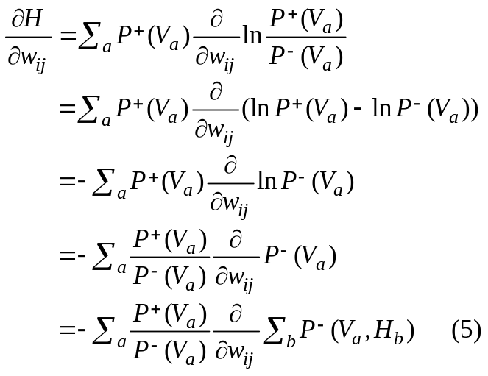
Derivation of BM learning rule

Slide 43
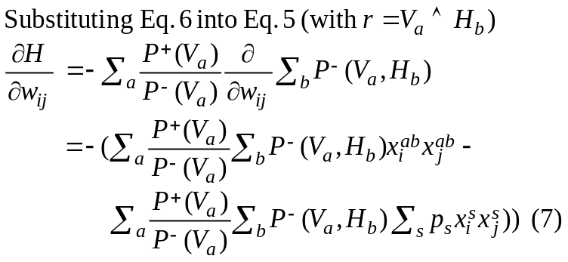




Derivation of BM learning rule

Slide 44
Additional NN Models
Reinforcement learning (RL)
Basic ideas:
  Supervised learning: (delta rule, BP)
    Samples (x, f(x)) to learn function f(.)
    precise error can be determined and is used to drive the learning.
  Unsupervised learning: (competitive, BM)
    no target/desired output provided to help learning,
    learning is self-organized/clustering
  reinforcement learning: in between the two
    no target output for input vectors in training samples
    a judge/critic will evaluate the output
    good: reward signal (+1)
    bad: penalty signal (-1)

Slide 45
RL exists in many places
  Originated from psychology( training animal)
  Machine learning community, different theories and algorithms
  major difficulty: credit/blame distribution
  chess playing: W/L (multi-step)
  soccer playing: W/L(multi-player)
  In many applications, it is much easier to determine good/bad, right/wrong, acceptable/unacceptable than to provide precise correct answer/error.
  It is up to the learning process to improve the system’s performance based on the critic’s signal.

Slide 46
Principle of RL
  Let r = +1 reword (good output)
  r = -1 penalty (bad output)
  If r = +1, the system is encouraged to continue what it is doing
  If r = -1, the system is encouraged not to do what it is doing.
  Need to search for better output
    because r = -1 does not indicate what the good output should be.
    common method is “random search”

Slide 47
ARP: the associative reword-and-penalty algorithm for NN (Barton and Anandan, 1985)
  Architecture
z(k)
critic
input: x(k)
output: y(k)
stochastic units: z(k) for random search
y(k)
x(k)

Slide 48



  Random search by stochastic units zi
or let z_{i} obey a continuous probability distribution
function.
or let is a random noise, obeys
certain distribution.
Key: z is not a deterministic function of x, this gives z a chance to be a good output.
  Prepare desired output (temporary)

Slide 49

  Compute the errors at z layer
  where E(z(k)) is the expected value of z(k) because z is a random variable
  How to compute E(z(k))
    take average of z over a period of time
    compute from the distribution, if possible
    if logistic sigmoid function is used,
  Training: BP or other method to minimize the error

