Slide 1
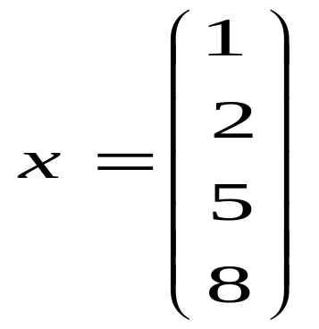
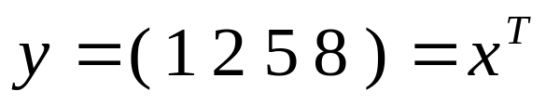
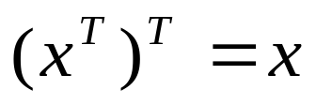
Review of Matrix Operations
Vector: a sequence of elements (the order is important)
e.g., x = (2, 1) denotes a vector
length = sqrt(2*2+1*1)
orientation angle = a
x = (x1, x2, ……, xn), an n dimensional vector
a point in an n dimensional space
column vector: row vector
X (2, 1)
a
transpose

Slide 2
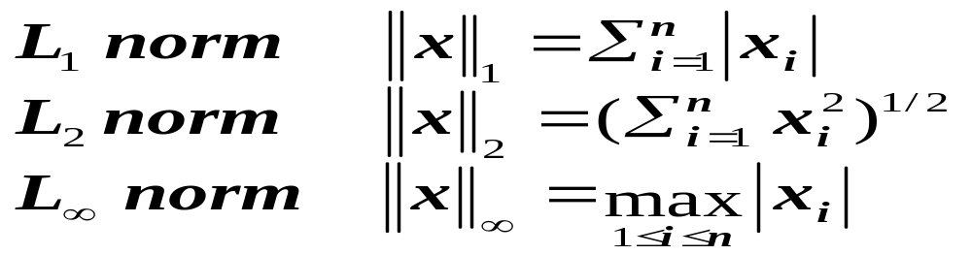
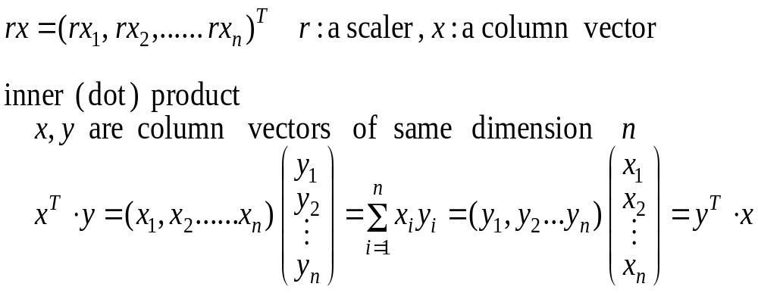
norms of a vector: (magnitude)
vector operations:

Slide 3
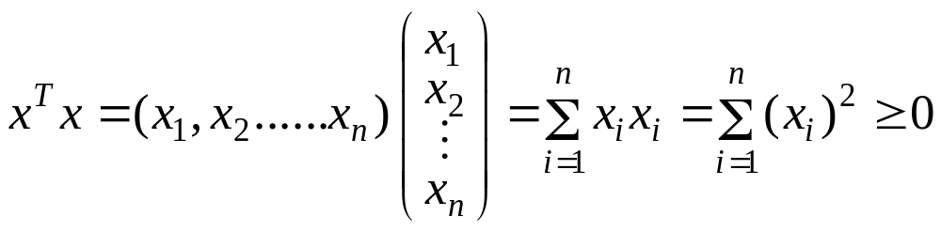

Cross product:
defines another vector orthogonal to the plan
formed by x and y.

Slide 4
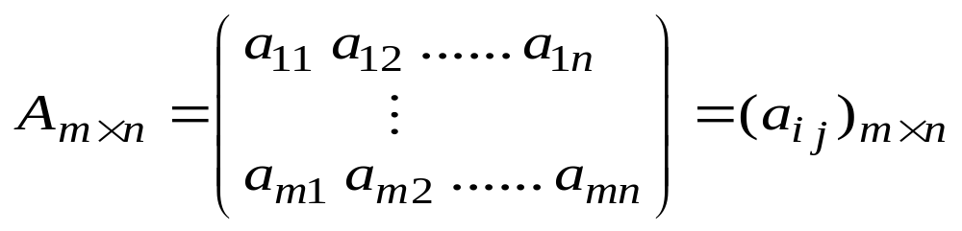
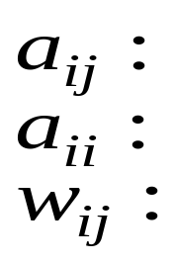
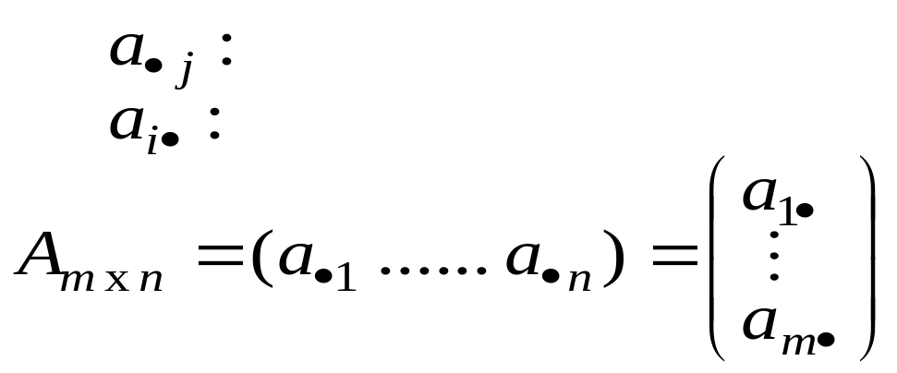
Matrix:
the element on the ith row and jth column
a diagonal element (if m = n)
a weight in a weight matrix W
each row or column is a vector
jth column vector
ith row vector

Slide 5
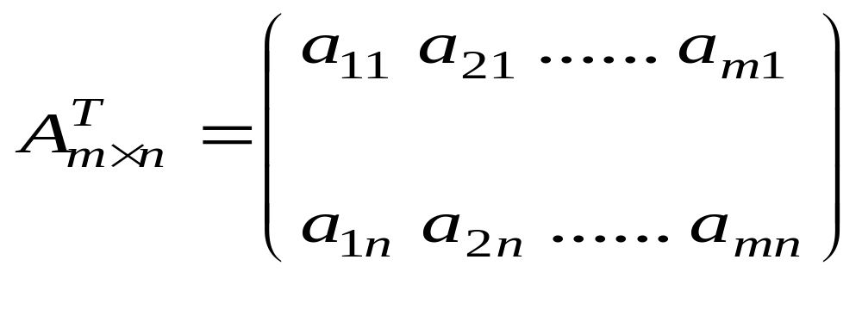
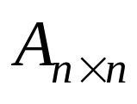
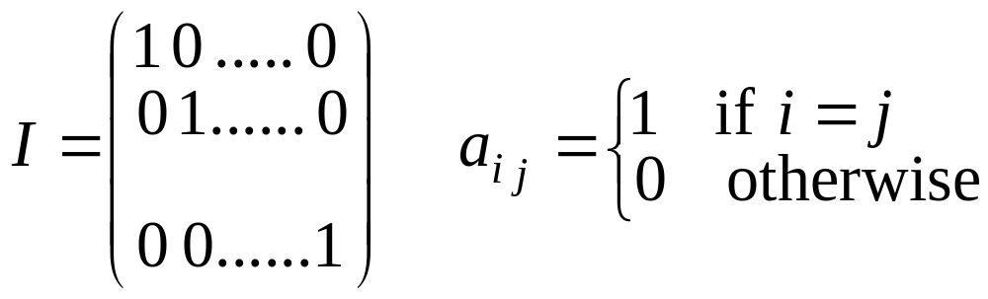
a column vector of dimension m is a matrix of m x 1
transpose:
jth column becomes jth row
square matrix:
identity matrix:

Slide 6
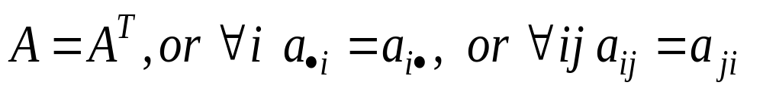
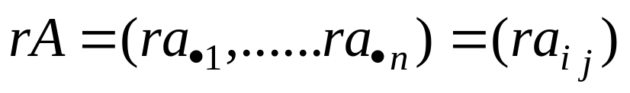
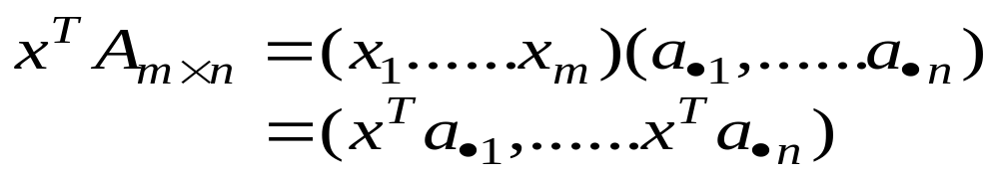
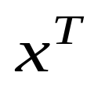
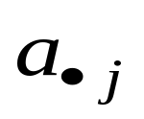
symmetric matrix: m = n and
matrix operations:
The result is a row vector, each element of which is an inner product of and a column vector

Slide 7
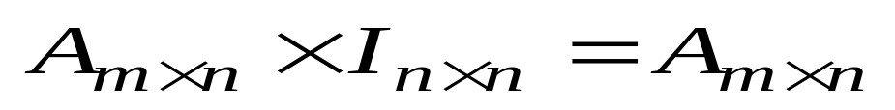
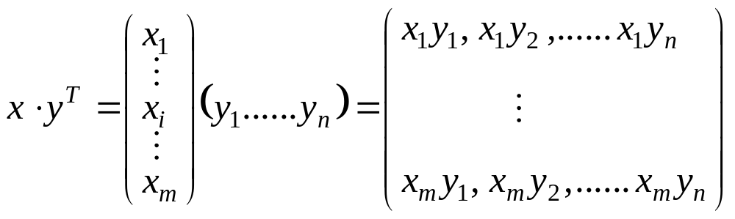
product of two matrices:
vector outer product:

Slide 8
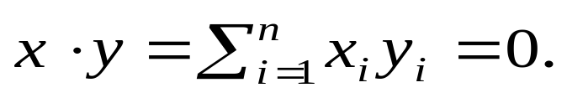
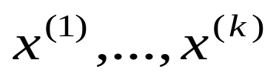

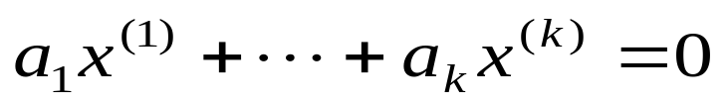
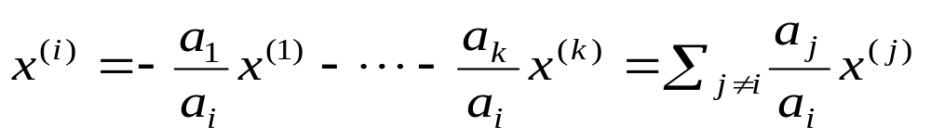
Linear Algebra
Two vectors
are said to be orthogonal to each other if
A set of vectors of dimension n are said to be linearly independent of each other if there does not exist a set of real numbers which are not all zero such that
otherwise, these vectors are linearly dependent and each one can be expressed as a linear combination of the others

Slide 9


Vector x != 0 is an eigenvector of matrix A if there exists a constant λ such that Ax = λx
  λ is called a eigenvalue of A (wrt x)
  A matrix A may have more than one eigenvectors, each with its own eigenvalues
Ex.
has 3 eigenvalues/eigenvectors

Slide 10
Matrix B is called the inverse matrix of square matrix A if AB = I (I is the identity matrix)
  Denote B as A⁻¹
  Not every matrix has inverse (e.g., when one of the row can be expressed as a linear combination of other rows)
Every matrix A has a unique pseudo-inverse A*, which satisfies the following properties
  AA*A = A; A*AA* = A*; A*A = (A*A)^{T}; AA* = (AA*)^{T}
  Ex. A = (2 1 -2), A* = (2/9 1/9 -2/9) ^{T}

Slide 11
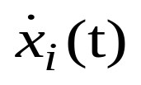
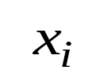

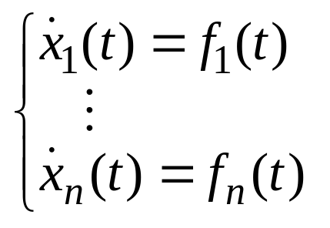
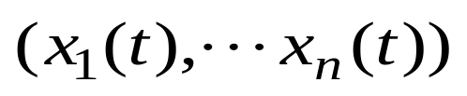

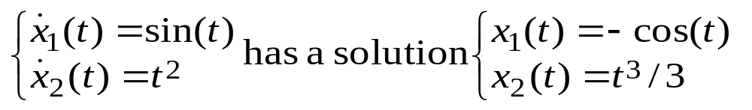
Calculus and Differential Equations
, the derivative of , with respect to time
System of differential equations
solution:
difficult to solve unless are simple

Slide 12
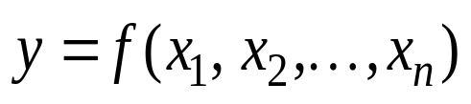

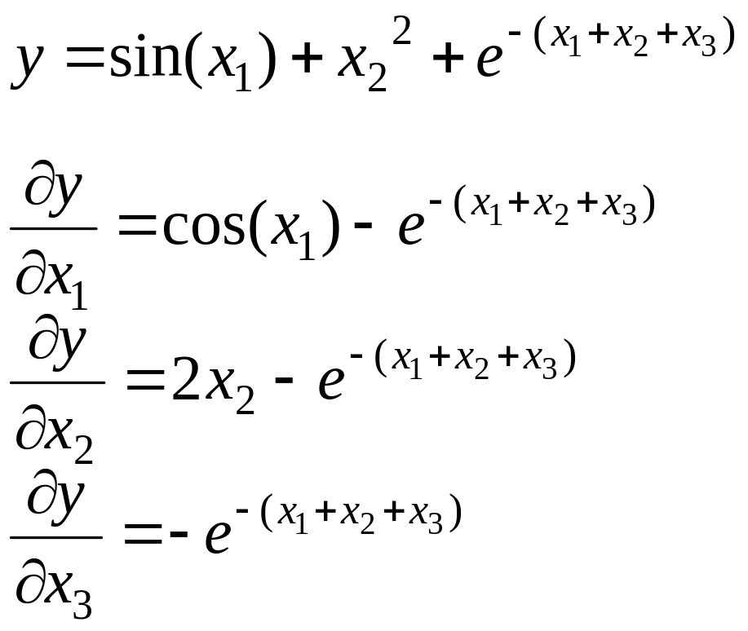
Multi-variable calculus:
partial derivative: gives the direction and speed of
change of y with respect to . Ex.

Slide 13
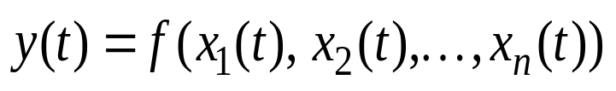
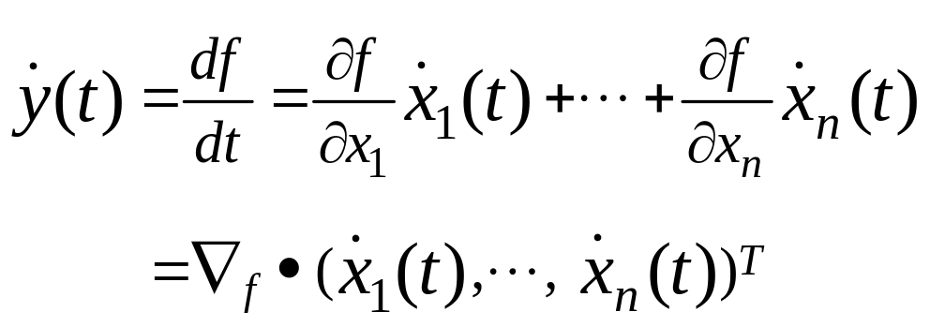
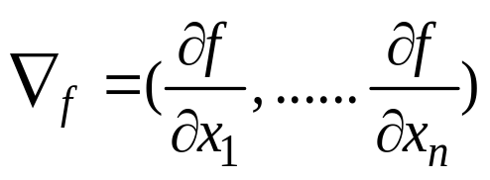
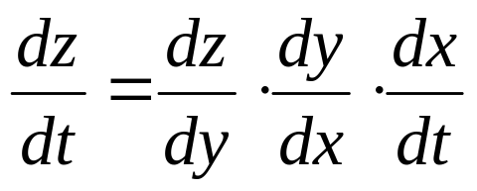
the total derivative of
gives the direction and speed of change of y, with respect to t
Gradient of f :
Chain-rule: z is a function of y, y is a function of x, x is a function of t

Slide 14
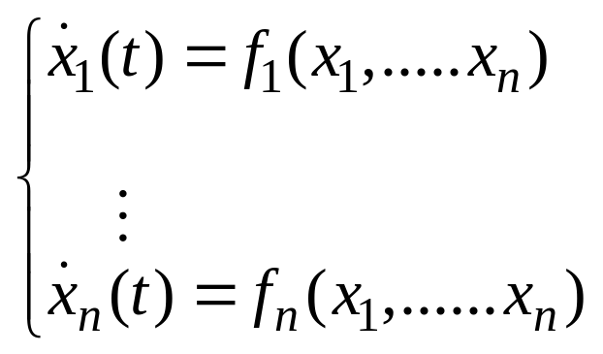

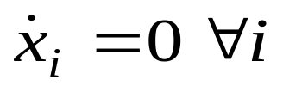
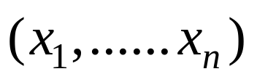
dynamic system:
  change of may potentially affect other x
  all continue to change (the system evolves)
  reaches equilibrium when
  stability/attraction: special equilibrium point
  (minimal energy state)
  pattern of at a stable state often represents a solution of the problem

