Slide 1
Adaptive Resonance Theory:
Application and Simulation
Michael Byrd
Neural Networks
Fall2008

Slide 2
Adaptive Resonance Theory
Adaptive Resonance Theory (ART) aims to solve the “Stability – Plasticity Dilemma”:
How can a system be adaptive enough to handle significant events while stable enough to handle irrelevant events?
Essentially, ART (Adaptive Resonance Theory) models incorporate new data by checking for similarity between this new data and data already learned; “memory”. If there is a close enough match, the new data is learned. Otherwise, this new data is stored as a “new memory”.
Variations:
ART1 – Designed for discrete input.
ART2 – Designed for continuous input.
ARTMAP – Combines two ART models to form a supervised learning model.

Slide 3
Adaptive Resonance Model
The basic ART model, ART1, is comprised of the following components:
The short term memory layer: F1 – Short term memory.
The recognition layer: F2 – Contains the long term memory of the system.
Vigilance Parameter: ρ – A parameter that controls the generality of the memory. Larger ρ means more detailed memories, smaller ρ produces more general memories.
Training an ART1 model basically consists of four steps.

Slide 4
Adaptive Resonance Model (2)
Step 1: Send input from the F1 layer to F2 layer for processing. The first node within the F2 layer is chosen as the closest match to the input and a hypothesis is formed. This hypothesis represents what the node will look like after learning has occurred, assuming it is the correct node to be updated.
y
F2
F1
ρ
F1 (short term memory) contains a vector of size M, and there are N nodes within F2. Each node within F2 is a vector of size M. The set of nodes within F2 is referred to as “y”.
Input (I)

Slide 5
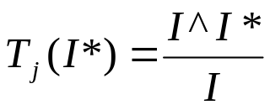


Adaptive Resonance Model (3)
Candidate
Step 2: Once the hypothesis has been formed, it is sent back to the F1 layer for matching. Let T_{j}(I*) represent the level of matching between I and I* for node j (“minimum fraction of the input that must remain in the matched pattern for resonance to occur”). Then:
y
F2
Hypothesis (I*)
F1
ρ
where
If
then the hypothesis is
accepted and assigned to that node. Otherwise, the process moves on to Step 3.
Input (I)

Slide 6
Adaptive Resonance Model (4)
Candidate
y
F2
Step 3: If the hypothesis is rejected, a “reset” command is sent back to the F2 layer. In this situation, the j^{th} node within F2 is no longer a candidate so the process repeats for node j+1.
Hypothesis (I*)
Reset
F1
ρ
Input (I)

Slide 7
Adaptive Resonance Model (5)
Rejected
Accepted
Step 4:
If the hypothesis was accepted, the winning node assigns its values to it.
If none of the nodes accepted the hypothesis, a new node is created within F2. As a result, the system forms a new memory.
y*
F2
F1
ρ
In either case, the vigilance parameter ensures that the new information does not cause older knowledge to be forgotten.
Input (I)

Slide 8
Application: Image-Text Associations
Querying data over the internet requires that noisy and/or junk data be discarded. Associating images and their annotations can be difficult because if an image-text pair is divided, the result has no meaning.
Goal: Filter out unnecessary data while keeping images and their captions.
Difficulties:
  Large amounts of textual and multimedia data.
  Captions can correspond to multiple images.
  Training learning models require time and lots of training data.
Solution: Fusion – ART model developed by Tao Jiang and Ah-Hwee Tan.

Slide 9
Fusion – ART Architecture
Fusion-ART uses two input vectors, one representing keywords of image data and the other representing textual data, to learn image-text associations.
F₂ – Association ART
Learning such associations consists of four steps:
F₂
ρ
J nodes
Visual Input Vector (v*)
Textual Input Vector (t*)
Choosing most relevant association.
Selecting association.
Determining if vectors are within vigilance.
Learning.

Slide 10
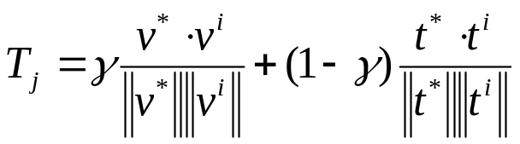

Fusion – ART (2)
Step 1 and 2:
For each of the J nodes, determine which one of them is most similar to the v* and t* vectors (i.e., calculate the resonance score T_{j} and determine the highest one).
Resonance score defined as:
F₂
ρ
J nodes
Visual Memory Vector (v*)
Textual Memory Vector (t*)
where is the factor for manually weighing visual and textual inputs (manually determined), and 0 ≤ i ≤ j. For example, if you have pictures with lengthy captions, you may want to make the value small to favor text. Choose the node with highest T_{j}.

Slide 11
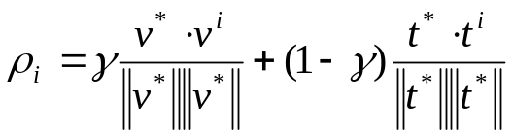
Fusion – ART (3)
Rejected
Candidate
Step 3:
Perform “Template Matching”. Once the node with the highest resonance score is chosen, determine if the input vectors are within vigilance of the candidate nodes.
Vigilance determined by:
F₂
ρ
J nodes
Visual Memory Vector (v*)
Textual Memory Vector (t*)
where 0 ≤ i ≤ j. That is, the vigilance of the candidate node is the weighted combination of the cosine similarities of the normals for each input vector with the appropriate vector in node i. If ρ_{i} ≥ ρ, the inputs are combined into node i.

Slide 12


Fusion – ART (4)
Rejected
Candidate
Step 4:
To learn the new data, the following equations are used for the visual and textual vectors respectively:
F₂
ρ
J nodes
Visual Memory Vector (v*)
Textual Memory Vector (t*)
where β_{t} and β_{v} are predefined learning rates for the textual and visual data.

Slide 13
Fusion – ART (5)
Rejected
New Node
?
If no candidate node is found, or the input produces a similarity value less than the vigilance, the two input vectors form a new node in the F₂ layer.
This enables Fusion-ART to learn new image-text pairs.
F₂
ρ
J+1 nodes
Visual Memory Vector (v*)
Textual Memory Vector (t*)

Slide 14
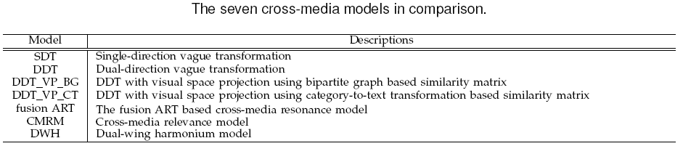
Fusion – ART Evaluation
The Fusion-ART architecture was evaluated using 60 images and the textual articles they were found in as input. For completeness, 5-fold cross validation* was employed; 4 folds (240 images) used for training and 1 fold for testing. Fusion-ART evaluated against other learning methods, whose descriptions are below:
* The 60 images were divided into five subgroups, four of which were trained at a time (48 images). The remaining twelve images were left for testing. This was repeated five times to produce twenty groups of twelve images each to train (240 total) and five groups of twelve images each for test (60 total).

Slide 15
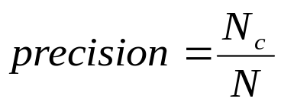
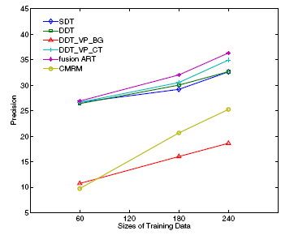
Fusion – ART Eval. Results
Precision of Fusion-ART was determined by dividing the number of correct image-text associations with the total number of associations:
N_{c} = correct image-text associations
N = number of associations
Here, the vigilance parameter ρ = 0, so very general memories were formed. Thus, overall precision is low.

Slide 16
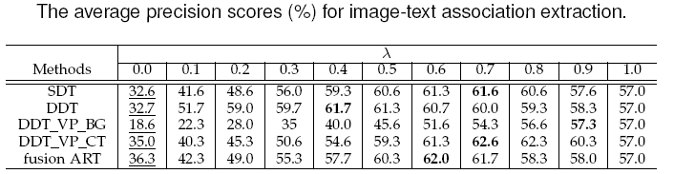
Fusion – ART Eval. Results (2)
By adjusting ρ, precision scores for each of the architectures fluctuate. When ρ = 0.6, Fusion-ART achieved 62% precision. Although DDT_VP_CT achieves higher precision, it does so with greater vigilance and therefore, it needs to form more detailed memories than Fusion-ART.
Conclusion: Fusion-ART can form more general memories, with only a slight drop in precision.

Slide 17
ART Simulation
Several simulation and software packages exist for ART systems. The one chosen for this project is the Java Neural Network Simulator (abbreviated: Java NNS): http://www.ra.cs.uni-tuebingen.de/software/JavaNNS/welcome_e.html
Based off of the Stuttgart Neural Network Simulator (SNNS) package.
  Written in C\C++.
Developed at the University of Tübingen by CS students/faculty.
Able to simulate multiple neural network architectures including:
  Backpropagation systems
  Radial Basis Functions
  Spiking Neural Networks
  ART1, ART2 and ARTMAP networks

Slide 18
Classifying Edible Mushrooms
Problem: Classify mushrooms as either being edible or poisonous based on various attributes.
Dataset: Taken from http://archive.ics.uci.edu/ml/datasets/Mushroom. Contains 8124 descriptions of mushrooms, where each description has 23 attributes:
Mushroom edibility
Cap-shape
Cap-surface
Cap-color
Etc…

Slide 19
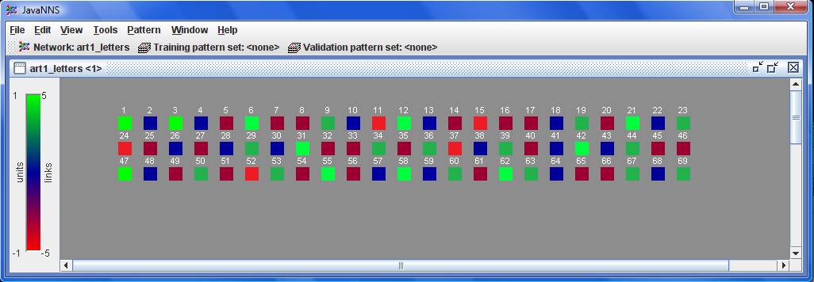
Mushrooms (2)
Experimentation: Train the ART1 network on the first 6093 rows of data and attempt to classify the remaining 2031 rows as edible mushrooms or poisonous ones.
Simulator: JavaNNS. Sample input:
Poisonous – Red
Edible - Green
Shades of Red to Green denote discrete values for each attribute.

Slide 20
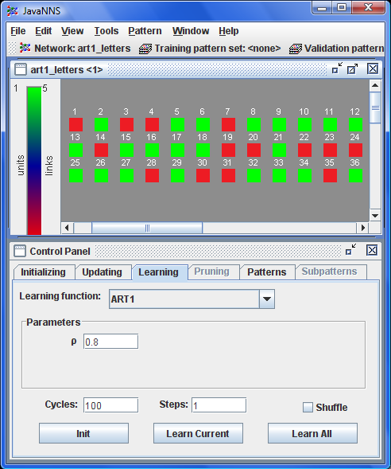
Mushrooms (3)
Used varying values of ρ to determine highest success (0.0 ≤ ρ ≤ 1.0) when classifying. Once all 6093 rows of data were trained, the remaining 2031 rows were classified.
Results: 1723/2031 rows were correctly classified (~84.8% success). This was the highest success rate and occurred when ρ = 0.8.
How was this verified: BY HAND!!!!!! Manually counted each success/failure and compared it to the results provided in the data set.
Last 36 rows of data that have been classified.

Slide 21
Mushrooms (4)
Analysis:
84.8% success is good, but that leaves 308 mushrooms improperly classified. Of those 308, 279 had an unknown attribute denoted by a question mark (?). This is most likely a contributing factor to the misclassification.
Also, it is possible that the model was improperly trained (human error).
Conclusion:
ART1 network can be useful for this type of classification.

Slide 22
ART Summary
Solves Stability – Plasticity Dilemma.
Forms new memories or incorporates new information based on a predefined vigilance parameter.
Higher vigilance produces more detailed memories, lower vigilance produces more general memories.
Fusion-ART useful for text-image associations

Slide 23
References
Santosh K. Rangarajan, Vir V. Phoha, Kiran S. Balagani, Rastko R.Selmic, S.S. Iyengar, "Adaptive Neural Network Clustering of Web Users," Computer, Vol. 37, No. 4, pp. 34-40, Apr., 2004
Gail A. Carpenter, and Stephen Grossberg, “Adaptive Resonance Theory”, The Handbook of Brain Theory and Neural Networks, Ed. 2, Sept., 1998
Gail A. Carpenter, “Default ARTMAP”, Neural Networks, July., 2003
Tao Jiang, Ah-Hwee Tan, “Learning Image-Text Associations”, (Not yet published), 2008
Jianhong Luo, and Dezhao Chen, “An Enhanced ART2 Neural Network for Clustering Analysis”, Proceedings of the 1st international conference on Forensic applications and techniques in telecommunications, information, and multimedia and workshop, 2008
E.P. Sapozhnikova, V.P. Lunin, "A Modified Search Procedure for the Art Neural Networks," ijcnn,pp.5541, IEEE-INNS-ENNS International Joint Conference on Neural Networks (IJCNN'00)-Volume 5, 2000
Gail A. Carpenter, and Stephen Grossberg, “The ART of Adaptive Pattern Recognition by a Self-Organizing Neural Network”, Computer, Vol. 21, No. 3, pp. 77-88, Mar., 1988
Robert A. Baxter, “Supervised Adaptive Resonance Networks”, Proceedings of the conference on Analysis of neural network applications, pp. 123 – 137, 1991
Pui Y. Lee, Siu C. Hui., and Alvis Cheuk Fong, “Neural Networks for Web Content Filtering”, IEEE Intelligent Systems, Vol. 17, No. 5, pp. 48-57, Sept., 2002
“Adaptive Resonance Theory”, Wikipedia, http://en.wikipedia.org/wiki/Adaptive_resonance_theory

