Slide 1
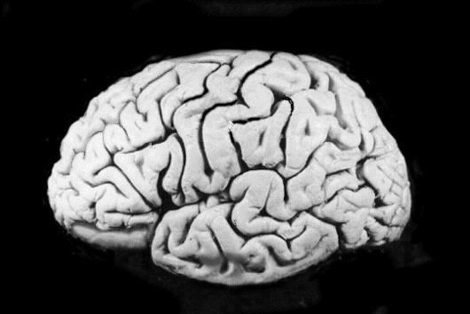
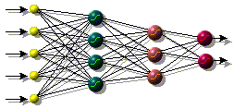
Foundations of Learning and Adaptive Systems
ICS320
Part 4:
Artificial Neural Networks

Slide 2
Outline
The Brain
Perceptrons
Gradient descent
Multi-layer networks
Backpropagation

Slide 3
Artificial Neural Networks
Other terms/names
    connectionist
    parallel distributed processing
    neural computation
    adaptive networks..
History
  1943-McCulloch & Pitts are generally recognised as the designers of the first neural network
  1949-First learning rule
  1969-Minsky & Papert - perceptron limitation - Death of ANN
  1980’s - Re-emergence of ANN - multi-layer networks

Slide 4
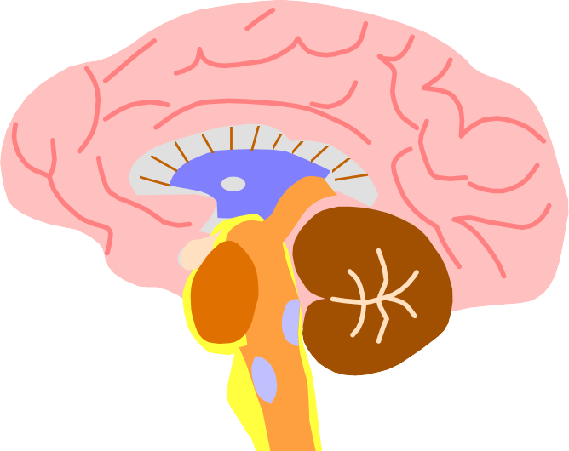
The biological inspiration
The brain has been extensively studied by scientists.
Vast complexity prevents all but rudimentary understanding.
Even the behaviour of an individual neuron is extremely complex

Slide 5

Features of the Brain
Ten billion (10¹⁰) neurons
Neuron switching time >10⁻³secs
Face Recognition ~0.1secs
On average, each neuron has several thousand connections
Hundreds of operations per second
High degree of parallel computation
Distributed representations
Die off frequently (never replaced)
Compensated for problems by massive parallelism

Slide 6
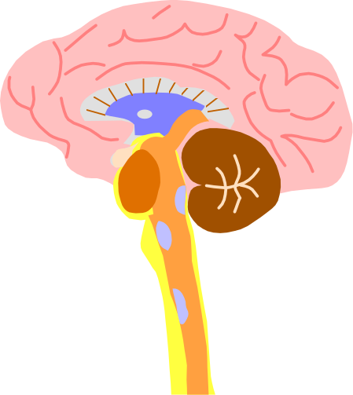

Brain and Machine
The Brain
  Pattern Recognition
  Association
  Complexity
  Noise Tolerance
The Machine
  Calculation
  Precision
  Logic

Slide 7
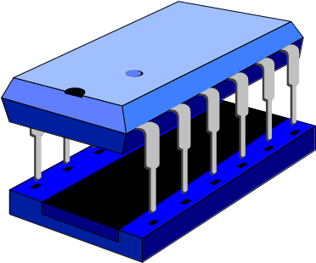

The contrast in architecture
The Von Neumann architecture uses a single processing unit;
  Tens of millions of operations per second
  Absolute arithmetic precision
The brain uses many slow unreliable processors acting in parallel

Slide 8
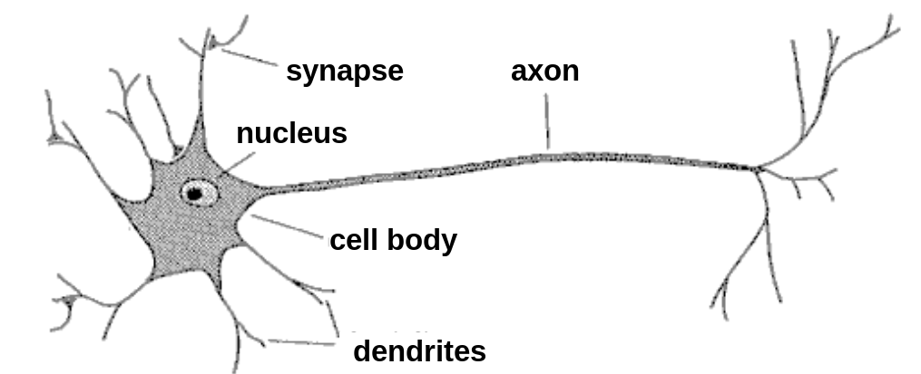
The Structure of Neurons

Slide 9
The Structure of Neurons
A neuron only fires if its input signal exceeds a certain amount (the threshold) in a short time period.
Synapses vary in strength
  Good connections allowing a large signal
  Slight connections allow only a weak signal.
  Synapses can be either excitatory or inhibitory.

Slide 10
The Structure of Neurons
A neuron has a cell body, a branching input
structure (the dendrIte) and a branching output structure (the axOn)
  Axons connect to dendrites via synapses.
  Electro-chemical signals are propagated from the dendritic input, through the cell body, and down the axon to other neurons

Slide 11

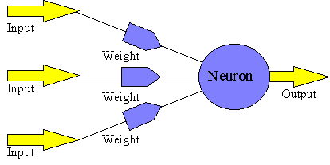
Properties of Artificial Neural Nets (ANNs)

Slide 12
Properties of Artificial Neural Nets (ANNs)
Many simple neuron-like threshold switching units
Many weighted interconnections among units
Highly parallel, distributed processing
Learning by tuning the connection weights

Slide 13
Appropriate Problem Domains for Neural Network Learning
Input is high-dimensional discrete or real-valued (e.g. raw sensor input)
Output is discrete or real valued
Output is a vector of values
Form of target function is unknown
Humans do not need to interpret the results (black box model)

Slide 14
Perceptron
Linear treshold unit (LTU)
x₀₌₁
x₁
w₁
w₀
w₂
x₂
Σ
o
.
.
.
^{n}
Σ w_{i} x_{i}
w_{n}
_{i=0}
x_{n}
^{n}
1 if Σ w_{i} x_{i} >0
o(x_{i})=
-1 otherwise
{
_{i=0}

Slide 15
Perceptron Learning Rule
w_{i} = w_{i} + Δw_{i}
Δw_{i} = η (t - o) x_{i}
t=c(x) is the target value
o is the perceptron output
η Is a small constant (e.g. 0.1) called learning rate
If the output is correct (t=o) the weights w_{i} are not changed
If the output is incorrect (t≠o) the weights w_{i} are changed
such that the output of the perceptron for the new weights
is closer to t.
The algorithm converges to the correct classification
  if the training data is linearly separable
  and η is sufficiently small

Slide 16
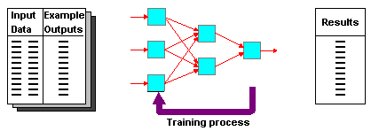

Supervised Learning
Training and test data sets
Training set; input & target

Slide 17
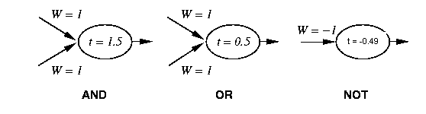
Perceptron Training
1 if Σ w_{i} x_{i} >t
Output=
0 otherwise
{
_{i=0}
Linear threshold is used.
W - weight value
t - threshold value

Slide 18
Simple network
1 if Σ w_{i} x_{i} >t
output=
0 otherwise
{
_{i=0}
-1
W = 1.5
X
t = 0.0
W = 1
Y

Slide 19
Training Perceptrons
For AND
A B Output
0 0 0
0 1 0
1 0 0
1 1 1
-1
W = ?
x
t = 0.0
W = ?
W = ?
y
What are the weight values?
Initialize with random weight values

Slide 20
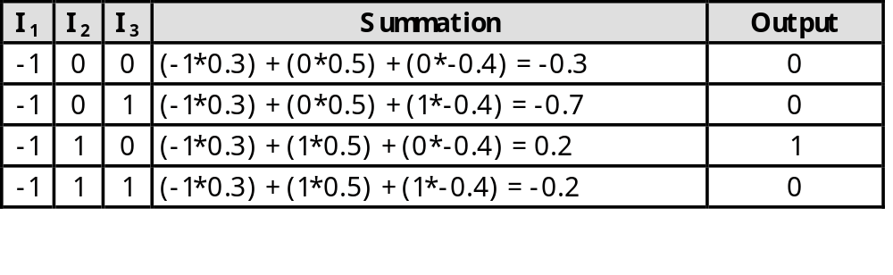
Training Perceptrons
For AND
A B Output
0 0 0
0 1 0
1 0 0
1 1 1
-1
W = 0.3
x
t = 0.0
W = 0.5
W = -0.4
y

Slide 21
Learning algorithm
Epoch : Presentation of the entire training set to the neural network.
In the case of the AND function an epoch consists of four sets of inputs being presented to the network (i.e. [0,0], [0,1], [1,0], [1,1])
Error: The error value is the amount by which the value output by the network differs from the target value. For example, if we required the network to output 0 and it output a 1, then Error = -1

Slide 22
Learning algorithm
Target Value, T : When we are training a network we not only present it with the input but also with a value that we require the network to produce. For example, if we present the network with [1,1] for the AND function the training value will be 1
Output , O : The output value from the neuron
Ij : Inputs being presented to the neuron
Wj : Weight from input neuron (I_{j}) to the output neuron
LR : The learning rate. This dictates how quickly the network converges. It is set by a matter of experimentation. It is typically 0.1

Slide 23
Decision boundaries
In simple cases, divide feature space by drawing a hyperplane across it.
Known as a decision boundary.
Discriminant function: returns different values on opposite sides. (straight line)
Problems which can be thus classified are linearly separable.

Slide 24
Linear Separability
X₁
A
A
A
Decision
Boundary
B
A
A
B
B
B
A
B
A
B
B
X₂
B

Slide 25
Decision Surface of a Perceptron
x₂
x₂
+
+
+
-
+
-
-
x₁
x₁
+
-
-
+
-
Linearly separable
Non-Linearly separable
Perceptron is able to represent some useful functions
AND(x₁,x₂) choose weights w₀=-1.5, w₁=1, w₂=1
But functions that are not linearly separable (e.g. XOR)
are not representable

Slide 26
Hyperplane partitions
An extra layer models a convex hull
  “An area with no dents in it”
  Perceptron models, but can’t learn
  Sigmoid function learning of convex hulls
  Two layers add convex hulls together
  Sufficient to classify anything “sane”.
In theory, further layers add nothing
In practice, extra layers may be better

Slide 27
Different Non-Linearly
Separable Problems
Types of
Decision Regions
Exclusive-OR
Problem
Classes with
Meshed regions
Most General
Region Shapes
Structure
Single-Layer
Half Plane
Bounded By
Hyperplane
A
B
B
A
B
A
Two-Layer
Convex Open
Or
Closed Regions
A
B
B
A
B
A
Three-Layer
Arbitrary
(Complexity
Limited by No.
of Nodes)
A
B
B
A
B
A

Slide 28
Multilayer Perceptron (MLP)
Output Values
Output Layer
Adjustable
Weights
Input Layer
Input Signals (External Stimuli)

Slide 29
Types of Layers
The input layer.
  Introduces input values into the network.
  No activation function or other processing.
The hidden layer(s).
  Perform classification of features
  Two hidden layers are sufficient to solve any problem
  Features imply more layers may be better
The output layer.
  Functionally just like the hidden layers
  Outputs are passed on to the world outside the neural network.

Slide 30
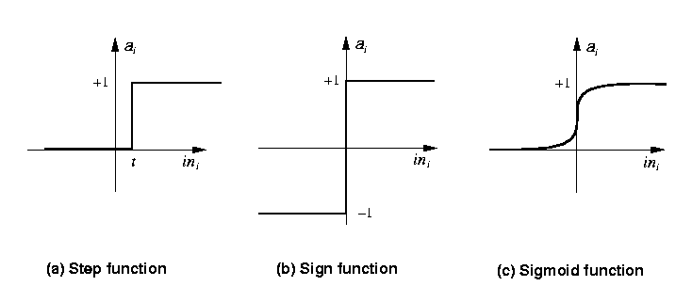
Activation functions
Transforms neuron’s input into output.
Features of activation functions:
  A squashing effect is required
    Prevents accelerating growth of activation levels through the network.
  Simple and easy to calculate

Slide 31
Standard activation functions
The hard-limiting threshold function
  Corresponds to the biological paradigm
    either fires or not
Sigmoid functions ('S'-shaped curves)
  The logistic function
  The hyperbolic tangent (symmetrical)
  Both functions have a simple differential
  Only the shape is important
1
φ(x) =
1 + e ^{-ax}

Slide 32
Training Algorithms
Adjust neural network weights to map inputs to outputs.
Use a set of sample patterns where the desired output (given the inputs presented) is known.
The purpose is to learn to generalize
  Recognize features which are common to good and bad exemplars

Slide 33
Back-Propagation
A training procedure which allows multi-layer feedforward Neural Networks to be trained;
Can theoretically perform “any” input-output mapping;
Can learn to solve linearly inseparable problems.

Slide 34
Activation functions and training
For feed-forward networks:
  A continuous function can be differentiated allowing gradient-descent.
  Back-propagation is an example of a gradient-descent technique.
  Reason for prevalence of sigmoid

Slide 35
Gradient Descent Learning Rule
Consider linear unit without threshold and continuous output o (not just –1,1)
  o=w₀ + w₁ x₁ + … + w_{n} x_{n}
Train the w_{i}’s such that they minimize the squared error
  E[w₁,…,w_{n}] = ½ Σ_{d∈D} (t_{d}-o_{d})²
  where D is the set of training examples

Slide 36
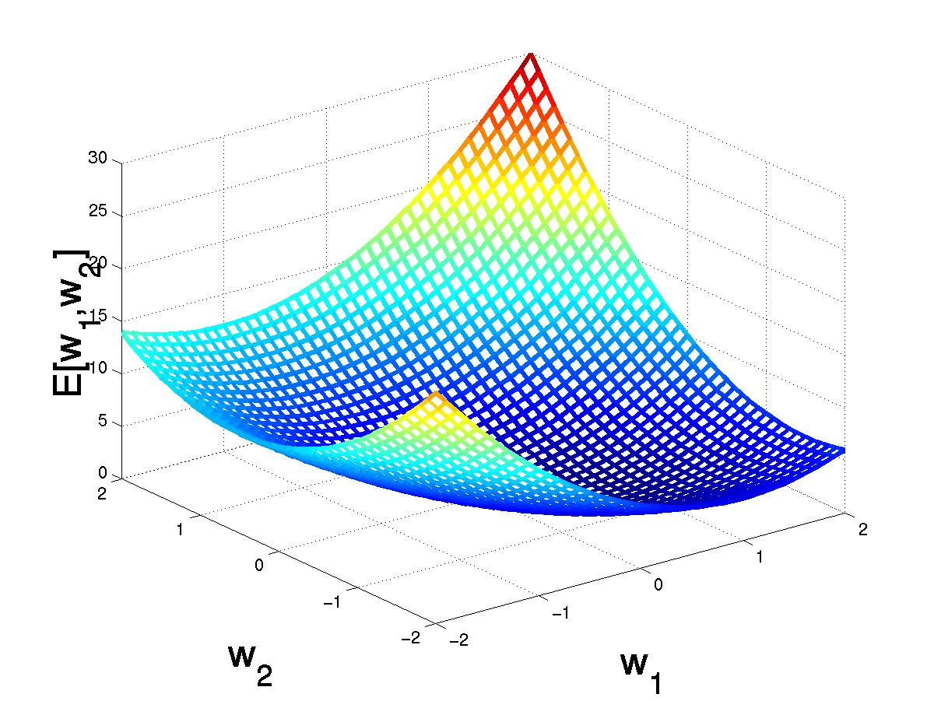
Gradient Descent
D={<(1,1),1>,<(-1,-1),1>,
<(1,-1),-1>,<(-1,1),-1>}
(w₁,w₂)
Gradient:
∇E[w]=[∂E/∂w₀,… ∂E/∂w_{n}]
Δw=-η ∇E[w]
(w₁+Δw₁,w₂ +Δw₂)
Δw_{i}=-η ∂E/∂w_{i}
=∂/∂w_{i} 1/2Σ_{d}(t_{d}-o_{d})²
= ∂/∂w_{i} 1/2Σ_{d}(t_{d}-Σ_{i} w_{i} x_{i})²
= Σ_{d}(t_{d}- o_{d})(-x_{i})

Slide 37
Gradient Descent
Gradient-Descent(training_examples, η)
Each training example is a pair of the form <(x₁,…x_{n}),t> where (x₁,…,x_{n}) is the vector of input values, and t is the target output value, η is the learning rate (e.g. 0.1)
Initialize each w_{i} to some small random value
Until the termination condition is met, Do
  Initialize each Δw_{i} to zero
  For each <(x₁,…x_{n}),t> in training_examples Do
    Input the instance (x₁,…,x_{n}) to the linear unit and compute the output o
    For each linear unit weight w_{i} Do
      Δw_{i}= Δw_{i} + η (t-o) x_{i}
  For each linear unit weight wi Do
    w_{i}=w_{i}+Δw_{i}

Slide 38
Incremental Stochastic Gradient Descent
Batch mode : gradient descent
w=w - η ∇E_{D}[w] over the entire data D
E_{D}[w]=1/2Σ_{d}(t_{d}-o_{d})²
Incremental mode: gradient descent
w=w - η ∇E_{d}[w] over individual training examples d
E_{d}[w]=1/2 (t_{d}-o_{d})²
Incremental Gradient Descent can approximate Batch Gradient Descent arbitrarily closely if η is small enough

Slide 39
Comparison Perceptron and Gradient Descent Rule
Perceptron learning rule guaranteed to succeed if
Training examples are linearly separable
Sufficiently small learning rate η
Linear unit training rules uses gradient descent
Guaranteed to converge to hypothesis with minimum squared error
Given sufficiently small learning rate η
Even when training data contains noise
Even when training data not separable by H

Slide 40
Multi-Layer Networks
output layer
hidden layer
input layer

Slide 41
Sigmoid Unit
x₀₌₁
x₁
w₁
w₀
net=Σ_{i=0}^{n} w_{i} x_{i}
o=σ(net)=1/(1+e^{-net})
w₂
x₂
Σ
o
.
.
.
w_{n}
σ(x) is the sigmoid function: 1/(1+e^{-x)}
dσ(x)/dx= σ(x) (1- σ(x))
x_{n}
Derive gradient decent rules to train:
one sigmoid function
∂E/∂w_{i} = -Σ_{d}(t_{d}-o_{d}) o_{d} (1-o_{d}) x_{i}
Multilayer networks of sigmoid units
backpropagation:

Slide 42
Backpropagation Algorithm
Initialize each w_{i} to some small random value
Until the termination condition is met, Do
  For each training example <(x₁,…x_{n}),t> Do
    Input the instance (x₁,…,x_{n}) to the network and compute the network outputs o_{k}
    For each output unit k
      δ_{k}=o_{k}(1-o_{k})(t_{k}-o_{k})
    For each hidden unit h
      δ_{h}=o_{h}(1-o_{h}) Σ_{k} w_{h,k} δ_{k}
    For each network weight w_{,j} Do
    w_{i,j}=w_{i,j}+Δw_{i,j} where
      Δw_{i,j}= η δ_{j} x_{i,j}

Slide 43
Backpropagation
Gradient descent over entire network weight vector
Easily generalized to arbitrary directed graphs
Will find a local, not necessarily global error minimum
-in practice often works well (can be invoked multiple times with different initial weights)
Often include weight momentum term
      Δw_{i,j}(t)= η δ_{j} x_{i,j} + α Δw_{i,j} (t-1)
Minimizes error training examples
  Will it generalize well to unseen instances (over-fitting)?
Training can be slow typical 1000-10000 iterations
(use Levenberg-Marquardt instead of gradient descent)
Using network after training is fast

Slide 44
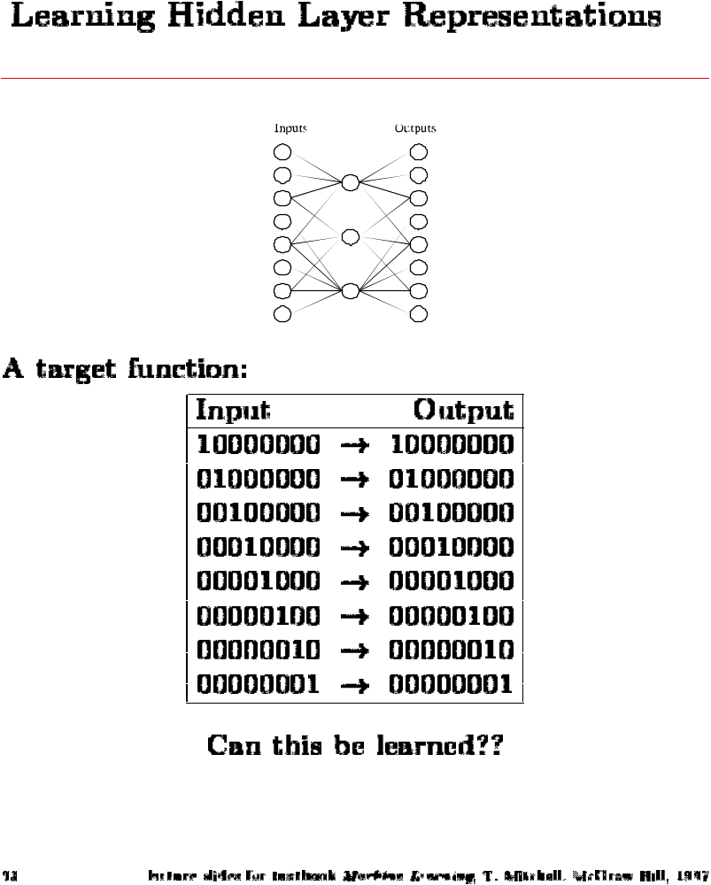
8-3-8 Binary Encoder-Decoder
8 inputs
3 hidden
8 outputs
Hidden values
.89 .04 .08
.01 .11 .88
.01 .97 .27
.99 .97 .71
.03 .05 .02
.22 .99 .99
.80 .01 .98
.60 .94 .01

Slide 45
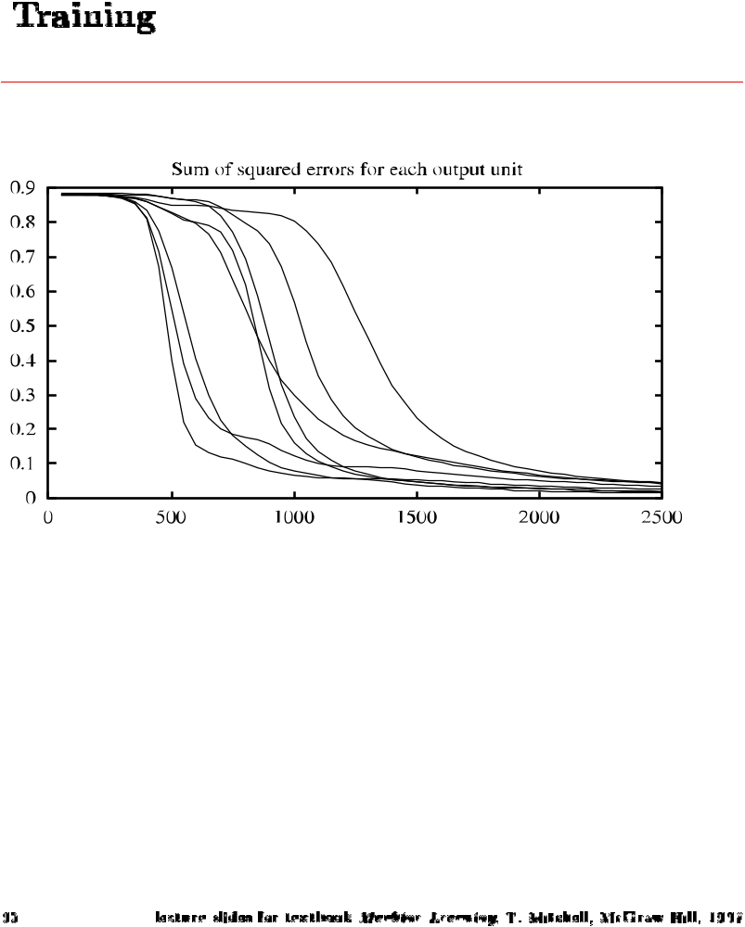
Sum of Squared Errors for the Output Units

Slide 46
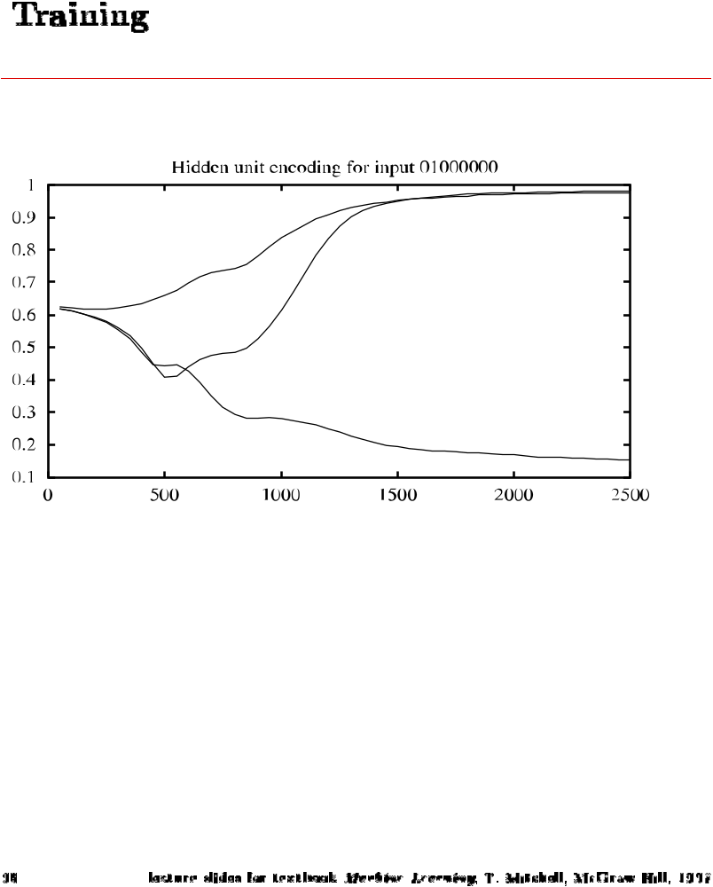
Hidden Unit Encoding for Input 0100000

Slide 47
Convergence of Backprop
Gradient descent to some local minimum
Perhaps not global minimum
Add momentum
Stochastic gradient descent
Train multiple nets with different initial weights
Nature of convergence
Initialize weights near zero
Therefore, initial networks near-linear
Increasingly non-linear functions possible as training progresses

Slide 48
Expressive Capabilities of ANN
Boolean functions
Every boolean function can be represented by network with single hidden layer
But might require exponential (in number of inputs) hidden units
Continuous functions
Every bounded continuous function can be approximated with arbitrarily small error, by network with one hidden layer [Cybenko 1989, Hornik 1989]
Any function can be approximated to arbitrary accuracy by a network with two hidden layers [Cybenko 1988]

Slide 49
Applications
The properties of neural networks define where they are useful.
  Can learn complex mappings from inputs to outputs, based solely on samples
  Difficult to analyse: firm predictions about neural network behaviour difficult;
    Unsuitable for safety-critical applications.
  Require limited understanding from trainer, who can be guided by heuristics.

Slide 50
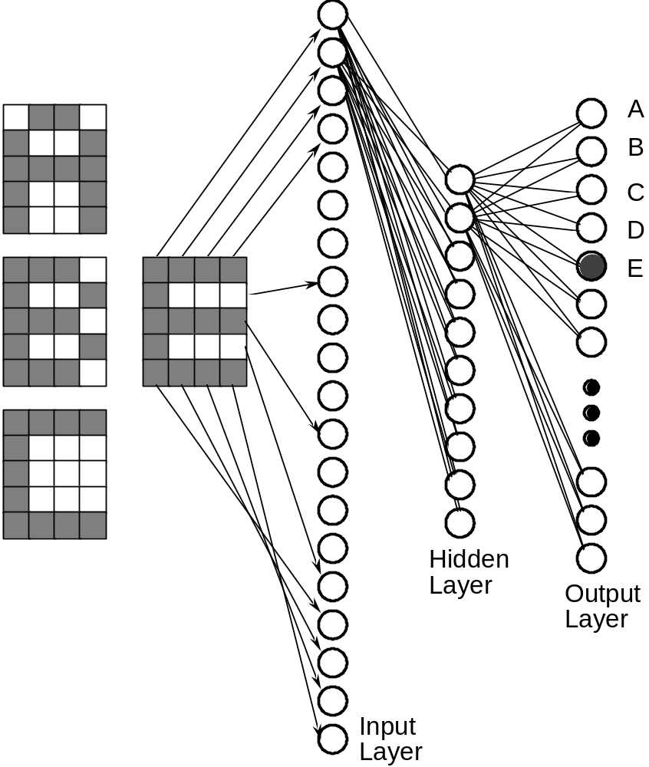
Neural network for OCR
feedforward network
trained using Back- propagation

Slide 51
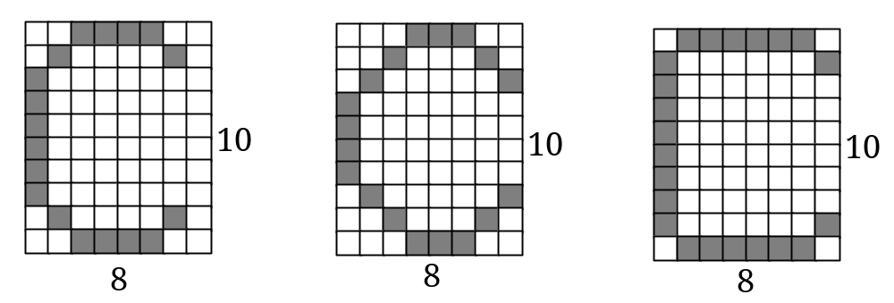
OCR for 8x10 characters
NN are able to generalise
learning involves generating a partitioning of the input space
for single layer network input space must be linearly separable
what is the dimension of this input space?
how many points in the input space?
this network is binary(uses binary values)
networks may also be continuous

Slide 52

Engine management
The behaviour of a car engine is influenced by a large number of parameters
  temperature at various points
  fuel/air mixture
  lubricant viscosity.
Major companies have used neural networks to dynamically tune an engine depending on current settings.

Slide 53
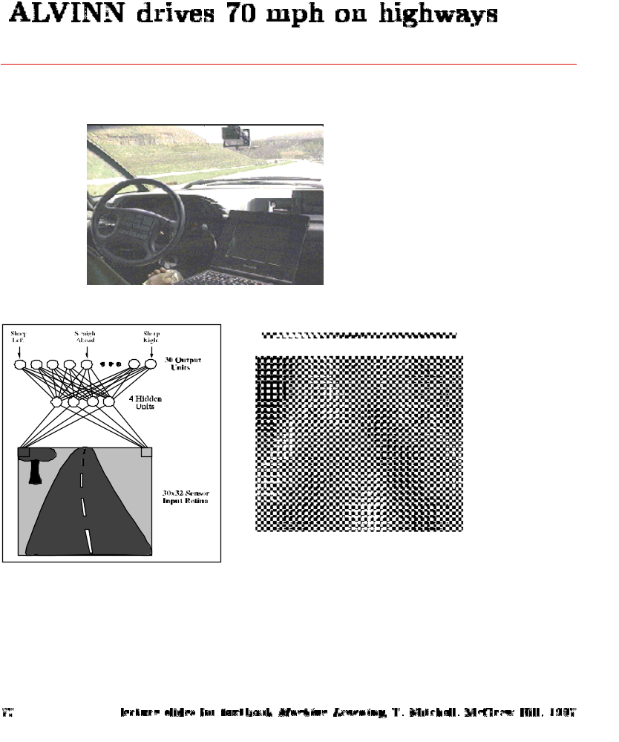
ALVINN
Drives 70 mph on a public highway
30 outputs
for steering
30x32 weights
into one out of
four hidden
unit
4 hidden
units
30x32 pixels
as inputs

Slide 54
Signature recognition
Each person's signature is different.
There are structural similarities which are difficult to quantify.
One company has manufactured a machine which recognizes signatures to within a high level of accuracy.
  Considers speed in addition to gross shape.
  Makes forgery even more difficult.

Slide 55
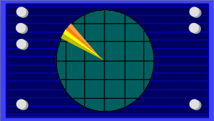
Sonar target recognition
Distinguish mines from rocks on sea-bed
The neural network is provided with a large number of parameters which are extracted from the sonar signal.
The training set consists of sets of signals from rocks and mines.

Slide 56
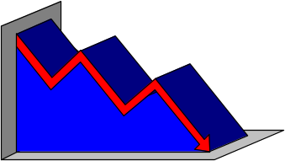
Stock market prediction
“Technical trading” refers to trading based solely on known statistical parameters; e.g. previous price
Neural networks have been used to attempt to predict changes in prices.
Difficult to assess success since companies using these techniques are reluctant to disclose information.

Slide 57

Mortgage assessment
Assess risk of lending to an individual.
Difficult to decide on marginal cases.
Neural networks have been trained to make decisions, based upon the opinions of expert underwriters.
Neural network produced a 12% reduction in delinquencies compared with human experts.

Slide 58
Neural Network Problems
Many Parameters to be set
Overfitting
long training times
...

Slide 59
Parameter setting
Number of layers
Number of neurons
    too many neurons, require more training time
Learning rate
    from experience, value should be small ~0.1
Momentum term
..

Slide 60
Over-fitting
With sufficient nodes can classify any training set exactly
May have poor generalisation ability.
Cross-validation with some patterns
  Typically 30% of training patterns
  Validation set error is checked each epoch
  Stop training if validation error goes up

Slide 61

Training time
How many epochs of training?
  Stop if the error fails to improve (has reached a minimum)
  Stop if the rate of improvement drops below a certain level
  Stop if the error reaches an acceptable level
  Stop when a certain number of epochs have passed

Slide 62
Literature & Resources
Textbook:
  ”Neural Networks for Pattern Recognition”, Bishop, C.M., 1996
Software:
  Neural Networks for Face Recognition
  http://www.cs.cmu.edu/afs/cs.cmu.edu/user/mitchell/ftp/faces.html
  SNNS Stuttgart Neural Networks Simulator
  http://www-ra.informatik.uni-tuebingen.de/SNNS
  Neural Networks at your fingertips
  http://www.geocities.com/CapeCanaveral/1624/
  http://www.stats.gla.ac.uk/~ernest/files/NeuralAppl.html

