Slide 1
Adaptive Networks
As you know, there is no equation that would tell you the ideal number of neurons in a multi-layer network.
Ideally, we would like to use the smallest number of neurons that allows the network to do its task sufficiently accurately, because of:
the small number of weights in the system,
fewer training samples being required,
faster training,
typically, better generalization for new test samples.
October 28, 2010
Neural Networks Lecture 13: Adaptive Networks

Slide 2
Adaptive Networks
So far, we have determined the number of hidden-layer units in BPNs by “trial and error.”
However, there are algorithmic approaches for adapting the size of a network to a given task.
Some techniques start with a large network and then iteratively prune connections and nodes that contribute little to the network function.
Other methods start with a minimal network and then add connections and nodes until the network reaches a given performance level.
Finally, there are algorithms that combine these “pruning” and “growing” approaches.
October 28, 2010
Neural Networks Lecture 13: Adaptive Networks

Slide 3
Cascade Correlation
None of these algorithms are guaranteed to produce “ideal” networks.
(It is not even clear how to define an “ideal” network.)
However, numerous algorithms exist that have been shown to yield good results for most applications.
We will take a look at one such algorithm named “cascade correlation.”
It is of the “network growing” type and can be used to build multi-layer networks of adequate size.
However, these networks are not strictly feed-forward in a level-by-level manner.
October 28, 2010
Neural Networks Lecture 13: Adaptive Networks

Slide 4
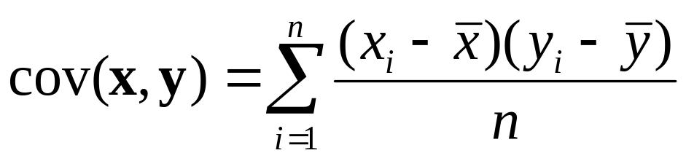
Refresher: Covariance and Correlation
For a dataset (x_{i}, y_{i}) with i = 1, …, n the covariance is:
y
y
y
y
y
y
x
x
x
x
x
x
cov(x,y) > 0
cov(x,y) ≈ 0
cov(x,y) < 0
October 28, 2010
Neural Networks Lecture 13: Adaptive Networks

Slide 5
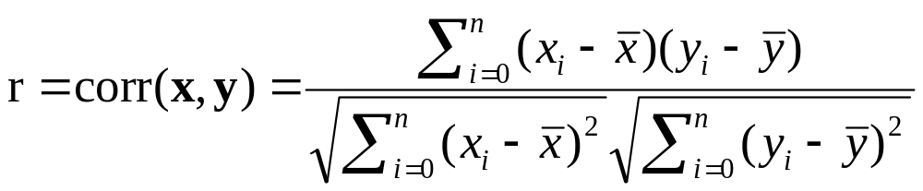
Refresher: Covariance and Correlation
Covariance tells us something about the strength and direction (directly vs. inversely proportional) of the linear relationship between x and y.
For many applications, it is useful to normalize this variable so that it ranges from -1 to 1.
The result is the correlation coefficient r, which for a dataset (x_{i}, y_{i}) with i = 1, …, n is given by:
October 28, 2010
Neural Networks Lecture 13: Adaptive Networks

Slide 6
Refresher: Covariance and Correlation
y
y
y
x
x
x
0 < r < 1
r ≈ 0
-1 < r < 0
y
y
y
x
x
x
r = 1
r = -1
r undef’d
October 28, 2010
Neural Networks Lecture 13: Adaptive Networks

Slide 7
Refresher: Covariance and Correlation
In the case of high (close to 1) or low (close to -1) correlation coefficients, we can use one variable as a predictor of the other one.
To quantify the linear relationship between the two variables, we can use linear regression:
y
regression line
x
October 28, 2010
Neural Networks Lecture 13: Adaptive Networks

Slide 8
Cascade Correlation
Now let us return to the cascade correlation algorithm.
We start with a minimal network consisting of only the input neurons (one of them should be a constant offset = 1) and the output neurons, completely connected as usual.
The output neurons (and later the hidden neurons) typically use output functions that can also produce negative outputs; e.g., we can subtract 0.5 from our sigmoid function for a (-0.5, 0.5) output range.
Then we successively add hidden-layer neurons and train them to reduce the network error step by step:
October 28, 2010
Neural Networks Lecture 13: Adaptive Networks

Slide 9
Cascade Correlation
Output node
o₁
Solid connections are being modified
x₁
x₂
x₃
Input nodes
October 28, 2010
Neural Networks Lecture 13: Adaptive Networks

Slide 10
Cascade Correlation
Output node
o₁
Solid connections are being modified
First hidden node
x₁
x₂
x₃
Input nodes
October 28, 2010
Neural Networks Lecture 13: Adaptive Networks

Slide 11
Cascade Correlation
Output node
o₁
Second
hidden node
Solid connections are being modified
First hidden node
x₁
x₂
x₃
Input nodes
October 28, 2010
Neural Networks Lecture 13: Adaptive Networks

Slide 12
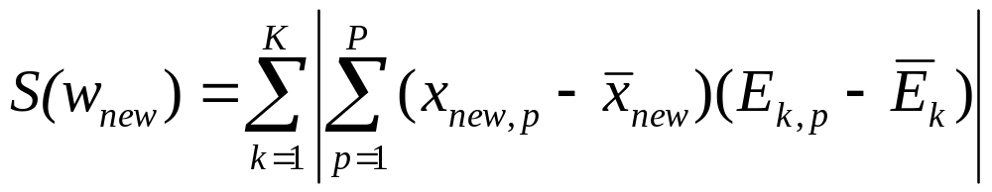

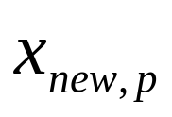
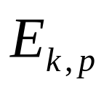
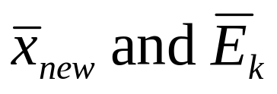
Cascade Correlation
Weights to each new hidden node are trained to maximize the covariance of the node’s output with the current network error.
Covariance:
: vector of weights to the new node
: output of the new node to p-th input sample
: error of k-th output node for p-th input sample
before the new node is added
: averages over the training set
October 28, 2010
Neural Networks Lecture 13: Adaptive Networks

