Slide 1
Particle System
Hao WAN (hxw161730)
implement a particle system:
1000 particles
simple physics (gravity and wind)
bouncing off the ground plane with damping

Slide 2
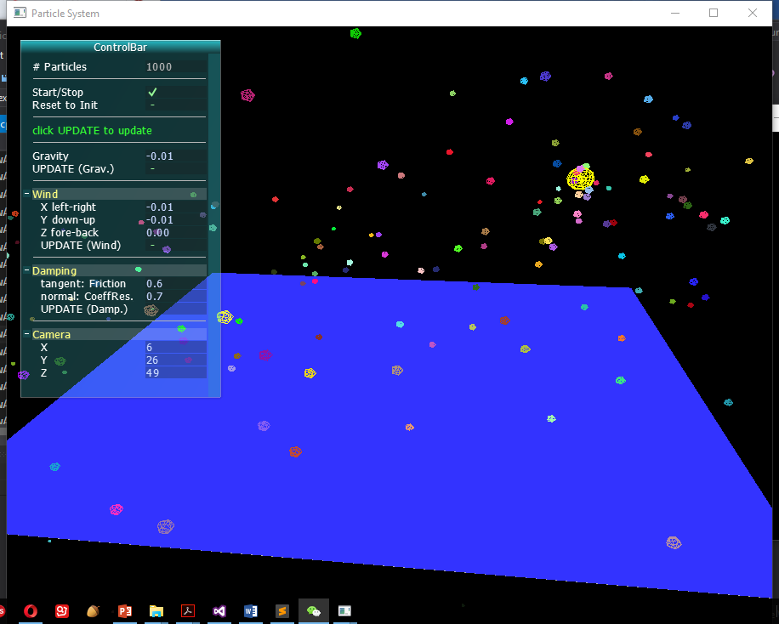
Particle System
Show the demo

Slide 3
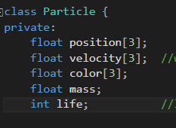
Particle Class
Define useful methods:
get/set position
get velocity
get color
get/update life time

Slide 4



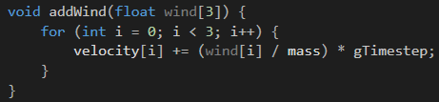

Particle Class
Define the forces on a particle:

Slide 5
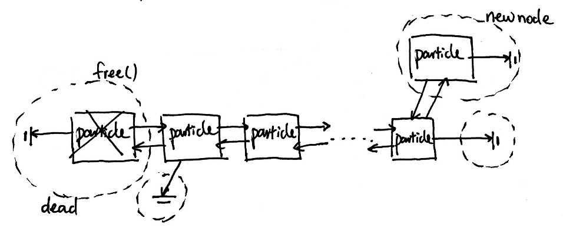
ParticleSystem Class
Useful methods:
Data Structure - Doubly linked list:

Slide 6
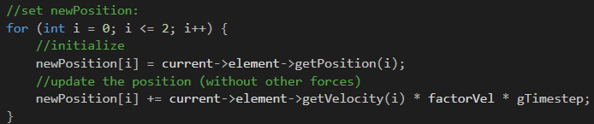

ParticleSystem Class
Update the position of the current particle

Slide 7
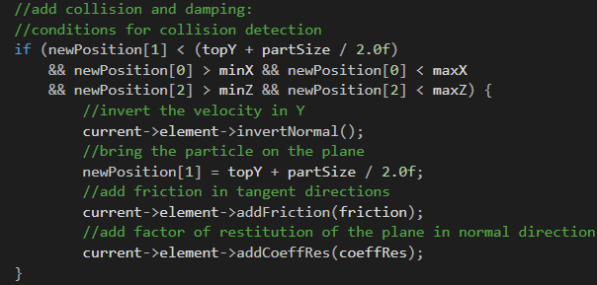
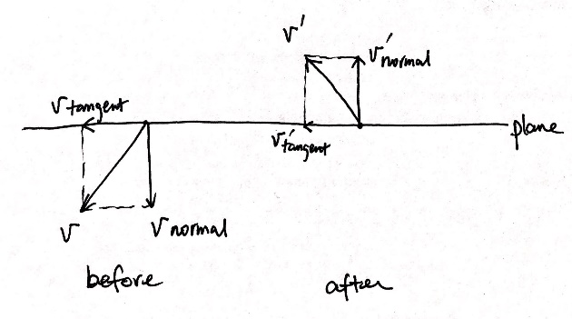
Collision
V = V normal + V tangent
V’= V’normal + V’tangent
V’normal = - e* V normal
V’tangent= k* V tangent

Slide 8
Analysis & Conclusions
Result meets the goals.
Choose a best Data structure
Physical laws

