Slide 1

燕文豪

Slide 2
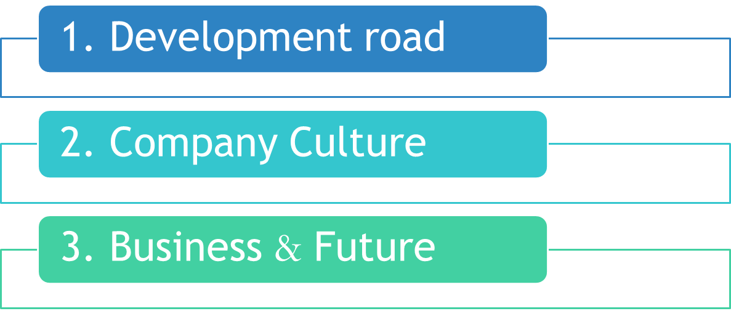
Topic

Slide 3
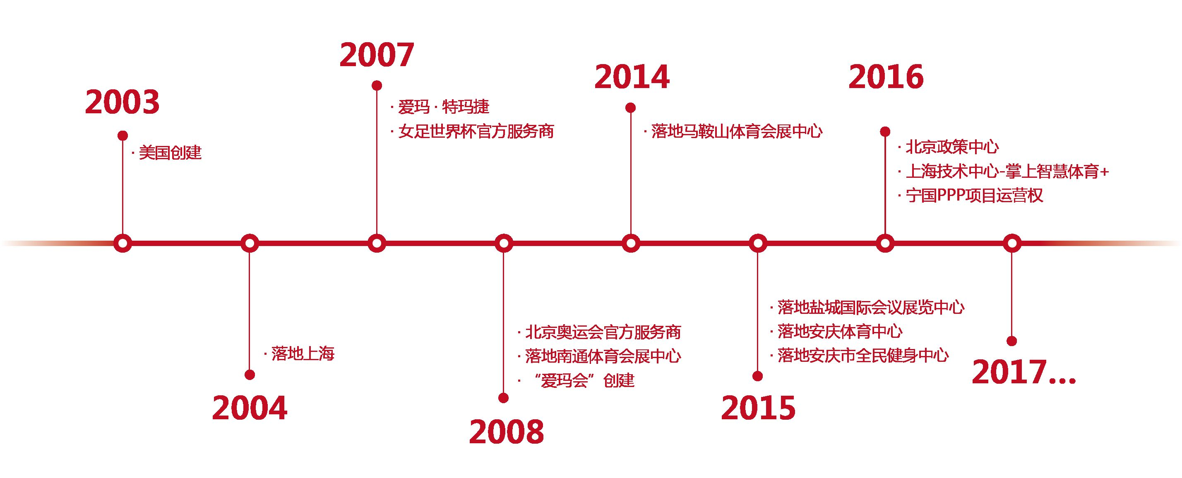



1. Roadmap

Slide 4
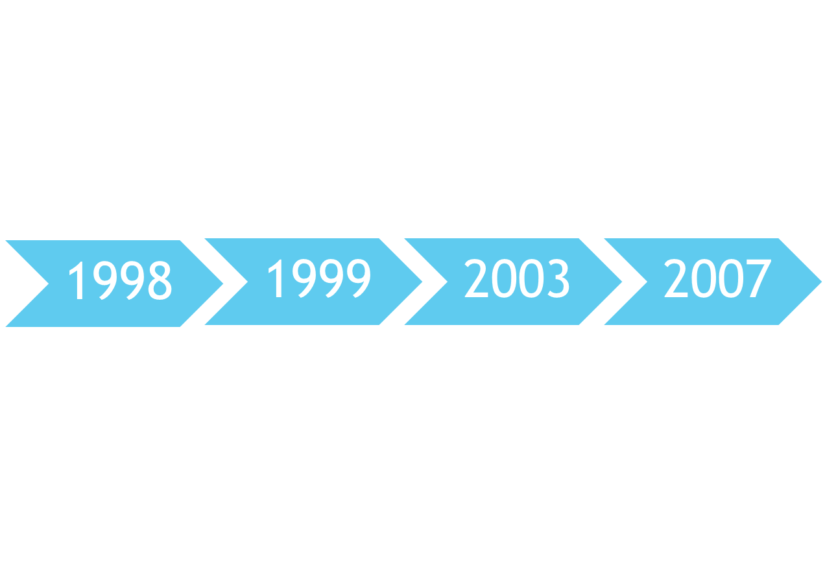
Tencent was founded
www.QQ.com
Games Market
Messaging service-QQ
Tencent Foundation

Slide 5

Open platform strategy
The concept of "Internet Plus" proposed by Pony Ma was made a national strategy
Wechat
Market capitalization reached US$ 100 billion
. . . . . .

Slide 6

2. Culture
The Tencent Building is an example of iconic architecture in Shenzhen.

Slide 7




Vision
To be the most respected Internet enterprise.
Mission
To enhance the quality of life through Internet services.
Business Philosophy
Users' needs are our first priority.
Management Philosophy
Is concerned with employee growth.

Slide 8
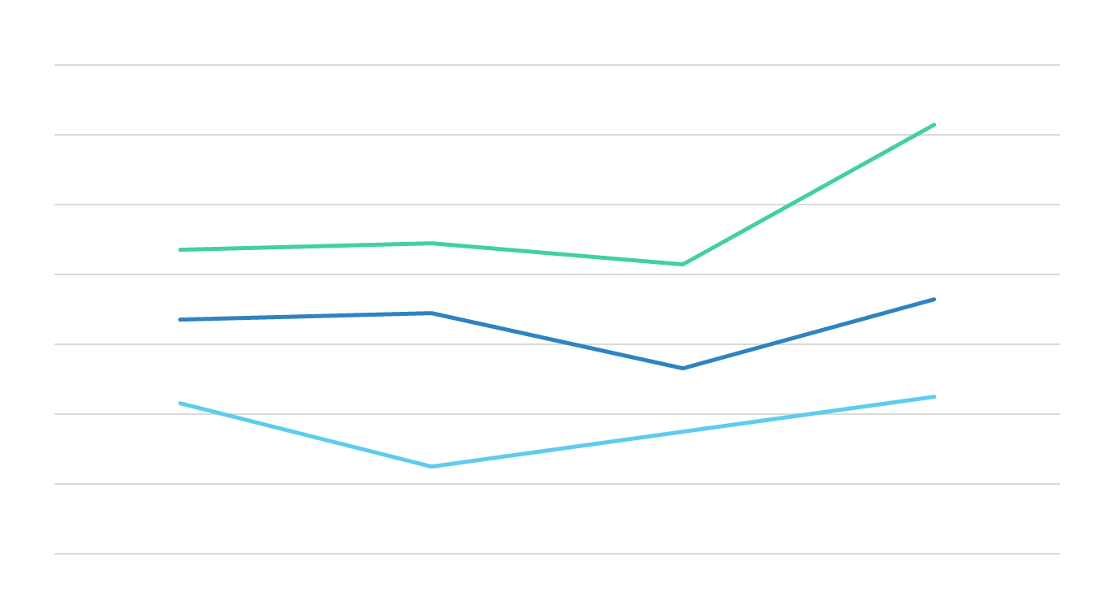
3. Business & Future

Slide 9























Social Networks
Platform
Happy
Artificial Intelligence
Utilities
Tencent
。。。

Slide 10

Make AI Everywhere
Unveiling Tencent's AI strategy, joint by 50 world-class AI scientists, researchers and experts.
Focusing on AI related research fields such as ML(machine learning), CV(computer vision), and NLP(natural language processing).
Building on Tencent’s massive data from hundreds of millions of users and its technical advantages in the vertical fields of Internet, aiming to build the top artificial intelligence team.

Slide 11
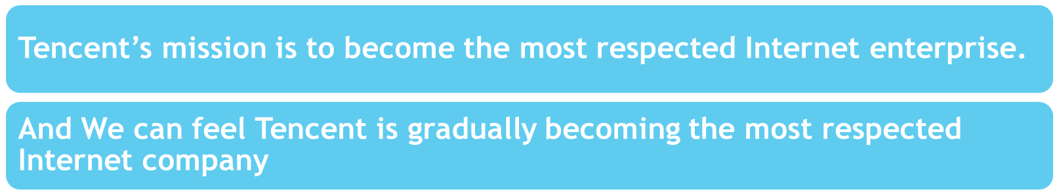
Open Break
Free Rock
< Tencent 18th >.
Crash Passion
Brave Try Everything

Slide 12


