Slide 1

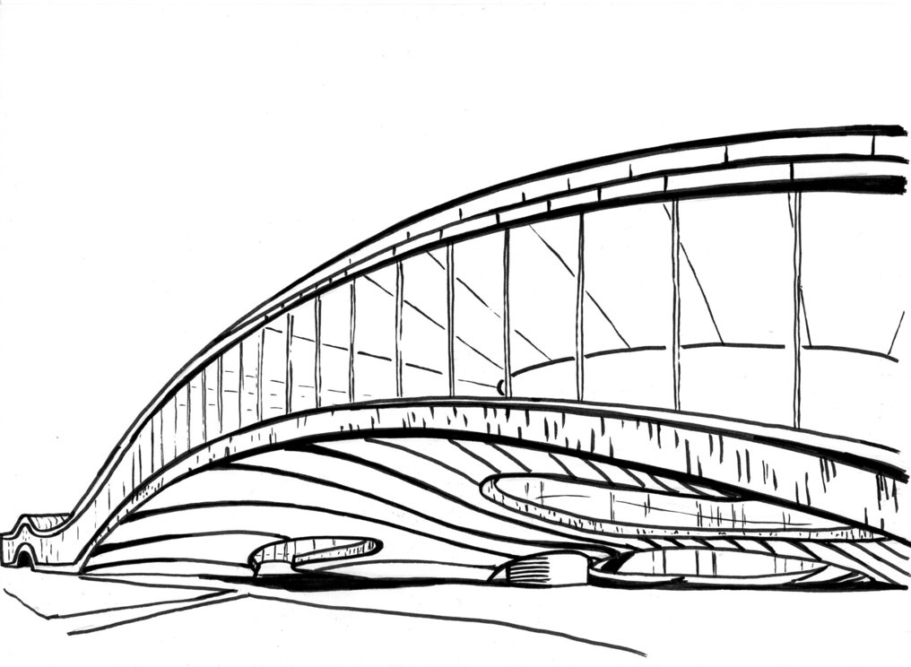

SAT Based Exact Synthesis using DAG Topology Families
Winston Haaswijk¹, Alan Mishchenko², Mathias Soeken¹, Giovanni De Micheli¹
¹Integrated Systems Laboratory, EPFL
²University of California at Berkeley

Slide 2
Exact Synthesis (ES)
ES Algorithm
Gives exact result (with respect to cost function)
SAT Based ES
Use SAT solvers to implement such algorithms
Not to be confused with approximate computing!

Slide 3
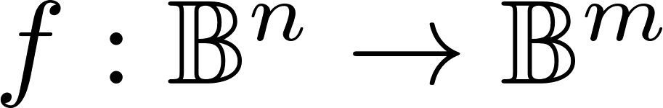
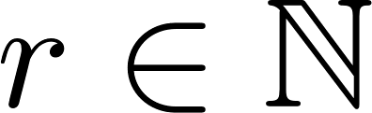
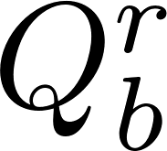


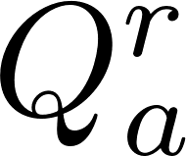
Exact Synthesis Decision Problems
Given a function and a number
We may ask different exact synthesis related questions
1. Two-level ES
2. Multi-level ES
: “Does there exist a SOP expression with cubes that represents ?”
: “Does there exist a logic network with gates that represents ?”

Slide 4
ES Algorithms
Two-level Algorithms
Quine-McCluskey [1]
Multi-level Algorithms
Ashenhurst decomposition [5]
Sasao [4]
Petrick’s method [2]
ESOP minimization
SOP minimization
SAT
Knuth [7]
Decomposition
Roth-Karp decomposition [6]
Enumeration
Amaru [8]
Een [9]
Kulikov [10]
Perkowski [3]

Slide 5
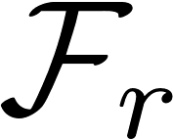
SAT Based ES
Given function f
Recall question (can we find such a network?)
We can encode this question as CNF formula
Initialize r = 0
Generate SAT Encoding _r
Our contribution:
novel encodings which are easier to solve
Solve F
SAT
UNSAT
Found optimum ntk
Set r = r + 1
Notes:
Mention that there are variations of this algorithm

Slide 6
Motivation
Exact Synthesis is Hard
E.g. size-optimum ES is the Minimum Circuit Size Problem [11]
Runtime
Unpredictable: given CNF, how much time will SAT solver take?
Conjectured to be intractable [12]
SAT itself is NP-complete
Hard to parallelize

Slide 7
Contribution
In SAT based ES, SAT solver conceptually solves two tasks in parallel
1. Enumerate valid DAG structures
2. Assign operators to nodes (labelling)
This work: mitigate runtime by helping SAT solver with task 1, using (families of) DAG topologies

Slide 8
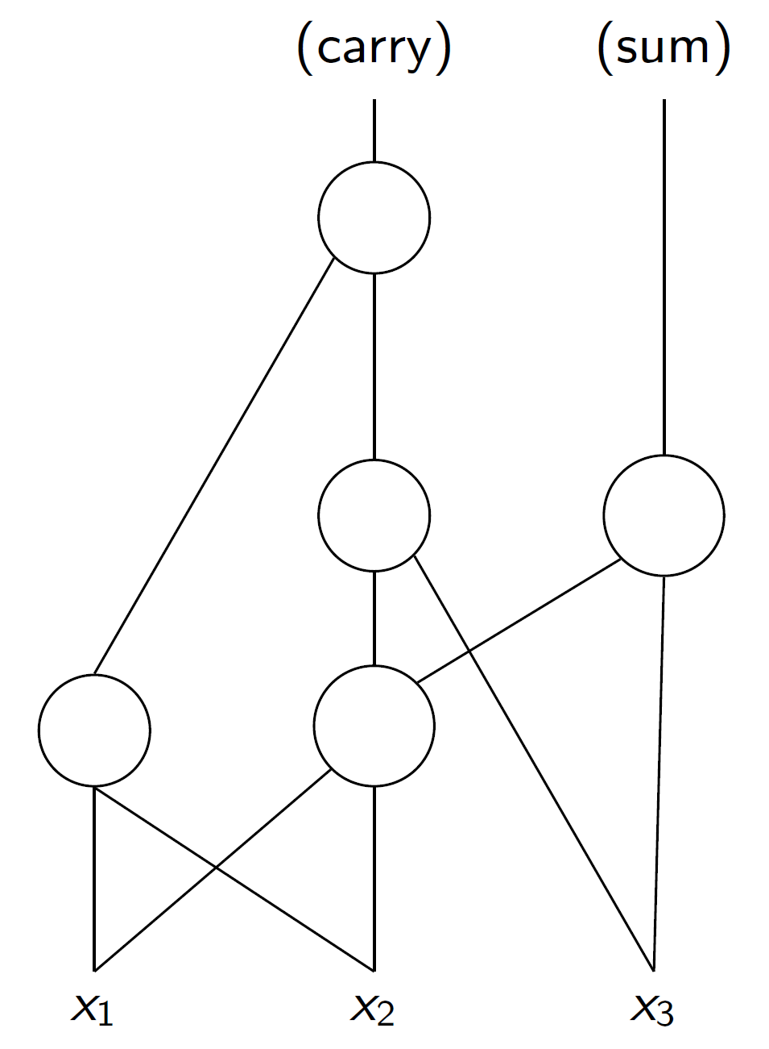
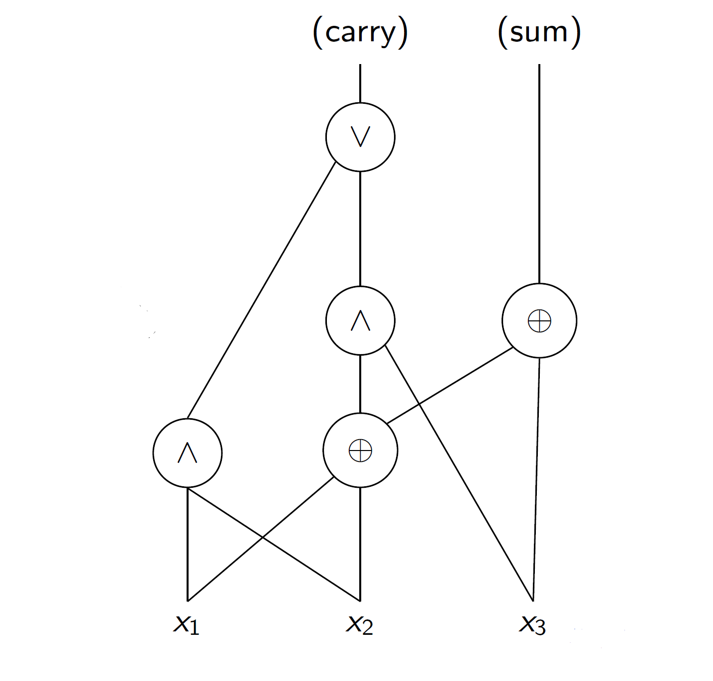
DAG Labelling
Suppose we want to synthesize a full adder
We are given additional information: a DAG structure
Can we put operators on DAG nodes to make the DAG a full adder?
We call this labelling a graph
Can be translated to CNF formula
Given to SAT solver
label
This labelling operation is fast
Several orders of magnitude faster than conventional ES

Slide 9
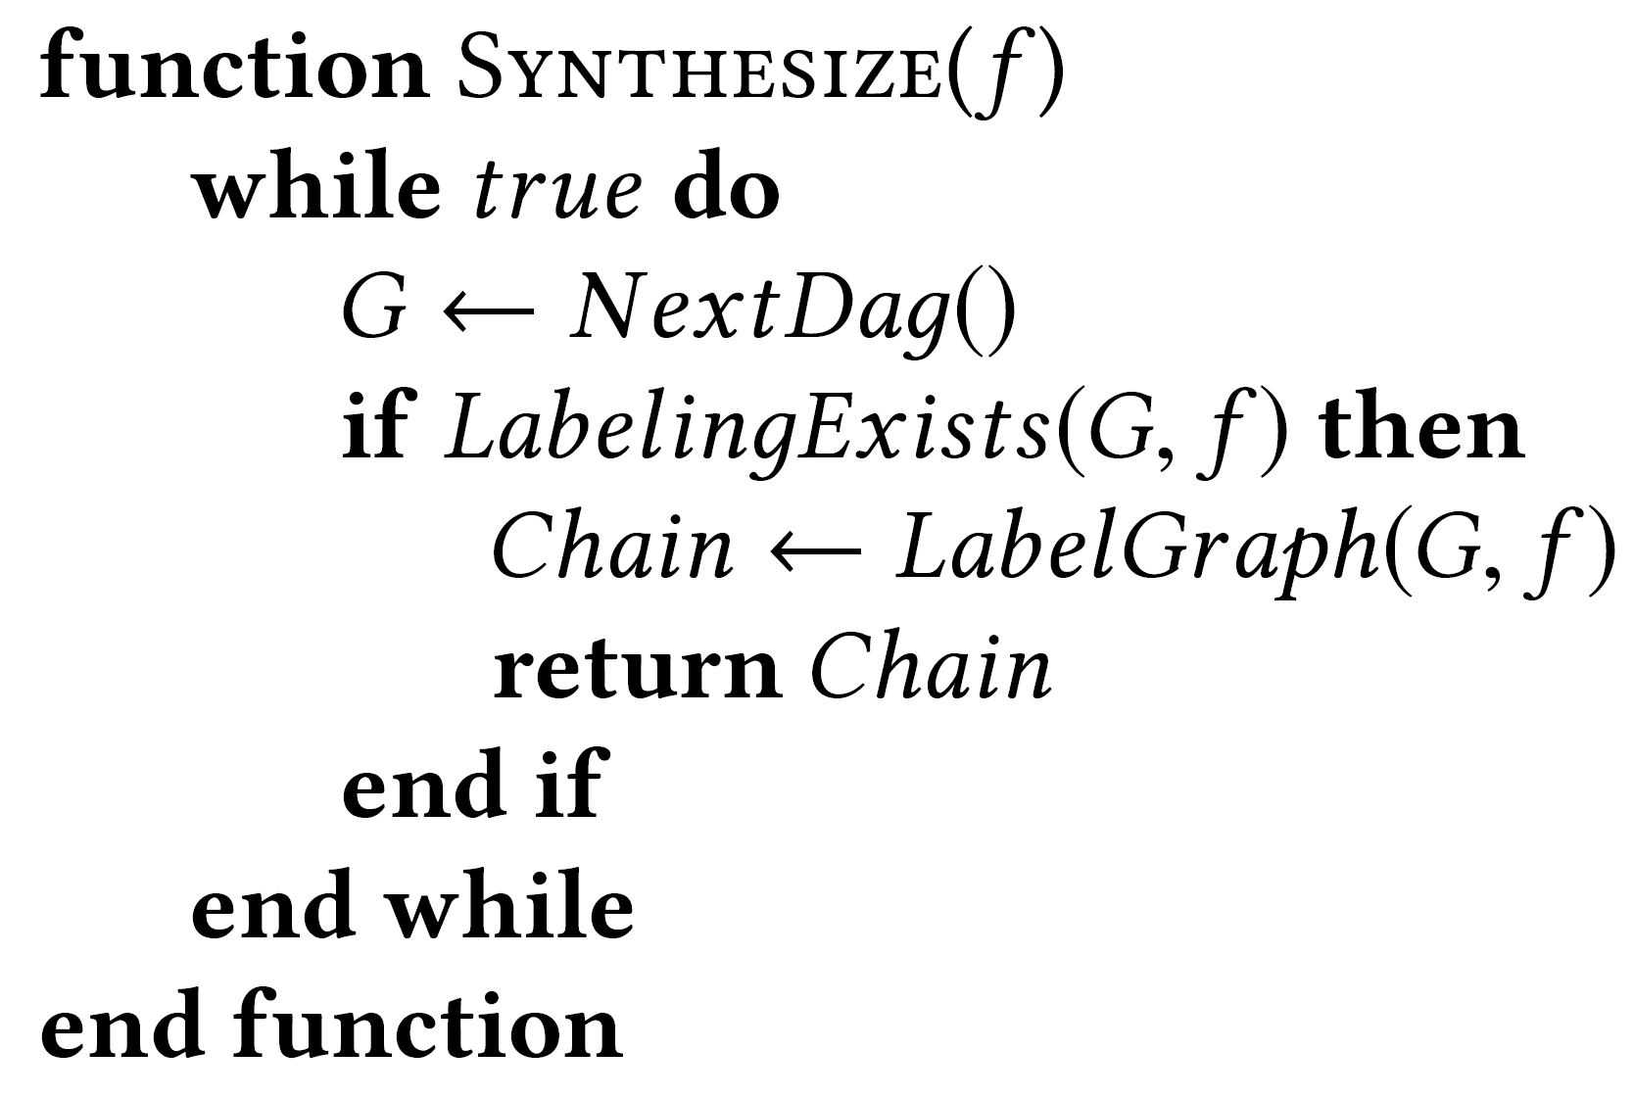
Shortcomings of Labelling
Why not use labelling to perform ES?
Problem: while labelling is fast, search space is too big
4175098976430590000

Slide 10


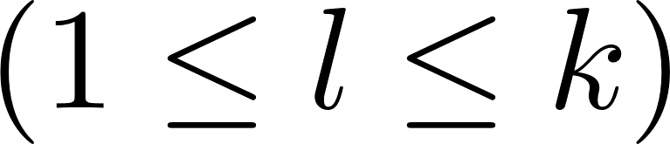
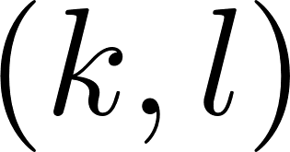
DAG Topology Families
We cannot enumerate all DAGs
Instead, enumerate families of DAG topologies
They provide additional topology information to the SAT solver
Which gives us similar advantages to DAG labelling
We call such families fences
Given two integers and
A fence is a partition of nodes over levels
NOTE: such a partition is not unique!

Slide 11
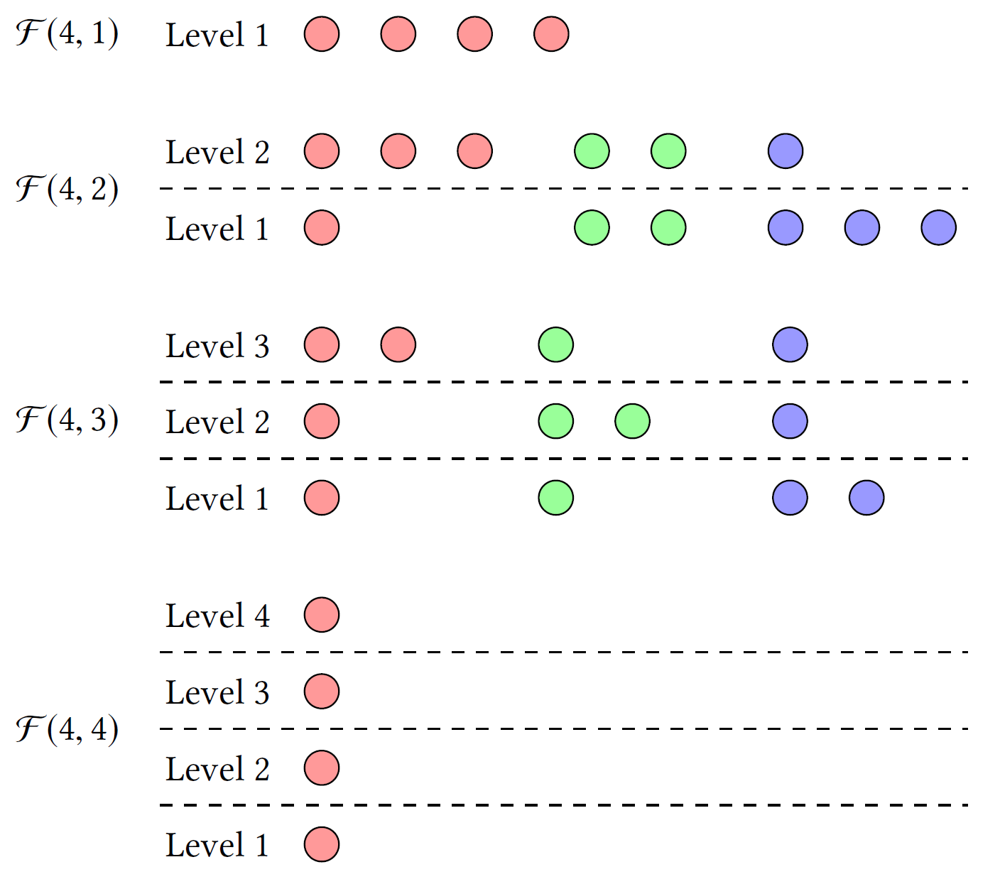
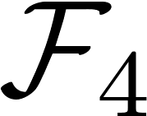
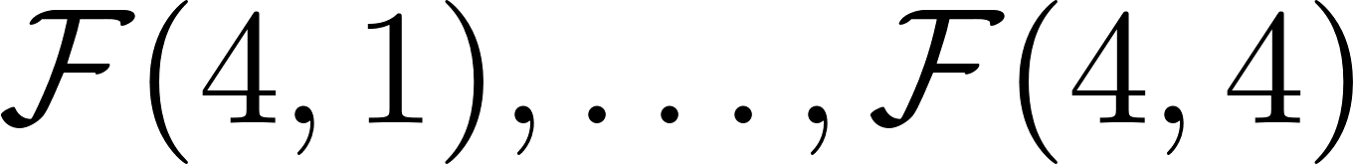
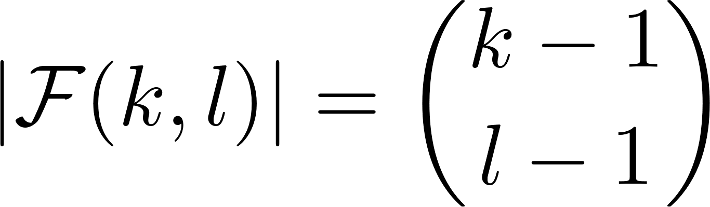
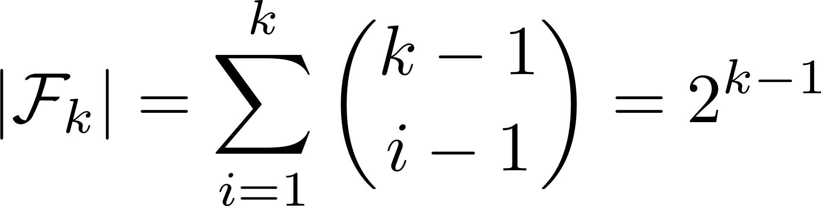
Fences – Example
Example of the fences in
There are 4 fence families
A colored group of nodes is a single fence
Fences have a nice regular structure
Counting and generating them is quite simple
NOTE: much fewer fences than DAGs
E.g. there are only 512 fences for 10 nodes

Slide 12
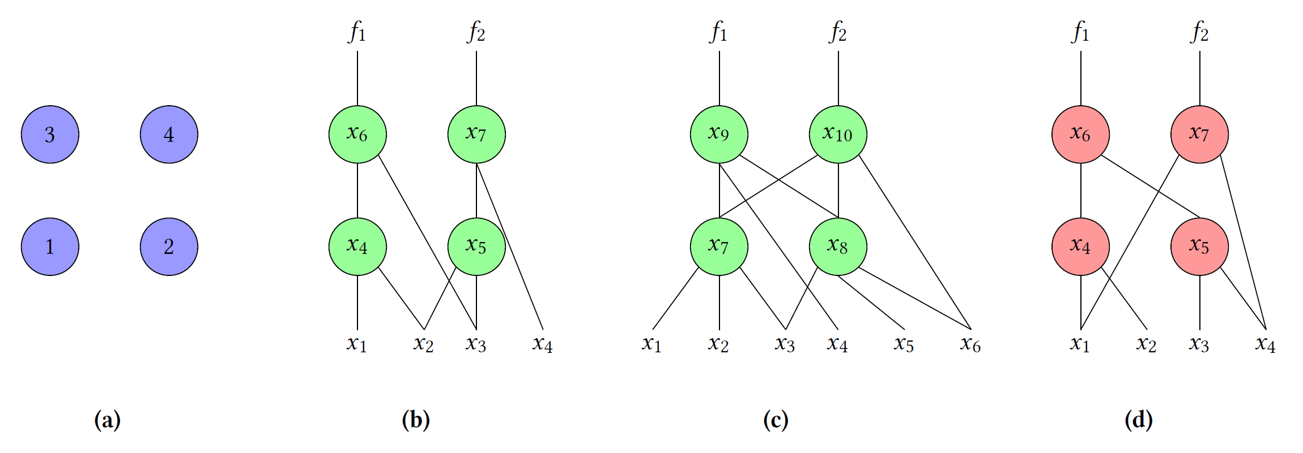
Fences Contain DAGs
Fences fix part of a DAG structure: the distribution of nodes over levels
Every DAG belongs to a unique fence
Fences are agnostic to connectivity or fanin size
This is desirable as basis for synthesis algorithms

Slide 13
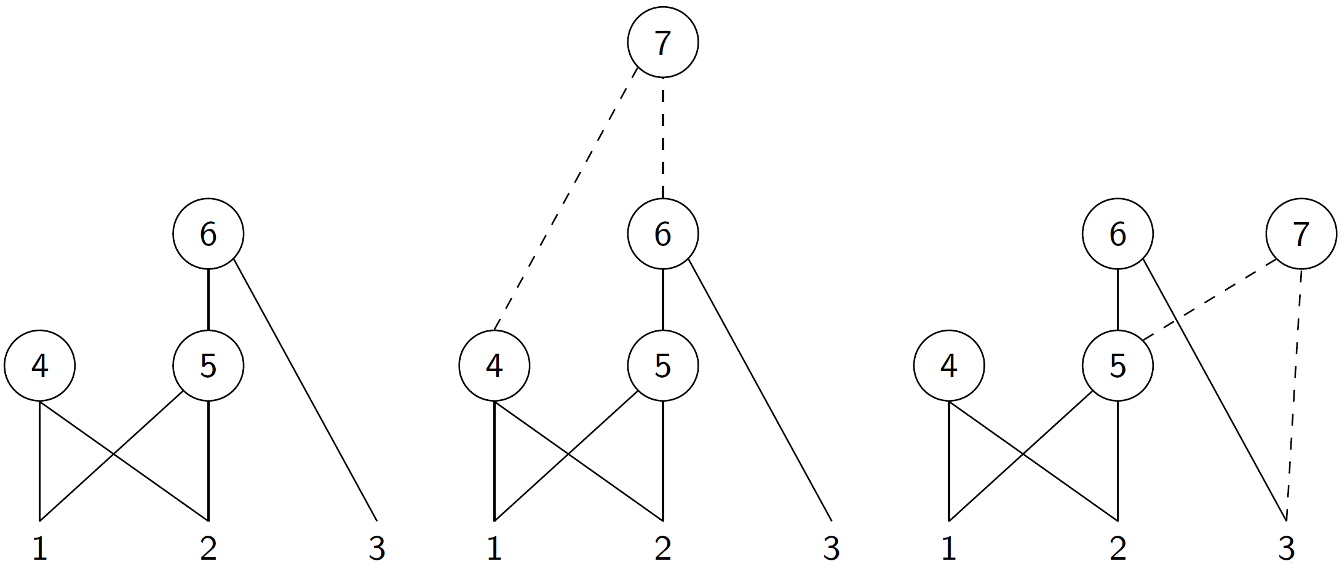
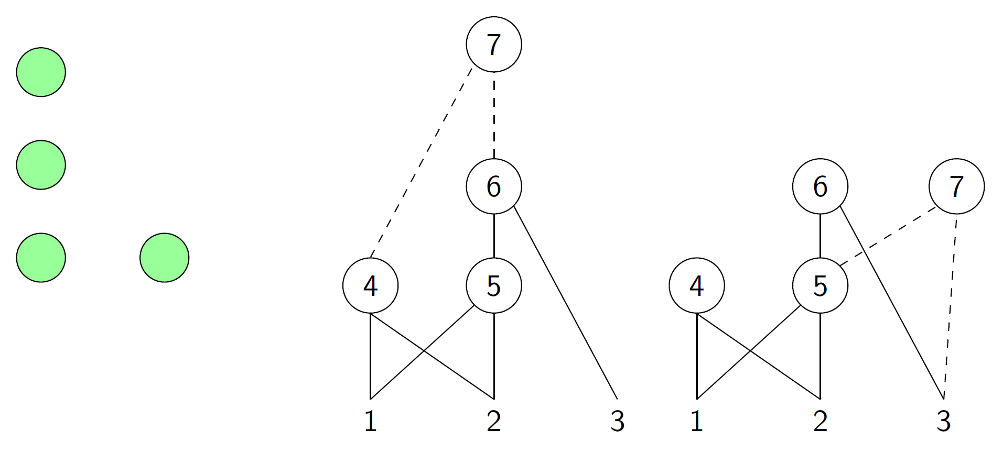
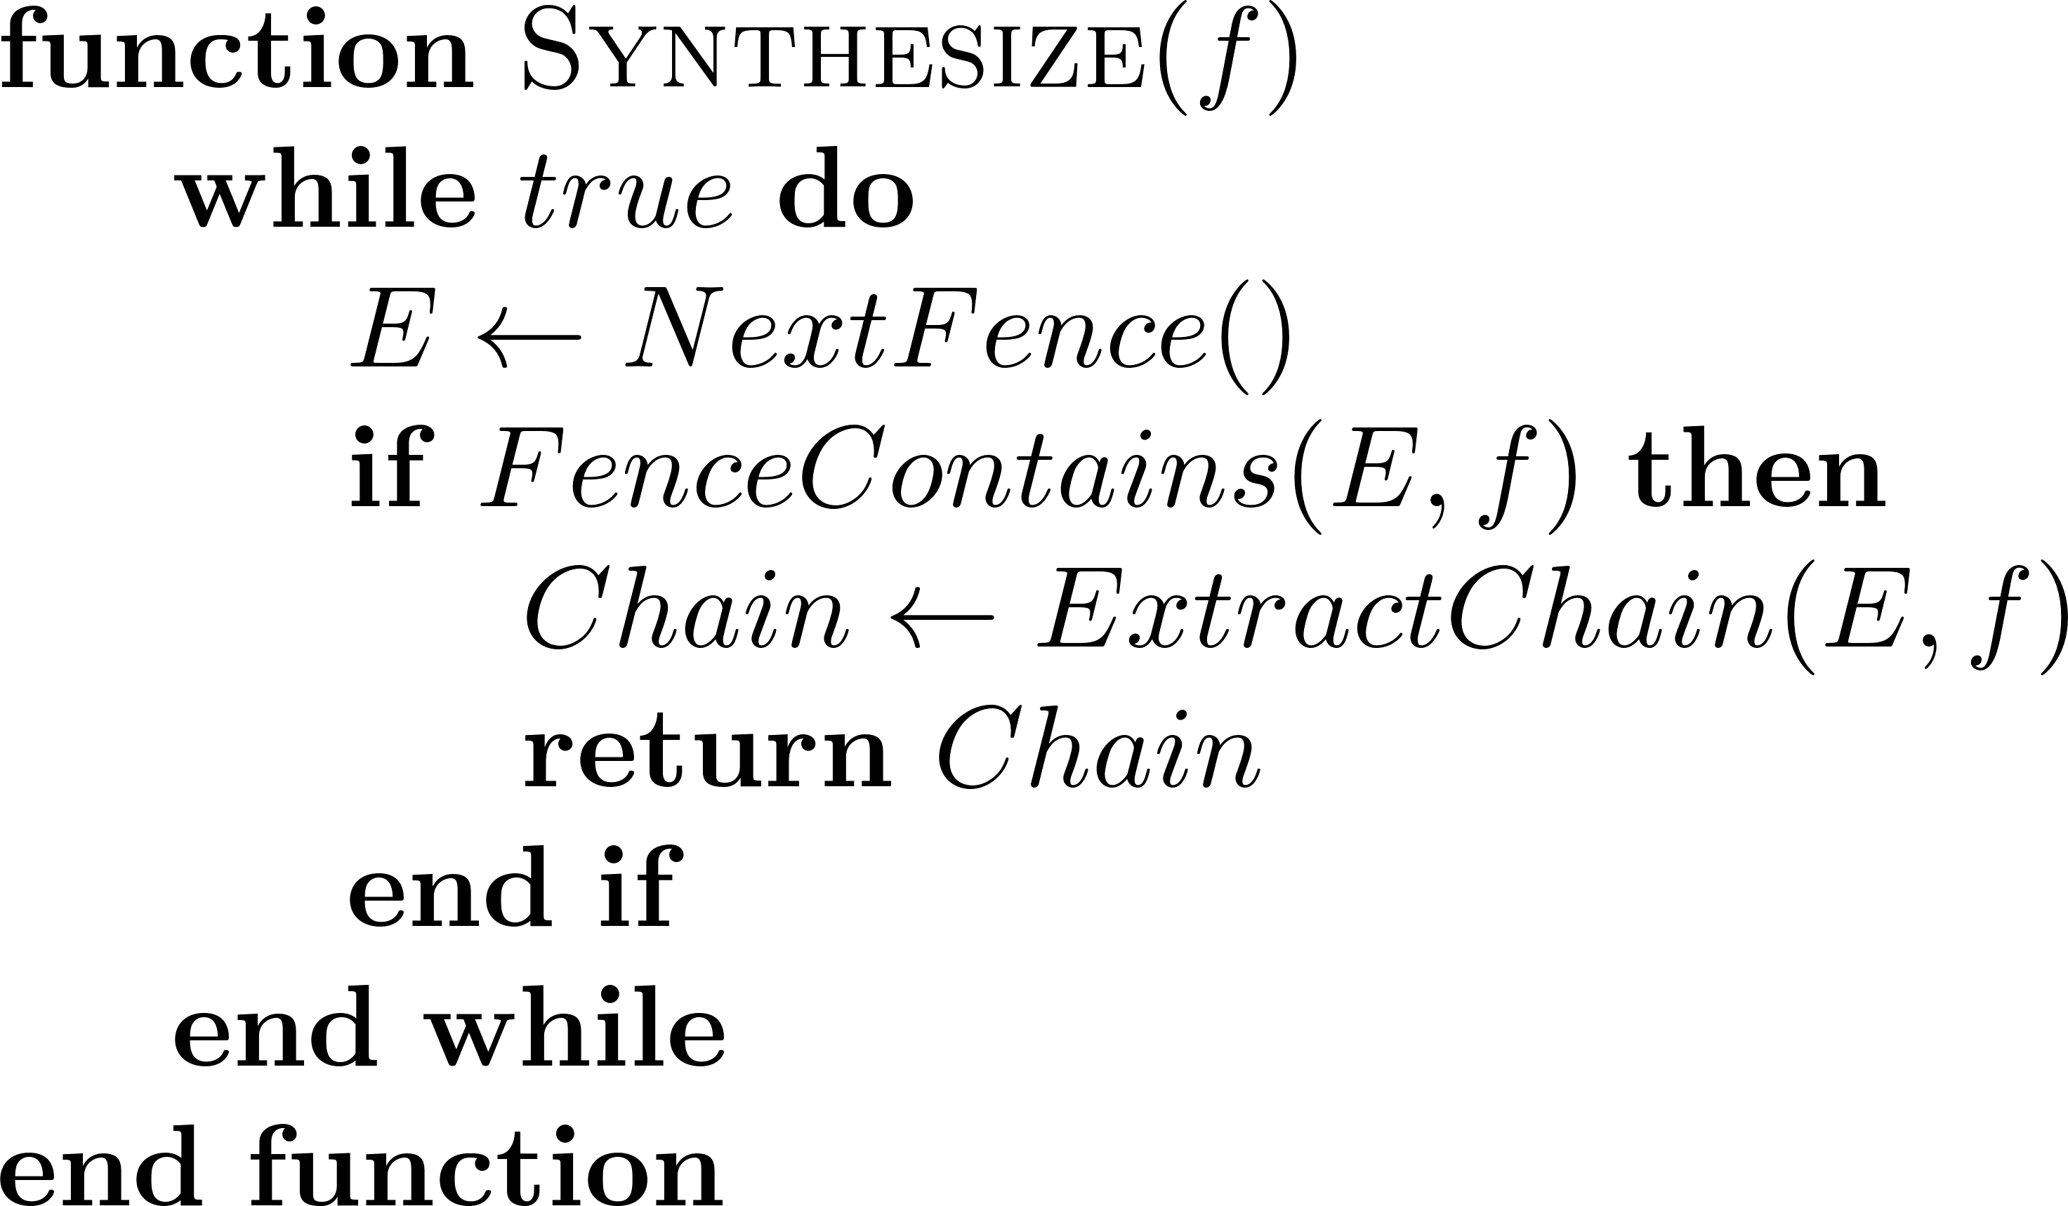
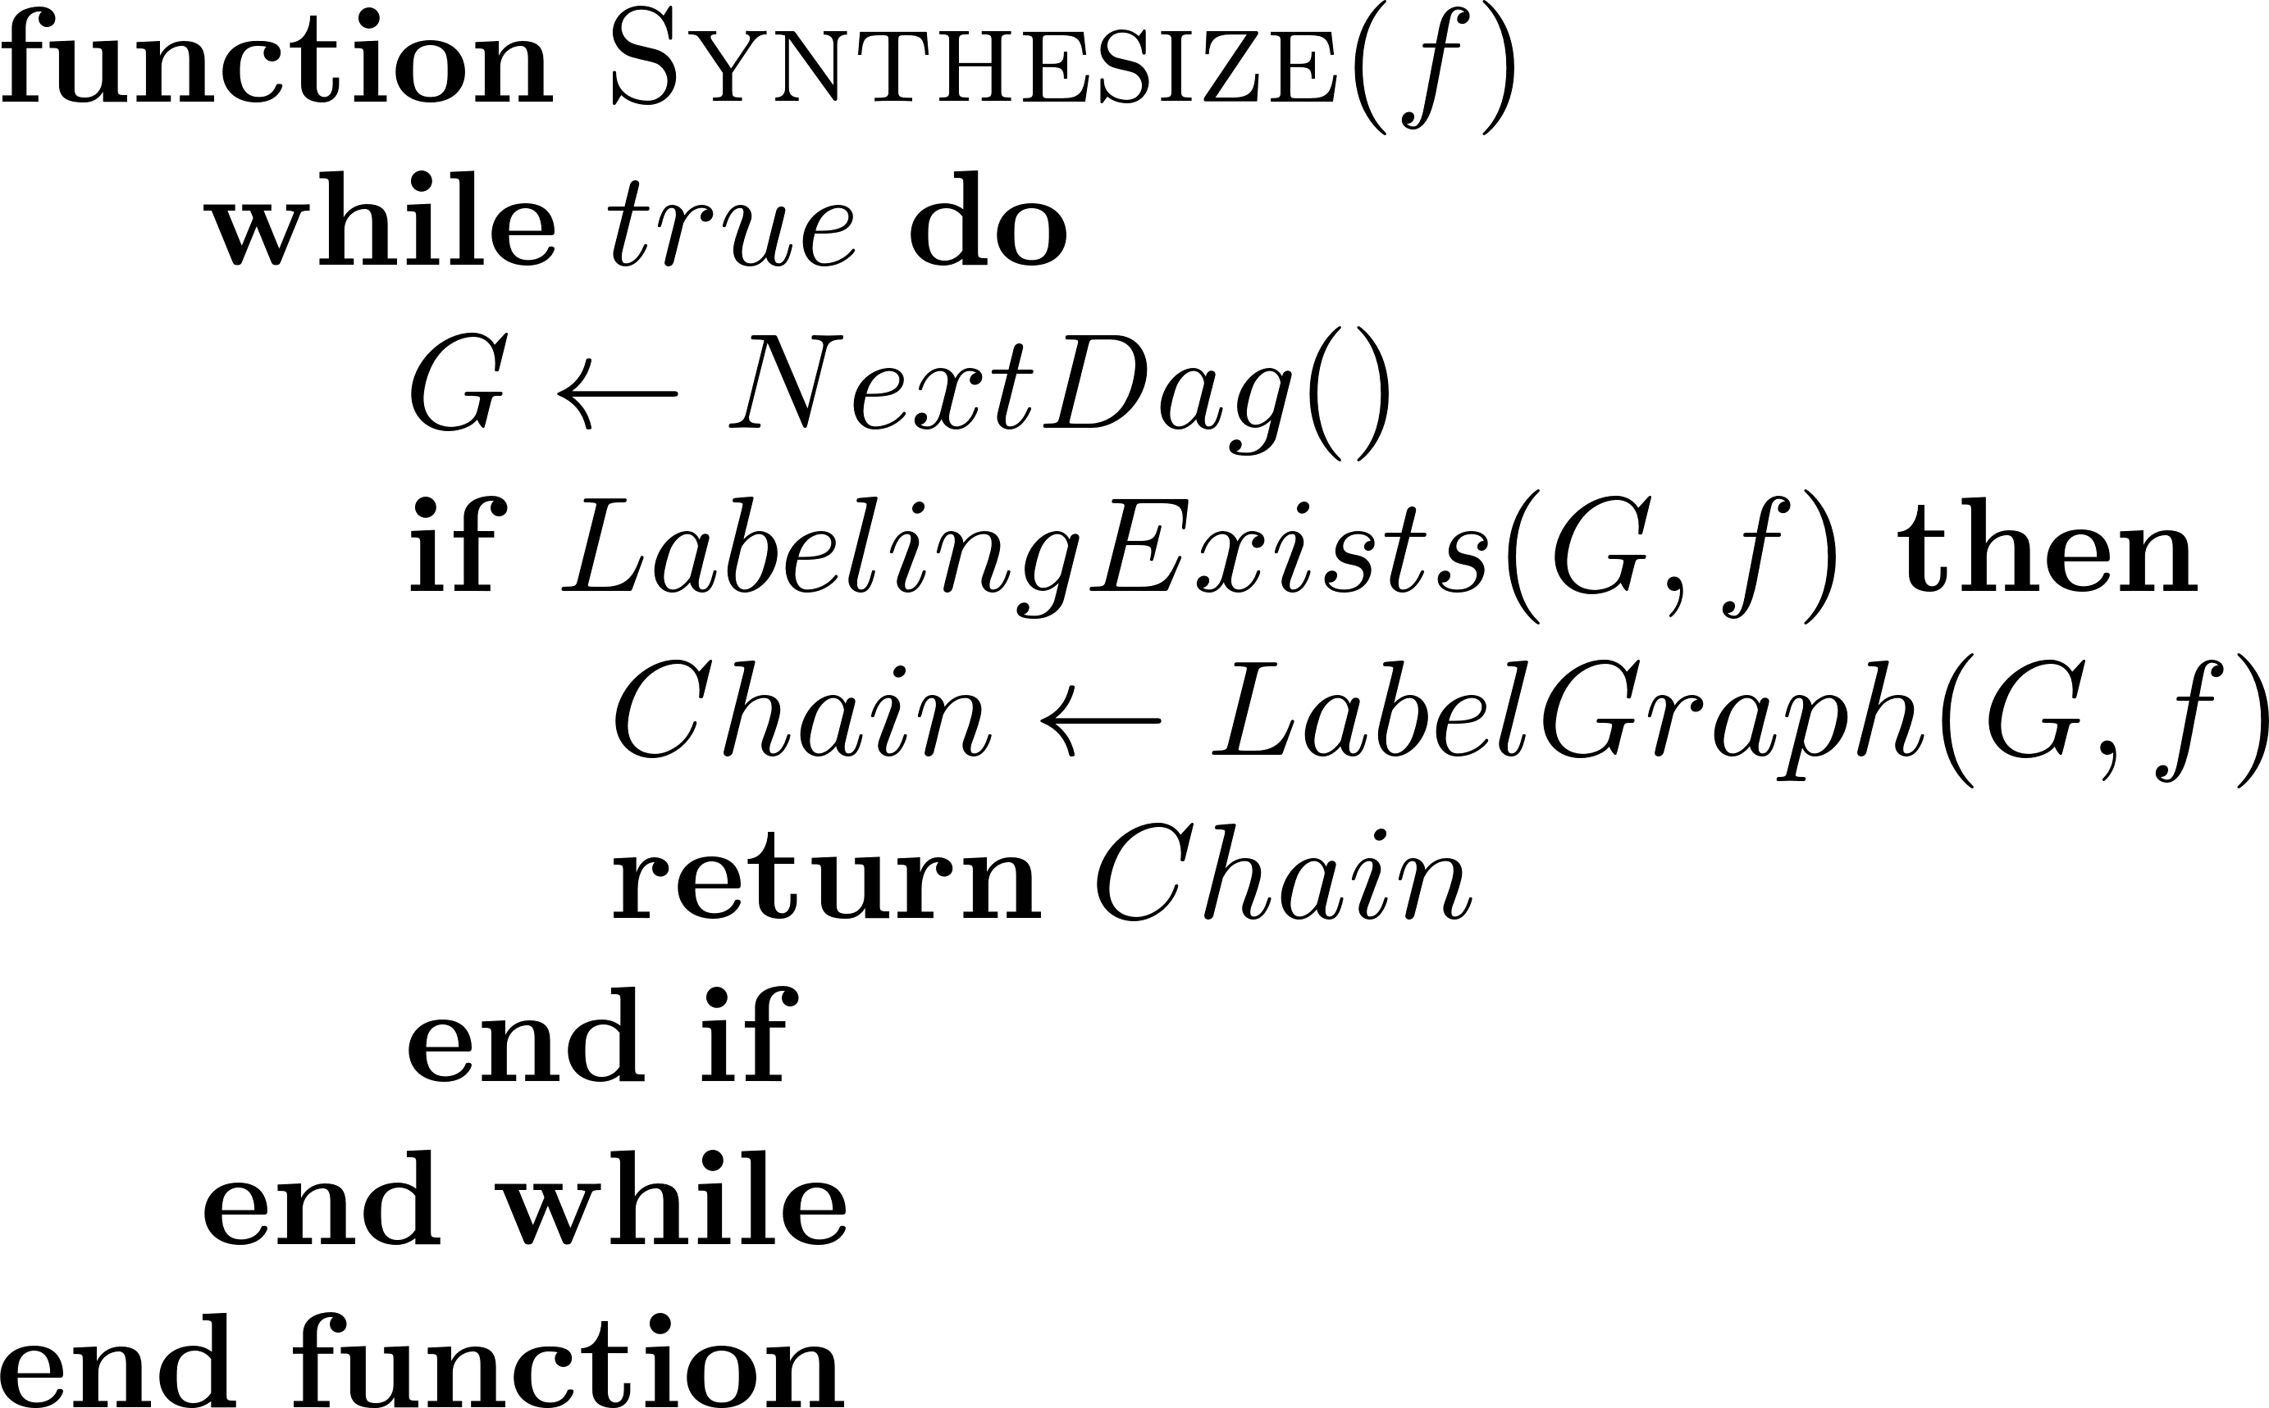
ES With Fences
Suppose we have a fixed topology of gates 4, 5, 6
We want to add gate 7
There are multiple places to add it, and different fanins we could choose
Conventionally, SAT solver has to consider all different combinations
Using fences, we fix the position of the gate (to a specific level)
They also limit the number of fanin connections to consider
This constrains the SAT search space and reduces the number of variables
Takeaways:
There are not many fences, and generating them is fast
Using fences allows for simpler and smaller CNF formulas
Notes:
We change the synthesis loop to use fences instead of DAGs
Generating fences is fast and simple to implement (see paper for details)
How does this help us?
We make simpler CNF formulas: fewer possibilities to encode
Conventionally, SAT solver has to generate variables to encode all possibilities
Fences reduce number of possibilities and thus lead to smaller/simpler CNF formulas

Slide 14
Experimental Results
Fence based runtime dominates baseline
Runtime is competitive with state-of-the-art
A bit slower for NPN-4 and FDSD-8 (18% and 8%, respectively)
Up to 62% faster
Fence-based synthesis dominates other all methods
Up to 61% fewer timeouts than state-of-the-art
Notes:
A baseline conventional SAT ES algorithm (SYM)
A state-of-the-art implementation (ABC)
Our fence-based synthesizer (TOP)
We compare both runtime and number of timeouts
Both are important measures of the efficiency and usability of ES algorithms

Slide 15

Conclusions and Future Work
Conclusions
We show how families of DAG topologies can be used in SAT based ES
Future Work
Use fences as a source of parallelism
Alternative topology families
Explore continuum between DAGs (completely fixed topologies) and conventional ES (no topology information)
Enables significant reductions in runtime, up to 62%
Enables significant reductions in number of timed out instances, up to 61%
This work has been implemented in the percy library
An open source header-only C++ library
Part of the EPFL logic synthesis libraries
Available at https://github.com/whaaswijk/percy
Future work will take place there as well

Slide 16



SAT Based Exact Synthesis using DAG Topology Families
Thanks for your attention
Contact
winston.haaswijk@epfl.ch
https://github.com/whaaswijk
https://whaaswijk.github.io

Slide 17
References
McCluskey, E. J., Minimization of Boolean Functions, 1956
Petrick, S R., A Direct Determination of the Irredundant Forms of a Boolean Function from the Set of Prime Implicants, 1956
Perkowski, M., An exact algorithm to minimize mixed-radix exclusive sum of products for incompletely specified Boolean functions, 1990
Sasao, T., An Exact Minimization of AND-EXOR Expressions Using Reduced Covering Functions, 1993
Ashenhurst, R., The Decomposition of Switching Functions, 1957
Roth, J. P. and Karp, R. M., Minimization Over Boolean Graphs, 1962
Knuth, D. E., The Art of Computer Programming Volume 4A, 2011
Amaru, L. et al., Enabling Exact Delay Synthesis, 2018
Een, N., Practical SAT – a tutorial on applied satisfiability solving, 2009
A. S. Kulikov et al., Improving circuit size upper bounds using sat-solvers, 2018
Kabanets, V and Cai, J.-Y. Circuit minimization problem, 2000
C. D. Murray and R. R. Williams, On the (non) NP-hardness of computing circuit complexity, 2015

