Slide 1

IWLS’18 Programming Contest
Giulia Meuli, Winston Haaswijk, Fereshte Mozafari, Bruno Schmitt, Eleonora Testa
Integrated Systems Laboratory, EPFL

Slide 2
Objective
Exact Synthesis Problem
Given a function f
Fixed: fanin k & number of gates r
Gates inputs lexicographically ordered
Find as many possible networks with r gates and fanin r as possible
Additional constraints
Time budget: one hour
Gate functions lexicographically ordered
Normal(ized) Boolean networks (i.e. g(0, …, 0) = 0)
Etc.
Our Solution
SAT-based exact synthesis

Slide 3
Our Approach
1. Given f, k, r
2. Generate F(f, k, r) _r
Given a new function and constraints
Generate initial CNF encoding F(f, k, r)
Solve CNF formula with SAT solver
UNSAT: we are sure that no more solutions exist
SAT:
- add clause C which blocks the current solution
- Go to 3
3. Solve F(f, k, r)F
Repeat steps 3-5 until UNSAT or time budget runs out
UNSAT
SAT
4. No more solutions
5. F’(f, k, r) = F(f, k, r) & C

Slide 4


percy implementation
// Create specification
spec synth_spec;
synth_spec[0] = tt;
synth_spec.add_colex_clauses = false;
synth_spec.add_lex_clauses = true;
synth_spec.fanin = fanin_size;
synth_spec.initial_steps = gates_size;
chain c; // Holds the synthesized network
bsat_wrapper solver; // Use ABC’s bsat2 solver
knuth_encoder encoder(solver); // Use Knuth's CNF encoding
// Enumerate solutions
while (next_solution(synth_spec, c, solver, encoder) == success) {
printf("%d\n", nr_solutions++); // Give feedback
if (c.satisfies_spec(synth_spec)) { // Only write correct solutions
to_iwls(c, outfile);
outfile << std::endl;
}
}
// Create specification
spec synth_spec;
synth_spec[0] = tt;
synth_spec.add_colex_clauses = false;
synth_spec.add_lex_clauses = true;
synth_spec.fanin = fanin_size;
synth_spec.initial_steps = gates_size;
chain c; // Holds the synthesized network
cmsat_wrapper solver; // Use the CryptoMinisat solver
knuth_encoder encoder(solver); // Use Knuth's CNF encoding
// Enumerate solutions
while (next_solution(synth_spec, c, solver, encoder) == success) {
printf("%d\n", nr_solutions++); // Give feedback
if (c.satisfies_spec(synth_spec)) { // Only write correct solutions
to_iwls(c, outfile);
outfile << std::endl;
}
}
Our solution has been implemented on top of the percy library
We created a command-line interface using alice

Slide 5
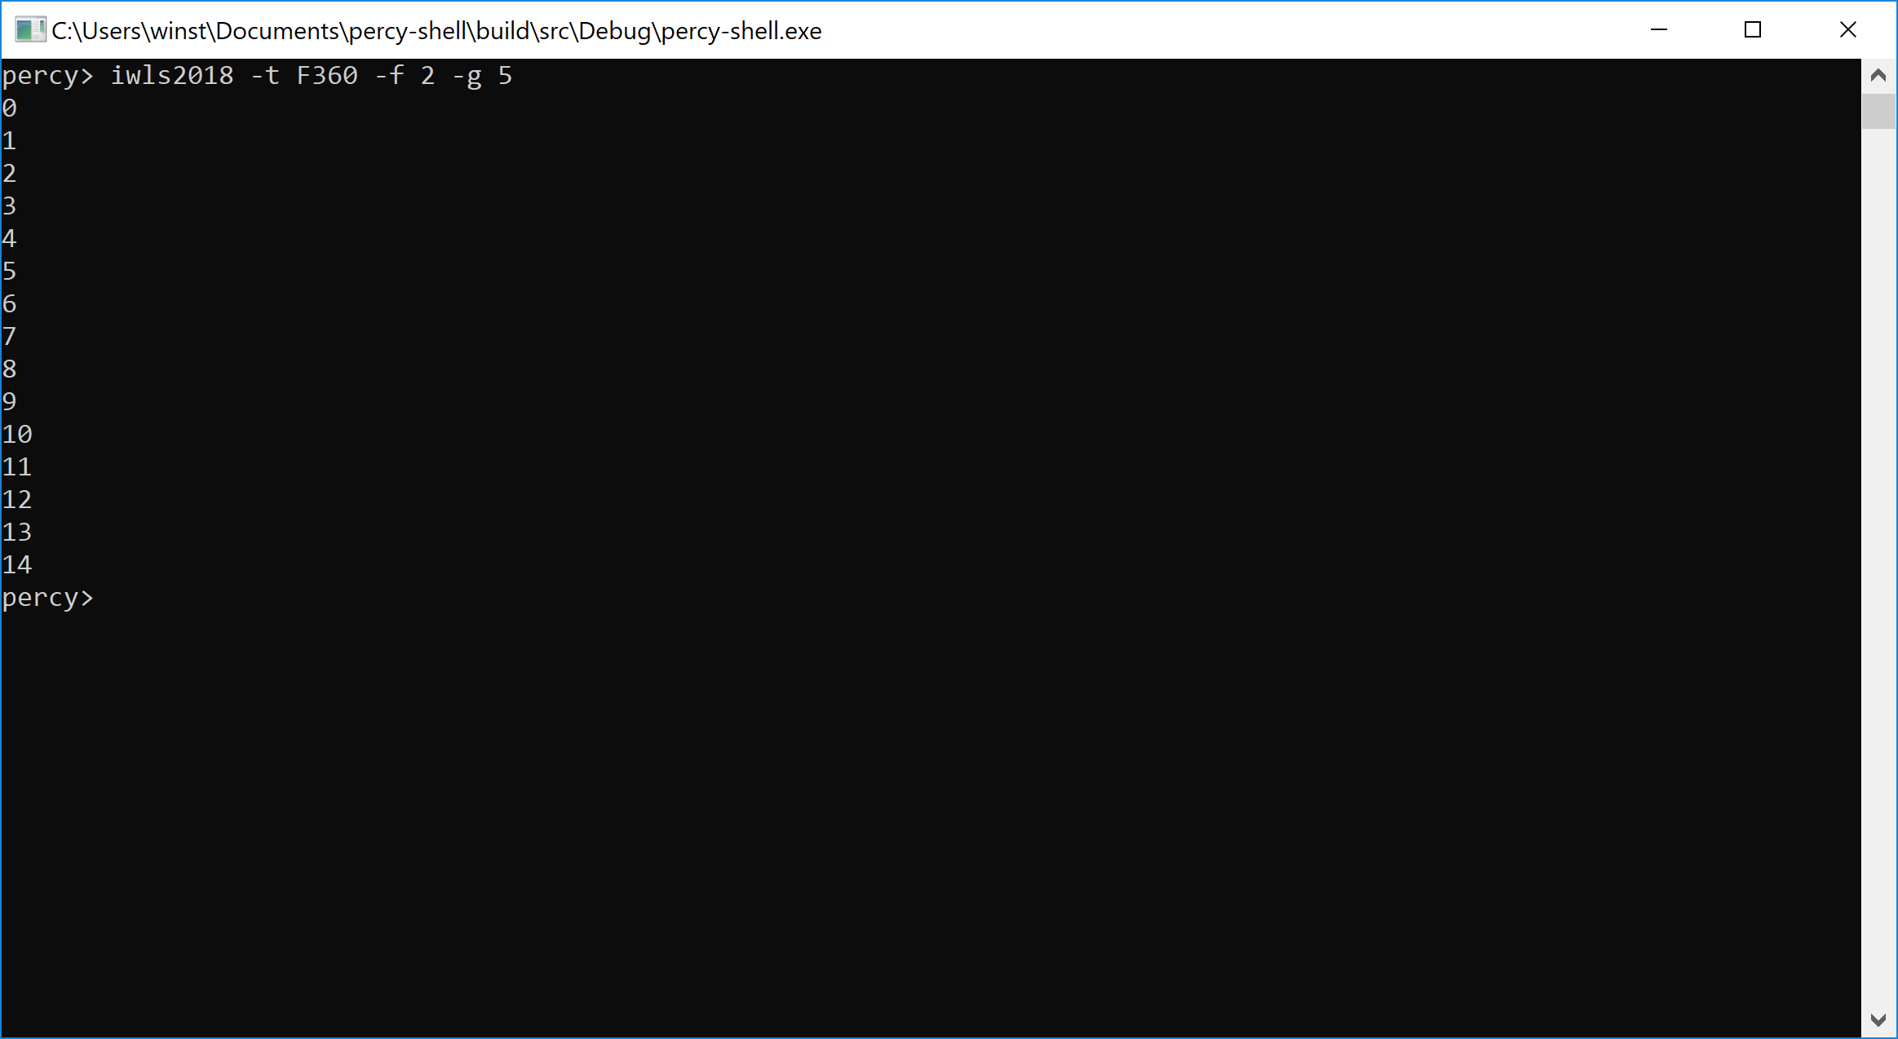
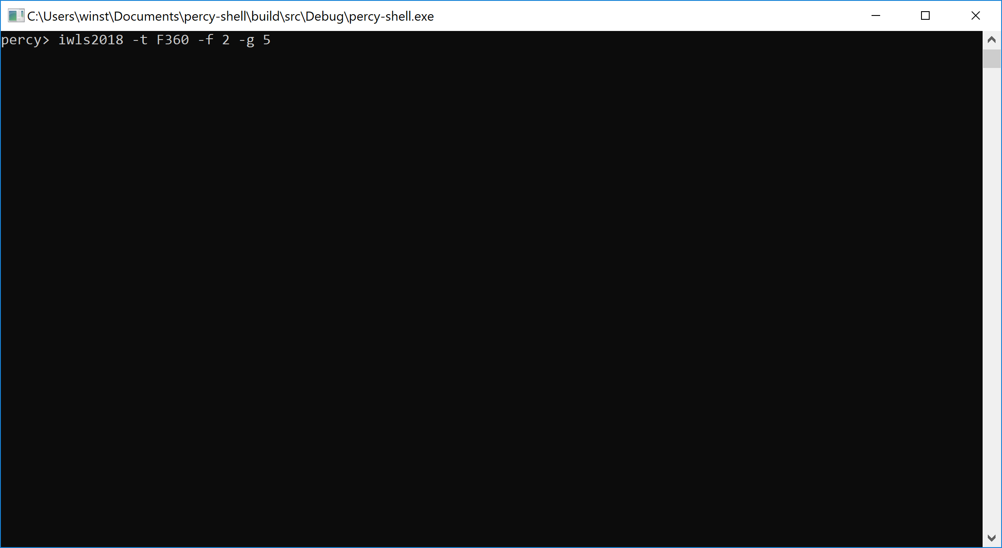


Slide 6



Thanks for Your Attention
Contact
winston.haaswijk@epfl.ch
https://github.com/whaaswijk/percy-shell
https://whaaswijk.github.io

