Slide 1

AI-Powered PDF Processing & RAG System
Intelligent document analysis with multilingual summarization and conversational AI
Text Extraction
Multilingual Support
Image Processing
RAG Technology
August 28, 2025

Slide 2




System Overview
Introducing a comprehensive PDF processing system that extracts text and images, creates structured summaries in English and Egyptian Arabic, integrates AI via Google Gemini, and supports chat-based document Q&A through RAG.
Smart Content Extraction
Extracts text and images from PDFs using PyMuPDF with high accuracy and
formatting preservation.
AI-Powered Summarization
Uses Gemini AI to generate comprehensive, structured summaries in bullet-point
format.
Multilingual Support
Creates parallel content in English and Egyptian Arabic with technical term
preservation.
Structured Output
Generates schema-validated JSON and formatted PDF reports with Pydantic models.
Image Processing
Extracts and stores images from documents with metadata preservation.
RAG Chat Interface
Enables interactive Q&A with document content using Retrieval-Augmented
Generation.

Slide 3

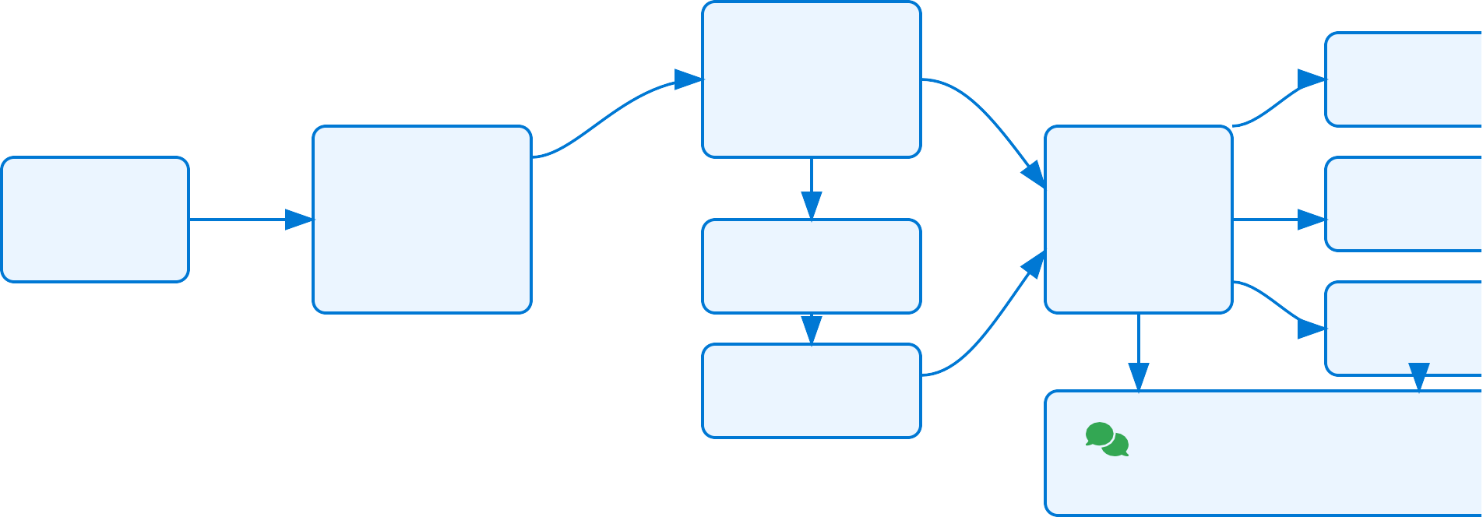


Architecture Diagram
Visual overview of the system architecture: PDF ingestion, content extraction, AI summarization, translation, structured output, and RAG chat modules.
Google Gemini AI LLM Processing API Integration
Generate
JSON Output
Structured Data
Text Content
Structure Data
PDF Document
Input Source
PDFProcessor
PyMuPDF
Text & Image Extraction
Process
Pydantic Models
Summary Translation
Data Validation
PDF Report
Formatted Summ
Input
Create
Summarization
Key Points Extract
Convert
Store
Images
Extracted Files
Query
Validate
Index
Translation
Egyptian Arabic
RAG Chat Interface
Document Q&A with Contextual Retrieval
Extract Images

Slide 4

Core Components
Breakdown of key modules and classes that power the PDF processing system, showcasing the modular architecture and component interaction.
PDFProcessor Class
Central class that orchestrates the entire PDF processing workflow: Initializes processing parameters and directories
Extracts text and images using PyMuPDF Manages AI summarization and translation Generates structured PDF reports
Pydantic Models
Schema validation for structured data handling:
Summary: Validates paper metadata, key points, and equations
Translation: Manages Egyptian Arabic translations Enforces data integrity and consistency
Enables JSON schema generation and validation
processor = PDFProcessor(pdf_path) results = processor.process_pdf()
class Summary(BaseModel): paper_name: str summary_in_english: List[str]
Gemini AI Integration
Google's Gemini model handles complex NLP tasks: Configures API with authentication
Generates structured summaries from raw text Translates content to Egyptian Arabic
Extracts equations and key points
Output Management
Handles various output formats and storage:
PDF Generation: Creates formatted summary reports
JSON Export: Stores structured data results
Image Storage: Organizes extracted images
Directory Management: Creates output structures
model = genai.GenerativeModel('models/gemini-1.5-flash') response = model.generate_content(prompt)
pdf_path = processor.save_summary_to_pdf(summary)
with open("results.json", "w") as f: json.dump(results,
f)
AI-Powered PDF Process^{M}inªg^{de}&^{wi}R^{th}A^{G}G^{e}S^{n}y^{sp}sªte^{rk}m

Slide 5
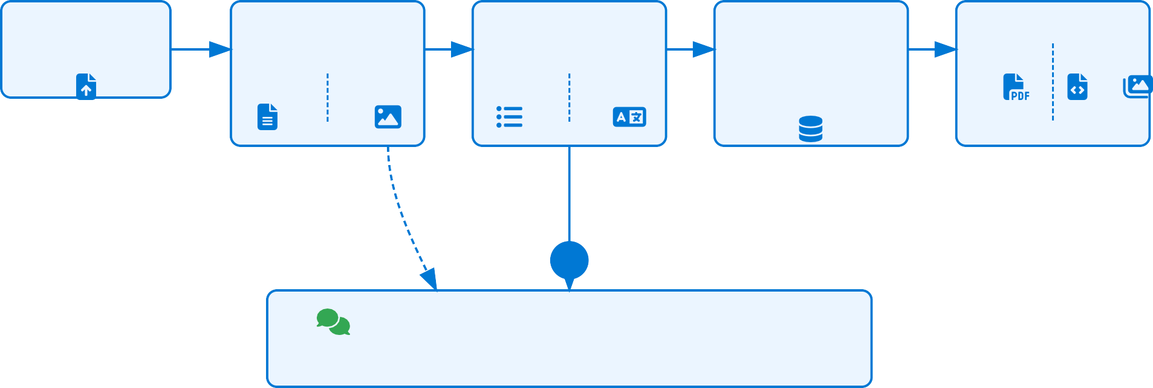
PDF Processing Pipeline
End-to-end flowchart showing the complete PDF processing workflow from upload to final output generation.
1
2
3
4
5
PDF Upload
Input Document
Extract | Content Extraction | Process | AI Processing | Structure | Data Structuring | Generate | Output Generation
 | Using PyMuPDF |  | Gemini 1.5 Flash |  | Pydantic Models |  | Multiple Formats
Summary
Translation
Text
Images
Summarize
Translate
RAG Chat Functionality
Interactive Q&A with Document Content

Slide 6



AI Integration: Google Gemini
Leverages Google's Gemini API for advanced natural language processing, summarization, translation, and question answering. The system uses the powerful Gemini 1.5 Flash model for optimal balance of performance and speed.
Gemini API Capabilities
Implementation Example
Document Summarization
Extracts key points and generates concise summaries from complex technical documents
# Configure API access
import google.generativeai as genai
API_KEY = "gemini"
genai.configure(api_key=API_KEY)
model = genai.GenerativeModel('models/gemini-1.5-flash')
Multilingual Translation
Translates content to Egyptian Arabic while preserving technical terminology
# Generate summary using Gemini API def generate_summary(text):
summarization_prompt = [
{"role": "user", "parts": [{"text": """
You are an expert in AI and text localization.
1. Read the provided English text.
Structured Data Extraction
Conforms output to predefined Pydantic schema for consistent data structure
RAG-Powered Q&A
Enables contextual question answering based on processed document content
Gemini 1.5 Flash Model Specifications
Model Type
Multimodal LLM
Context Window
Up to 1M tokens
Optimized For
SpeedA&I-PEofwfiecrieedncPyDF Process^{M}inªg^{de}&^{wi}R^{th}A^{G}G^{e}S^{n}y^{sp}sªte^{rk}m

Slide 7




Multilingual Support
The system processes content in English and generates outputs in both English and Egyptian Arabic (colloquial), preserving technical terms while ensuring natural fluency in both languages.
English Processing
Extracts and processes original English content from PDFs Creates structured English summaries in key points
Preserves academic and technical terminology
Maintains mathematical equations in standard notation
Egyptian Arabic Adaptation
Translates content to colloquial Egyptian Arabic
Maintains technical terms and equations in English
Adapts formal language to natural, conversational tone Preserves names, places, and scientific terminology
Translation Example:
English Summary Point:
The Transformer model architecture relies entirely on attention
mechanisms, eliminating the need for recurrence and convolutions, resulting in more parallelizable models that require significantly less
Egyptian Arabic Equivalent:
ﺔﺟﺎﺤﻟا ﻲﻐﻠﻴﺑ هدو ،attention تﺎﻴﻟآ ﻰﻠﻋ ﻞﻣﺎﻜﻟﺎﺑ ﺪﻤﺘﻌﻴﺑ Transformer جذﻮﻤﻧ جﺎﺘﺤﺘﺑو يزاﻮﺘﻠﻟ ﺔﻴﻠﺑﺎﻗ ﺮﺘﻛأ جذﺎﻤﻨﻟا ﻲﻠﺨﻴﺑو ،convolutions ـﻟاو recurrence ـﻠﻟ .ﺮﻴﺘﻜﺑ ﻞﻗأ ṇﻳرﺪﺗ ﺖﻗو
Translation Methodology:
Context-aware translation using Gemini API
Preserves meaning while adapting style
Maintains data inte^{A}g^{I-}r^{P}itºy^{w}a^{e}c^{re}r^{d}os^{P}s^{D}l^{F}an^{Pr}gºu^{c}a^{e}g^{ssM}e^{in}s^{agde&wiRthAGGeSnyspsaterkm}

Slide 8

Output Generation
Produces outputs tailored for research and business needs with structured data, professional PDF reports, and extracted image files for comprehensive document analysis.
Professional PDF Reports
Beautifully formatted papers with proper section hierarchy
Numbered summary points in both English and Egyptian Arabic Highlighted equations in dedicated sections
Metadata with author information and timestamps
Structured JSON Output
Schema-validated data using Pydantic models with consistent structure:
{
"paper_name": "Attention is All You Need", "authors_name": {"A. Vaswani": "Google Brain"}, "summary_in_english": [
"Introduces the Transformer architecture", "Utilizes self-attention mechanisms..."
],
"summary_in_egyptian": [ "ﺔﻴﻠﻜﻴﻫ مﺪﻘﻴﺑ Transformer",
"تﺎﻴﻟآ مﺪﺨﺘﺴﻴﺑ self-attention..."
],
"equations": "Attention(Q,K,V) = softmax(QK^T/√d)V"
summary_20250828.pdf
}
Extracted Images
Automatically identifies and extracts all embedded images:
page1_img0.png
page2_img1.png
AI-Powered ^{p}PªD^{g}F^{e3}P^{_i}r^{m}o^{g}ce^{0.}s^{p}s^{Mn}in^{ga}g^{de}&^{wi}R^{th}A^{G}G^{e}S^{n}y^{sp}sªte^{rk}m

Slide 9

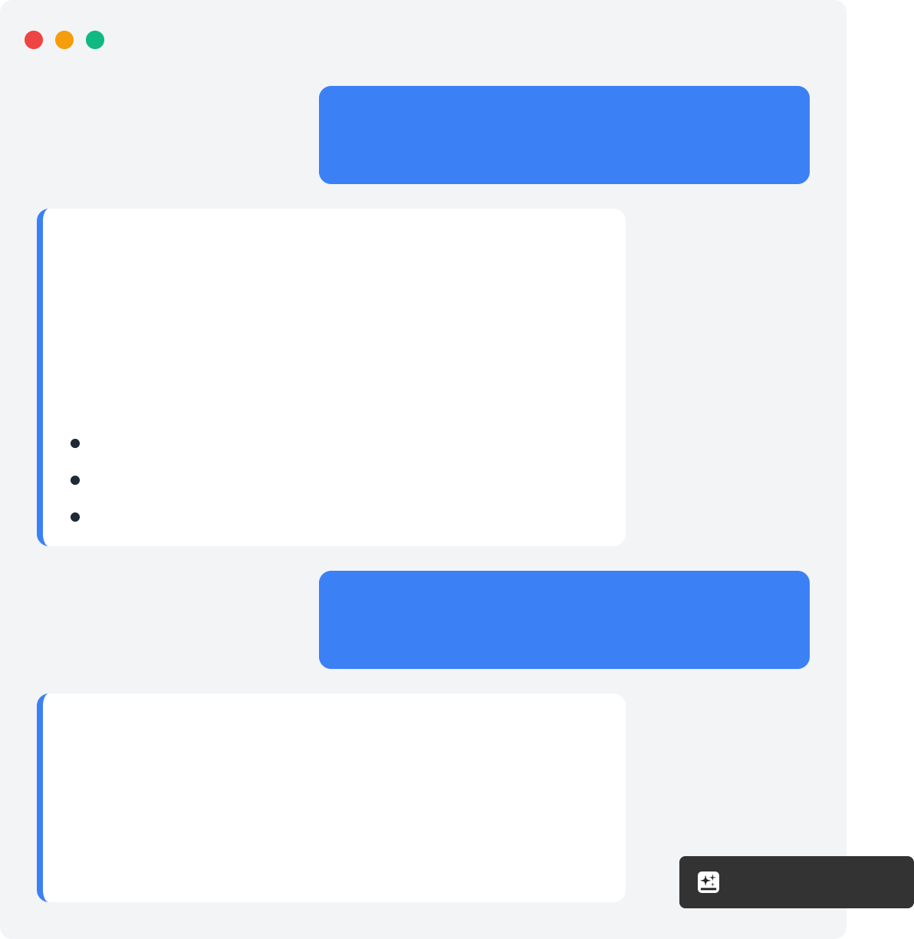

RAG Integration
Chat with Document Summaries
Retrieval-Augmented Generation (RAG) enhances the PDF processing system with interactive, knowledge-based chat capabilities that allow users to:
Document Chat Interface
What are the key features of the attention mechanism?
Query Summary Points
Ask questions about specific aspects of the processed document and receive targeted answers.
From the document:
The attention mechanism allows the model to focus on different parts of the input sequence when generating each part of the output. Key features include:
Self-attention for capturing relationships
Multi-head attention for parallel processing Scaled dot-product attention for efficiency
Contextual Understanding
The system retrieves relevant information from the document to provide accurate, contextual responses.
Bilingual Interaction
Interact with document content in both English and Egyptian Arabic, maintaining technical accuracy.
Explain multi-head attention in simple terms.
Multi-head attention runs multiple attention operations in parallel, allowing the model to
focus on different positions and representation aspects simultaneously, resulting in better
performance.
AI-Powered PDF Process^{M}inªg^{de}&^{wi}R^{th}A^{G}G^{e}S^{n}y^{sp}sªte^{rk}m

Slide 10



Technical Implementation
A modular Python-based system leveraging PyMuPDF for extraction, Google Gemini API for AI processing, and Pydantic for data validation, with extensible components for RAG integration.
Core Classes & Structure Implementation Highlights
class PDFProcessor:
def init (self, pdf_path, output_dir="output"): # Initialize paths and directories
PDF Text & Image Extraction
Uses PyMuPDF (fitz) to extract text content while preserving formatting. Image extraction maintains metadata and resolution quality.
doc = fitz.open(pdf_path)
def extract_text_and_images(self) -> tuple: # Extract content from PDF using PyMuPDF
def generate_summary(self, text: str) -> Summary: # Generate summary using Gemini API
AI-Powered Summarization
Gemini API processes text with specialized prompts, extracting structured information with schema validation via Pydantic models.
model = genai.GenerativeModel('models/gemini-1.5- flash')
def translate_to_egyptian(self, text: str) -> str: # Translate text to Egyptian Arabic
def save_summary_to_pdf(self, summary: Summary) -> str: # Create structured PDF output
def process_pdf(self) -> Dict: # Main processing pipeline
RAG Implementation
Summarized content is indexed for retrieval, allowing users to query the system with natural language and receive contextually relevant
responses.
response = rag.query(user_question, summary_context)
Pydantic Data Models
class Summary(BaseModel): paper_name: str = Field(...)
authors_name: Dict[str, str] = Field(...) summary_in_english: List[str] = Field(...) summary_in_egyptian: List[str] = Field(...) equations: str = Field(...)
class Translation(BaseModel): translated_text: str = Field(...)
AI-Powered PDF Process^{M}inªg^{de}&^{wi}R^{th}A^{G}G^{e}S^{n}y^{sp}sªte^{rk}m

Slide 11

Use Cases
Practical applications of our AI-powered PDF processing system with RAG capabilities across different domains:
Academic Research
Enables researchers to rapidly summarize scientific papers, extract key equations, and interact with content through natural
language queries.
Business Intelligence
Process technical reports and market
analyses, allowing executives to quickly
extract insights and ask follow-up questions on specific data points.
Multilingual Documentation
Makes English technical content accessible to Egyptian Arabic speakers while
preserving key terminology for consistency across languages.
Legal Document Analysis
Extracts key clauses from contracts and legal documents, allowing legal teams to quickly identify important terms and
conditions through conversational queries.
Educational Support
Transforms textbooks and course materials into interactive learning tools where
students can ask questions about concepts in their preferred language.
Medical Research
Helps medical professionals process clinical studies and research papers, extracting key findings and enabling contextual queries
about methodologies and results.

Slide 12

Future Enhancements
Planned improvements and extensions to further enhance the PDF processing system's capabilities, scalability, and user experience.
Expanded Language Support
Add support for more languages beyond English and Egyptian Arabic, including
European and Asian languages.
Advanced RAG Capabilities
Implement more sophisticated retrieval algorithms, multi-document context, and semantic search for deeper document
understanding.
Enhanced Image OCR
Integrate advanced OCR for extracting text from images and diagrams with higher
accuracy and structured data recognition.
Batch Processing
Support for processing multiple PDFs
simultaneously with distributed computing for enterprise-level document
management.
API Integration
Develop RESTful API services to enable seamless integration with existing
applications and third-party systems.
Interactive UI Dashboard
Build a comprehensive user interface for
document management, visualization, and interactive chat with processing analytics.
AI-Powered PDF Process^{M}inªg^{de}&^{wi}R^{th}A^{G}G^{e}S^{n}y^{sp}sªte^{rk}m

Slide 13

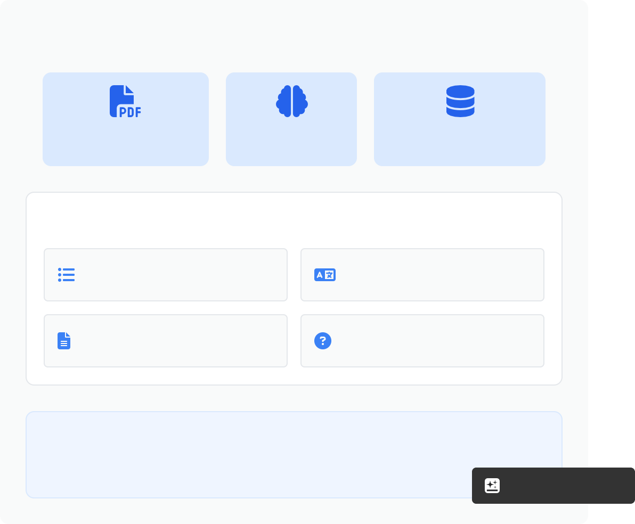



Conclusion
Transforming Document Analysis with AI & RAG
Our AI-Powered PDF Processing System with RAG
integration delivers comprehensive document analysis capabilities with multiple benefits:
System Capabilities
Automated Intelligence
Leverages Google Gemini's powerful AI to extract, summarize, and structure document content with minimal human intervention.
PDF Processing
AI Analysis
RAG Integration
Key Outputs
Multilingual Accessibility
Processes English content and creates Egyptian Arabic translations while preserving technical terms and equations.
Structured Summaries
Bilingual Content
Interactive Document Exploration
RAG-powered chat functionality allows users to query documents and receive contextual, knowledge-grounded responses.
Professional PDFs
Interactive Q&A
Ready for deployment in academic, business, and research environments
AI-Powered PDF ProcessMinagde&wiRthAGGeSnyspsaterkm

Slide 14
