Slide 1
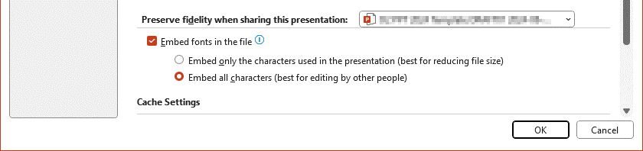
Fonts
How to use this template
  On Air or Arial?
The On Air is embedded in this PowerPoint file and should work fine for editing on Windows and macOS computers (and as of lately also on the iPad), no matter if the font is installed or not.
Please check if this template shows the On Air on your computer!
In case of trouble the On Air should be installed on your computer, or the alternative PowerPoint file with system font Arial should be used instead:
o2_PPT_Template_DE_2024_Arial.pptx
  Sharing a PowerPoint presentation with On Air
Since the On Air is embedded, sharing the presentation should work just fine, as long as the file was not edited in the browser version of PowerPoint (the embedding is lost in this case).
To be sure, you should check the font embedding settings (the On Air has to be installed on your machine).
Mac users:
PowerPoint > Preferences > Output and Sharing > Save > Embed fonts in the file
Windows users:
File > Options > Save
Use the following setting:

Slide 2
Presentation title grows from top
Presentation subtitle
Team Name – Date

Slide 3
Presentation title grows from top
Presentation subtitle
Team Name – Date

Slide 4
Presentation title grows from top
Presentation subtitle
Team Name – Date

Slide 5
Presentation title
Presentation subtitle
(Layout “Title-4”, fixed image)
Team Name – Date

Slide 6
Presentation title
Presentation subtitle
(Layout “Title-5”, fixed image)
Team Name – Date

Slide 7
Presentation title
Presentation subtitle
(Layout “Title-6”, fixed image)
Team Name – Date

Slide 8
Chapter Title (grows up)
1
Chapter Subtitle
Layout “Section Header Blue”

Slide 9
Chapter Title (grows up)
2
Chapter Subtitle
Layout “Section Header White”

Slide 10
Intermediate Title
(grows up)
Intermediate Subtitle
Layout “Intermediate Header Blue”

Slide 11
Intermediate Title
(grows up)
Intermediate Subtitle
Layout “Intermediate Header White”

Slide 12
Contents
First main topic (list level 1)
Second main topic
  Subtopic (list level 2)
  Subtopic
  Subtopic
Third main topic
etc.
etc.
etc.
etc.

Slide 19


Slide 23



























































Icons
A collection of icons is available from Brand Factory.

Slide 24














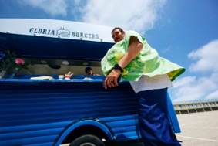



Images
The full image collection is available on the Brand Factory.

Slide 25






23,000
55
8
Sample text first line.
Sample text second line.
Sample text first line.
Sample text second line.
Sample text first line.
Sample text second line.
€6.3m
607
16
Sample text first line.
Sample text second line.
Sample text first line.
Sample text second line.
Sample text first line.
Sample text second line.

Slide 26
5.2%
We’ve already
reached our goal

Slide 29
May
We’ve had 530 views in May

Slide 30
75%
25%
80%
50%
Broadband
Mobile
Technology
Communication
Sample text
Sample text
Sample text
Sample text
75%
25%
80%
50%
Broadband
Mobile
Technology
Communication
Sample text
Sample text
Sample text
Sample text

Slide 31
75%
25%
80%
50%
Broadband
Mobile
Technology
Communication
Sample text
Sample text
Sample text
Sample text
75%
25%
80%
50%
Broadband
Mobile
Technology
Communication
Sample text
Sample text
Sample text
Sample text

Slide 32
Table with style “o2 Beyond Blue” (default)
 | Header Row | Header Row | Header Row | Header Row | Header Row
First Column | Normal Cell | Normal Cell | Normal Cell | Normal Cell | Last Column
First Column | Normal Cell | Normal Cell | Normal Cell | Normal Cell | Last Column
First Column | Normal Cell | Normal Cell | Normal Cell | Normal Cell | Last Column
First Column | Normal Cell | Normal Cell | Normal Cell | Normal Cell | Last Column
First Column | Normal Cell | Normal Cell | Normal Cell | Normal Cell | Last Column
First Column | Normal Cell | Normal Cell | Normal Cell | Normal Cell | Last Column
First Column | Normal Cell | Normal Cell | Normal Cell | Normal Cell | Last Column
Total Row | Total Row | Total Row | Total Row | Total Row | Total Row

Slide 33
Table with style “o2 Beyond Blue” (default)
 | Small | Medium | Large | XL
Row title | • | • | • | •
Row title | • | • | • | •
Row title | • | • | • | •
Row title | • | • | • | •
 | 30€ per month | 50€ per month | 60€ per month | 70€ per month

Slide 34
 | Jan | Feb | Mar | Apr | May | Jun | Jul | Aug | Sep | Oct | Nov | Dec
Phase 1
Phase 2
Phase 3
Phase 4
Phase 5
Milestone 1
5 Jan
Milestone 2
10 Apr
A – 1 Jan – 10 Mar
B – 10 Mar – 10 May
Milestone 3
1 May
C – 10 Feb – 5 May
Milestone 4
1 Jun
Milestone 5
10 Aug
D – 15 Apr – 8 Jun
E – 1 Jul – 30 Aug
F – 1 – 30 Sep
Milestone 6
15 Oct
G – 1 Sep – 15 Nov
Milestone 7
1 Nov
H – 1 – 30 Oct
I – 1 – 30 Nov
J – 1 – 31 Dec

Slide 35








2002
23.000
1,5m
8
Sample text first line.
Sample text second line.
Sample text first line.
Sample text second line.
Sample text first line.
Sample text second line.
Sample text first line.
Sample text second line.
2002
2005
2010
2015
2020
2025
42
€6,3m
607
16
Sample text first line.
Sample text second line.
Sample text first line.
Sample text second line.
Sample text first line.
Sample text second line.
Sample text first line.
Sample text second line.

Slide 36
Thank you

Slide 42

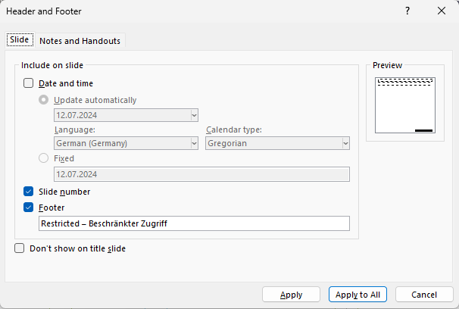
Setting security level in footer
How to use this template
In tab “Insert” click on “Header & Footer”.
In the “Header and Footer” dialog box edit field “Footer” to represent the security level requited (use the security levels from the next slide’s table).
Click on “Apply to All” to change all footers.

Slide 43
Security Levels
How to use this template
Level | Level | Description
0 | Public – nicht vertraulich | All information from whose publication no damage to the company or the person concerned can result. The respective release procedures for official company documents must be complied with, but are not within the scope of this guideline.
1 | Internal Use – Interner Gebrauch | All information that is only intended for use within the company and where there is a need for all employees to have access to it. In principle, this class also includes personal data that is voluntarily made available to all employees in the company or is publicly available anyway.
2 | Restricted – Beschränkter Zugriff | All information that should only be accessible to certain groups of people, even within the company. This includes all personal data that is not explicitly assigned to another group. Personal data that either falls under "special categories of personal data" pursuant to Article 9 of the GDPR, telecommunications traffic data and data protected in an equivalent manner, or generally represents a high risk for the data subject, must also be assigned to this group. However, additional protective measures may be necessary for these in individual cases.
3 | Secret – Geheim | All information, the publication of which could result in damage to the company's existence. The classification as "Secret" must be released at least by a person authorized at director level.

Slide 44
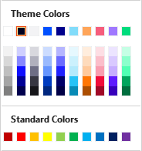
Colours
How to use this template
  Please only use the first row of colours (“Theme Colors”) in the colour palette!
The “Standard Colors” are PowerPoint settings and should not be used.
The RGB colours and their usage are shown on the right.
o2 White | o2 Black | o2 20% Black | o2 Beyond Blue | o2 Dark Blue | o2 Light Blue | o2 Orange | o2 Lila | o2 Green | o2 Red
R235 G235 B235 | R0 G0 B30 | R243 G243 B245 | R0 G80 B255 | R0 G0 B140 | R130 G220 B250 | R255 G165 B90 | R160 G120 B255 | R0 G220 B125 | R246 G93 B124
Text, backgrounds
Secondary and accent colours
For use in graphical elements, tables, infographics etc.
The Chart Assistant uses these colours in the order given.
Eye-catcher

Slide 45
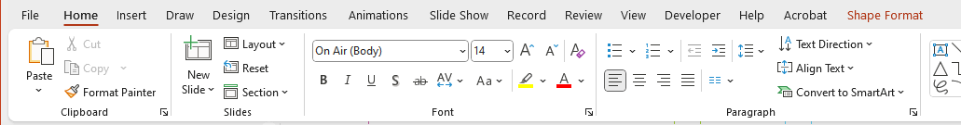
List levels
How to use this template
Throughout the presentation, different text formattings are provided using the “Increase List Level” and “Decrease List Level” buttons in section “Paragraph” of the “Home” tab. These formattings are defined for text placeholders and text boxes (without subheadline formatting in table cells):
List level 1 – copy text without bullet point
  List level 2 – subheadlines in text
    List level 3 – bullet list (bullet can be switched off and on again)
      List level 4 – bullet list indented (bullet can be switched off and on again)
        List level 5 – bullet list further indented (bullet can be switched of and on again)

Slide 46
Icons and photos
How to use this template
  Icon pool o2
We’ve created an icon system that’s strong, simple and consistent. Contemporary and digitally-focused, our icons work as well on screen as they do in print. They are designed to flex from the largest to the smallest format, static or in motion.
This library is regularly updated with new icons, so check and make sure you’re using the latest versions. Primary, Secondary and Solid icon artwork can be downloaded here for all the icons in the library.
https://brandfactory.telefonica.com/document/3393
  Photo library (o2)
https://brandfactory.telefonica.com/document/3955/collection/2246

Slide 47
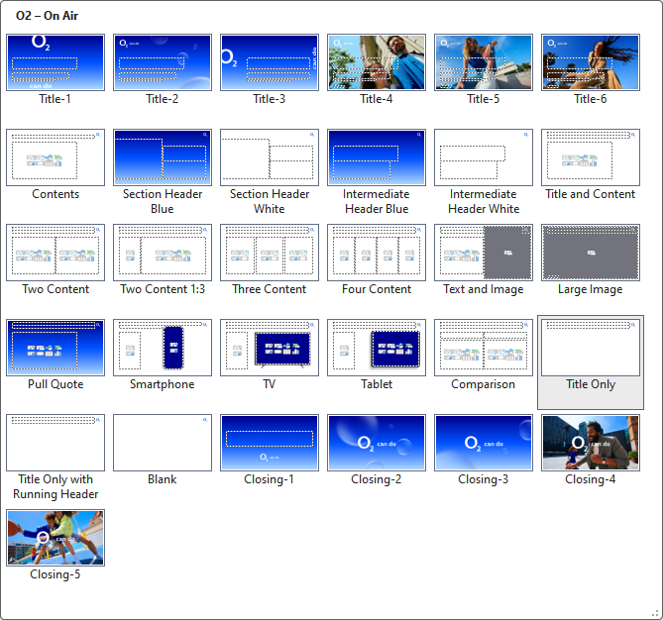
Slide layouts
How to use this template
  This PowerPoint file contains several layouts for use in o2 presentations.
Layout for title slides, chapter (section header) slides, a multitude of content slides, and closing slides are available. They contain different placeholders to insert text, images, tables, drawings etc. They contain all relevant settings and text formats via list levels.
The layouts can be selected using the “New Slide” button in the “Home” tab.
The layout for the current slide can be changed using the “Layout” button on the “Home” tab.
To help you with the layout, we have set up a grid that you can access via the “View” tab and the “Guides” option (section “Show”).
Please be careful not to place any elements outside the purple guides.

Slide 48















Design for different target groups
How to use this template
When designing a document, think about its use and how it will be presented.
For example, text-heavy reports may require a more functional approach – simple layouts, clear dividers and concise infographics to easily convey information.
On the other hand, images, typography and animations can be used to better engage the audience during presentations.
The master slides in this file help you to prepare different content for different audiences.
  Presentation
  Report

Slide 49
Checklist
How to use this template
  Create a new document
It's best to start each new presentation with a new template. Avoid copying slides from other presentations in their entirety. We recommend copying and pasting only text and images to avoid additional slide layouts being imported and to avoid increasing the size and complexity of the document unnecessarily. To paste text, use the Keep Text Only text function to delete the previous formatting.
  Footers
Use “Header and Footer” on the “Insert” tab to check that the footer information is correct for the current document.
  Restrict editing
You can protect your PowerPoint presentation from further editing with a password:
Mac users: File > Passwords… > Password to modify > Require a password to modify the presentation
Windows users: File > Info > Protect Presentation
There is also the option to open the presentation with the "Read only" function.
  Save as PDF
If the final presentation does not contain moving images or does not require further editing, it is easier to save it as a PDF and share it with others:
File > Save as... > PDF

