Slide 1
图书馆画像：每日更新与画像标准优化
谢绍康、龚明道、郑微言、李佳纯、冯柏钧

Slide 2
画像标准优化
郑微言、李佳纯

Slide 3
Our Data
...
入馆天数
入馆总时长
预约讨论间次数
预约讨论间总时长
借书总数
各类书籍借阅数量

Slide 4
Method 1: KM Method 2: GMM

Slide 5
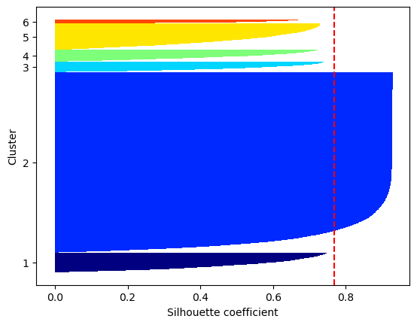
All data
examples of center:
[2.35579954e+01, 5.68630448e+03, 9.20361420e-01, 9.91211389e+01,
1.30898298e+01, 6.25131330e-02, 6.79764656e-01, 2.77894516e-01,
2.07921832e-01, 7.08131960e-02, 8.16978357e-01, 3.39672200e-01,
7.00567346e-01, 2.02889262e+00, 4.41374238e-01, 5.75646144e-01,
5.73649926e-02, 2.49138474e+00, 1.73776003e-01, 4.35805842e-01,
1.97205295e-01, 1.97520487e-02, 3.30762765e+00, 1.10317294e-02,
7.97436436e-02, 7.16537088e-02, 2.18533305e-02],
[1.54755068e+02, 4.57848995e+05, 9.25844595e+00, 1.01146284e+03,
1.45050676e+01, 7.77027027e-02, 5.82770270e-01, 2.60135135e-01,
1.65540541e-01, 7.93918919e-02, 4.79729730e-01, 1.82432432e-01,
6.58783784e-01, 3.00506757e+00, 3.04054054e-01, 4.74662162e-01,
3.37837838e-02, 3.66722973e+00, 2.41554054e-01, 3.63175676e-01,
1.55405405e-01, 1.52027027e-02, 3.56756757e+00, 3.37837838e-03,
7.26351351e-02, 7.60135135e-02, 1.18243243e-02],
KM

Slide 6
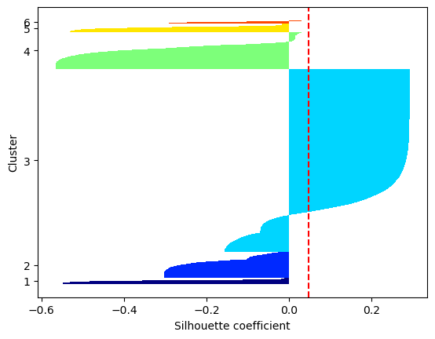
All data
examples of center:
[6.09241573e+01, 2.62800963e+00, 1.06793740e+01, 6.78170144e-02, 5.93900482e-01, 2.50000000e-01,1.67335474e-01,5.97913323e-02, 5.87078652e-01, 2.16693419e-01, 5.16452648e-01, 1.96829856e+00, 3.26645265e-01, 4.48234350e-01, 4.73515249e-02, 2.14406100e+00, 1.35232745e-01, 4.20947030e-01, 1.64927769e-01, 1.52487961e-02, 2.39887640e+00, 1.12359551e-02, 5.69823435e-02, 4.29373997e-02, 1.64526485e-02],
[2.37976893e+02, 1.43068036e+01, 2.02259307e+01, 1.16816431e-01, 1.45057766e+00, 4.64698331e-01, 2.79845956e-01, 1.02695764e-01, 1.17073171e+00, 4.13350449e-01, 1.02439024e+00, 4.51732991e+00, 6.00770218e-01, 9.11424904e-01, 7.83055199e-02, 4.44929397e+00, 2.34916560e-01, 4.68549422e-01, 3.11938383e-01, 2.56739409e-02, 3.35815148e+00, 1.54043646e-02, 1.00128370e-01, 6.29011553e-02, 4.10783055e-02]
GMM

Slide 7
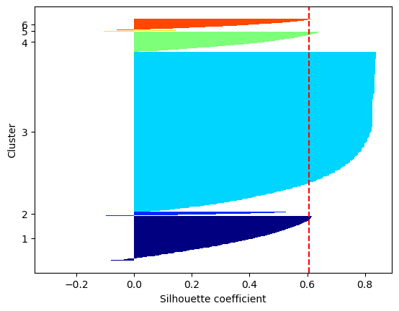

Data without the time in library and rooms
Data without the times going into library and rooms
KM

Slide 8
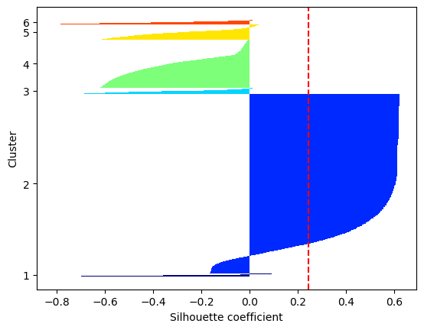
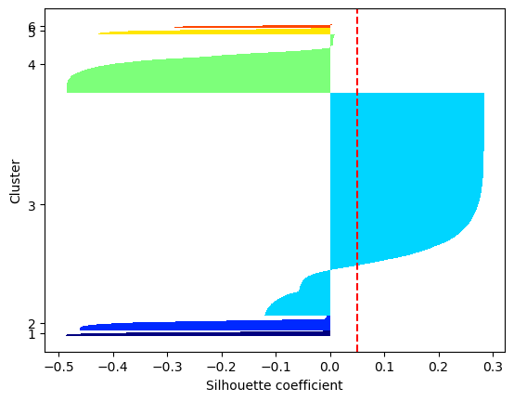
Data without the time in library and rooms
Data without the times going into library and rooms
GMM
KM

Slide 9
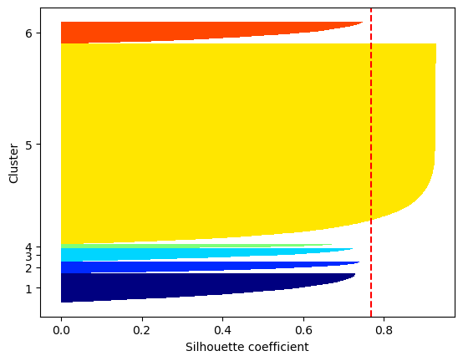

Data without the borrowing times about different types of books
Data without the borrowing times of all books
KM

Slide 10
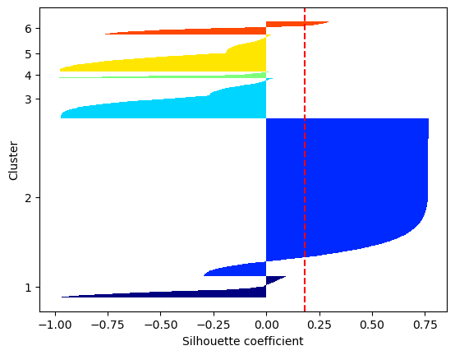
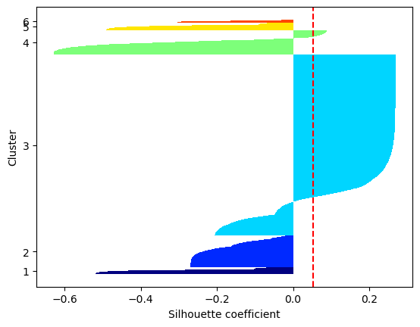
Data without the borrowing times about different types of books
Data without the borrowing times of all books
GMM
KM

Slide 11
...
入馆天数
入馆总时长
预约讨论间次数
预约讨论间总时长
借书总数
Not equal
各类书籍借阅数量
Space
3
2
Books

Slide 12
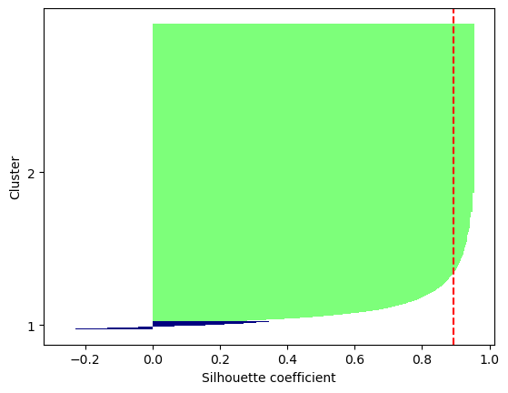
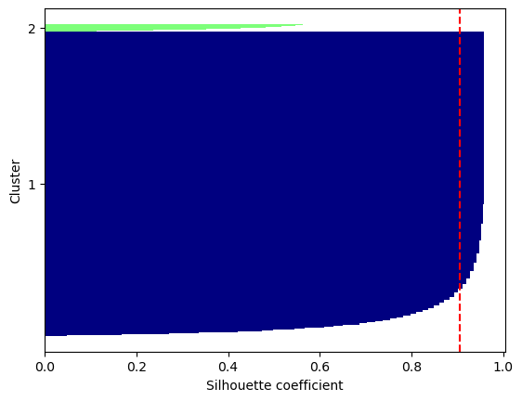
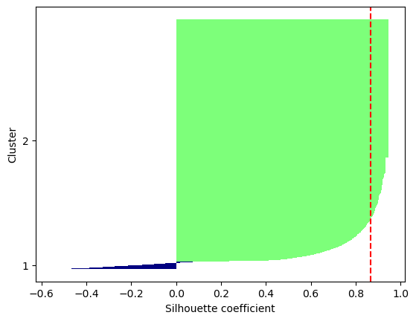
Data of the borrowing times about different types of books
All data about books
Data of all the borrowing times of books
KM

Slide 13
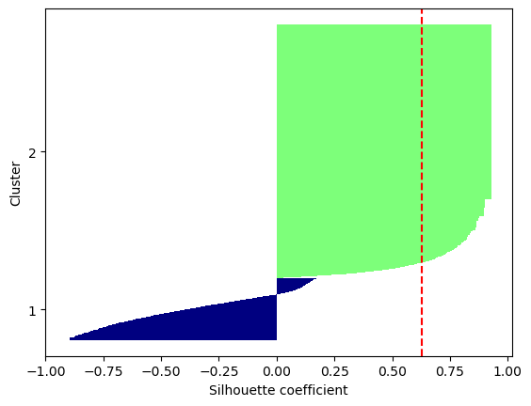
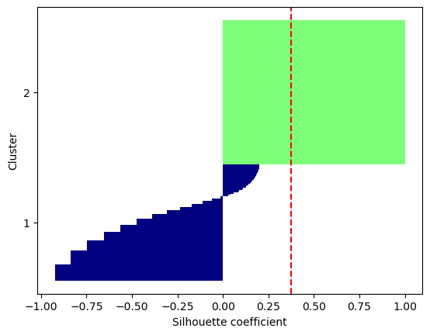
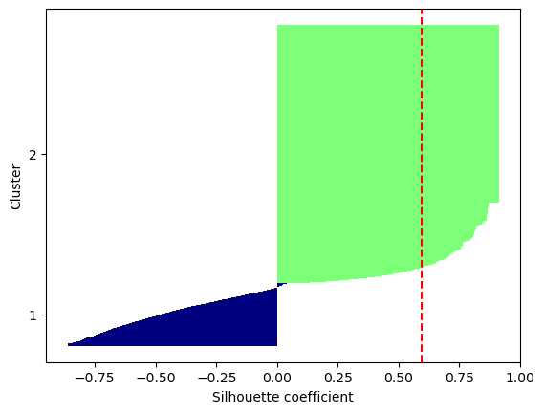
Data of the borrowing times about different types of books
All data about books
Data of all the borrowing times of books
GMM
KM

Slide 14
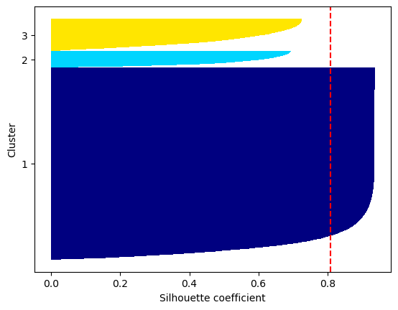
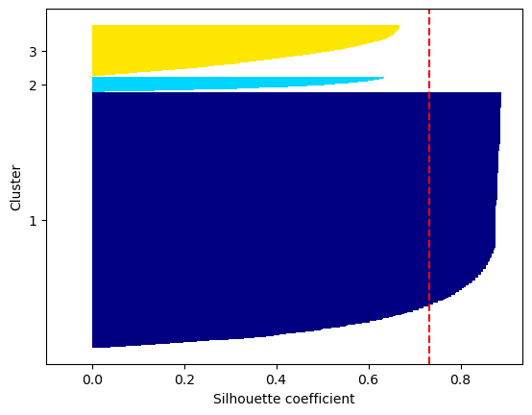
Data of the time in library and rooms
Data of the times going into library and rooms
All data about space
KM

Slide 15
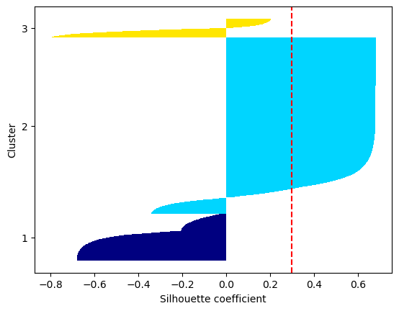
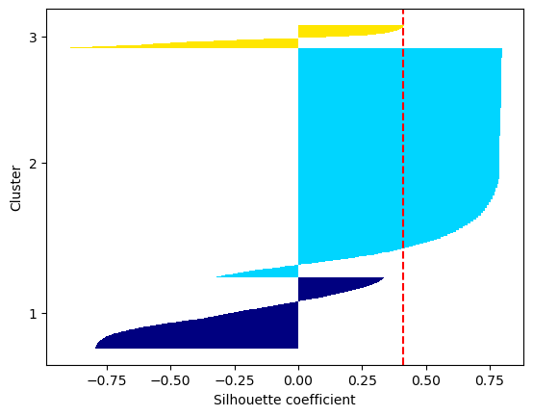
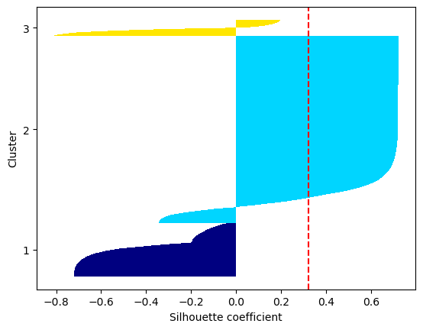
Data of the time in library and rooms
Data of the times going into library and rooms
All data about space
GMM
KM

Slide 16
>85%
Few extreme value
Log to decrease the influence from the order of magnitudes

Slide 17
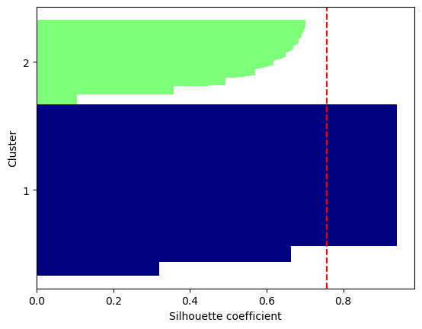
Data of the borrowing times about different types of books
Data of the borrowing times about different types of books
KM
Before log
After log

Slide 18
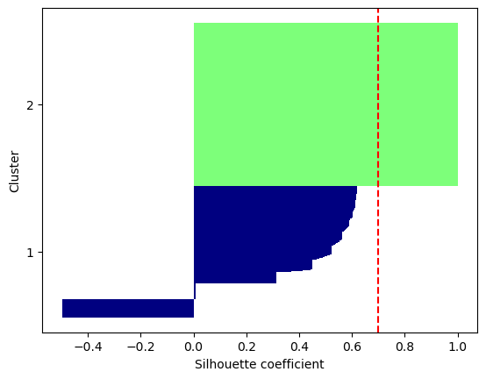
Data of the borrowing times about different types of books
Data of the borrowing times about different types of books
GMM
KM
Before log
After log

Slide 19
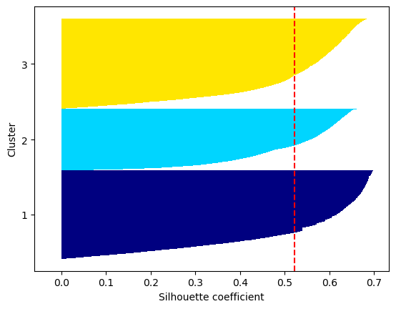
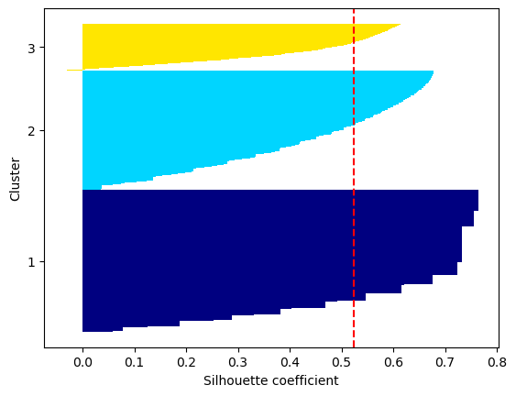

Data of the time in library and rooms
Data of the times going into library and rooms
All data about space
Before log
After log
KM

Slide 20
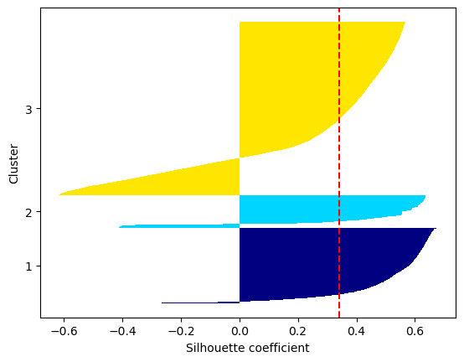
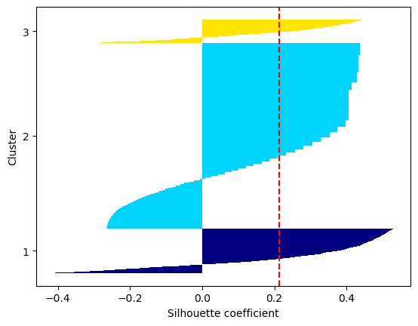
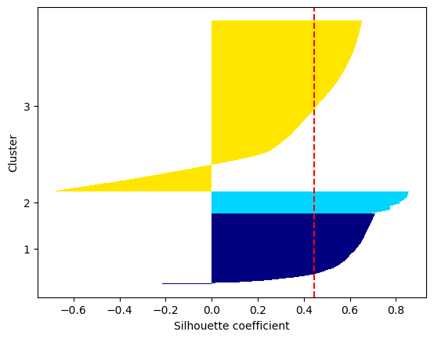
Data of the time in library and rooms
Data of the times going into library and rooms
All data about space
Before log
After log
GMM

Slide 21
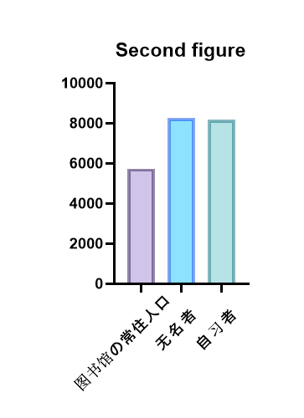
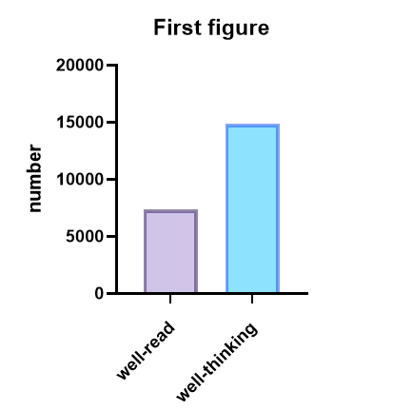
Standard
KM
Data of the time in library and rooms
Data of the borrowing times about different types of books
图书馆时长长，讨论间时长长。
图书馆时长长，讨论间时长短。
借书多
借书少
图书馆时长短，讨论间时长短。

