Slide 1

16组 智能图书馆
队长：谢绍康
组员：李佳纯，郑微言，龚明道，冯柏钧
2022-12-24

Slide 2

Outline
Some Problems of Demo Program
Daily Data Update
User Tag Classification

Slide 3
1
Some Problems of Demo
401 Failure Error
Data Format from models.rs

Slide 4
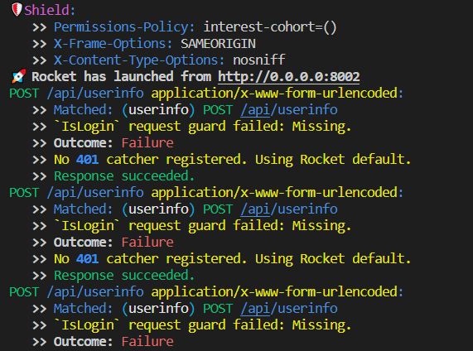
Outcome: 401 Failure

Slide 5

Cookie
Add cookie
Get cookie (Cannot)

Slide 6


Database
Add cookie => Add into database
Get cookie => Read from database

Slide 7
2
Daily Data Update
Python Script
Linux crontab

Slide 8
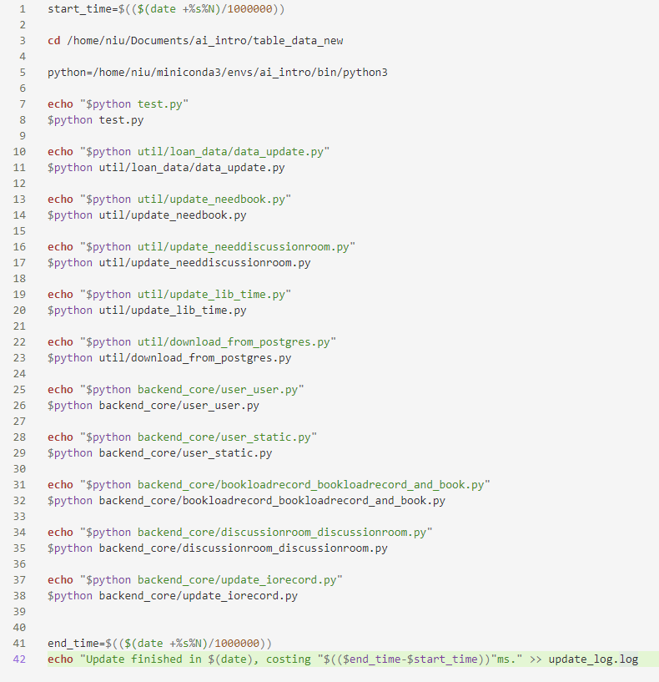
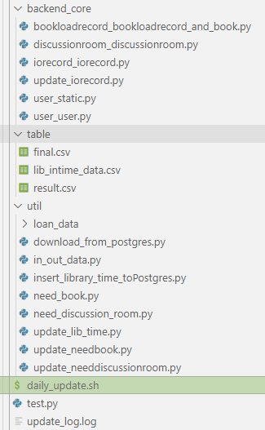
Daily Data Update
Update bash file
Update core py file

Slide 9
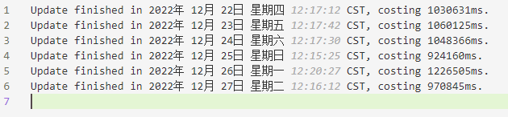
Daily Data Update
Crontab -l
Update log

Slide 10
3
User Tag Classification
Tag’s Daily Update
Standard for User_Tag

