Slide 1

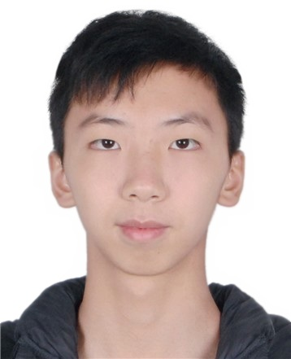
个人介绍
冯柏钧
12011124
计算机科学与工程系

Slide 2


Homework 01 (PPT) – By Next Wednesday
What you like to learn from the class
Tell me about yourself and suggestion
to my class to make it YOURS

Slide 3
Homework 01 (PPT) – By Next Wednesday
What you like to learn from the class
I’d like to learn about popular AI algorithms and their application currently, and the trend of AI in the future.

Slide 4
Homework 01 (PPT) – By Next Wednesday
Tell me about yourself and suggestion
to my class to make it YOURS
I am a junior student from the Department of Computer Science and Engineering, majoring in Intelligence Science and Technology. At present, I am participating in a project of confidential blockchains, and I am wondering how to apply AI technology in the field of computer security, so it is my suggestion that you introduce some AI algorithms and their application that related to computer security and discuss the possible way of how AI and computer can interact.

