Slide 1

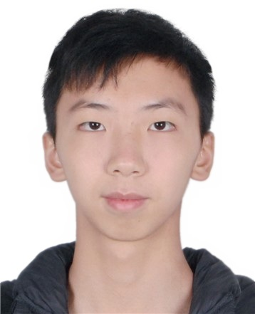
个人介绍
姓名 冯柏钧
学号 12011124
院系 计算机科学与工程系

Slide 2

Homework 02 (PPT)
From The Topics Listed, Choose a Project and Start to Form a Project Team
I decide to choose the project.
Our team choose to do the project 4 智能图书馆.
The group head is 谢绍康.
The other group members are 冯柏钧,龚明道,郑微言 and 李佳纯.

