Slide 1

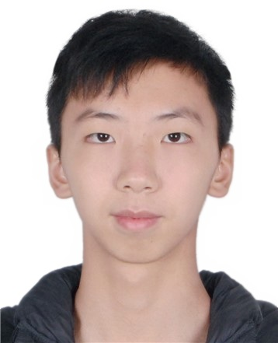
个人介绍
姓名 冯柏钧
学号 12011124
院系 计算机科学与工程系

Slide 2



Homework 03
Finalize your Project Title. Team Leaders are To Arrange Meetings with TA and Industrial Supervisors. Record Why You Choose Such Topic for Your Project? Write a Preliminary Project Plan Describing How You Want to Do the Project?
Define Your Version of AI
Think about the AI principle behind ALPHAGO by Watching
https://www.bilibili.com/video/av456221765/

Slide 3
Homework 03
Project Title: Smart Library (智能图书馆)
Group 16
Reason: We choose this project because library is one of best places for us students to study, and we find it interesting to see how
Long students spend in the library and how often they usually go to the library.
Plan: We plan to divide the reader data into 6 dimensions, reduce dimensionality clustering, and redefine the portrait according to the clustering results.

Slide 4
Homework 03
My definition of AI:
Artificial intelligence is a type of technology concerned with making machines act rationally and intelligently.

Slide 5
Homework 03
AI principle behind ALPHAGO :
1.Use two independent neural network, policy network and evaluation network.
Both are basically composed of 13-layer convolutional neural network, and the size of convolution kernel is 5*5.

Slide 6
Homework 03
AI principle behind ALPHAGO :
1.1 Policy network
The policy network is basically a simple supervised learning of where the opponent is most likely to move. It takes a huge amount of the scores of professional chess players in the world and predict the most likely positions of its opponents.
The policy network uses reinforced-learning (RL) policy network and exclude some regions from convolution core before calculation to optimize.

Slide 7
Homework 03
AI principle behind ALPHAGO :
1.2 Evaluation network
The evaluation network calculates the win rate of each position given the current situation.
The result is an approximate solution, and through the convolution of the neural network approach to calculate the convolution kernels range of the average winning percentage (mainly the purpose of this practice is to change the evaluation function smoothing, and at the same time avoid over-fitting problem)

Slide 8
Homework 03
AI principle behind ALPHAGO :
2.Use Monte Carlo search tree.
In the previous policy network and evaluation network, AlphaGo has been able to narrow down the likelihood of the next player (including the opponent) to a manageable range, and then he can quickly use the Monte Carlo search tree to calculate the best solution among a limited number of combinations.

