Slide 1

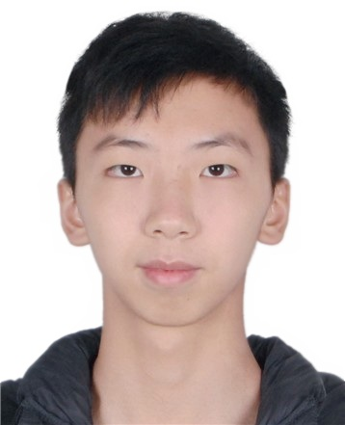
个人介绍
姓名 冯柏钧
学号 12011124
院系 计算机科学与工程系

Slide 2

Homework 04
For Project Teams， Discuss Among Your Group on What kind of Algorithm Development
Tools Your Project Intend to Use, and the Reasons Behind Your Choice.
For data processing (core part) : every day through the interface to get every "yesterday" data, load data into the database, and then through the database to capture.
Objective: To achieve daily data update

Slide 3
Homework 04
For Project Teams， Discuss Among Your Group on What kind of Algorithm Development
Tools Your Project Intend to Use, and the Reasons Behind Your Choice.
For the portrait: after data processing, we first look at the classification of the population through clustering (unsupervised learning), and then define a new classification standard according to the principal components of each group.
Objective: According to the overall situation of teachers and students in Southern University of Science and Technology to divide the groups, more suitable for the current group

Slide 4

Homework 04
Analysis How CNN Borrow Idea from Human Vision System
CNN imitates the process of human vision forming. Principle of convolutional neural network mimicking vision.
Principle of convolutional neural network:
(1) Principle of simulated vision: human visual recognition involves different levels of visual cortex, and each layer processes different transactions;
(2) Construct multi-layer neural network model: imitates the visual cortex, and creates multi-layer neural network model, such as convolutional neural network;
(3) Hierarchical working mechanism: multi-layer neural network model mechanism, the bottom layer recognizes the edge features of the image, the upper layer gradually recognizes the shape, and the upper layer determines and classifies the image pixels.

