Slide 1

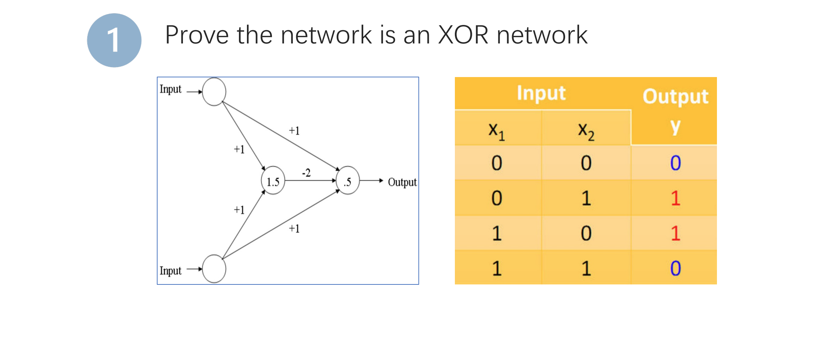
Homework 07

Slide 2
Homework 07
a
H(a)
b
x₁ | x₂ | a | H(a) | b | Y
0 | 0 | 0<1.5 | 0 | 0<0.5 | 0
0 | 1 | 1<1.5 | 0 | 1>0.5 | 1
1 | 0 | 1<1.5 | 0 | 1>0.5 | 1
1 | 1 | 2>1.5 | 1 | 0<0.5 | 0

