Slide 1

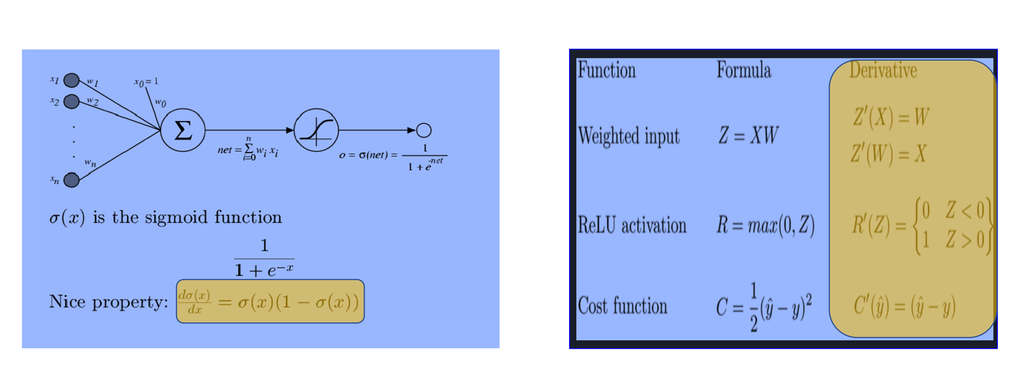
Homework 08:Prove the derivative formula (in yellow box) of Sigmoid and ReLU Transfer Functions

Slide 2
