Slide 1

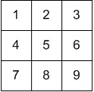
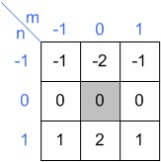
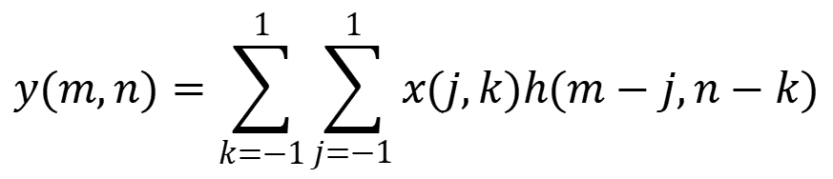
Homework 9
Given the Image X and the Convolution operator H.
The 2D discrete convolution of Y = X*H is here is defined as:
Please use the zero-padding to extend the image during calculation
Please calculate Y
$$y(m,n)=\sum_{k=−1}^{1}{\sum_{j=−1}^{1}{x(j,k)h(m−���,n−���)}}$$

Slide 2
Image
Y = -60
-13 | -20 | -17
-18 | -24 | -18
13 | 20 | 17

