Slide 1



Project2 - Passive_radar
Group Members: 张骥霄,冯柏钧,杨牧之,周安然

Slide 2

Introduction
Background Information
Multipath Propagation
Doppler Shifting
Radar
Results & Analysis

Slide 3
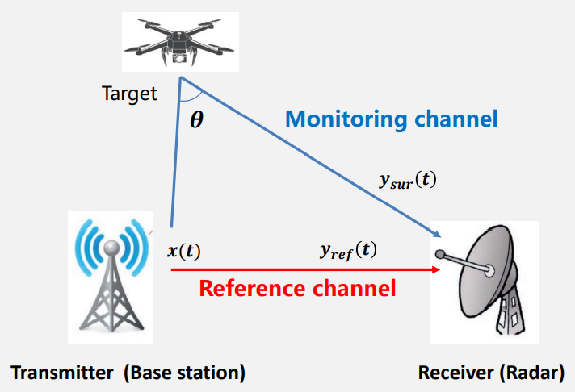

Background Information
-- Multipath propagation
Signals reaching the receiving antenna by two or more paths. Because of the existence of buildings and the mountain, signals may be reflected, thus the multipath propagation formed.
Multipath propagation led to attenuation and limit the broadband and transmitting speed. The signal received by the receiver is the superposition of the direct wave and many reflected waves.
Denote the signal as $x\left(t\right)$, we can define that
$$\begin{aligned}y_{ref}\left(t\right)=αx\left(t−τ_{r}\right)\#\#\end{aligned} \\ \begin{aligned}y_{sur}\left(t\right)=βx\left(t−τ_{s}\right)e^{j2πf_{d}t}\#\end{aligned}$$

Slide 4
Background Information
-- Doppler shifting
$$f^{′}=\left(\frac{v±v_{0}}{v∓v_{s}}\right)f$$
When the source and observer of a signal are moving relatively, the frequency will change. Increase when approaching (which is called a “blue shift”), decreasing when move apart (which is called a “red shift”).
The wave source will send out a wave after vibration, and the receiver will receive different frequency due to relative movement.

Slide 5
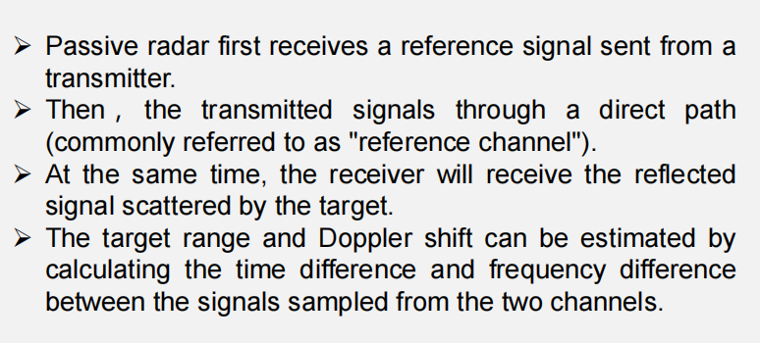
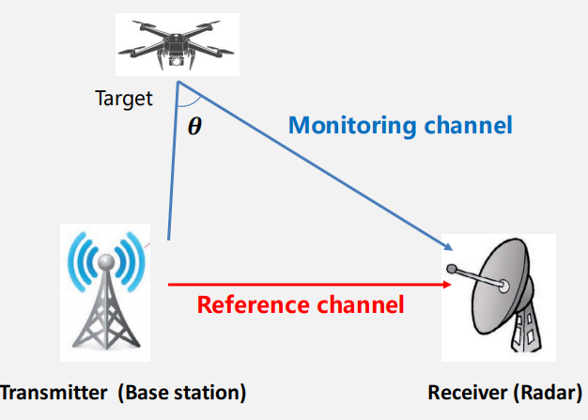
Background Information
-- Basic principle of passive radar
Radar: A method of detecting distant objects and determining their position, velocity, or other characteristics by analysis of very high frequency radio waves reflected from their surfaces.

Slide 6
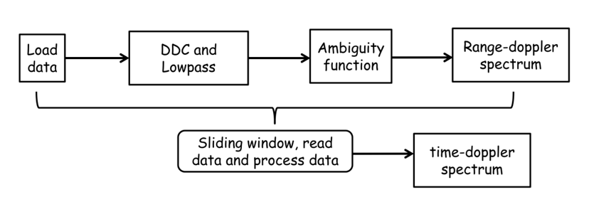
Results&Analysis
Task1: Load data, Sliding window, read data and process data —— 杨牧之
Task2:DDC and Lowpass filter: Origin, After DDC, After LPF —— 周安然
Task3:Ambiguity function Process and Spectrum plotting ——冯柏钧 张骥霄

Slide 7
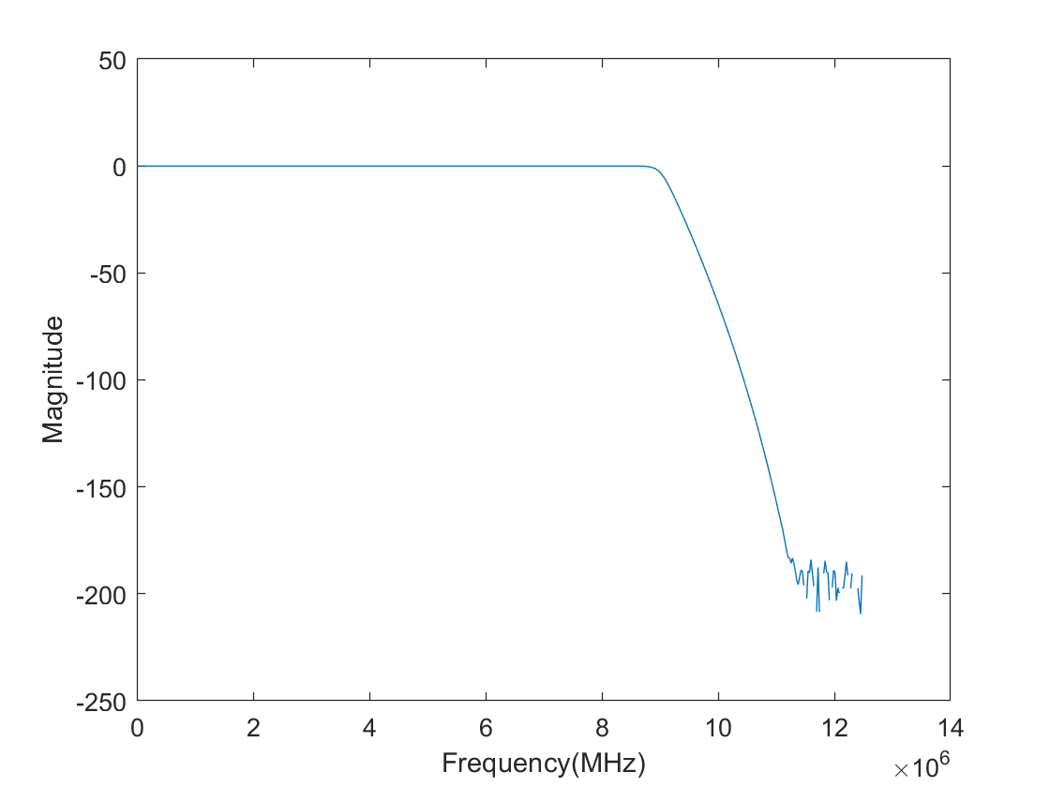
Validation of filters

Slide 8
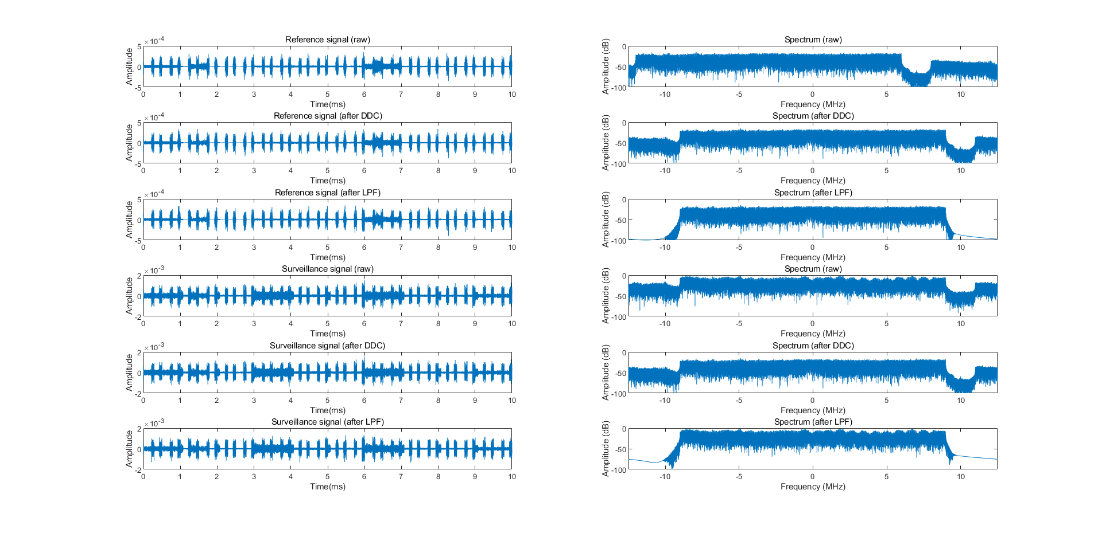
Original signal, frequency domain diagram and time domain diagram after frequency conversion and low pass filtering

Slide 9
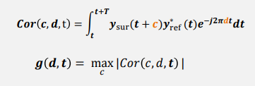
Task 3: Ambiguity function Process and Spectrum plotting
Procedure Introduction
Define the function
Calculate all possible value for the spectrum
Record the estimation of c and d for each data segment

Slide 10
Task 3: Ambiguity function Process and Spectrum plotting
Procedure Introduction
Convert the integral to summation
T = 0.5s
N = 12500000
Ts = 4 * 10^(-8) s
Vectorization to speed up
Plot

Slide 11
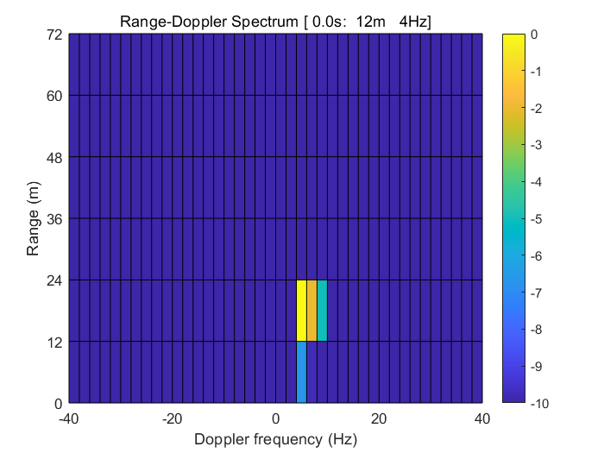
Task 3: Ambiguity function Process and Spectrum plotting
Spectrum display

Slide 12
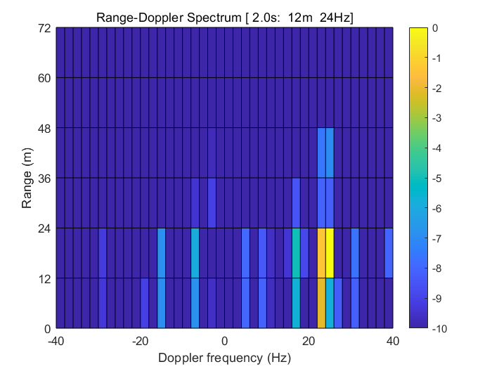
Task 3: Ambiguity function Process and Spectrum plotting
Spectrum display

Slide 13
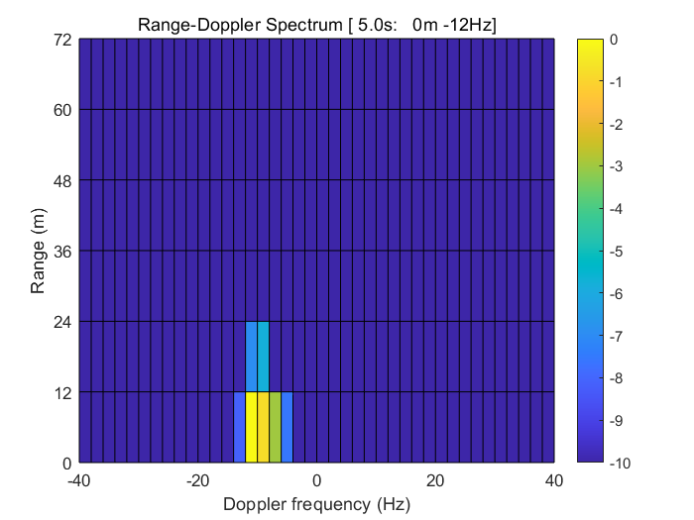
Task 3: Ambiguity function Process and Spectrum plotting
Spectrum display

Slide 14
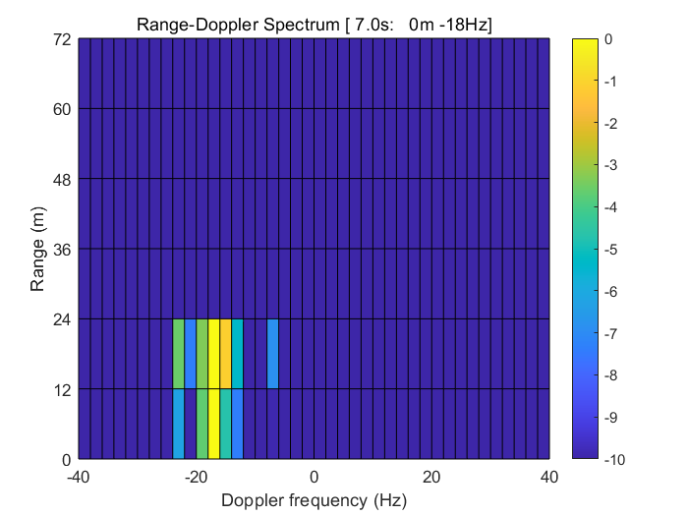
Task 3: Ambiguity function Process and Spectrum plotting
Spectrum display

Slide 15
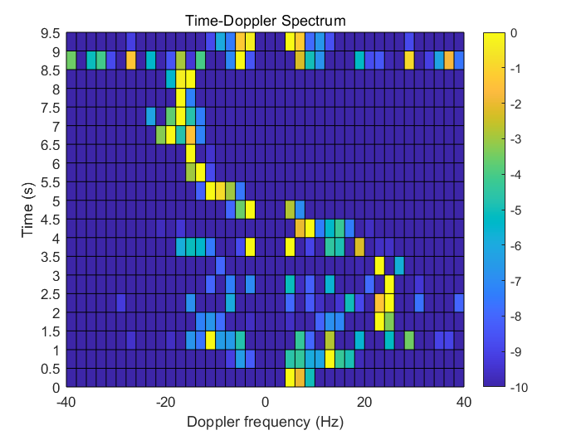
Task 3: Ambiguity function Process and Spectrum plotting
Spectrum display

Slide 16
Experience
Principles of passive radars
Vectorization
Conjugate transpose(.’ or transpose()) and nonconjugate transpose(’)

Slide 17
Thanks For Watching

