Slide 1
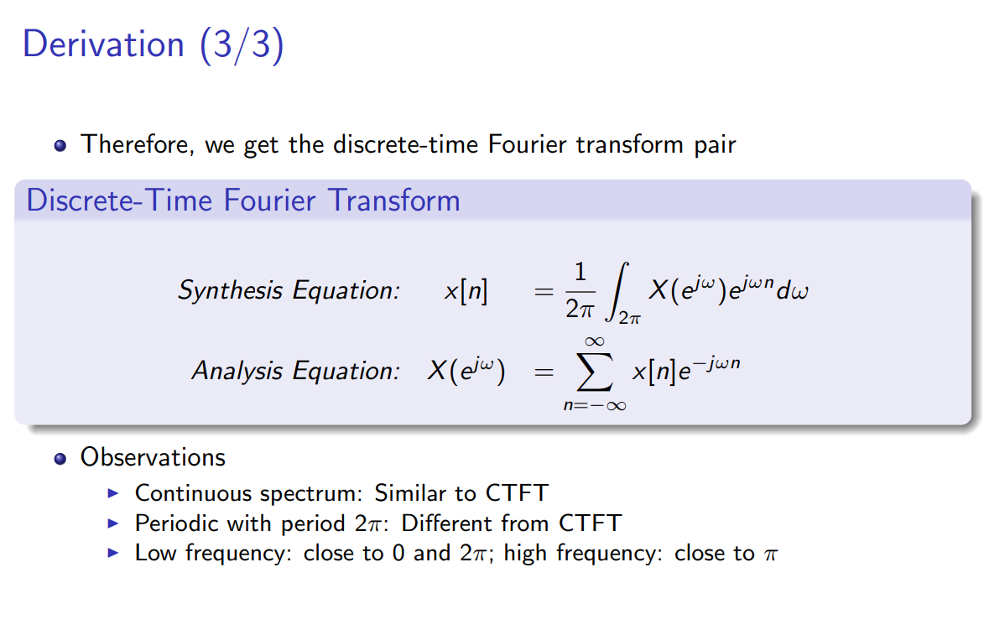

Slide 2
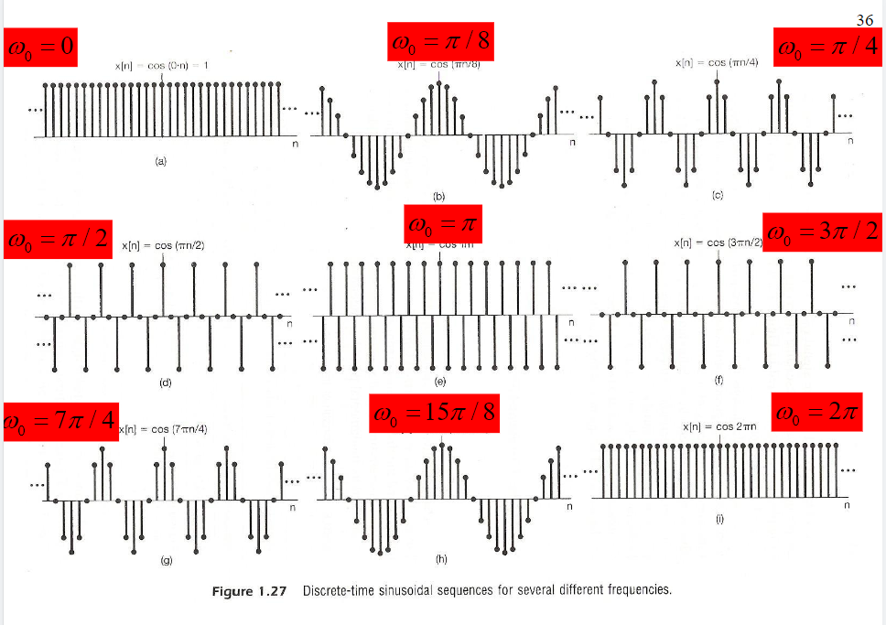
为什么pi是高频？

Slide 3
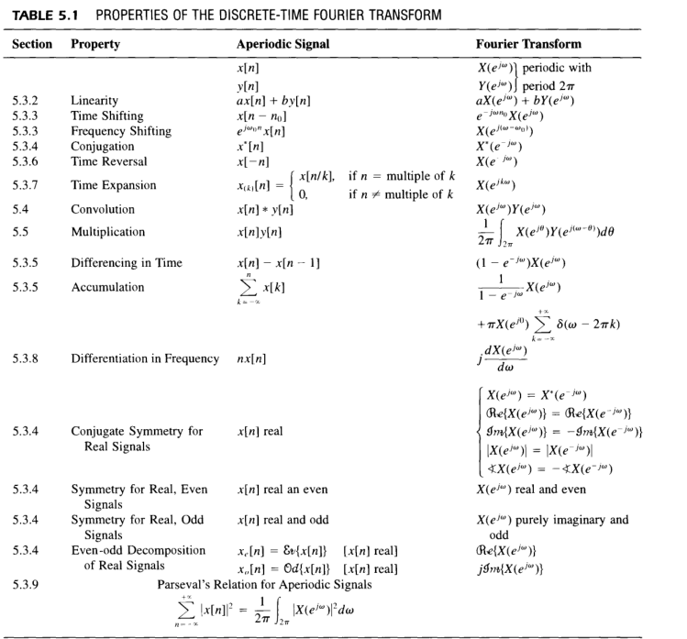

Slide 4
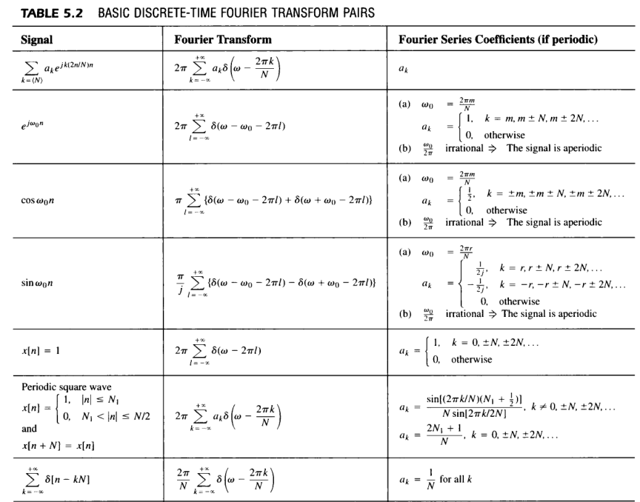

Slide 5
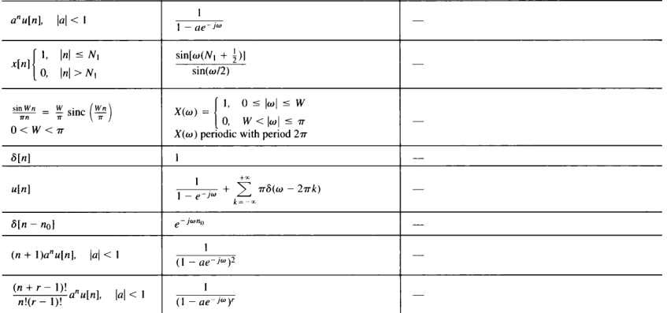

Slide 6



Slide 8




Slide 11


Slide 14
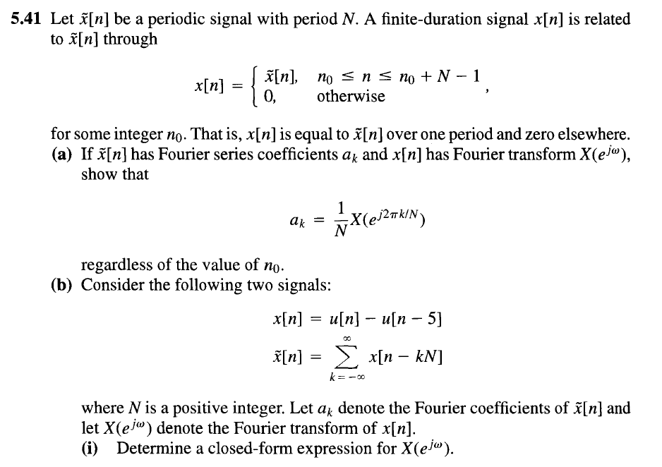

Slide 15
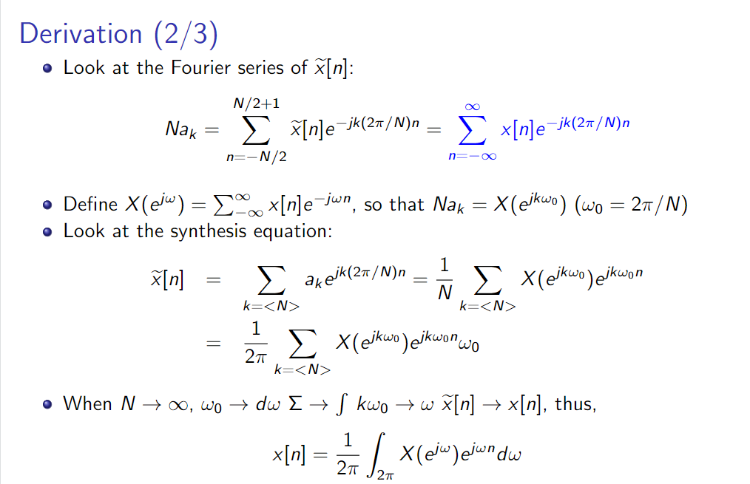

Slide 16
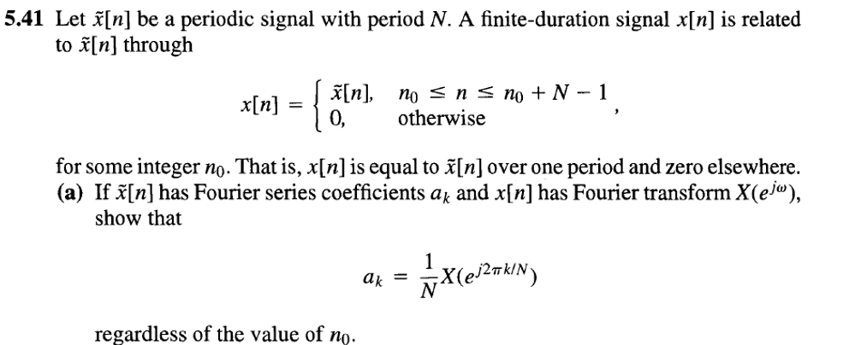

Slide 17
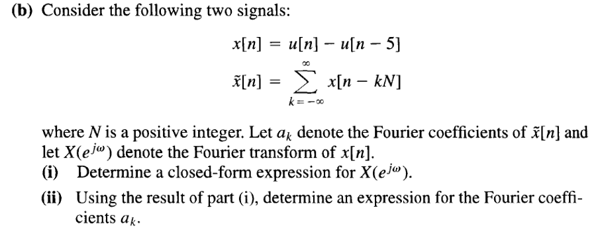
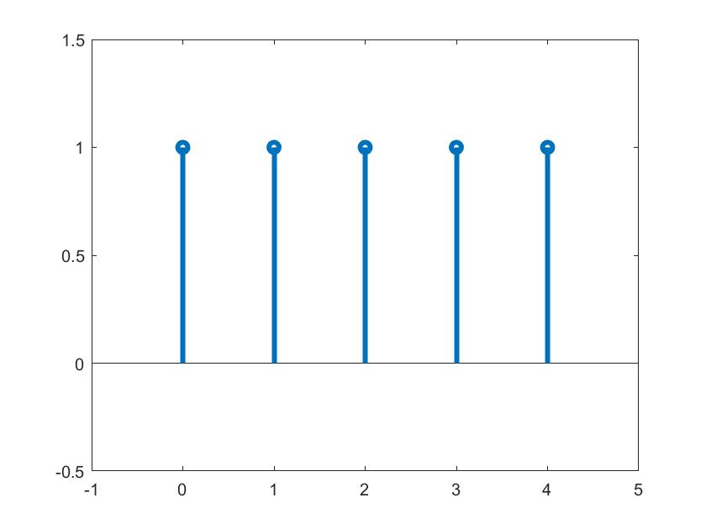

Slide 18



CTFS
CTFT
DTFS
DTFT

Slide 19
时域 频域
Continuous，periodic Discrete, aperiodic
Discrete，periodic Discrete, periodic
Continuous，aperiodic Continuous，aperiodic
Discrete，aperiodic Continuous，periodic

Slide 20
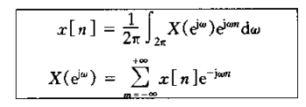
Problem 5.1

Slide 21

Answer 5.1

Slide 22
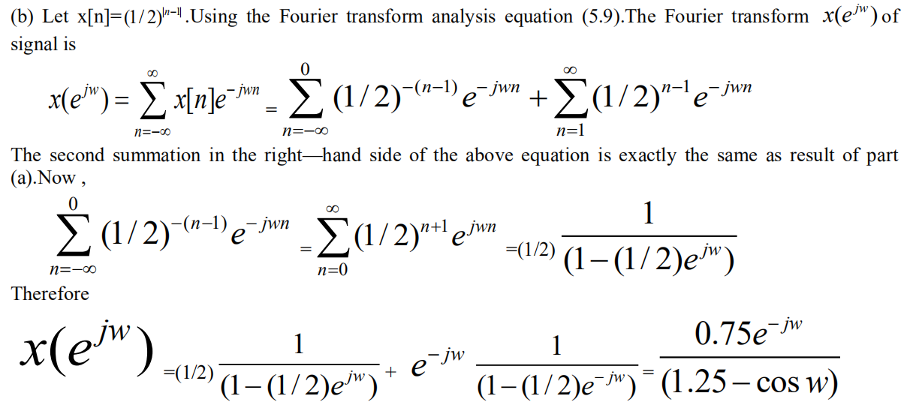
Answer 5.1

Slide 23

Problem 5.3

Slide 24

Answer 5.3

Slide 25
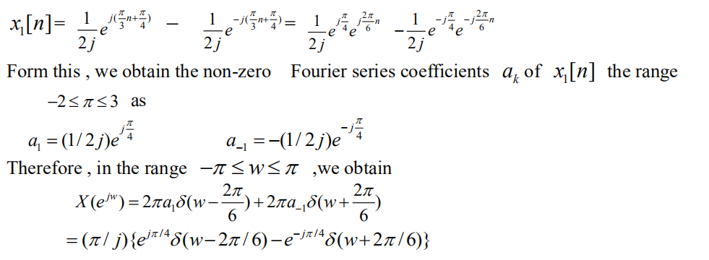
Answer 5.3

Slide 26
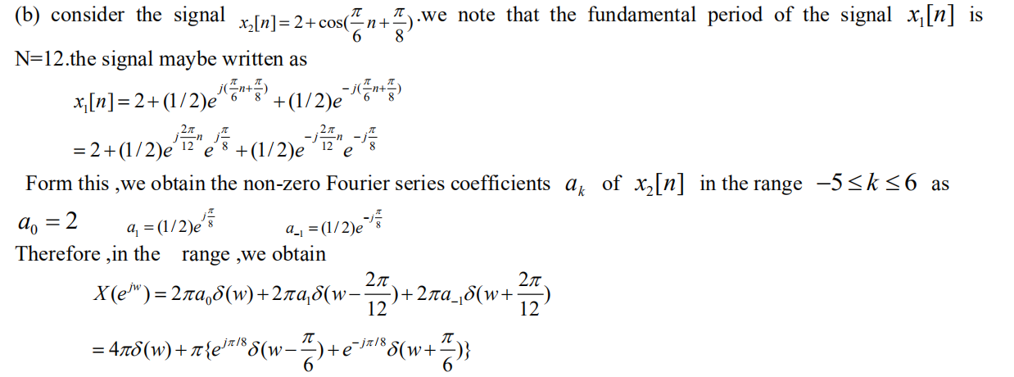
Answer 5.3

Slide 27

Problem 5.4

Slide 28
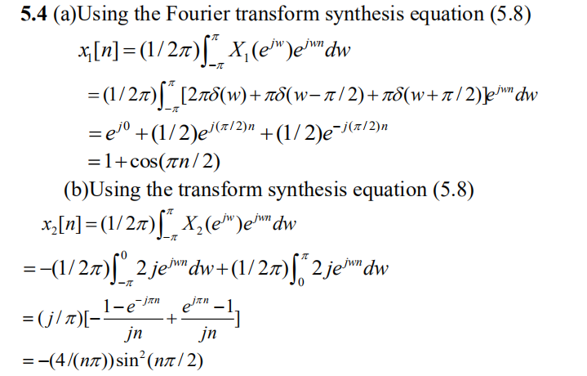
Answer 5.4

Slide 29
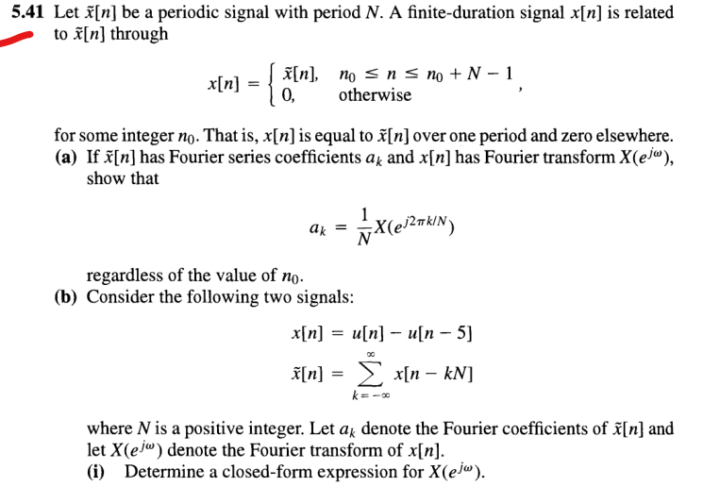

Problem 5.41

Slide 30


Problem 5.41

Slide 31
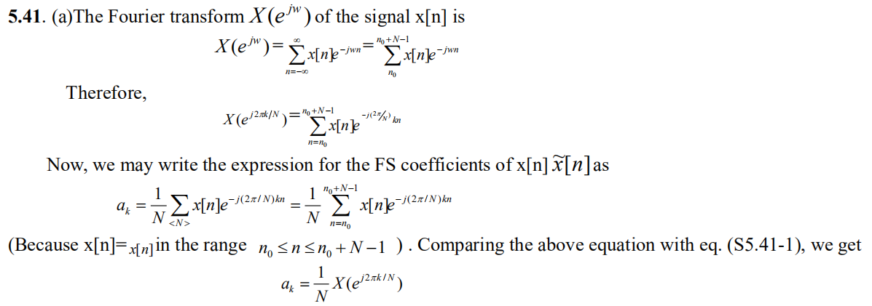
Answer 5.41

