Slide 1
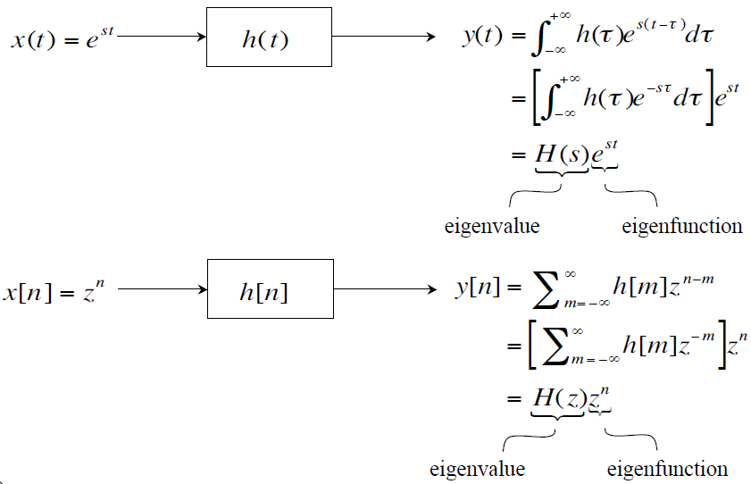
Two Special Signals for LTI Systems

Slide 2
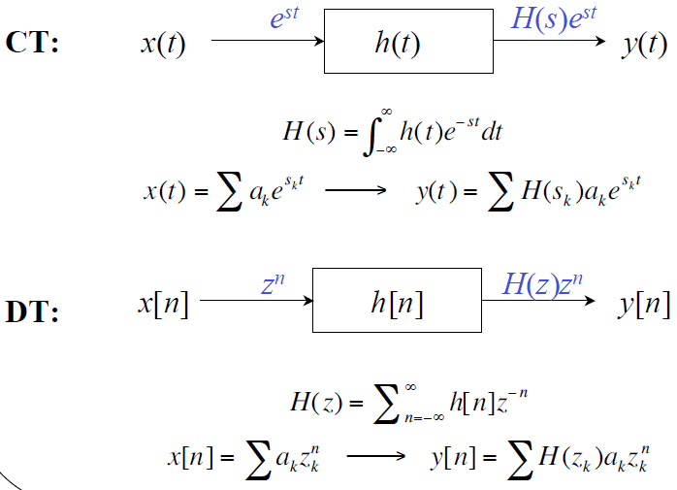
System Functions H(s) or H(z)

Slide 3

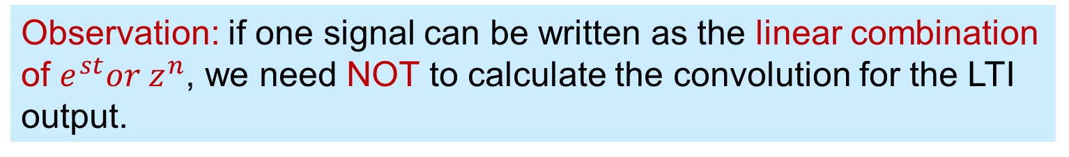

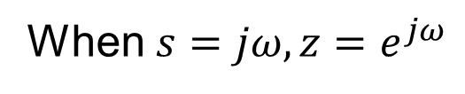
Fourier and Beyond
Observation: if one signal can be written as the linear combination of $e^{st}or z^{n}$, we need NOT to calculate the convolution for the LTI output.
When $s=jω, z=e^{jω}$
$$⇒ e^{jωt},e^{jωn}: Fourier Series$$
When s or z is general complex number
$$⇒Laplace Transform \& Z Transform$$

Slide 4
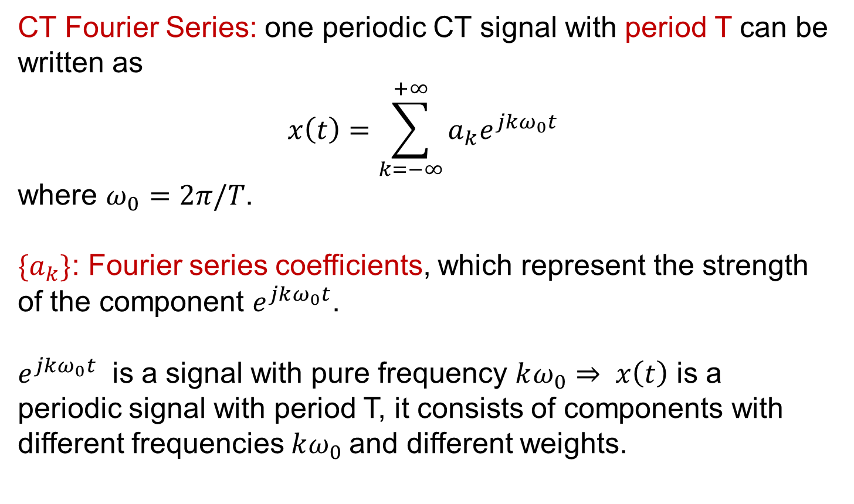
A “Special” Class of Periodic Signals
CT Fourier Series: one periodic CT signal with period T can be written as
$$x\left(t\right)=\sum_{k=−∞}^{+∞}{a_{k}e^{jkω_{0}t}}$$
where $ω_{0}=2π/T$.
$\{a_{k}\}$: Fourier series coefficients, which represent the strength of the component $e^{jkω_{0}t}$.
$e^{jkω_{0}t}$ is a signal with pure frequency $kω_{0}⇒ x\left(t\right)$ is a periodic signal with period T, it consists of components with different frequencies $kω_{0}$and different weights.

Slide 5

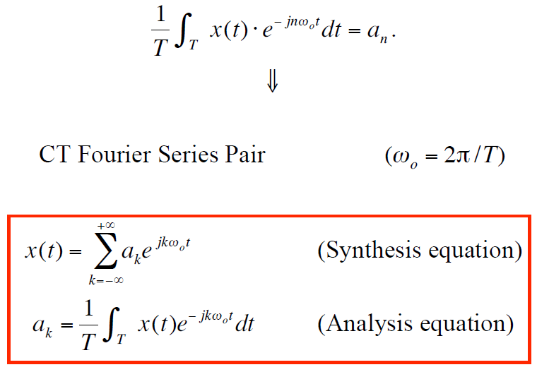
CT Fourier Series Pair

Slide 6
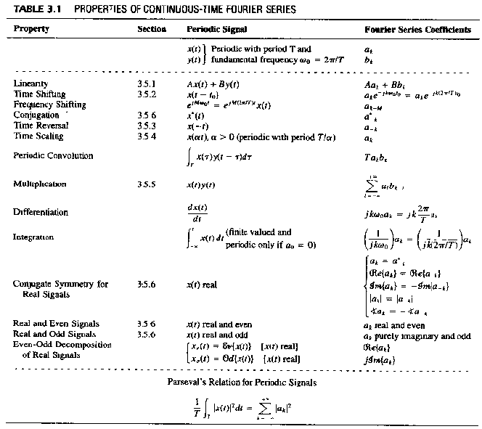

Slide 7
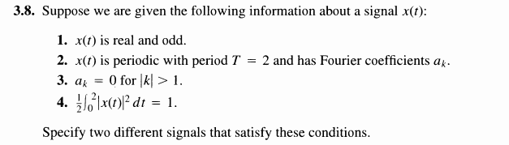
1
3.8

Slide 8
1
3.8

Slide 9
1
3.8

Slide 10
1
3.8

Slide 11
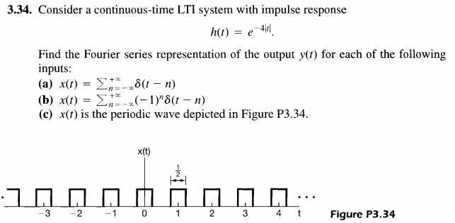
1
3.34

Slide 12
Two Special Signals for LTI Systems

Slide 13
System Functions H(s) or H(z)

Slide 14
1
3.34

Slide 15
1
3.34

Slide 16
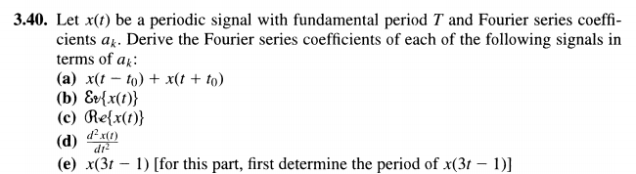
1
3.40

Slide 17
1
3.40

Slide 18
1
3.40

Slide 19
1
3.40

Slide 20
1
3.40

Slide 21
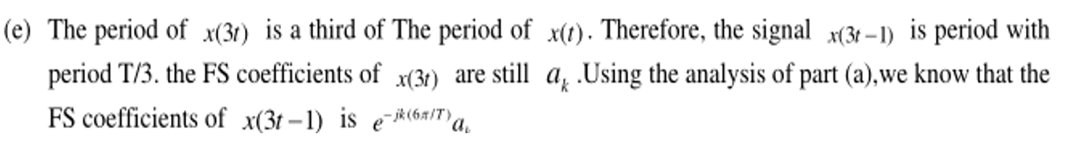
1
3.40

Slide 22
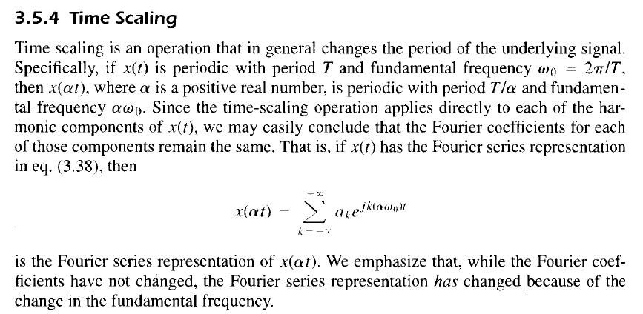
1
3.40

Slide 23
1
3.40

Slide 24
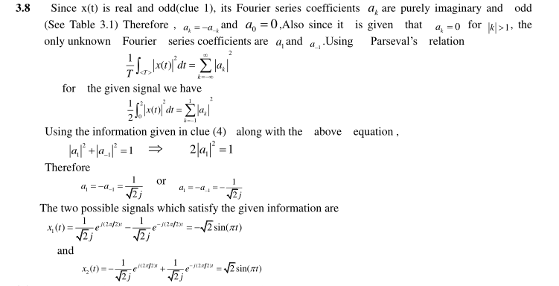
Answer 3.8

Slide 25
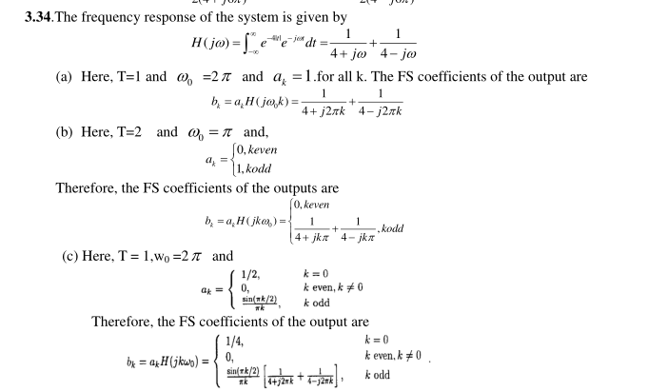
Answer 3.34

Slide 26
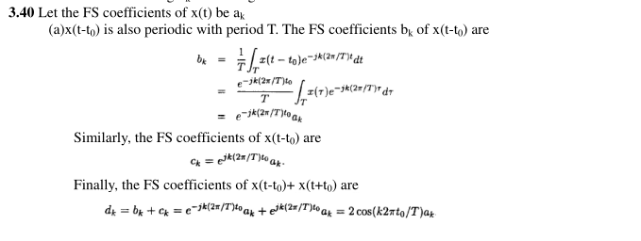
Answer 3.40

Slide 27
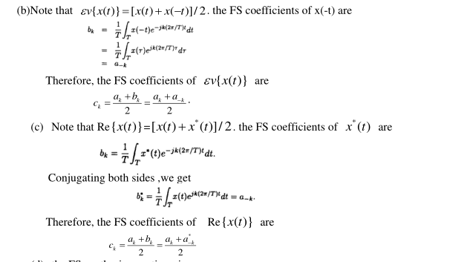
Answer 3.40

Slide 28
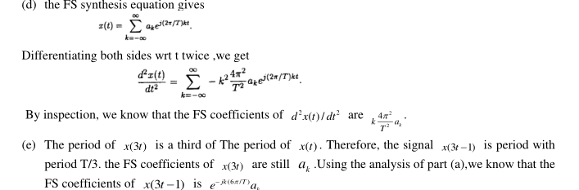

Answer 3.40
$${−k}^{2}w_{0}^{2}a_{k}$$

