Slide 1
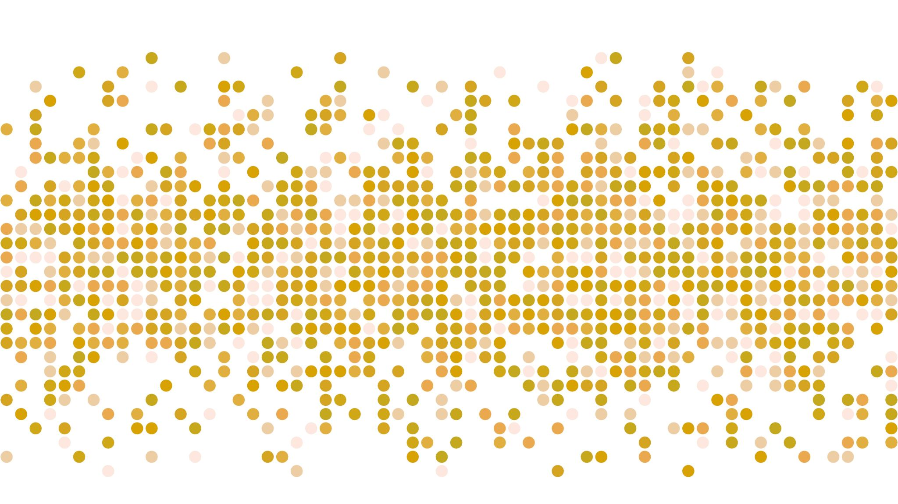
DECCRA

Slide 2
Problem statement
Create a platform for content creators to share all forms of media content to the world, and at the same thing share a connection with their fans and viewers.

Slide 3
Value propositions
Most forms of media can be uploaded and shared.
-> images, videos, books, audio files, etc.

