Slide 1

Environmental Influences on pathogen spillover in a multihost forest disease
Whalen Dillon | North Carolina State University
@dillott
IALE World Congress | July 6, 2015

Slide 2
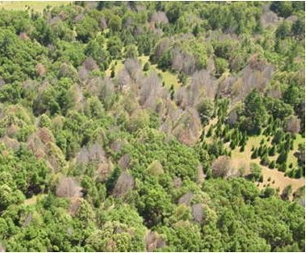
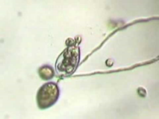
Sudden Oak Death (SOD)
Phytophthora ramorum (oomycete) - water mold
P. ramorum
SOD
Trees
&
Shrubs
California
Forests
Notes:
Emerging infectious forest disease
Moisture-dependent, temperature & light sensitive
Disease triangle
To examine the relationships between pathogen spillover, coexistence, and environmental heterogeneity I focus on the forest disease sudden oak death. It is caused by P. ramorum, which is moisture dependent, and sensitive to temperature and light.

Slide 3
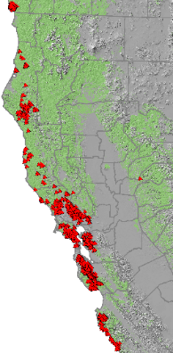
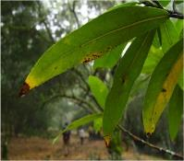
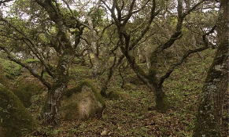
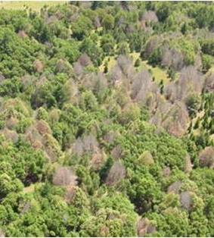

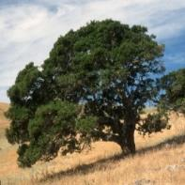
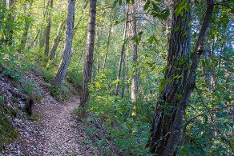

Sudden Oak Death
46 wildland host species (generalist) – 5 key host tree species
Notes:
Of particular importance are Coast live oak, California black oak, tanoak, and California bay laurel.
As the name suggests, the oak trees are killed by this disease, but that is only the beginning of the story because they do not effectively transmit the pathogen.
- They are “dead-end” hosts.
Transmission is predominantly driven by the foliar host California bay laurel, which does not suffer negative effects from infections.

Slide 4

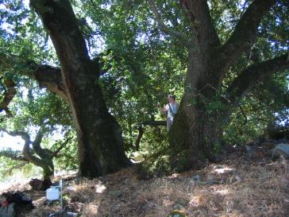
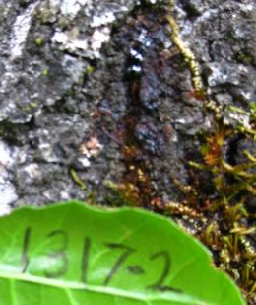

Pathogen Spillover (SOD)
“when disease epidemics are driven by transmission from an alternate reservoir host population” – Power & Mitchell (2004)
Notes:
The asymmetry in host competency for pathogen transmission can be described by pathogen spillover.
Spillover is a predicted characteristic of multihost disease systems (interspecific).
Interspecific vs. Intraspecific: intraspecific if there are individuals responsible for greater proportion of transmission events.
Reference: “Pathogen Spillover in Disease Epidemics” Am. Nat.

Slide 5

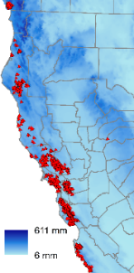
Research Question
How does environmental variation in space & time influence pathogen spillover?
611mm
6mm
Notes:
I aim to examine how aspects of the environment influence pathogen spillover. In other words, how do environmental conditions, such as the temperature, rainfall, and local plant community, directly and indirectly affect pathogen reproduction and subsequent infection and mortality of oak species across the landscape?

Slide 6
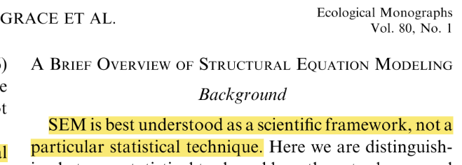
Analytical Framework - SEM
Structural Equation Modeling
Notes:
SEM is better thought of as a scientific framework rather than a specific statistical technique.
“for when causal questions can’t be answered with randomized experiments” – Shipley 2004
Explicitly relates observation to theory.
It may be used to conceptualize and test a comprehensive set of hypotheses about a system in either a confirmatory or exploratory effort.

Slide 7
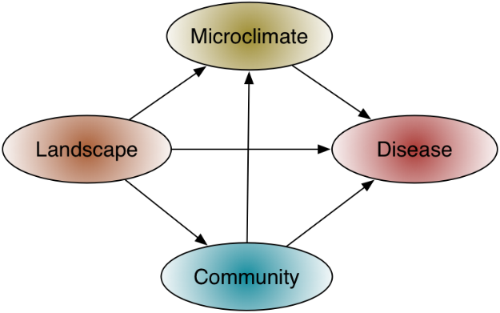
SEM Framework
Notes:
Structural equation meta-model conceptualizing the relationships among theoretical constructs that influence infection and spillover in the SOD system.
Using this approach I aim to discern the direct, indirect, and total effect of the observed environment across hierarchical levels.
For example, a characteristic of the landscape may have a direct effect on disease, and also an indirect effect through microclimate and community.
The total effect is composed of the direct and indirect effects.

Slide 8
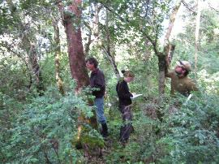
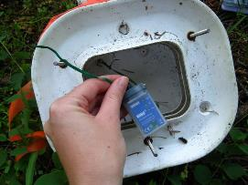
Data - Spillover
Disease monitoring plots
Ecology
Microclimate
Notes:
200 15mx15m plots visited annually during April-May 2004-2012, and most recently in 2014 across 275-square-km area.
This is typically near the end of California’s wet season. Measure disease on bay laurel via counts of leaves with characteristic symptoms, and on oaks via visual inspection for cankers.
These are reasonable but imperfect indicator metrics of disease because we may always have some observation error.

Slide 9
Path Model – Spillover
Defines hypotheses
(independence claims)
Number of hours between 14-20 C
Spillover
Test independence claims: C-statistic (Shipley 2000, 2004, 2009)
Notes:
The path model is a directed acyclic graph, and so based on graph theory it defines a set of independence claims. In short, any measurements that do not have an arrow directly between them are claimed to be independent conditional on the other measurements that are directly connected to each of the variables in the independence set. Enables testing each claim with appropriate model. If the C-statistic is not significantly different from a chi-square distribution with 2k degrees of freedom, then the data fits with the structure of the causal model.

Slide 10
Path Model – 2005 Data
0.02
-0.03
-0.31
-0.37(ns)
-0.39
-0.05
Spillover
0.71
-0.05
-0.05
-0.02(ns)
-0.33(ns)
-0.04(ns)
(59/1141 infected)
Notes:
Path coefficients are all scaled to a mean of zero and standard deviation of 1, so the effects may be interpreted relative to each other

Slide 11
Path Model – 2014 Data

Slide 12
Path Model – 2014 Data
Fails C-test

Slide 13
Path Model – 2014 Data

Slide 14
Path Model – 2014 Data
-0.01
-0.05
-0.16
0.47
-0.14(ns)
-0.18
0.10
0.20
0.36
-0.39
-0.07
-0.05
-0.03(ns)
-0.02(ns)
-0.13(ns)
(139/1241 infected)

Slide 15
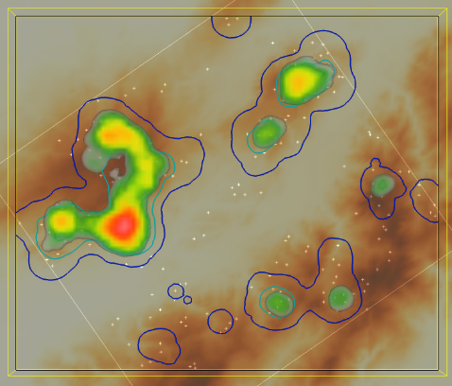
Pathogen Hotspots
N
N
N
Notes:
Because of the characteristics of the system we would expect there to be variation in disease intensity across the landscape and through time, resulting in hot spots where disease is high, and other locations were disease is low or absent. Visualization of disease intensity (symptomatic leaf counts) on bay laurel in space and time. This lends support to further examination of how the environment is influence pathogen spillover from bay laurel to oak. Since P. ramorum is sensitive to environmental factors and California bay laurel is the host that would be driving spillover we would expect that infection intensity would vary across the landscape, resulting in hot spots of infection.

Slide 16



Pathogen Spillover & Coexistence
Spillover to dead end hosts (mortality) may increase reservoir host abundance
Notes:
This would apparent competition brought on by the pathogen, a destabilizing effect on what is presumably the current coexistence of these species. The community could be sent on a new (or at least different) successional trajectory. We have observed some evidence for shifts in the dominant species of forest communities infested by P. ramorum. (The case of pathogen mediated apparent competition? Examples of “destabilization” might especially be found at the ecotones of communities characterized by dominant species)

Slide 17


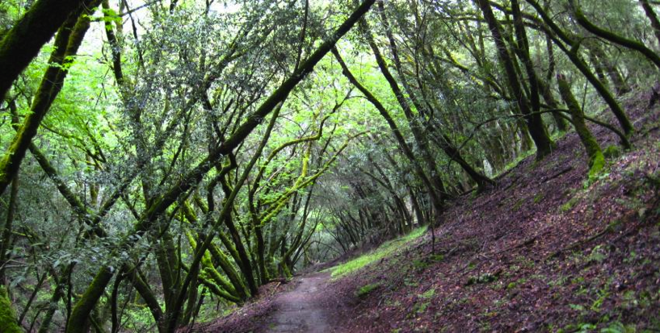
Questions…?
wwdillon@ncsu.edu

Slide 18

Assessing Model Fit – C-statistic
Notes:
Combine the k probabilities into the C-statistic:
C=-2i=1k ln(Pi)
Compare this C-statistic to a χ2 distribution with 2k degrees of freedom (12 in this case). If the model fit according to this test is sufficient (i.e. p > 0.05), then the coefficients from the multiple regression models may be applied to the appropriate paths.
1. The strength of a compound path is the product of coefficients along that path.
2. The total effect one variable has on another equals the sum of its direct and indirect effects through directed (causal) pathways
d-sep test can not be applied to models that include latent variables (no probability estimate for unmeasured variables)

