Slide 1
David Whale
Computer Programmer
Inventor
Book Author

Slide 2
How many computers in your house?
?

Slide 3
How many computers in your house?
PC, Mac, Laptop, Tablet, Raspberry Pi?

Slide 4
How many computers in your house?
PC, Mac, Laptop, Tablet, Raspberry Pi?
Mobile phones?

Slide 5
How many computers in your house?
PC, Mac, Laptop, Tablet, Raspberry Pi?
Mobile phones?
Smart TV?

Slide 6
How many computers in your house?
PC, Mac, Laptop, Tablet, Raspberry Pi?
Mobile phones?
Smart TV?
Things with a display?

Slide 7
How many computers in your house?
PC, Mac, Laptop, Tablet, Raspberry Pi?
Mobile phones?
Smart TV?
Things with a display?
Things without a display?

Slide 8
How many computers in your house?
PC, Mac, Laptop, Tablet, Raspberry Pi?
Mobile phones?
Smart TV?
Things with a display?
Things without a display?
How many computers inside each product?

Slide 9
How many computers in your house?
PC, Mac, Laptop, Tablet, Raspberry Pi?
Mobile phones?
Smart TV?
Things with a display?
Things without a display?
How many computers inside each product?
What is a computer?

Slide 10
How many computers in your house?
PC, Mac, Laptop, Tablet, Raspberry Pi?
Mobile phones?
Smart TV?
Things with a display?
Things without a display?
How many computers inside each product?
What is a computer?
Is a mouse a computer? Keyboard? Memory stick?

Slide 11
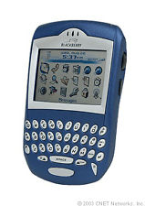
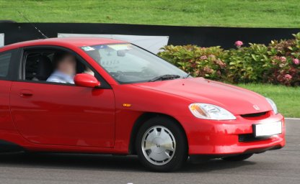
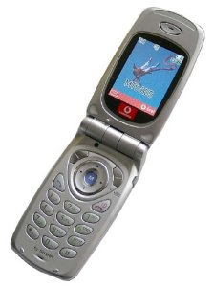
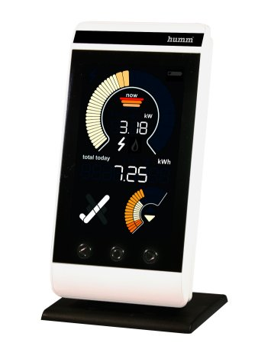
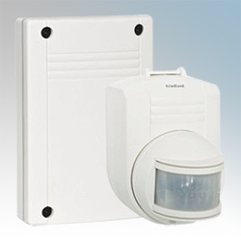
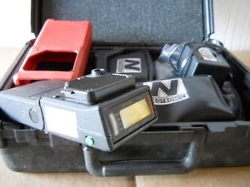
Some inventions I helped with
first blackberry!
wow!

Slide 12

Look who did the advertising?

Slide 13
Coding in 3 easy steps
1...2...3...

Slide 14
1. Sequence
Put up your LEFT hand
Put up your RIGHT hand
Put down BOTH hands

Slide 15
2. Selection
if you have brown hair:
  put up any hand for 1 second
put down your hand

Slide 16
3. Loops
until I say stop:
  clap twice
  wait 1 second

Slide 17
Who likes computer games
?

Slide 18

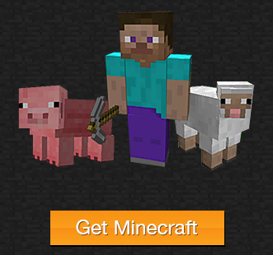
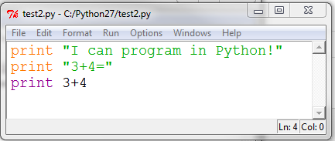
Minecraft Programming
+

