Slide 1

Weronika Halicka
Capstone Project - The Battle of Neighborhoods

Slide 2
Goal of the project
To help people planning to open a new restaurant in Toronto to chose the right location by:
providing data about the income
providing data about the population of each neighborhood
providing data about the competitors already present in the same regions

Slide 3
Collecting Data
To assure best results the Toronto's 2016 Census that contains Population, Average income per Neighborhood was combined with Toronot's Neighborhoods shapefile and Foursquare API
https://www.toronto.ca/city-government/data-research-maps/open-data/open-data-catalogue/#8c732154-5012-9afe-d0cd-ba3ffc813d5a
https://www.toronto.ca/city-government/data-research-maps/open-data/open-data-catalogue/#a45bd45a-ede8-730e-1abc-93105b2c439f

Slide 4
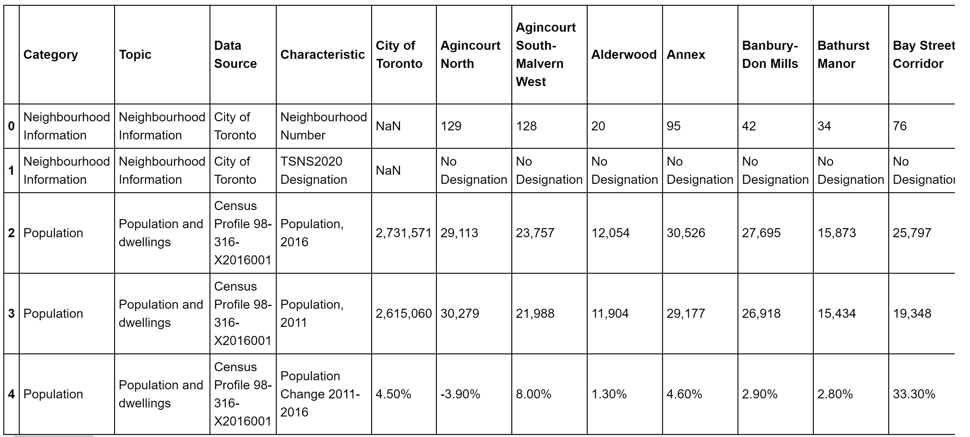
Toronto's 2016 Census

Slide 5
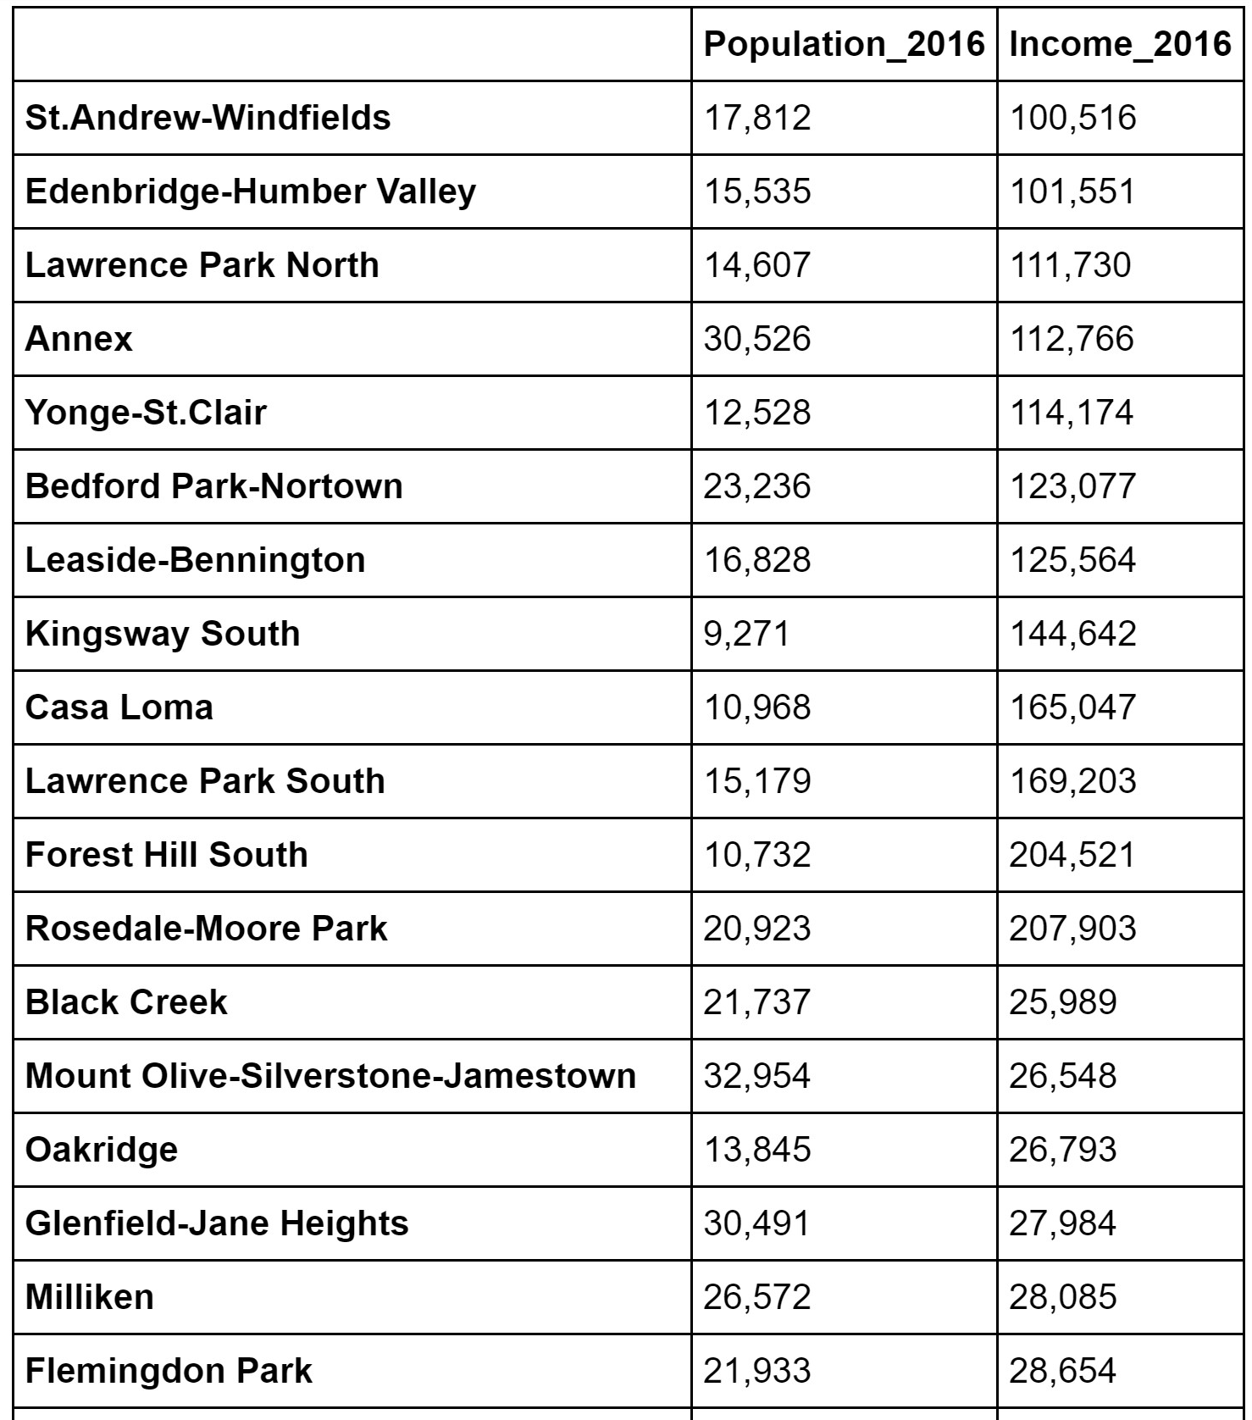
Methodology
Created income, population table for each neighborhood to see which are the best to open new restaurant.

Slide 6
Conclusion
Most of the restaurants grouped on main streets.
The areas with a dense population don't reflect on the number of restaurants.
This project may be helpful for someone planning on opening a restaurant in Toronto.
However, it may not cover all variables such as access to public transportation.

