Slide 1

Predicting emerging variants in Influenza by assessing new metrics using GISAID and FluNet metadata
Data cleaning and pre-processing of GISAID and FluNet metadata to acquire ‘#FluNet_Cases/#GISAID_Samples’ as a new feature
Implementing moving window technique with window_size = ‘200D’ and monthly snapshots (applying dynamic smoothing to be plotted in line-graphs)
Automatic pipeline (crontab) to extract up-to-date FluNet metadata in the script
Wilbert Nathaniel Halim
(Supervisor: Raphael Tze Chuen Lee)
Biomolecular Sequence to Function Division – Protein Sequence Analysis Group

Slide 2
OBJECTIVES
Estimate the total burden of influenza cases, sourced from GISAID’s sampling database that is more sensitive in picking up variants (based on genomic sequence and represented by unique ‘EPI_ISL_’ or accession IDs), highlighting phenotypically relevant features that affect the viral fitness.
Concatenating with FluNet’s metadata (from WHO website) that detects the number of cases and sequences submitted for each mutations/variants in Influenza
All scripts and .tsv files are saved within ‘analysis_script’ directory and ‘README.txt’ that contains the step-by-step methodology/script’s documentation. ‘crontab_commands.txt’ contains the documented commands to activate the automated pipeline for crontab (in generating the most updated database and plotted graphs)
To assess and add new feature ‘#FluNet_Cases/#GISAID_Samples’ into the neural network ‘MLPClassifier (scikit-learn 1.7)’ - to optimize the prediction of emerging variants.
GISAID’s Column
$thisAccession\t$currIsolatename\t$currCollectiondate\t$currLocation\t$currCountry\t$currCountryCode\t$currContinent\t$currLatitude\t$currLongitude\t$combineMuts\t$currSubmissiondate\t$currCovClade\t$currLineage\t$currOrigLab\t$currSubmLab\t$currSubmLabAddr\t$currSeqTech\t$currAssemblyMethod\t$currHost\t$currGender\t$currPatientAge\t$currPatientStatus\t$currLastVaccinated\t$currSamplingStrategy\t$currAddLocationInfo\t$currAddHostInfo\t$currLocationOri\t$currIsComplete\n
FluNet’s Column
WHOREGION | FLUSEASON | HEMISPHERE | ITZ | COUNTRY_CODE | COUNTRY_AREA_TERRITORY | ISO_WEEKSTARTDATE | ISO_YEAR | ISO_WEEK | MMWR_WEEKSTARTDATE | MMWR_YEAR | MMWR_WEEK | ORIGIN_SOURCE | SPEC_PROCESSED_NB | SPEC_RECEIVED_NB | AH1N12009 | AH1 | AH3 | AH5 | AH7N9 | ANOTSUBTYPED | ANOTSUBTYPABLE | AOTHER_SUBTYPE | AOTHER_SUBTYPE_DETAILS | INF_A | BVIC_2DEL | BVIC_3DEL | BVIC_NODEL | BVIC_DELUNK | BYAM | BNOTDETERMINED | INF_B | INF_ALL | INF_NEGATIVE | ILI_ACTIVITY | ADENO | BOCA | HUMAN_CORONA | METAPNEUMO | PARAINFLUENZA | RHINO | RSV_PROCESSED | RSV | OTHERRESPVIRUS | OTHER_RESPVIRUS_DETAILS | LAB_RESULT_COMMENT | WCR_COMMENT | ISO2 | ISOYW | MMWRYW | PSOURCE_SUBTYPE_INF | PSOURCE_PPOS_INF | PSOURCE_RSV

Slide 3
OUTPUT FILES (.TSV)
GISAID_Country | FluNet_Country | Collection_Year_Month | Flunet_ISO_WEEK_STARTDATE | #GISAID_Samples | #FluNet_Cases | #FluNet_Cases/#GISAID_Samples | 200_days_#FluNet_Cases/#GISAID_Samples | Smoothed_#FluNet_Cases/#GISAID_Samples | 200_days_smoothed_#FluNet_Cases/#GISAID_Samples | Yearly_Median_#FluNet_Cases/#GISAID_Samples | Accession_IDs
‘GISAID_Country’ and ’FluNet_Country’ shows the standardized format and naming of successfully mapped countries
‘Collection_Year_Month’ is sourced from gisaid_df[‘currCollectiondate’] that is converted/mapped according to the ISO_WEEK calendars (complying to all the ‘Monday’ date regulations to determine the week and month of which the sequence is being collected); going from 2015-07 until 2025-07, with a monthly interval and is structured sequentially
‘FluNet_ISO_WEEKSTARTDATE’ sourced from FluNet’s dataset directly
‘#GISAID_Samples’ and ‘#FluNet_Cases’ are the monthly aggregates (or summation) of samples and cases for each month
‘#FluNet_Cases/#GISAID_Samples’ sets as the ratio of monthly aggregates of each component (raw values) and ‘Smoothed_#FluNet_Cases/#GISAID_Samples’ is when the smoothing value of 0.3 is applied
’200_days_#FluNet_Cases/#GISAID_Samples’ ONLY differs in the aggregates that take the LAST DATE of each month, calculating the weekly aggregates which covers -200 days from the LAST DATE of each month, and averaging these 30+ data points into a singular value
‘Accession_IDs’ ensures that there are no IDs that are repeated on a different ‘Collection_Year_Month’ and it ONLY appear once, unique for each timeframe and its number that MUST match the value shown in ‘#GISAID_Samples’

Slide 4
METHODOLOGY
Develops the automatic pipeline to extract the ’VIW_FNT.csv’, renamed to ‘flunet_metadata.tsv’ from the WHO’s FluNet website (using ‘requests’ library to send HTTP requests via Python script).
Properly defining and reading the files: gisaid_file is mapped to ‘accession2metadata.tsv’, flunet_file is mapped to ‘flunet_metadata.tsv’, and output_dir to create your own directory (for output files).
Defining the ‘window_size_days: int = 200, years_back: int = 10’ which refers to the 200-days sliding window technique being implemented throughout the 10 years back (from datetime.now()).
Extracting ONLY the string values of country names and standardizing them to remove any whitespaces and for all letters/words to be in lowercase – for GISAID and FluNet database.
Handling the remaining unmapped countries (with manual mappings). Maps FluNet’s countries to standardized names and GISAID’s countries that are specifically mapped to the standardized versions (mapped 174 countries, inclusive of the 20+ manually mapped countries)
Exception: ‘Hong Kong (SAR)’ and ‘Palestinian Territory’ in GISAID that cannot be mapped in FluNet (due to error in reading/identifying ‘China Hong Kong (SAR)’ and ‘Occupied Palestinian Territory including East Jerusalem’ respectively.
‘unmapped_countries.tsv’ contain all the unmapped countries (from both database) due to incompatible location resolutions or inaccurate file reading.

Slide 5
METHODOLOGY
6) Country mappings with >= 70% accuracy is saved to ‘high_accuracy_country_mappings.tsv’ and is involved in the calculation for the new metric. ‘low_accuracy_country_mappings.tsv’ and ‘unmapped_country.tsv’ are omitted.
Formula:
(len(gisaid_words.intersection(flunet_words)) / len(flunet_words) – by splitting the ‘gisaid_country’ and ‘flunet_country’ into words for comparison
7) Implementing moving windows by standardizing the ‘end_date’ to always be the last day of THIS month, going from 2025-07, 2025-06, ... (with a monthly snapshot) that spans over 10 years from the present day.
8) Mapping GISAID into FluNet’s subtype with the pre-requisite of ‘currHost’ == ‘Human’ and emphasis on:
FluNet’s ‘AH1N12009’ is all mapped to GISAID’s ‘A/H1N1’ by the assumption that all A/H1N1 is caused by the AH1N1pdm2009, ‘A/H3N2’ in GISAID that constitutes to almost the entire set (~95%) of ’AH3’ in FluNet – with undetermined neuraminidase, and ‘B/Victoria’ to ‘BVIC’.
All subtypes in FluNet are primarily transmitted to and by humans, making the dataset compatible with GISAID’s.
9) Converts gisaid_df[‘currCollectiondate’] to ‘ISO_WEEKSTARTDATE’ (from FluNet) by taking into account the week of which the Monday belongs to in the case of overlapping months i.e. end-June and early-July.
The ‘Collection_Year_Month’ in the output_file is reflective of this conversion.

Slide 6
METHODOLOGY
10) Output files contain the monthly aggregation (have no overlaps of ‘Accession_IDs’ – unique for each ‘Collection_Year_Month’ and matches with the number ‘#GISAID_Samples’ recorded in that specific month.
‘#FluNet_Cases/#GISAID_Samples’ are recorded only for the monthly snapshot, without the treatment of a sliding moving sized 200-days.
‘Accession_IDs’ are extracted directly from gisaid[‘thisAccession’].startswith(‘EPI_ISL_’) that is made as the parameter to verify the proper logic of the script to pre-process the GISAID’s database.
11) Group the data by weeks (ISO_WEEKSTARTDATE) - map out the gisaid_df → calculate the ratio of each week → compute the mean of these 30+ weeks (within -200 days from the LAST date of the month)
The ratio of '#FluNet_Cases/#GISAID_Samples' over 30+ weeks or 30+ rows (starting from the last date of each month to -200 days in the past) - with monthly snapshot | window_size = '200D', frequency = 'M'
The '200_days_#FluNet_Cases/#GISAID_Samples' contain the raw values of the average whereas the '200_days_smoothed_#FluNet_Cases/#GISAID_Samples' contain the smoothed values (with dynamic alpha, either 0.3 or 0.5).
Include the scikit-learn’s regression metrics ONLY for the 200-days sliding window technique.

Slide 7
METHODOLOGY
12) flunet_df ['BNOTDETERMINED'] and gisaid_df['currLineage':'B’] are added into the '#FluNet_Cases' and '#GISAID_Samples' for B/Victoria and B/Yamagata (or BVIC and BYAM).
**Used the proportion of B/Victoria and B/Yamagata in GISAID's database over 60 days (window_size = '60D’).
The additional '#FluNet_Cases' from 'BNOTDETERMINED' is classified/added into both 'BVIC' and 'BYAM' depending on the proportion/ratio of gisaid_df['B/Victoria'] and gisaid_df['B/Yamagata'] over 60 days → only to get the ratio/proportion
Sum/add the additional FluNet's cases and GISAID's samples to the pre-existing ones in the ''#FluNet_Cases' and '#GISAID_Samples' columns which still aggregate the total cases and samples which belong to each month | apply the 200-days sliding window per usual
i.e. if '#FluNet_Cases' == 10 and gisaid_df['currLineage': 'B/Victoria'] == 0.7 and gisaid_df['currLineage': 'B/Yamagata'] == 0.3, then 7 additional #FluNet_Cases belong to BVIC and 3 belong to BYAM
‘output_columns’ – (columns in output_file)
['GISAID_Country', 'FluNet_Country', 'Collection_Year_Month', 'Flunet_ISO_WEEK_STARTDATE’, '#GISAID_Samples', '#FluNet_Cases', '#FluNet_Cases/#GISAID_Samples’, '200_days_#FluNet_Cases/#GISAID_Samples’, 'Smoothed_#FluNet_Cases/#GISAID_Samples', '200_days_smoothed_#FluNet_Cases/#GISAID_Samples’, 'Yearly_Median_#FluNet_Cases/#GISAID_Samples', 'Accession_IDs’]
13) Used dynamic values to apply smoothing to raw values produced from (1) monthly aggregates and (2) 200-days sliding windows – (default – 0.3).
Library: pandas.DataFrame.ewm, with alpha = 0.3

Slide 8
METHODOLOGY
14) Crontab & Automated HTTP Retriever
Applied ‘0 0 1 * * python3 /HOME_ann/BII/biihalimwn/analysis_scripts/trial_documented_revised_all_country_script.py >> /HOME_ann/BII/biihalimwn/analysis_scripts/cron_output.log 2>&1as the command, which automatically run the script on a monthly basis, exactly at 00:00 on the first day of each month
‘cron_output.log’ is the terminal, reflecting all the extracted values and script’s progress (easier to backtrack the errors/debugging)
‘crontab_commands.txt’ contains all the manuals to use crontab on Linux (MobaXTerm) / Mac (Terminal)
To automatically run the plotter script, ‘weighted_location_plotter_smoothed.py’, such steps are applied – used crontab.guru website to ease the visualization of date, month, year, time formatting on crontab.

Slide 9
METHODOLOGY – PLOTTING
15) ‘weighted_location_plotter_smoothed.py’ is applied separately (after all the output_files are imported into the output_dir - being read and processed as ‘*_all_countries.tsv’
The plotted line-graphs are saved in separate .png files for those with and without the 200-days sliding window technique (as indicated in the y-axis label)
Each .png file contain the plotted graphs of raw and pre-smoothed values from ‘output_columns’
This script prevents re-applying smoothing technique (with alpha = 0.3)
x-axis is used to represent the time window, ranging from 2015-07 until 2025-07 (freq=‘M’)
Incorporates accuracy metrics, with reports saved as ‘*_summary_statistics.tsv’ and ‘trend_analysis_report_smoothed.txt’
Used ‘np.argmax()’ which are: ‘np.min()’ and ‘np.max()’ on relevant columns to acquire true min/max values – the usage of ‘scipy.signal.find_peaks()’ failed to identify the single, highest value of y-axis (for each country). Added separate storage for the peak data in both, raw and smoothed values
Added country labels next to the rightmost datapoint (using the last x, y coordinate) by using ‘ha = left’ alignment and provide space in the sub-plot margins (‘plt.subplots_adjust(right=0.85)’)
Legend shows the absolute maximum peak coordinates for y-axis with formatting: “Country (YYYY-MM), ‘max_value’)”
Attempts to fix the unwanted data scaling issue (in the visualization, where the data points in y-axis are bigger in magnitude in comparison to the input files) – removes the NaN values before calculation and sets more precise limits ‘ax.set_ylim(max(0, y_min_exact - y_margin), y_max_exact + y_margin)’
Omit the country, labelled as ‘Unknown’, in the plotted line graphs
Each subtype shows the number of countries shown/plotted in the graph (‘trends_analysis_report_smoothed.txt’)
Modify the figure size and resolution
fig, (ax_raw, ax_smooth) = plt.subplots(2, 1, figsize=(18, 14), sharex=True, dpi=60)

Slide 10
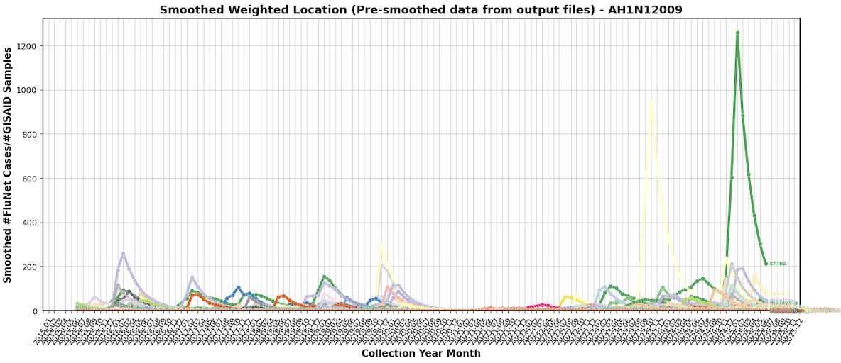
RESULTS – AH1N12009 (Monthly Snapshot)
China (2025-02, 1259.54)
Iran (2023-11, 946.63)

Slide 11
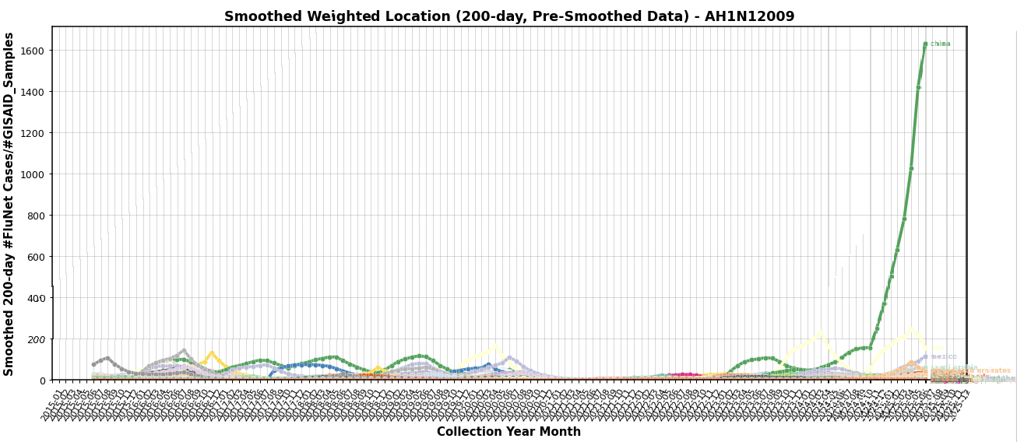
RESULTS – AH1N12009 (200-Days Moving Window Technique)
China (2025-07, 1632.34)
Iran (2025-05, 244.85)

Slide 12
ANALYSIS – AH1N12009
Monthly Snapshot
GISAID_Country | FluNet_Country | Collection_Year_Month | Flunet_ISO_WEEK_STARTDATE | #GISAID_Samples | #FluNet_Cases | #FluNet_Cases/#GISAID_Samples | 200_days_#FluNet_Cases/#GISAID_Samples | Smoothed_#FluNet_Cases/#GISAID_Samples | 200_days_smoothed_#FluNet_Cases/#GISAID_Samples | Yearly_Median_#FluNet_Cases/#GISAID_Samples | Accession_IDs
china | china | 2025-02 | 2025-02-24 | 8.0 | 22311.0 | 2788.875 | 820.5303309785736 | 1259.5439036141074 | 503.96260330573386 | 0.0 | EPI_ISL_19898116,EPI_ISL_19898117,EPI_ISL_19898118,EPI_ISL_19898119,EPI_ISL_19898127,EPI_ISL_19898128,EPI_ISL_19898129,EPI_ISL_19898130
iran | iran | 2023-10 | 2023-10-30 | 2.0 | 3007.0 | 1503.5 | 122.5 | 524.7500513159127 | 56.13266890023606 | 0.0 | EPI_ISL_18798273,EPI_ISL_18798274
200-Days Moving Window Technique
china | china | 2025-07 | 2025-07-28 | 0.0 | 82.0 | 0.0 | 2126.0555555555557 | 211.691543880423 | 1632.3353836250978 | 0.0
iran | iran | 2025-05 | 2025-05-26 | 0.0 | 31.0 | 0.0 | 330.0 | 39.557950510851946 | 244.8465638747987 | 0.0
*The collective average of 30+ data points (weekly basis) or equivalent to -200 days before the end date of 2025-07 and 2025-05 in China and Iran respectively, have particularly shown that the GISAID sampling is severely under-represented with respect to the upsurging case counts (detected by FluNet) – marked by the ‘#GISAID_Samples’ = 0

Slide 13
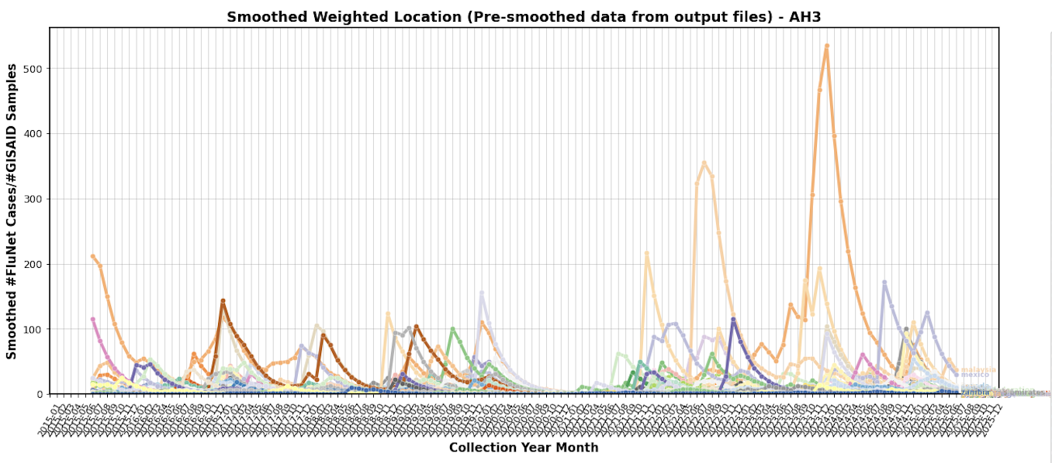
RESULTS – AH3 or A/H3N2 (Monthly Snapshot)
China (2024-01, 535.46)
Malaysia (2022-08, 354.91)

Slide 14
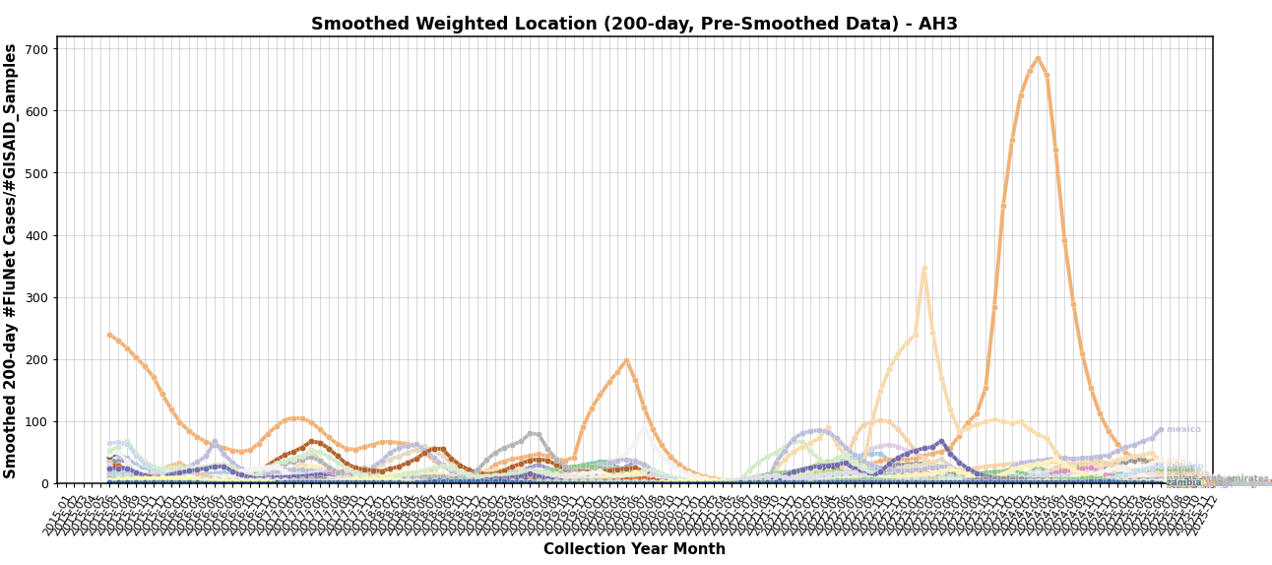
RESULTS – AH3 or A/H3N2 (200-Days Moving Window Technique)
China (2024-05, 684.93)
Iran (2023-04, 347.25)

Slide 15
ANALYSIS – AH3 (A/H3N2)
Monthly Snapshot
GISAID_Country | FluNet_Country | Collection_Year_Month | Flunet_ISO_WEEK_STARTDATE | #GISAID_Samples | #FluNet_Cases | #FluNet_Cases/#GISAID_Samples | 200_days_#FluNet_Cases/#GISAID_Samples | Smoothed_#FluNet_Cases/#GISAID_Samples | 200_days_smoothed_#FluNet_Cases/#GISAID_Samples | Yearly_Median_#FluNet_Cases/#GISAID_Samples | Accession_IDs
china | china | 2024-01 | 2024-01-29 | 30.0 | 20898.0 | 696.6 | 828.5921786249081 | 535.4556745608235 | 446.83172529390896 | 31.680555555555557 | EPI_ISL_18851508,EPI_ISL_18851540,EPI_ISL_18851541,EPI_ISL_18851542,EPI_ISL_18851543,EPI_ISL_18851544,EPI_ISL_18851545,EPI_ISL_18851546,EPI_ISL_18851547,EPI_ISL_18851548,EPI_ISL_19150980,EPI_ISL_19150981,EPI_ISL_19150984,EPI_ISL_19290969,EPI_ISL_19290970,EPI_ISL_19290972,EPI_ISL_19377021,EPI_ISL_19377024,EPI_ISL_19609695,EPI_ISL_19609696,EPI_ISL_19609697,EPI_ISL_19609698,EPI_ISL_19609699,EPI_ISL_19609700,EPI_ISL_19609701,EPI_ISL_19718438,EPI_ISL_19786486,EPI_ISL_19898144,EPI_ISL_19898145,EPI_ISL_19898146
malaysia | malaysia | 2022-08 | 2022-08-29 | 2.0 | 859.0 | 429.5 | 164.5 | 354.9135928113332 | 72.88625402439297 | 8.31111111111111 | EPI_ISL_16613694,EPI_ISL_16613695
200-Days Moving Window Technique
china | china | 2024-05 | 2024-05-27 | 18.0 | 605.0 | 33.611111111111114 | 734.8709037300655 | 163.69795771846393 | 684.931505028218 | 31.680555555555557 | EPI_ISL_19291246,EPI_ISL_19291252,EPI_ISL_19291257,EPI_ISL_19291304,EPI_ISL_19373950,EPI_ISL_19373952,EPI_ISL_19373987,EPI_ISL_19373988,EPI_ISL_19373989,EPI_ISL_19373990,EPI_ISL_19373992,EPI_ISL_19373993,EPI_ISL_19373994,EPI_ISL_19373995,EPI_ISL_19373996,EPI_ISL_19373997,EPI_ISL_19373998,EPI_ISL_19609706
iran | iran | 2023-04 | 2023-04-24 | 0.0 | 56.0 | 0.0 | 600.0 | 11.86954574521805 | 347.24639733239144 | 0.0
*'China’ is mutually under-sequenced with significantly lower values of ‘#GISAID_Samples’ in comparison to the #FluNet_Cases that blew up for both, (1) monthly snapshot and (2) 200-days moving window technique
*Further analysis can be done by excluding these outliers (causing significant fluctuations) in countries such as: China, Malaysia (does not show significant peaks in the 200-days), and Iran (with 0.0 sampling being done) from 2023-04 to -200 days prior

Slide 16
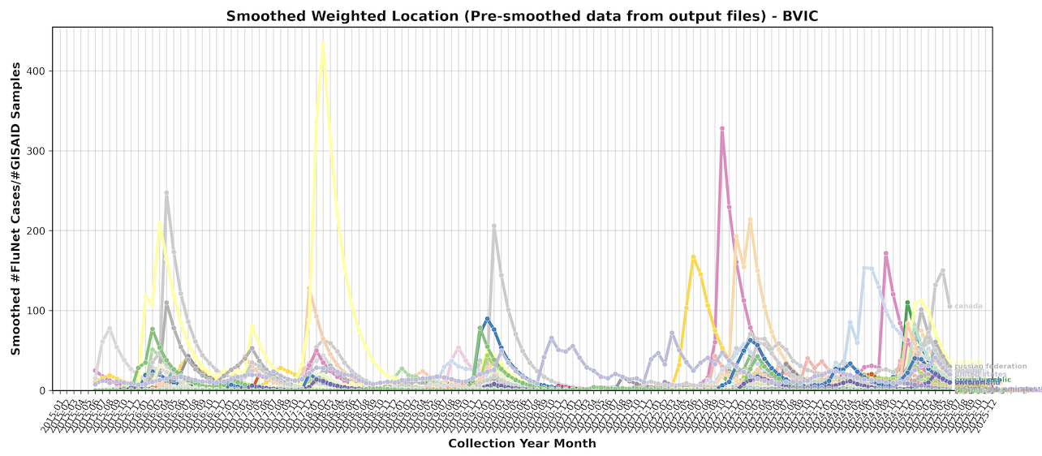
RESULTS – BVIC (Monthly Snapshot)
Norway (2018-03, 433.23)
Argentina (2022-11, 328.15)
Belgium (2023-03, 214.32)

Slide 17
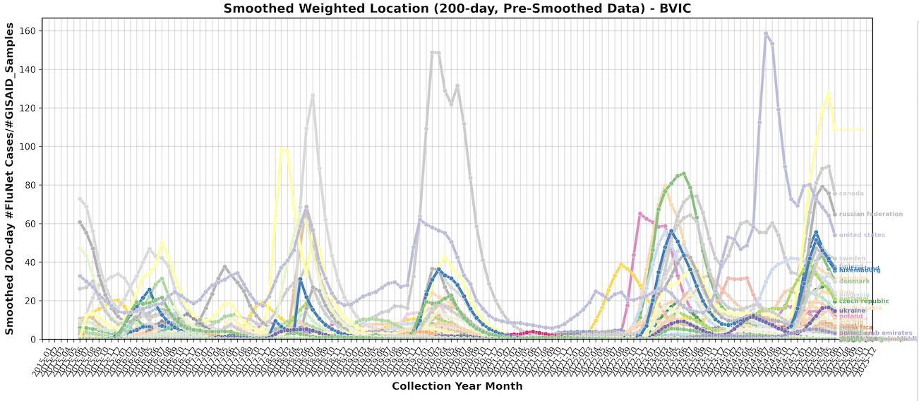
RESULTS – BVIC (200-Days Moving Window Technique)
United States (2024-08, 158.66)
Canada (2020-03, 148.79)
Norway (2025-06, 127.66)

Slide 18
ANALYSIS - BVIC
Monthly Snapshot
GISAID_Country | FluNet_Country | Collection_Year_Month | Flunet_ISO_WEEK_STARTDATE | #GISAID_Samples | #FluNet_Cases | #FluNet_Cases/#GISAID_Samples | 200_days_#FluNet_Cases/#GISAID_Samples | Smoothed_#FluNet_Cases/#GISAID_Samples | 200_days_smoothed_#FluNet_Cases/#GISAID_Samples | Yearly_Median_#FluNet_Cases/#GISAID_Samples | Accession_IDs
norway | norway | 2018-03 | 2018-03-26 | 2.0 | 1320.4285714285713 | 660.2142857142857 | 179.8472222222222 | 433.23211178117833 | 98.64142029617842 | 0.25 | EPI_ISL_310861,EPI_ISL_315496
argentina | argentina | 2022-11 | 2022-11-28 | 3.0 | 2859.0 | 953.0 | 104.60313479623825 | 328.14616570175644 | 43.641143502790776 | 0.0 | EPI_ISL_16761702,EPI_ISL_16761704,EPI_ISL_16761741
belgium | belgium | 2023-03 | 2023-03-27 | 1.0 | 353.0 | 353.0 | 108.77312271062269 | 214.3163975049299 | 69.9179389151953 | 0.0 | EPI_ISL_18167410
200-Days Moving Window Technique
canada | canada | 2020-03 | 2020-03-30 | 5.0 | 3128.0 | 625.6 | 240.83617684694227 | 206.1017757872268 | 148.78530207784289 | 0.0 | EPI_ISL_467810,EPI_ISL_471650,EPI_ISL_471651,EPI_ISL_471652,EPI_ISL_471660
united states | united states | 2024-08 | 2024-08-26 | 11.0 | 121.0 | 11.0 | 266.5097237784476 | 12.87378765896235 | 158.65661691081013 | 10.595238095238095 | EPI_ISL_19448274,EPI_ISL_19448349,EPI_ISL_19448352,EPI_ISL_19471793,EPI_ISL_19495919,EPI_ISL_19495926,EPI_ISL_19539043,EPI_ISL_19539044,EPI_ISL_19591549,EPI_ISL_19668970,EPI_ISL_19787456
norway | norway | 2025-06 | 2025-06-30 | 0.0 | 26.0 | 0.0 | 148.52745514611277 | 50.191219837771854 | 127.6634887616097 | 69.0
*Norway is mutually the outlier (for the monthly snapshot and 200-days moving window), can be omitted for future analysis (generates more stable trends from other countries). In the 200-days, Norway displayed 0.0 ‘#GISAID_Samples’, making it severely under-represented
**’Accession_IDs’ has no repetitions (or only have unique values appearing once in 1 ‘Collection_Year_Month’ due to it being mapped to the monthly snapshot calculation/logic. The 200-days moving window will have overlapping ‘Accession_IDs’

Slide 19
OVERALL ANALYSIS
Out of 163 countries (excluding ‘Unknown’) that are plotted in the line-chart:
AH1N12009 is composed of 161 countries, with China, Iran, and Mexico receiving the highest value of smoothing treatment (in order)
AH3 is composed of 156 countries, with Iran, Malaysia, and China receiving the highest value of smoothing treatment (in order)
BVIC is composed of 152 countries, with Argentina, Canada, and Norway receiving the highest value of smoothing (in order)
These countries are seen with significant peaks and frequent fluctuations with respect to the remaining countries (analyzed under the same sub-type).
Need to optimize the script, 'weighted_location_plotter_smoothed.py’, including the remaining ‘high_accuracy_country_mappings.tsv’ that roughly have ~174 countries in comparison to the 163 counterpart being used
This is attributed to how the ~174 “high accuracy” countries that are supposedly mapped and factored into the global calculation, were not registered or extracted in the output files – impacting the line-chart to only show the 163 countries as the maximum value/scope
Possible to look into FluNet’s database and check for the inconsistent spelling/syntax that affect a few countries not properly read by the automated script
For 200-days sliding window technique, refrain from using the collective summation of cases/samples over 200-days. Instead, use the average of each collection weeks (~30+ weeks or 200+ days from the current date) and calculate the global average of these data points (resulting in 1 singular value for 1 ’Collection_Year_Week’

Slide 20
FUTURE IMPROVEMENTS
Location Analysis (Higher Resolution & Accuracy)
currCountry, currLocation (Province/City - third-level location data) across different countries (in proportion to the population size) by detecting how many currLocation belong to the same country (1 country contain how many locations in GISAID's database | compare it to FluNet’s)
USAGE: To find the weighted_location to better normalize the #GISAID_Samples from different countries (which have varying locations i.e. city/province within each country and the population density/count of these countries)
NOTION: More accurate estimator to quantify how widespread the emerging mutations of Influenza in comparison to the sampling/sequence counts, which may be over- or under-represented for some countries, and significantly less biased
Proposed Logic:
Administrative Divisions of Country: https://www.geopostcodes.com/administrative-divisions/ - compare with the number of ‘currLocation’ (sourced from the identical ‘currCountry’ in ‘accession2metadata.tsv’)
Population Tracker By Countries:
https://www.worldometers.info/world-population/population-by-country/ (less accuracy - based on scientific findings, 2025) - exported in html
https://databank.worldbank.org/reports.aspx?source=2&series=SP.POP.TOTL&country=# (WHO, last updated: 2024) - exported in .csv file
Proposed Formula #1:
Weighted_Location = Population_Size (categorized by each country) / #GISAID_Locations (# locations in GISAID's database)
Normalization Technique:
scikit-learn – ‘normalizing function’: https://scikit-learn.org/stable/modules/generated/sklearn.preprocessing.normalize.html
Putting labels such as: 'over-represented' and 'under-represented' if:
Over-represented: gisaid_df['currLocation'] in countries > #Actual_Locations (directly sourced from geopostcodes)
Under-represented: gisaid_df['currLocation'] in countries < #Actual_Locations

Slide 21
FUTURE IMPROVEMENTS
The next step is to predict the emerging variants of Influenza using the metrics of: (1) ratio of #FluNet_Cases and #GISAID_Samples (for both, monthly snapshots and 200-days sliding window technique) and (2) ‘weighted_location’ – quantifying the normalization factor that needs to be multiplied with the ratio (for better accuracy and higher resolution of locations being used, not limited by countries but tertiary-level locations within the countries).
Implement the neural network, scikit-learn (‘MLPClassifier’)
https://scikit-learn.org/stable/modules/generated/sklearn.neural_network.MLPClassifier.html
Modify the script ‘EV_classification_train_MLP_100runs.py’ in assessing the new metric of ’#FluNet_Cases/#GISAID_Samples’
Achieve predictions that nears the value of 1.0 (using sklearn.metrics – accuracy_score)
OTHERS
Run the crontab on a more robust computational networks. Access by:
ssh annnode7
qsub -I -l nodes=annnode7

Slide 22
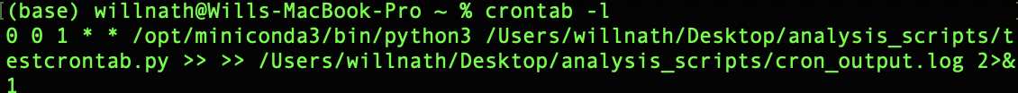
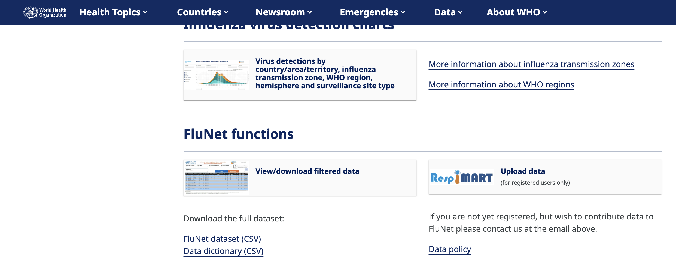
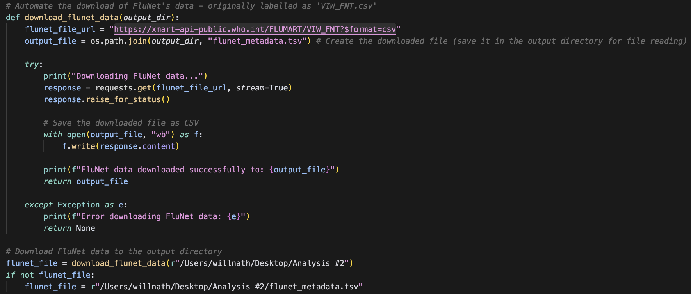
AUTOMATIC PIPELINE
Crontab command/settings – to automate running the script on the 1st date of every month (00:00)
Displayed in MacBook’s Terminal (directory needs to be modified)
WHO’s FluNet - ‘ FluNet dataset (CSV)’ (https://xmart-api-public.who.int/FLUMART/VIW_FNT?$format=csv)
Automated script to download the uploaded file (.CSV) in the website – making the ‘flunet_file’ for analysis updated every month

