Slide 1
Project Presentation
Notes:
<numéro>

Slide 2
What questions did we answer ?
Dimensionality ( number of features ) affect on performance for certain classification algorithms
Overfitting and regularization techniques
Underfitting and model complexity
Notes:
<numéro>

Slide 3
Dimensionality
Notes:
<numéro>

Slide 4
Synthetic data : create 3 realistic datasets of different dimensionalities
The algorithms : a neural network, logistic regression and randomForest classifier
Split the data and fit it to the models
How did we evaluate the performance ?
Notes:
<numéro>

Slide 5
Evaluation techniques
Skickit Learn classification reports (f1-score)
ROC curves ( TP rate vs FP rate )
What did we learn from the results ?
Notes:
<numéro>

Slide 6
First results
Neural networks adapt the best to the dimensionality
5/10 features is better to generalize than 15/30
Non-important features affect the model drastically
LogisticRegression is the most sensitive to « dimensional noise »
The curse of dimensionality is real
Notes:
<numéro>

Slide 7
Dimensionality reduction techniques
Briefly, we can classify them into two categories :
Feature Selection : delete non-important features
Feature Extraction : high-dimensional space to a lower one
Notes:
<numéro>

Slide 8
Question 03 :
How does model complexity impact the underfitting?
How did we proceed?
Two models : RandomForest and Neural Network
03 configurations for the RandomForest
02 configurations for the Neural Network

Slide 9
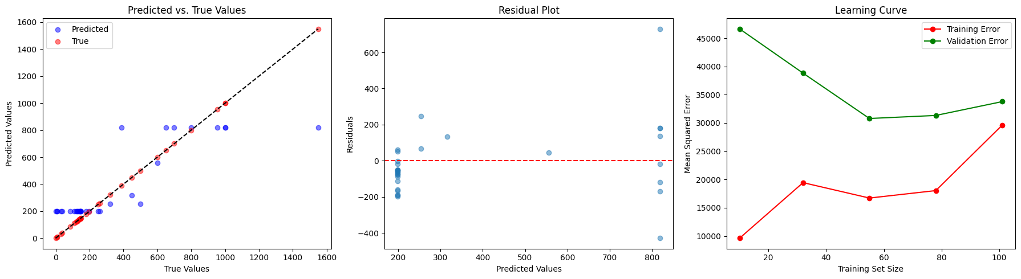
Random Forest
Configuration 01 :
Estimators : 10
Maximum depth : 1
Random state : 5

Slide 10
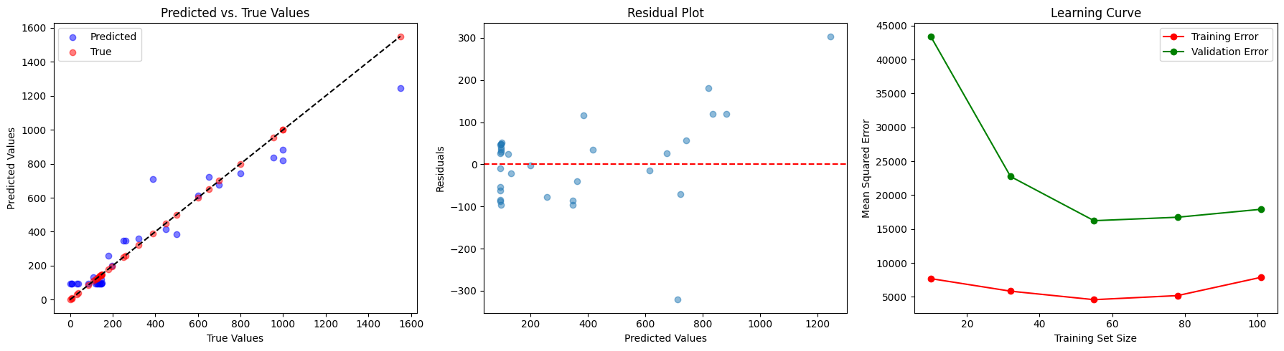
Random Forest
Configuration 02:
Estimators : 100
Maximum depth : 2
Random state : 42

Slide 11
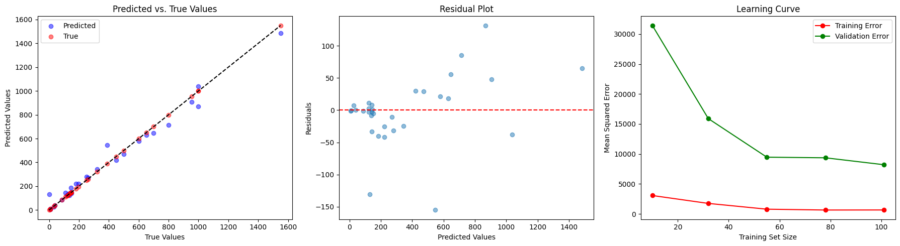
Random Forest
Configuration 03:
Estimators : 500
Maximum depth : 15
Random state : 42

Slide 12
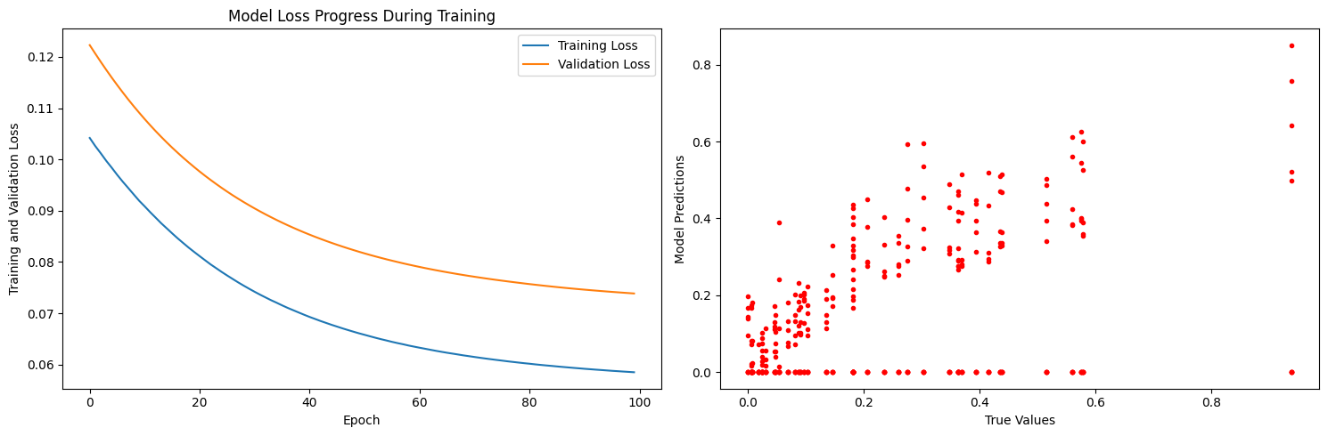
Neural Network
Configuration 01 :
Hidden layer : 1
Neurons: 10

Slide 13
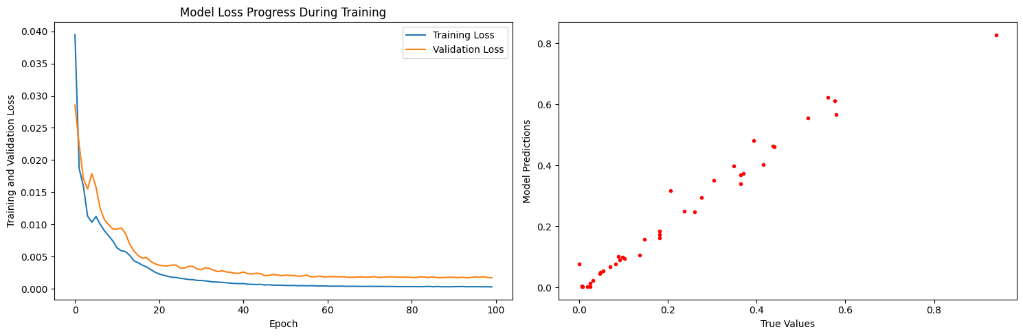
Neural Network
Configuration 02 :
Hidden layer : 4
Neurons: 100, 100, 100, 1

Slide 14
Conclusions
The simpler the model, the more difficult it is for it to capture patterns in the dataset.
More complex models have a higher capacity to capture intricate patterns and relationships in the dataset.
Balancing model complexity is important to prevent overfitting or underfitting.
The trade-off between model simplicity and capturing dataset patterns should be carefully considered when designing machine learning models.

