Slide 1
Gaming Trends 2024
Cori Esposito Wade Hallerud Brandon Schaeffer
Chris Thomas

Slide 2
Analyzing Gaming Trends in 2024
Using the dataset Gaming Trends 2024 from Kaggle we compared factors involving revenue, game specs, and social media influence through correlation, comparison, and statistical analysis to better understand how to achieve success in the gaming industry.

Slide 3
Data Source
The Kaggle Gaming Trends 2024 dataset contains 4,989 entries and 11 columns related to gaming trends. We chose this for our project because it was small enough to run on our computers and gave valuable insight into answering our project goals.

Slide 4
Column Description
Date - The date of data collection.
Platform - Gaming platform (PC, Console, VR, Mobile, etc.).
Daily Active Users (DAU) - Number of active users per day.
New Registrations - New user registrations on that day.
Session Duration (minutes) - Average session duration in minutes.
In-game Purchases ($) - Revenue from in-game purchases.
Social Media Mentions - Number of mentions on social media.
Stream Viewership - Viewership numbers for streams.
Revenue ($) - Total revenue generated.
Top Genre - Leading game genre for the day.
Influencer Endorsements - Number of endorsements by influencers.

Slide 5
Relation to the Gaming Industry
Developers and game creation studios have to look at market factors to be able to understand what is popular. By understanding what worked for past developers, confidence can be gained in the direction of creating a successful new game. Many time game developers on the smaller scale will search for funding, and those people that fund them will require some assurances that the developer has done research and that they aren’t throwing their money away investing in a game that will fail.

Slide 6

Key Questions:
Which platforms and genres within gaming are the most profitable?
What time of year is best to release games?
How much impact does social media presence have on a game?
What effect does the streaming industry have on the success of a game?

Slide 7

Findings and Insights

Slide 8
Pre-Analysis Overview
There were many steps before we could analyze the dataset. A few of them included:
We created an excel spreadsheet to brainstorm columns and their relationship to each other, as well as their use for our presentation, and how they could answer our research questions.
Formatting the date into date time data.
Rounding decimals to the appropriate length
We had to verify some of the data types were represented correctly (streamer endorsement was mis-categorized).
Pull particular fields into subset analysis.

Slide 9
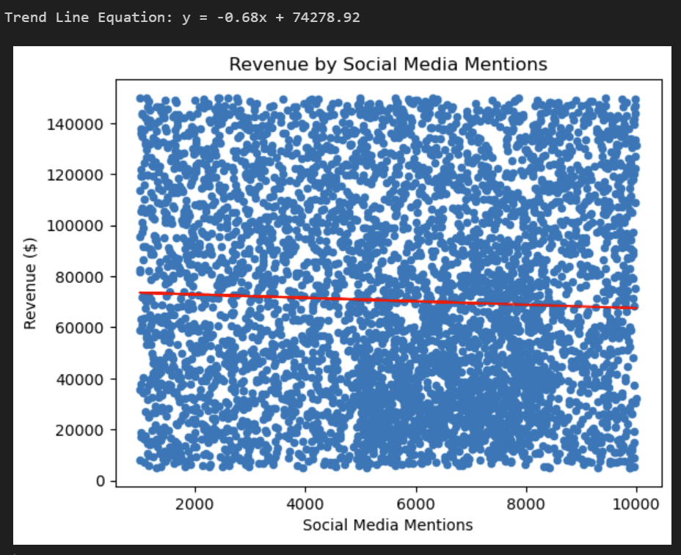
How much impact does social media presence have on a game? (Exploration)

Slide 10
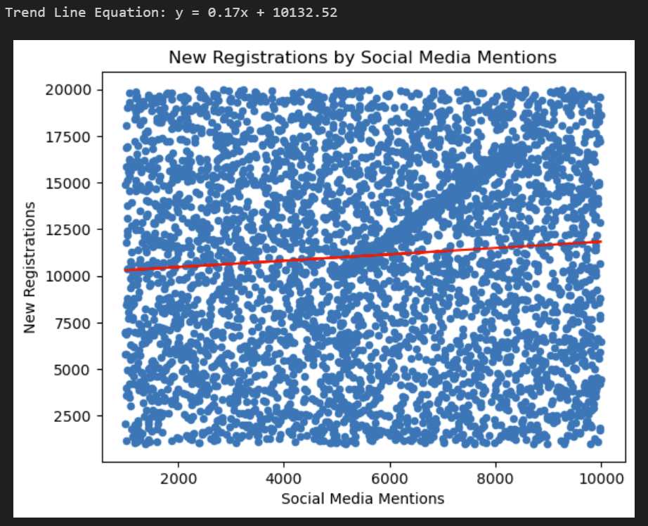
How much impact does social media presence have on a game? (Exploration)

Slide 11
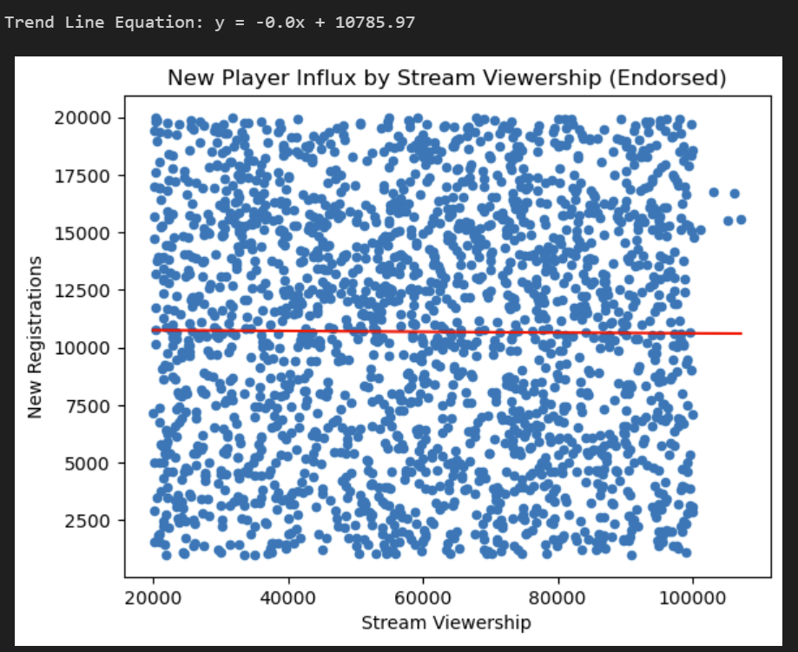
What effect does the streaming industry have on the success of a game? (Exploration)

Slide 12
Let’s Take a Peak

Slide 13
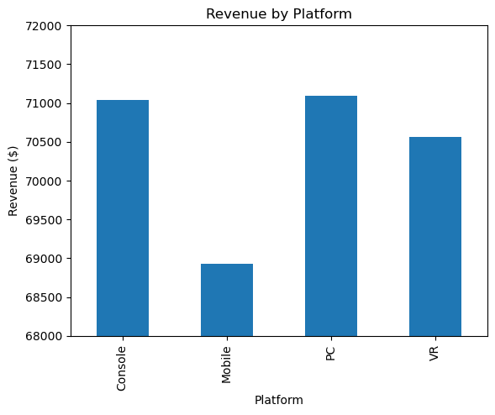
Which platforms and genres within gaming are the most profitable?
PC and Console are the most profitable platforms each generating an average of $71,000 per game in 2024.
Mobile being the least profitable at roughly $69,000.

Slide 14
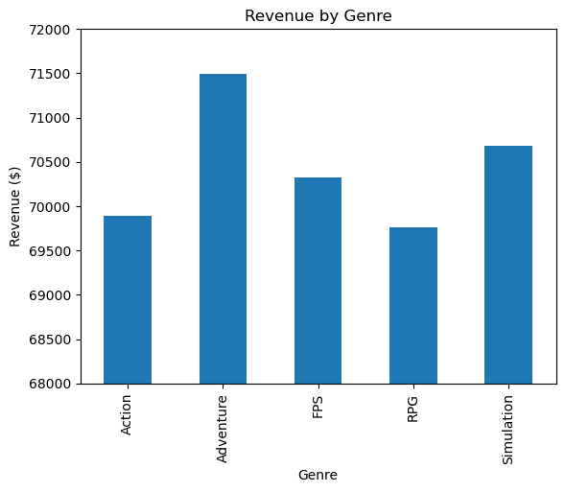
Which platforms and genres within gaming are the most profitable?
Adventure is the leading genre in profitability in 2024 generating an average of $71,500 per game in revenue.

Slide 15
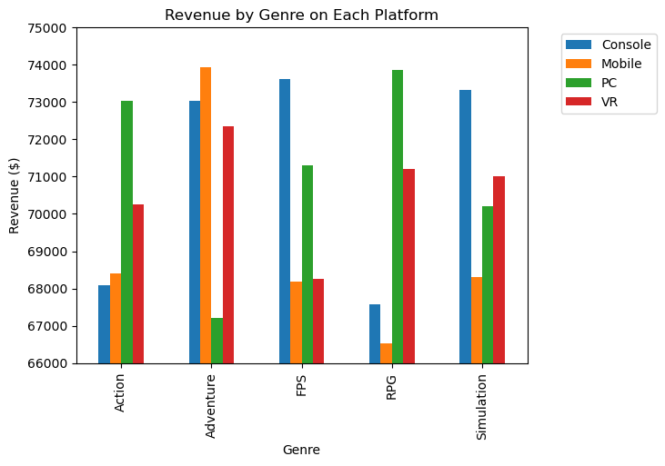
Which platforms and genres within gaming are the most profitable?
Most popular games on each platform by average revenue:
Console - FPS - $73,500
Mobile - Adventure - $74,000
PC - RPG - $74,000
VR - Adventure - $72,500

Slide 16
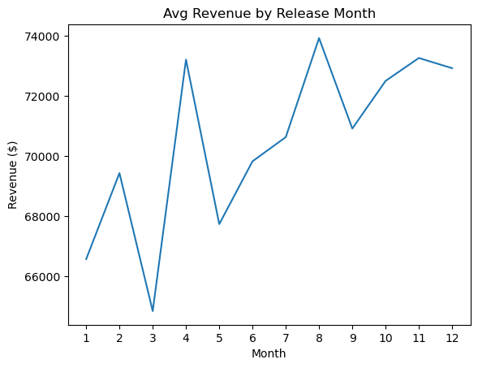
What time of year is best to release games?
The best month for releasing a game is August, with April at a close second.

Slide 17
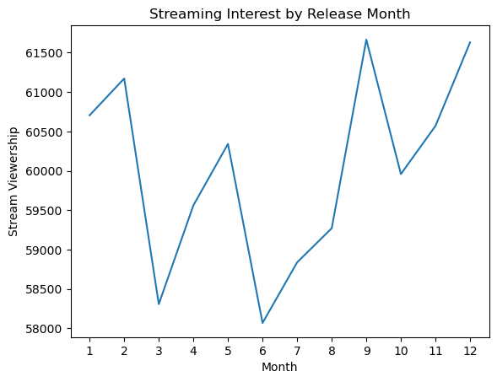
What time of year is best to release games?
Stream viewership is highest in September and December with an average of 62,000 viewers per game.

Slide 18
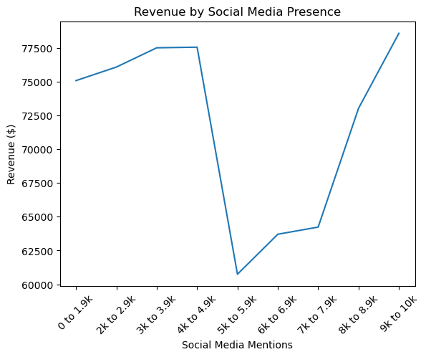
How much impact does social media presence have on a game?
There is an unexpected drop in revenue once social media mentions hit the 5K range, and spike again at 8K.

Slide 19
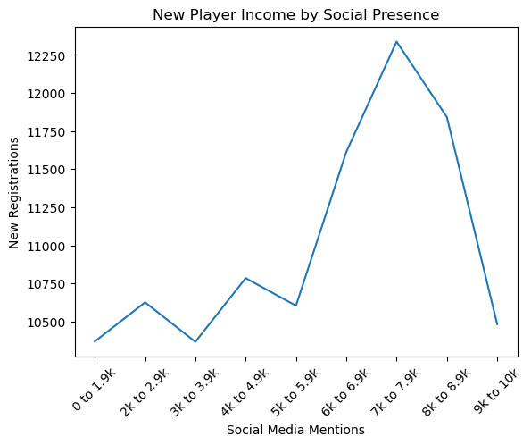
How much impact does social media presence have on a game?
New player registrations hit a peak at an average of 12,250 per game when social media mentions are in the 7k range.

Slide 20
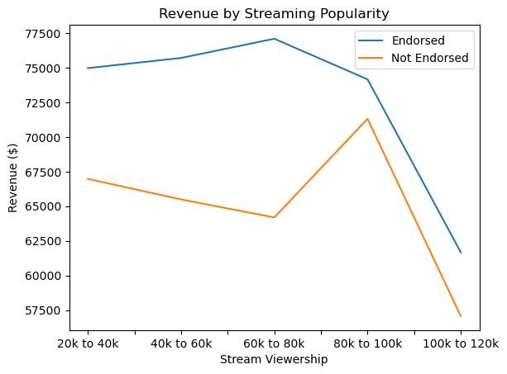
What effect does the streaming industry have on the success of a game?
Influencer endorsements have a significant effect on revenue as well as stream viewership.

Slide 21
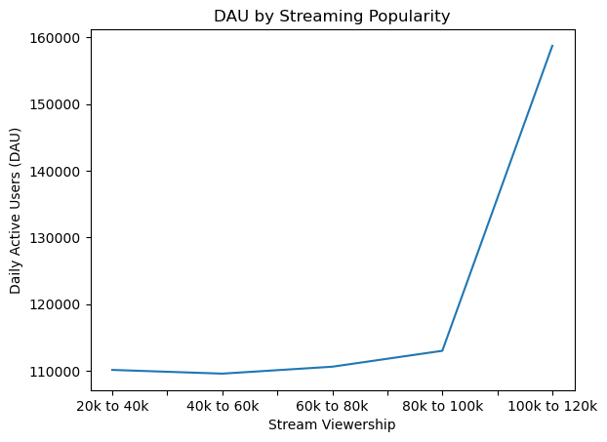
What effect does the streaming industry have on the success of a game?
Daily Active Users significantly increase once stream viewership surpasses 100K viewers.

Slide 22
Summary

Slide 23
Summary of Findings
1. Most Profitable Platforms & Genres
Console & PC
Adventure
3. Social Media Impacts
Social media mentions brings significant amount of new player registrations, but is risky
2. Best Time
Release: August & April and 4th quarter
Stream Viewership: September
4. Streaming Industry Effects
Positive impact from influencer endorsements
Streaming increases DAU

Slide 24
Thank You!

