Slide 1
Seneca
Final solution
MST400 Project 2
• Azure P2S VPN using OpenVPN
• Certificate-based authentication
• Linux VM private IP only
• SSH allowed only from VPN client pool
Secure Point-to-Site VPN Connection
Cloud Network | Summer 2026
Private SSH access to an Azure Linux VM, delivered entirely over an encrypted OpenVPN tunnel with certificate-based authentication.
Walid Hasan Ansary
VM username: whansary
MST400 Project 2 | Walid Hasan Ansary | 1

Slide 2
Corrected P2S VPN Architecture
Gateway and workload subnets are both inside the same Azure VNet; traffic is routed privately after the VPN tunnel terminates.
Encrypted
OpenVPN tunnel
Walid-VNet-CanadaCentral
Address space: 104.104.104.0/25
Local Ubuntu PC
Current VPN IP
172.16.104.2/24
GatewaySubnet
WorkloadSubnet
104.104.104.0/27
104.104.104.32/27
Walid-VpnGw
Public IP: 20.220.251.24
VPN type: Route-based
Walid-P2S-VM
Key configuration
Ubuntu 24.04
Private IP: 104.104.104.36
Public IP: None
• P2S client pool: 172.16.104.0/24
• Tunnel type: OpenVPN (SSL)
• Authentication: Azure certificate
• Root certificate: Walid-P2SRootCert
• VM access: SSH to private IP only
Azure private routing
Walid-P2S-VM-NSG
Allow SSH TCP 22 only from 172.16.104.0/24
Testing approach
1) Connect VPN → verify tun0 and SSH success. 2) Disconnect VPN → verify SSH timeout.
MST400 Project 2 | Walid Hasan Ansary
Corrected diagram: Gateway inside GatewaySubnet, VM inside WorkloadSubnet.

Slide 3
CONCEPT
How Point-to-Site VPN Works
Plain-language walkthrough of the connection flow used in this project.
1
2
3
4
Authenticate
Get an address
Enter the tunnel
Reach the VM
The Ubuntu laptop starts OpenVPN with the Azure-generated profile. Its client certificate proves it's trusted by the uploaded root certificate.
Azure assigns the laptop an address from the P2S pool, 172.16.104.0/24 — separate from the VNet's own range.
Traffic bound for Azure private resources travels through the encrypted tunnel to Walid-VpnGw.
The VM has no public IP, so SSH to 104.104.104.36 is reachable only through the VPN path; the NSG allows SSH solely from the P2S pool.
Connection flow: certificate auth → 172.16.104.x assigned → enters VNet 104.104.104.0/25 → SSH reaches VM at 104.104.104.36
MST400 Project 2 | Walid Hasan Ansary
3

Slide 4
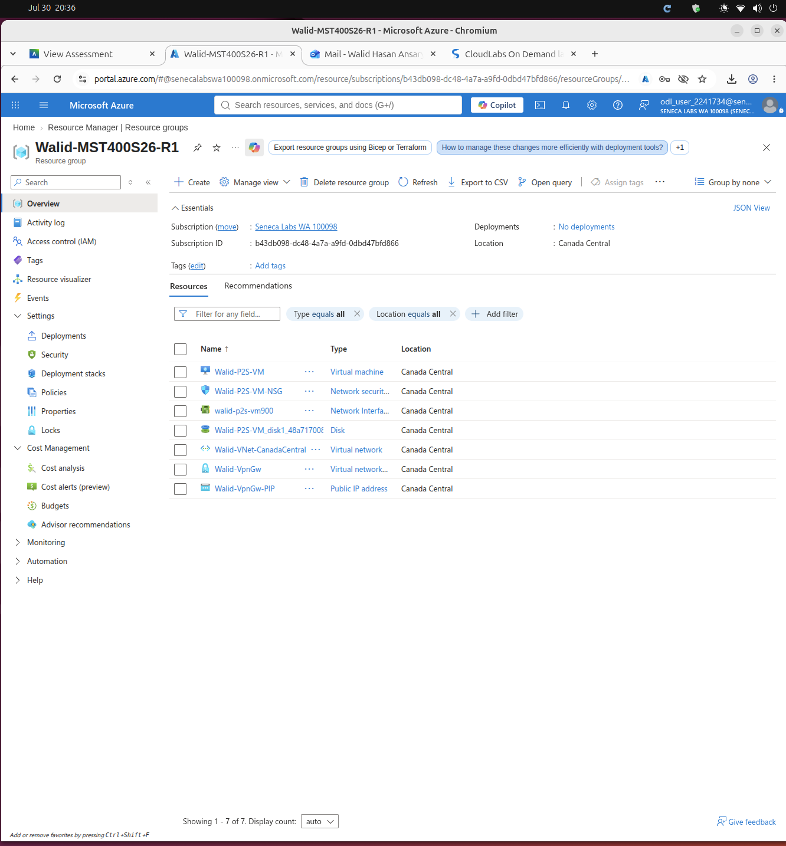
RESOURCE INVENTORY
All Provisioned Azure Resources
Linux VM: Walid-P2S-VM
NSG: Walid-P2S-VM-NSG
NIC and OS disk for the VM
VNet: Walid-VNet-CanadaCentral
VPN Gateway: Walid-VpnGw
Gateway public IP: Walid-VpnGw-PIP
Resource group: Walid-MST400S26-R1
MST400 Project 2 | Walid Hasan Ansary
4

Slide 5
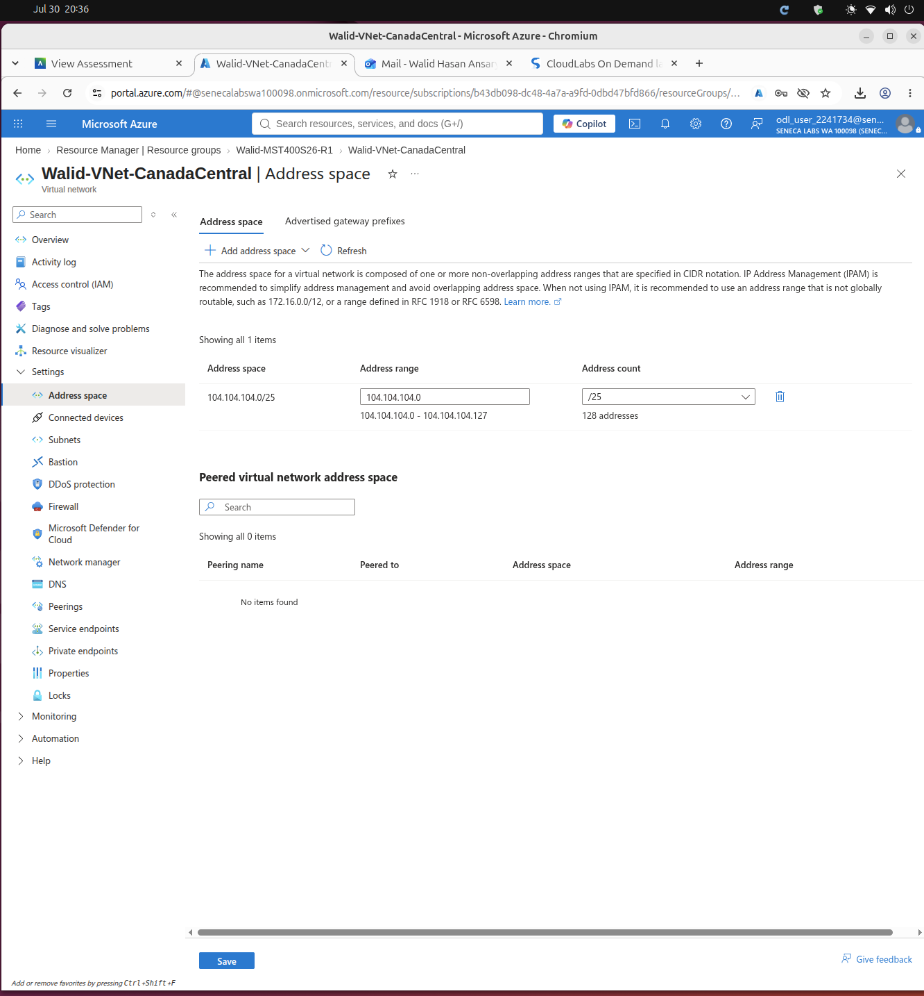
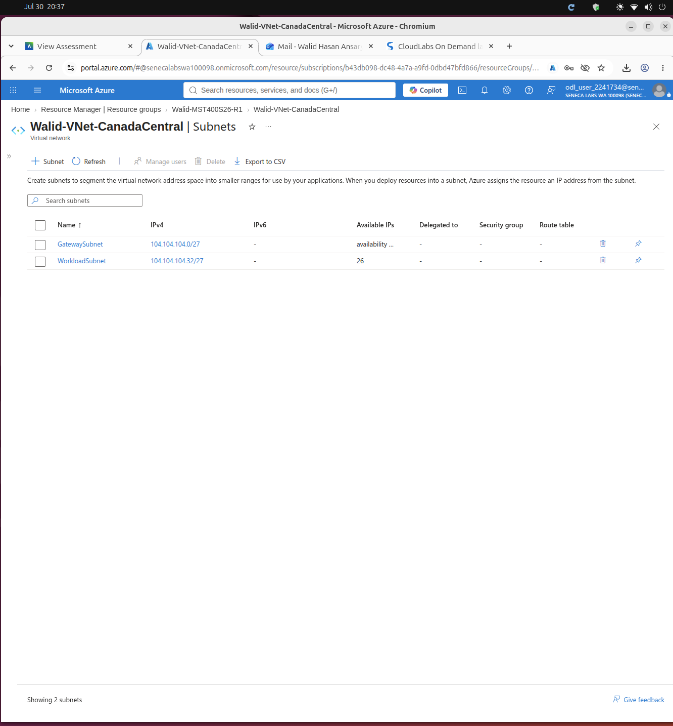
VNet and subnet IP address spaces
Assigned address range and required subnet split
VNet address space: 104.104.104.0/25
GatewaySubnet 104.104.104.0/27 ,WorkloadSubnet 104.104.104.32/27
MST400 Project 2 | Walid Hasan Ansary | 5

Slide 6
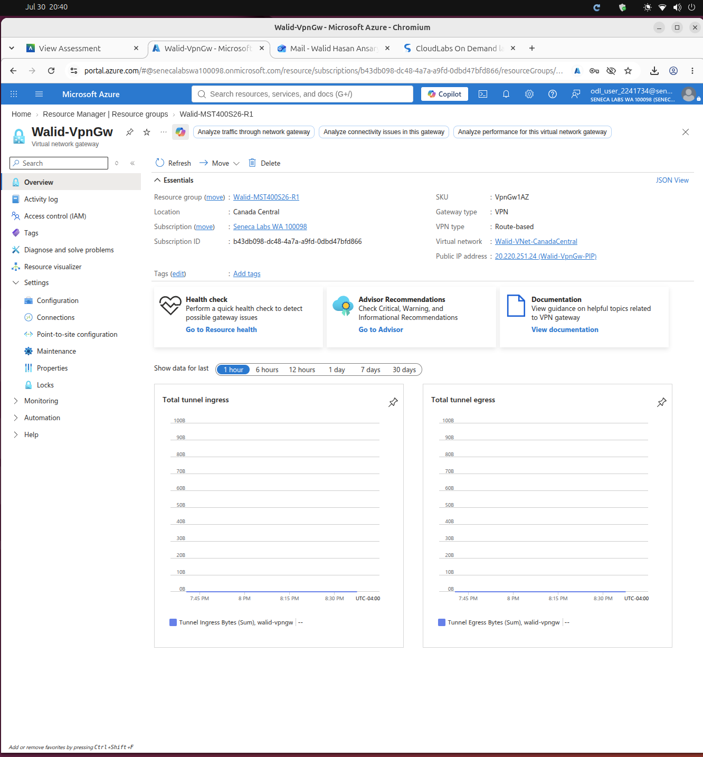
VPN Gateway configuration
Route-based VPN Gateway used for Point-to-Site access
Walid-VpnGw overview
• Gateway type: VPN
• VPN type: Route-based
• SKU: VpnGw1AZ
• Region: Canada Central
• VNet: Walid-Vnet-Canada central
• Gateway public IP: 20.220.251.24
MST400 Project 2 | Walid Hasan Ansary | 8

Slide 7
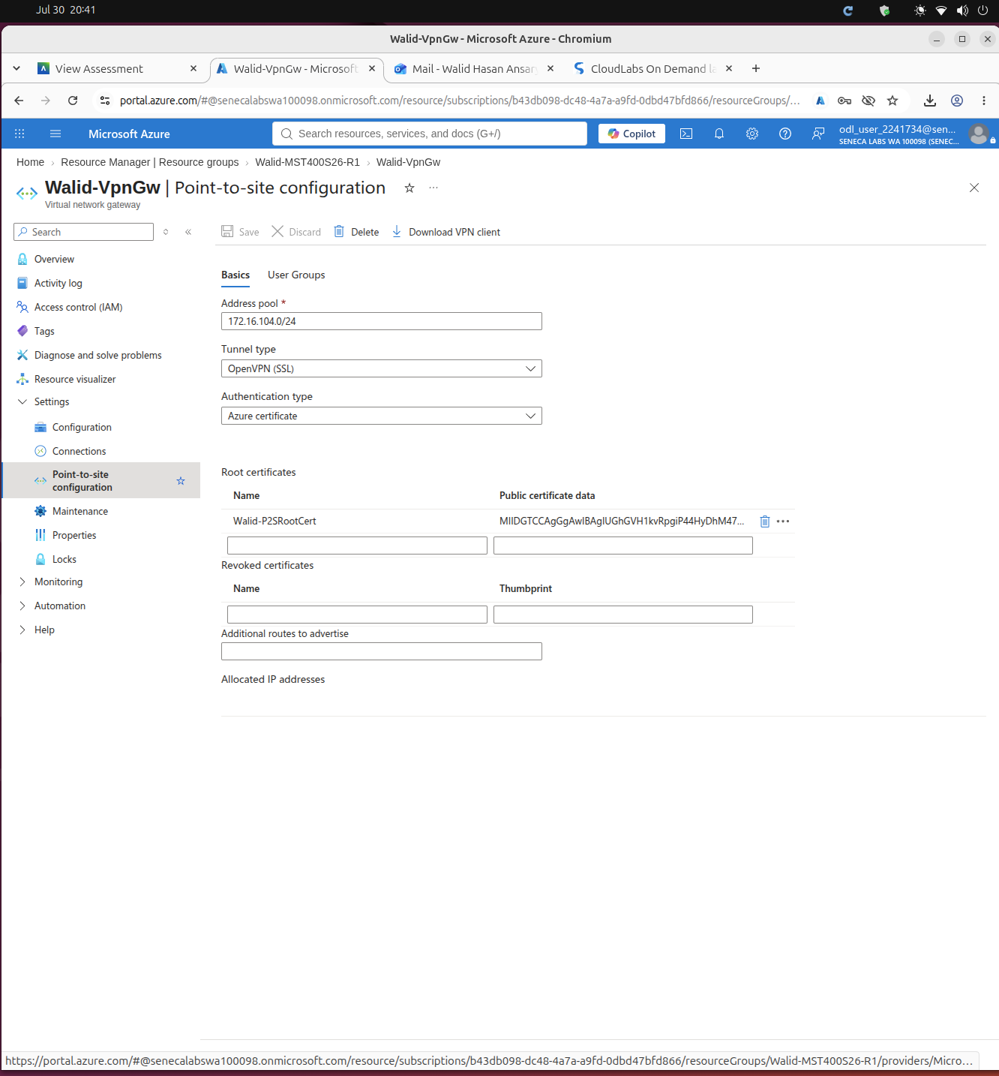
Point-to-Site VPN configuration
Client pool, tunnel type and certificate authentication
Point-to-site configuration
Address pool: 172.16.104.0/24
Tunnel type: OpenVPN (SSL)
Authentication: Azure certificate
Root certificate: Walid-P2SRootCert
VPN client profile downloaded from Azure
MST400 Project 2 | Walid Hasan Ansary | 9

Slide 8
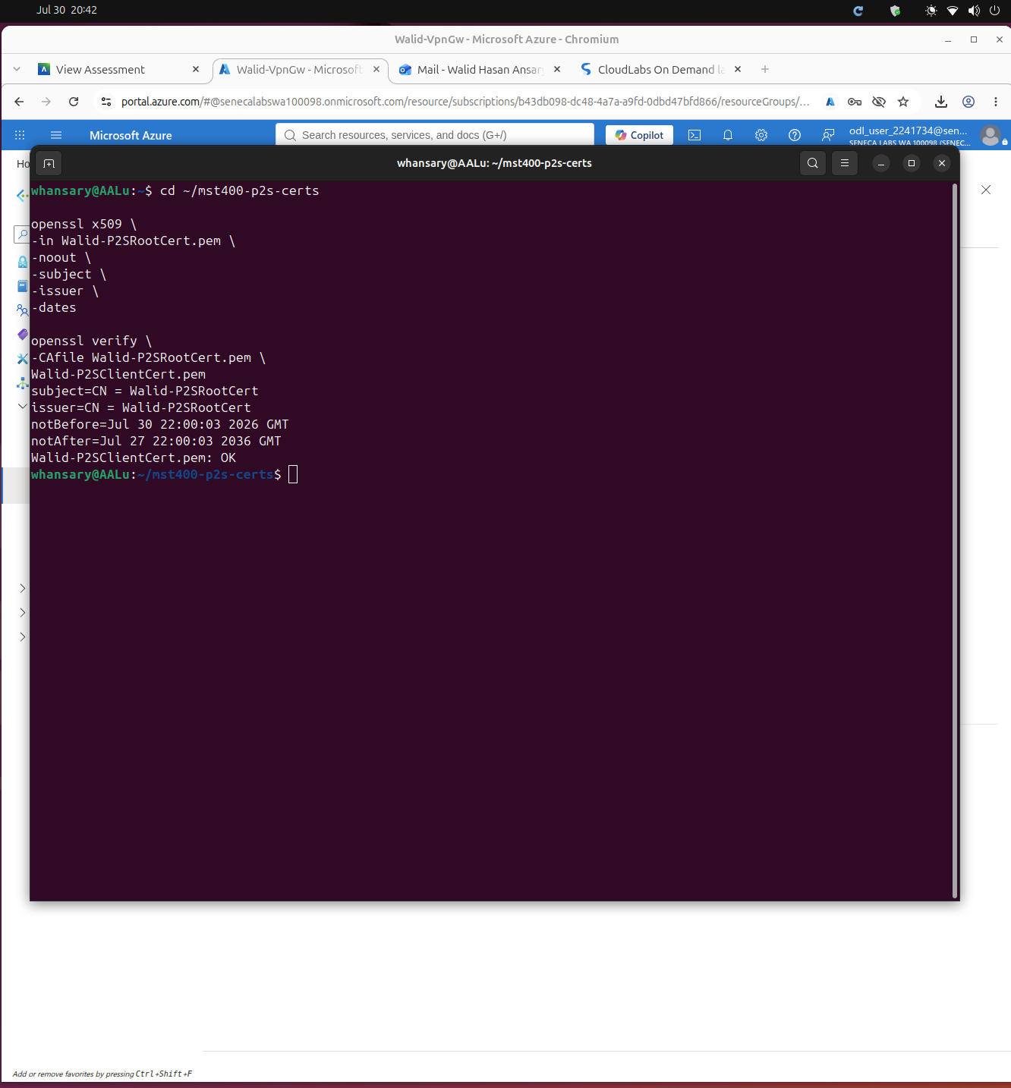
Certificates generated and used
Root certificate uploaded to Azure; client certificate used locally
Certificate verification terminal output
Root cert subject / issuer: Walid-P2SRootCert
Azure uses the root public certificate data
Client certificate signed by the root certificate
Verification result: Walid-P2SClientCert.pem: OK
Private keys kept local, never uploaded
MST400 Project 2 | Walid Hasan Ansary | 10

Slide 9
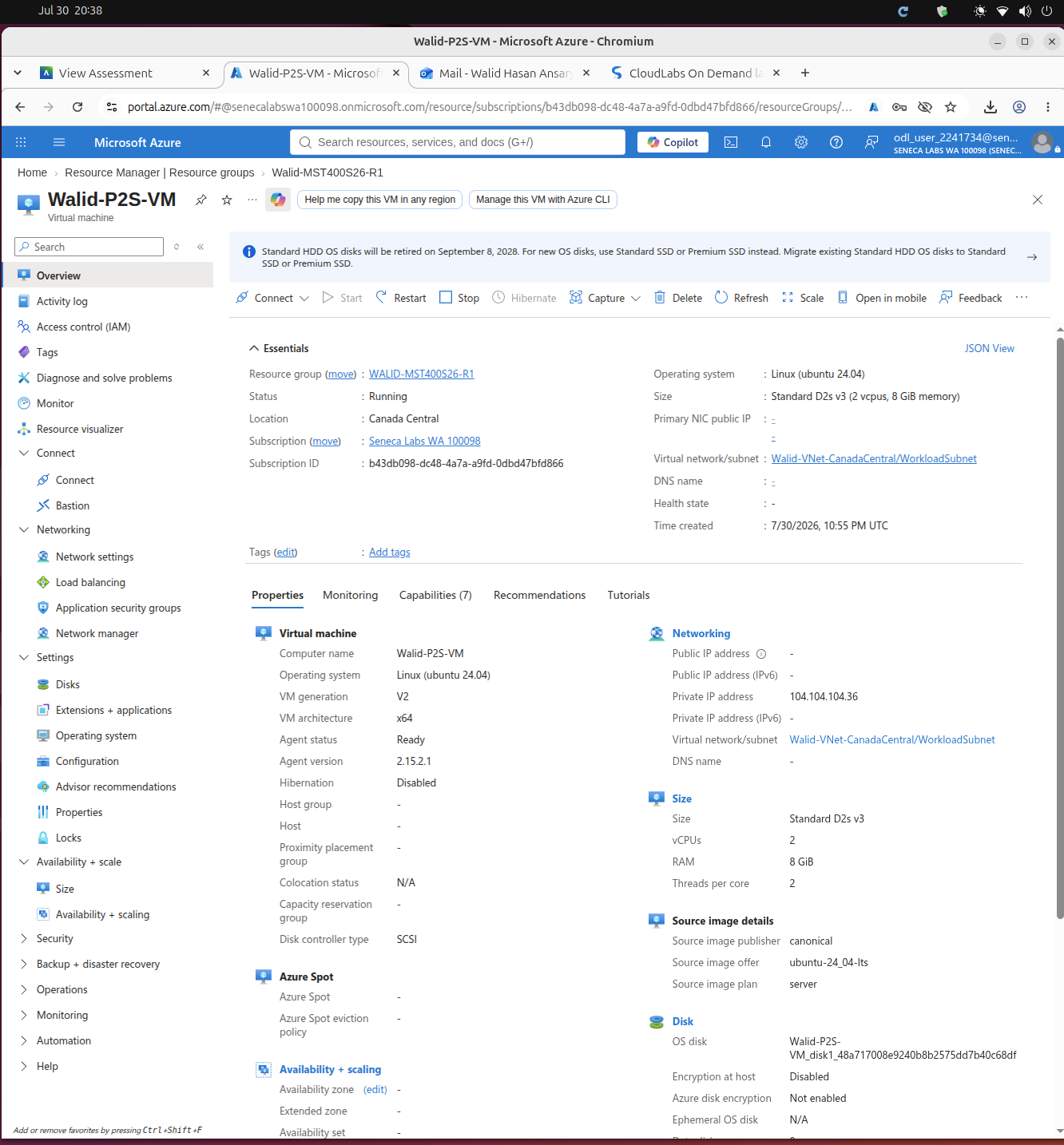
Linux VM configuration
Private Azure Linux VM for SSH testing
Walid-P2S-VM overview
Rule: Allow-SSH-From-P2S
Source: 172.16.104.0/24
Port: 22, Protocol: TCP
Action: Allow
No public-Internet SSH rule exists
MST400 Project 2 | Walid Hasan Ansary | 6

Slide 10
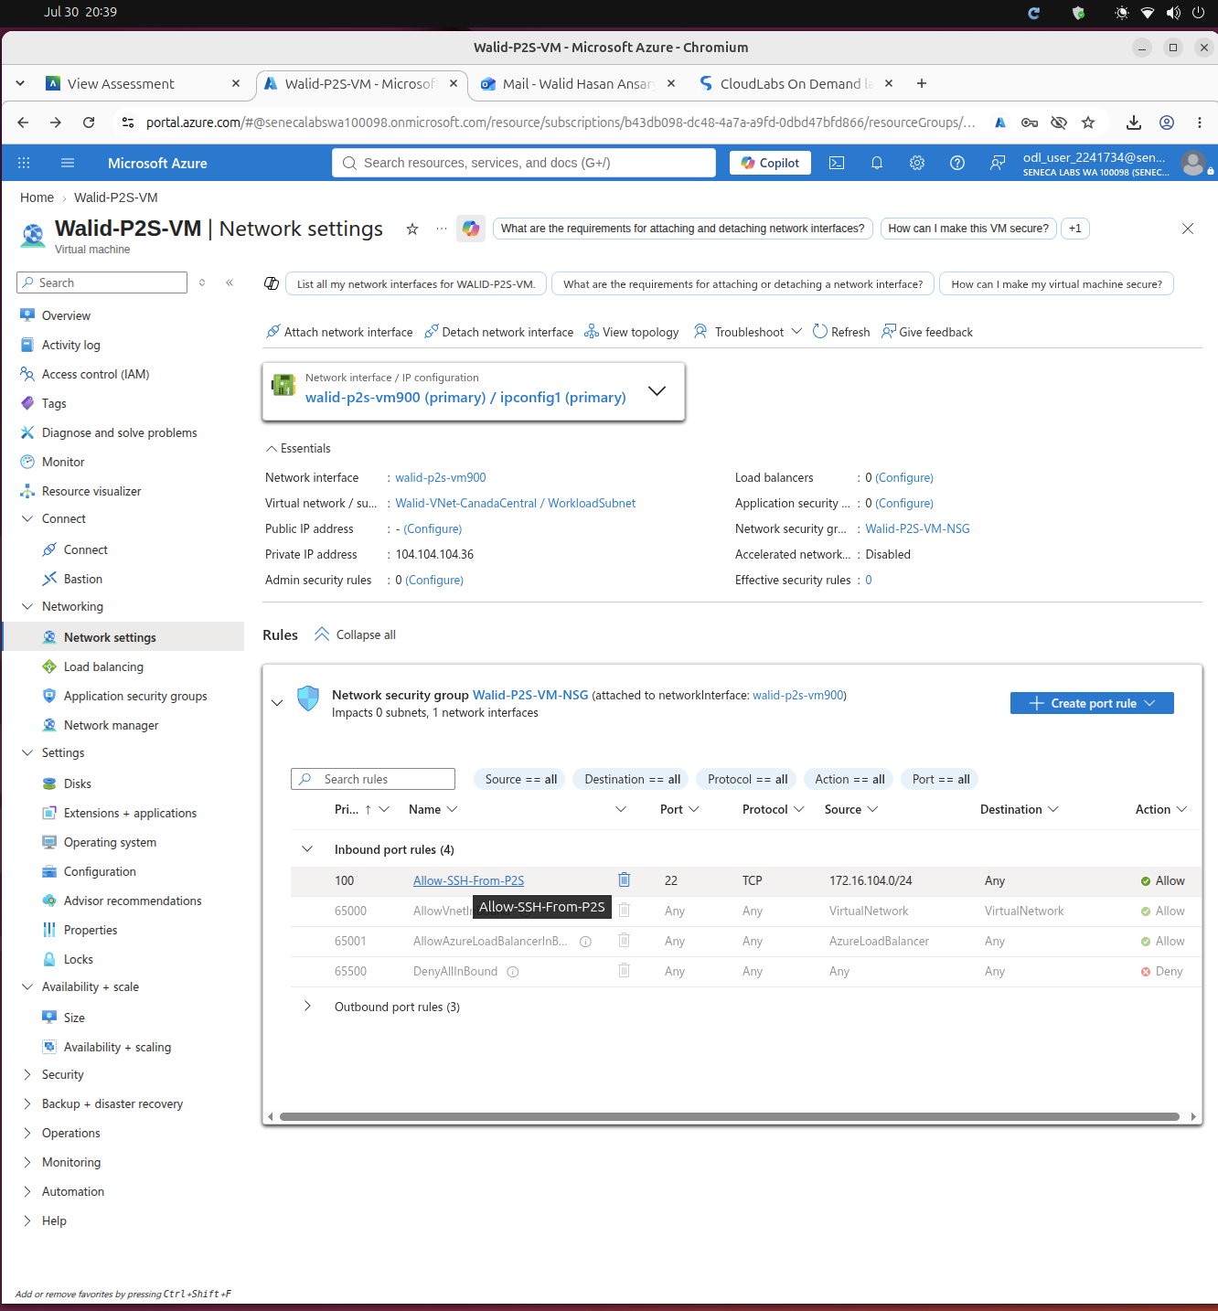
NSG rule for secure SSH
SSH is allowed only from the P2S client address pool
Network security group attached to VM NIC
• Rule: Allow-SSH-From-P2S
• Source: 172.16.104.0/24
• Port: 22
• Protocol: TCP
• Action: Allow
• No public Internet SSH rule
MST400 Project 2 | Walid Hasan Ansary | 7

Slide 11
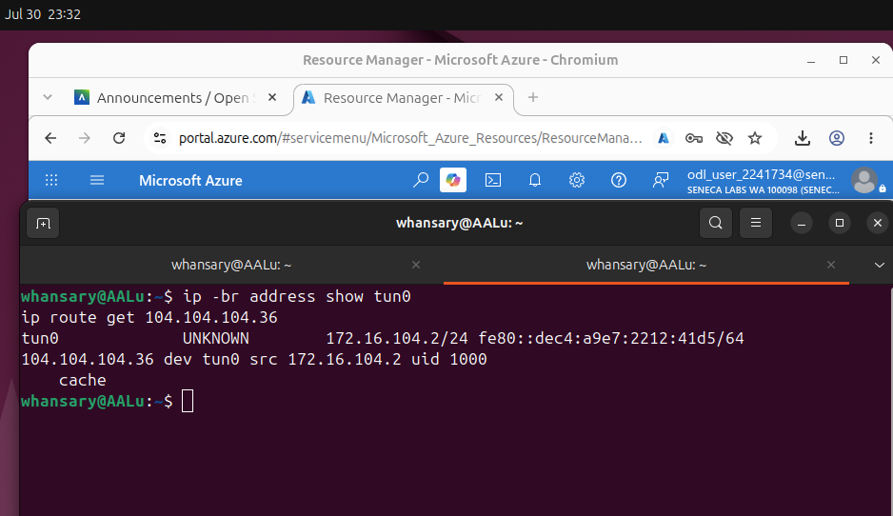
EVIDENCE
VPN Client IP Evidence
The tun0 interface shows the local computer received a P2S address.
tun0 confirms the VPN tunnel interface is active
172.16.104.2/24 assigned from the P2S pool 172.16.104.0/24
The routing table sends 104.104.104.36 traffic via the tunnel
Next: successful SSH proves the VM was reachable
MST400 Project 2 | Walid Hasan Ansary
11

Slide 12
VERIFICATION
Testing Approach
How the working solution was verified end-to-end.
Confirm the VPN client receives a P2S IP from 172.16.104.0/24
Confirm routing to 104.104.104.36 uses the tunnel when connected
SSH to the VM using private IP 104.104.104.36
Run hostname, whoami, hostname -I and ip addr in the VM
Stop OpenVPN and confirm the tunnel interface is gone
Retry SSH to 104.104.104.36 and confirm it times out
$ ip -br address show tun0
$ ip route get 104.104.104.36
$ ssh -i ~/.ssh/walid-mst400-key \
whansary@104.104.104.36
$ hostname
$ whoami
$ hostname -I
$ ip addr
$ sudo pkill openvpn
$ ssh -o ConnectTimeout=10 \
-i ~/.ssh/walid-mst400-key \
whansary@104.104.104.36
MST400 Project 2 | Walid Hasan Ansary
12

Slide 13
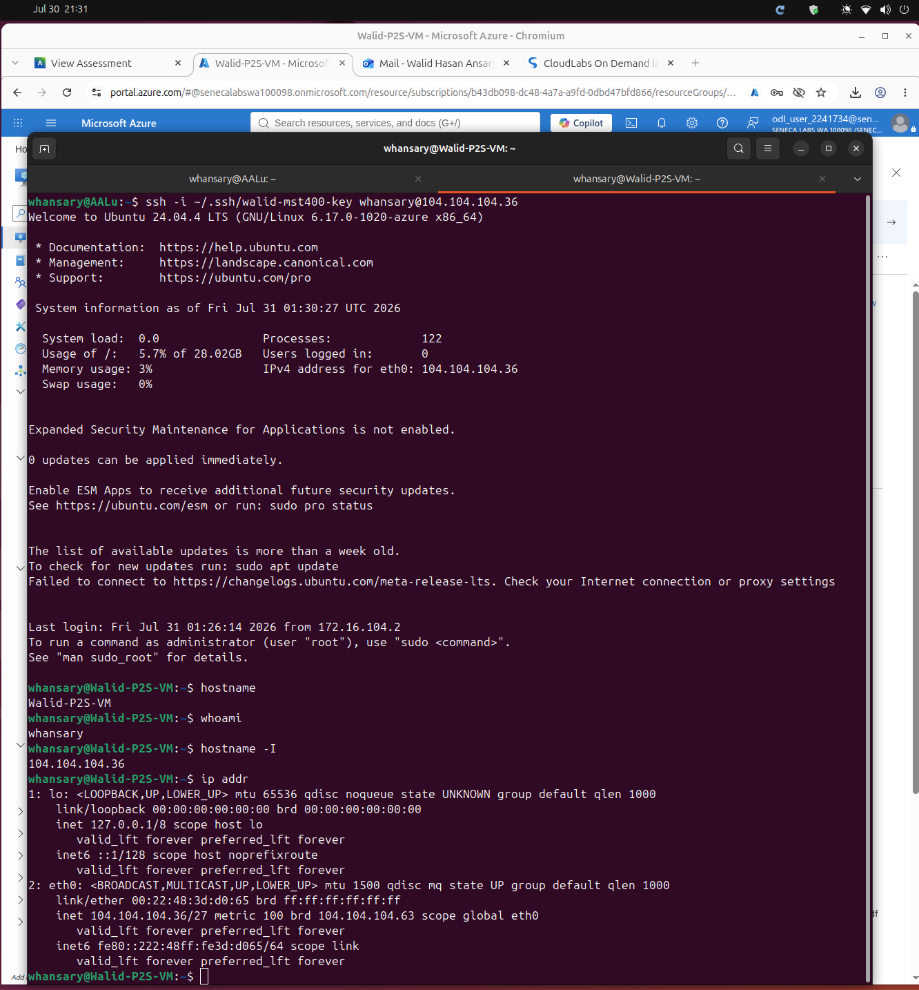
DEMO
Successful SSH over VPN
Private-IP SSH access to Walid-P2S-VM.
✓ SSH connection succeeded
SSH target: whansary@104.104.104.36
Last login source: 172.16.104.2
hostname: Walid-P2S-VM
whoami: whansary
ip addr shows eth0 private address
104.104.104.36/27
MST400 Project 2 | Walid Hasan Ansary
13

Slide 14
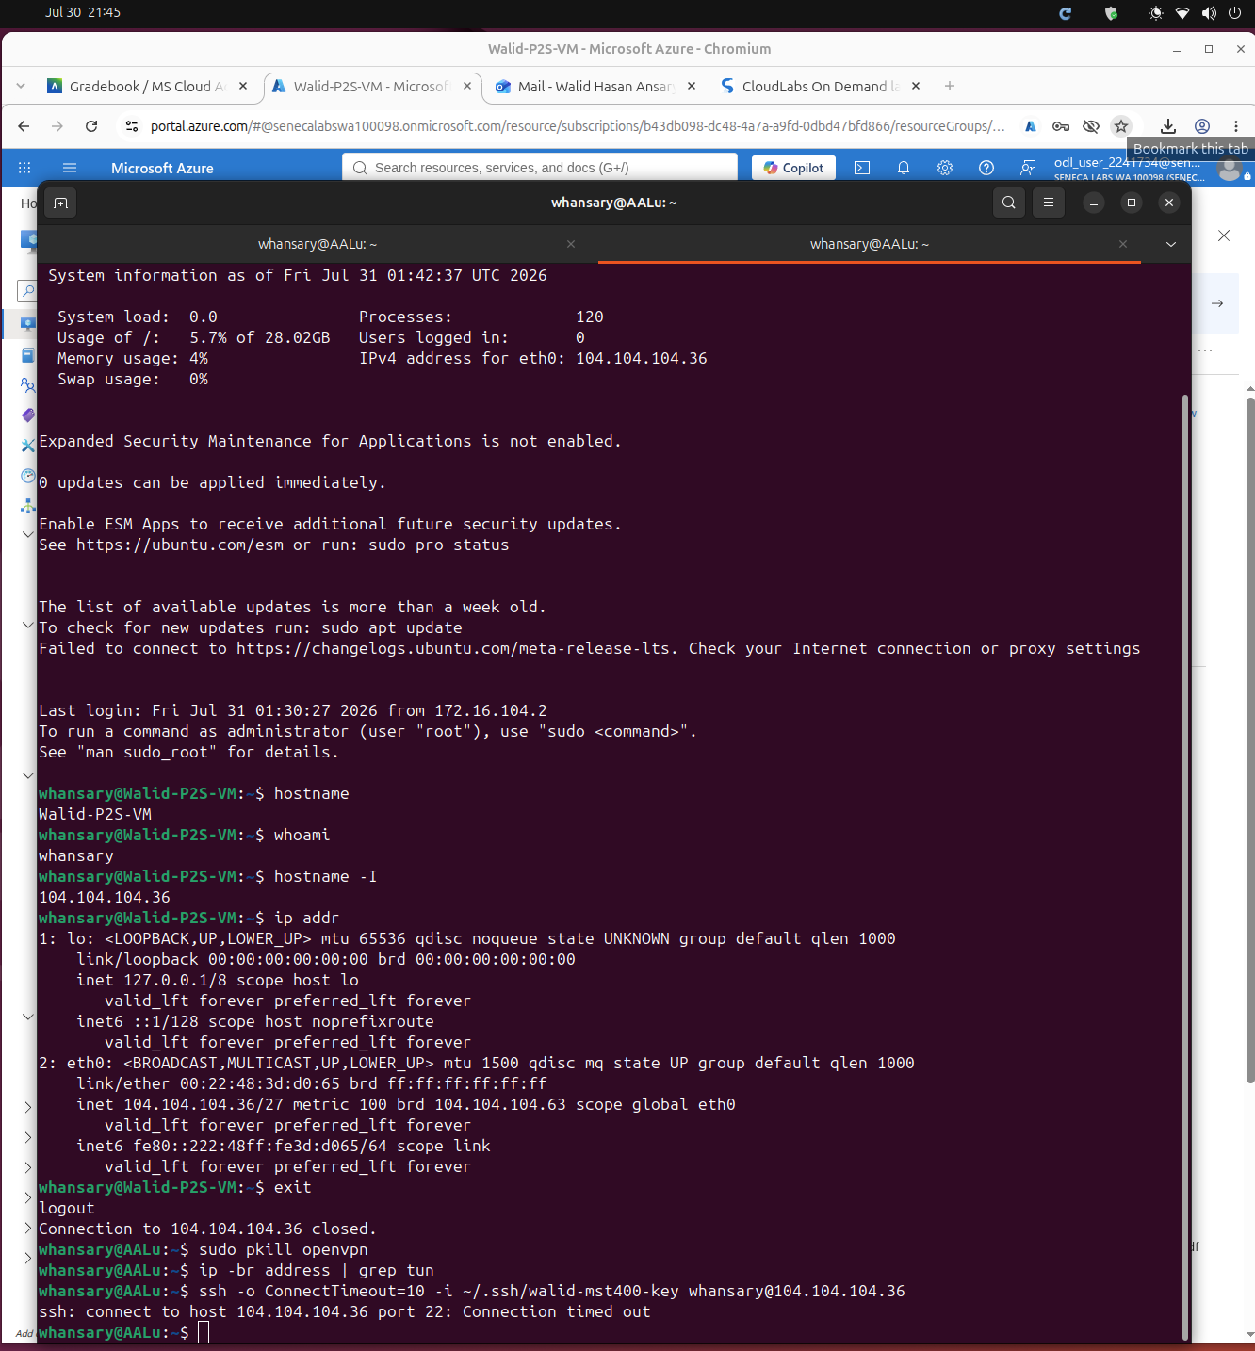
DEMO
VPN Disconnected Test
SSH fails once the VPN tunnel is stopped.
✕ SSH connection timed out
OpenVPN stopped with sudo pkill openvpn
No tun interface remains after disconnect
SSH attempted to the same private IP
Result: connection timed out
Proves the VM requires the active VPN tunnel
MST400 Project 2 | Walid Hasan Ansary
14

Slide 15
Conclusion and reflection
What was learned from the project
• The solution provides secure remote access without assigning a public IP to the VM.
• Point-to-Site VPN creates an encrypted client-to-Azure tunnel.
• Certificate authentication controls who can connect to the VPN.
• NSG source filtering limits SSH to the VPN client address pool.
• Testing proved SSH works with the VPN connected and fails after disconnecting the VPN.
MST400 Project 2 | Walid Hasan Ansary | 16

