Slide 1
Seneca
Azure Point-to-Site VPN
MST400 Project 2
OpenVPN SSL • Certificate authentication • Private IP SSH
Secure Point-to-Site VPN Connection
Cloud Network • Summer 2026
Private VM access without public exposure
Walid Hasan Ansary
Username: whansary
MST400 Project 2 | Walid Hasan Ansary | 1

Slide 2
Project Objective
Secure remote access to a private Azure Linux VM
Goal
VM has no public IP address
Azure VPN Gateway terminates the client tunnel
OpenVPN SSL tunnel with certificate authentication
NSG permits TCP/22 only from the VPN client pool
Provide secure SSH access to a Linux server in Azure without exposing the VM to the public internet.
Local users connect to Azure through Point-to-Site VPN. SSH is allowed only after the VPN tunnel is established.
Canada Central
OpenVPN SSL
Azure certificate
Private IP SSH
MST400 Project 2 | Walid Hasan Ansary | 2

Slide 3
Architecture Design
IP addressing and resource flow
Local Ubuntu PC
Encrypted Point-to-Site tunnel
Azure VPN Gateway
Private Azure route
Virtual Network
SSH TCP/22
Linux VM
VPN IP: 172.16.104.x
OpenVPN client
Walid-VpnGw
GatewaySubnet: 104.104.104.0/27
Walid-VNet-CanadaCentral
104.104.104.0/25
Walid-P2S-VM
Private IP: 104.104.104.36
P2S client address pool: 172.16.104.0/24
Tunnel: OpenVPN (SSL)
Authentication: Azure certificate
No VM public IP. Access must enter through the VPN Gateway and match the NSG source range.
NSG rule: Allow-SSH-From-P2S
Source: 172.16.104.0/24 → Port 22
MST400 Project 2 | Walid Hasan Ansary | 3

Slide 4
Addressing Plan
Assigned IP space used only for this deployment
Component
IP / CIDR
Purpose
VNet
104.104.104.0/25
Main Azure network
GatewaySubnet
104.104.104.0/27
Required by Azure VPN Gateway
WorkloadSubnet
104.104.104.32/27
Linux VM subnet
P2S client pool
172.16.104.0/24
VPN clients receive this range
Linux VM
104.104.104.36
Private IP only
Important grading evidence: show the VNet address space and both subnet ranges clearly in the Azure portal.
MST400 Project 2 | Walid Hasan Ansary | 4

Slide 5
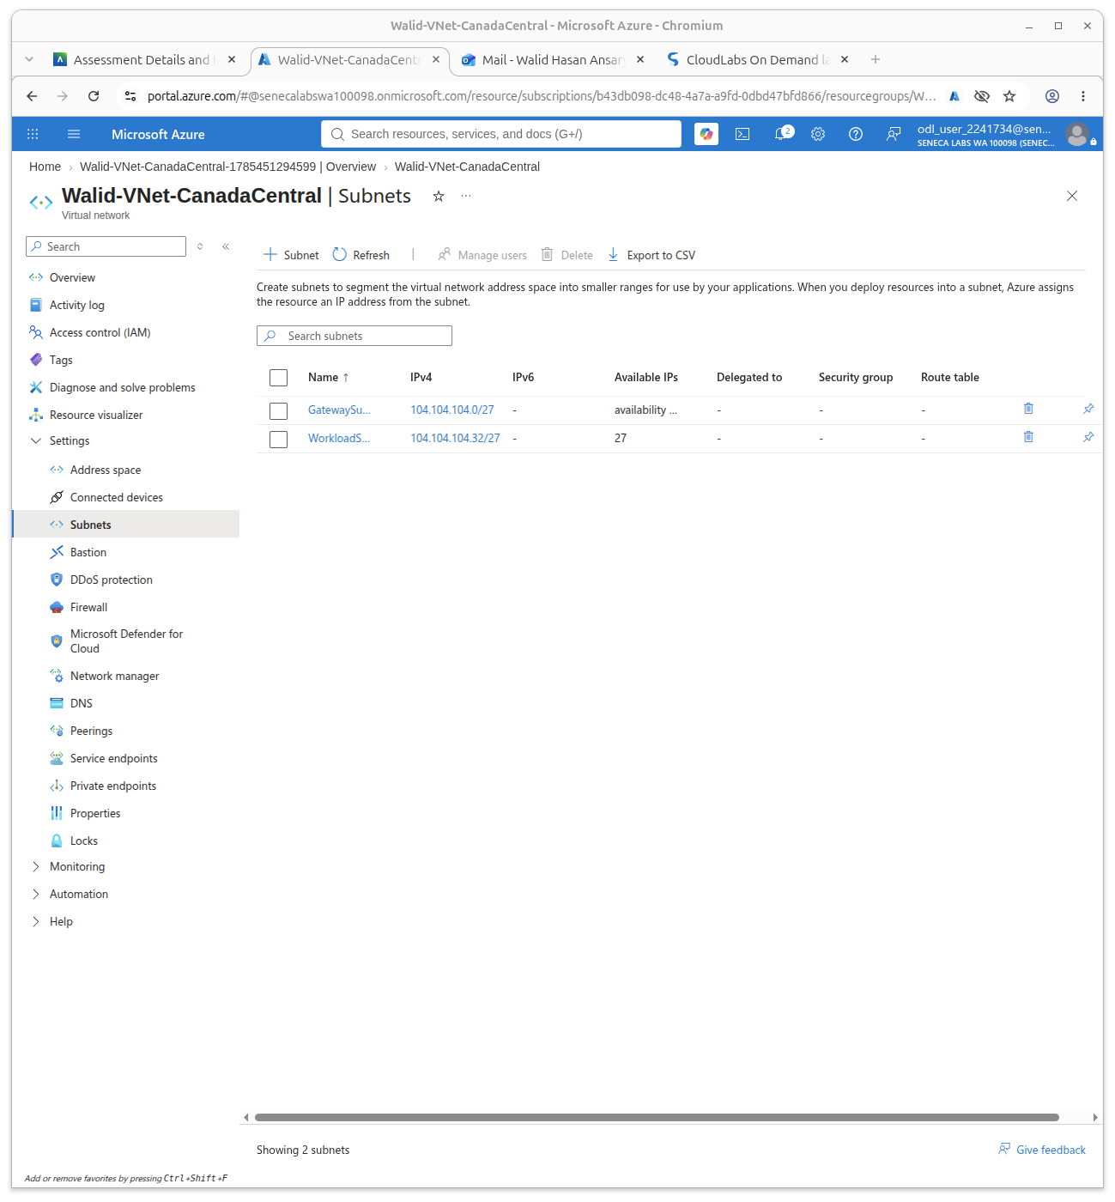
VNet and Subnets
Azure portal evidence
Confirmed settings
VNet: Walid-VNet-CanadaCentral
GatewaySubnet: 104.104.104.0/27
WorkloadSubnet: 104.104.104.32/27
Default subnet removed
ODL account visible in portal
GatewaySubnet is reserved for the Azure VPN Gateway. WorkloadSubnet hosts the Linux VM.
MST400 Project 2 | Walid Hasan Ansary | 5

Slide 6
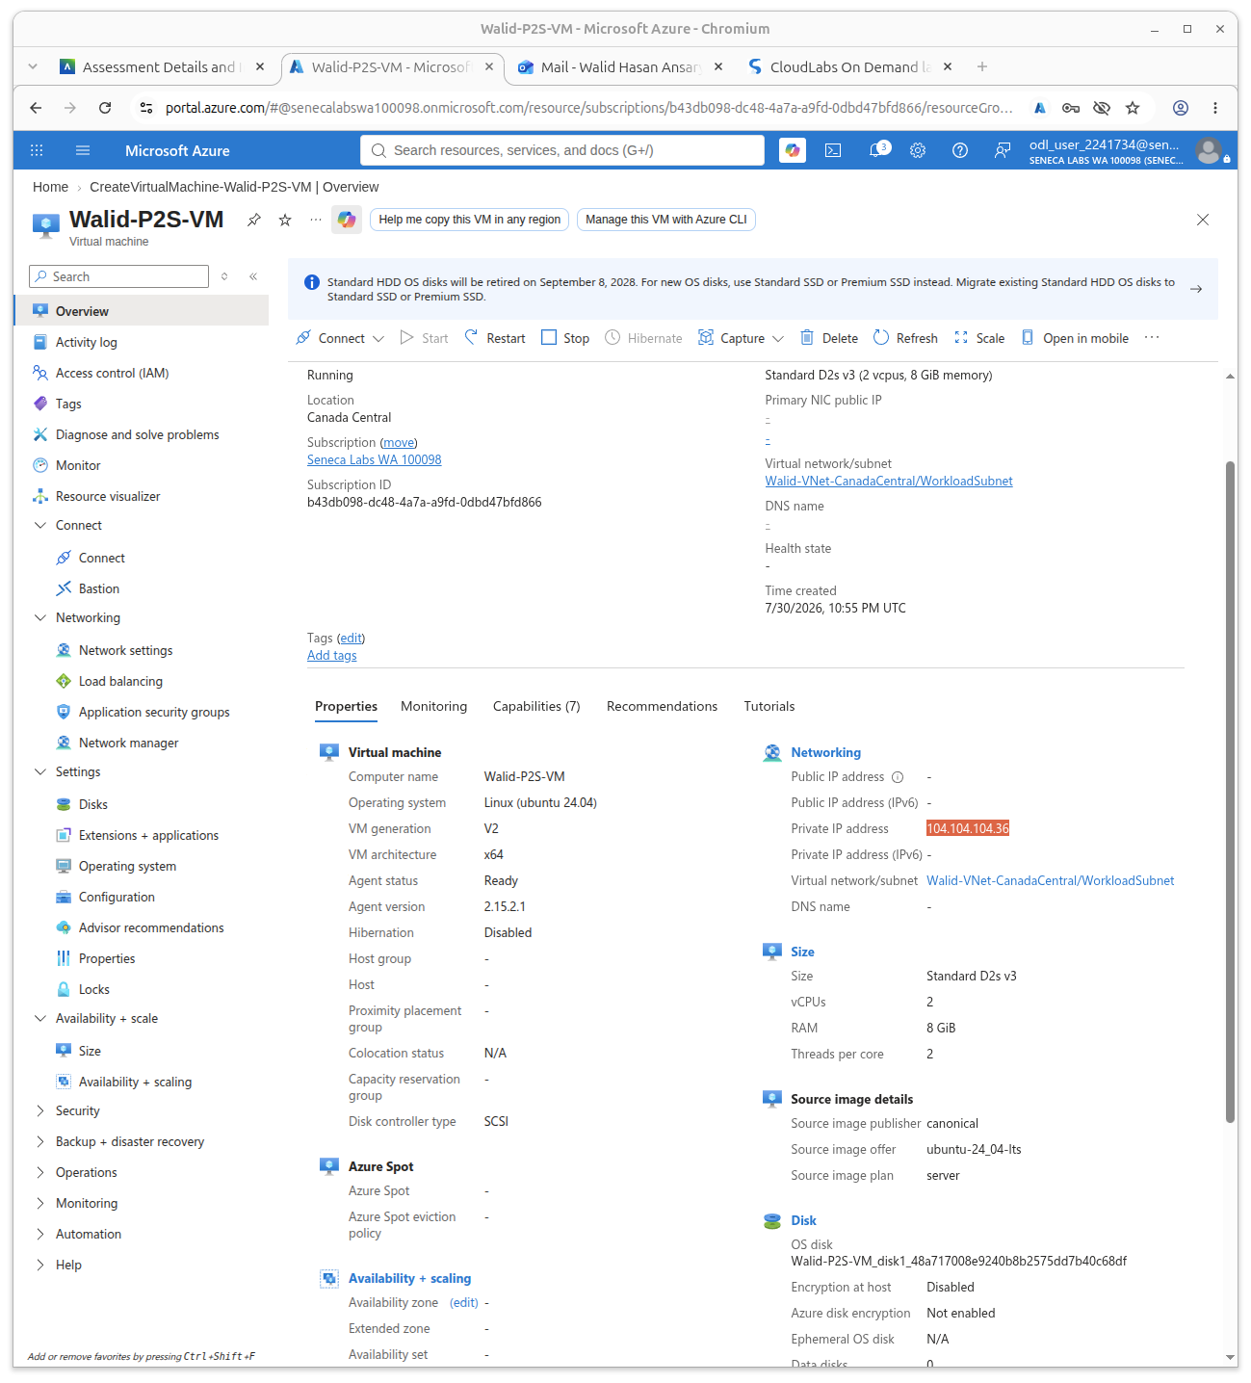
Linux VM Configuration
Private server with no public IP
VM evidence
Name: Walid-P2S-VM
OS: Ubuntu Server 24.04 LTS
Private IP: 104.104.104.36
Public IP: None
Subnet: WorkloadSubnet
No public IP means the VM cannot be reached directly from the internet. Access must use the P2S VPN.
MST400 Project 2 | Walid Hasan Ansary | 6

Slide 7
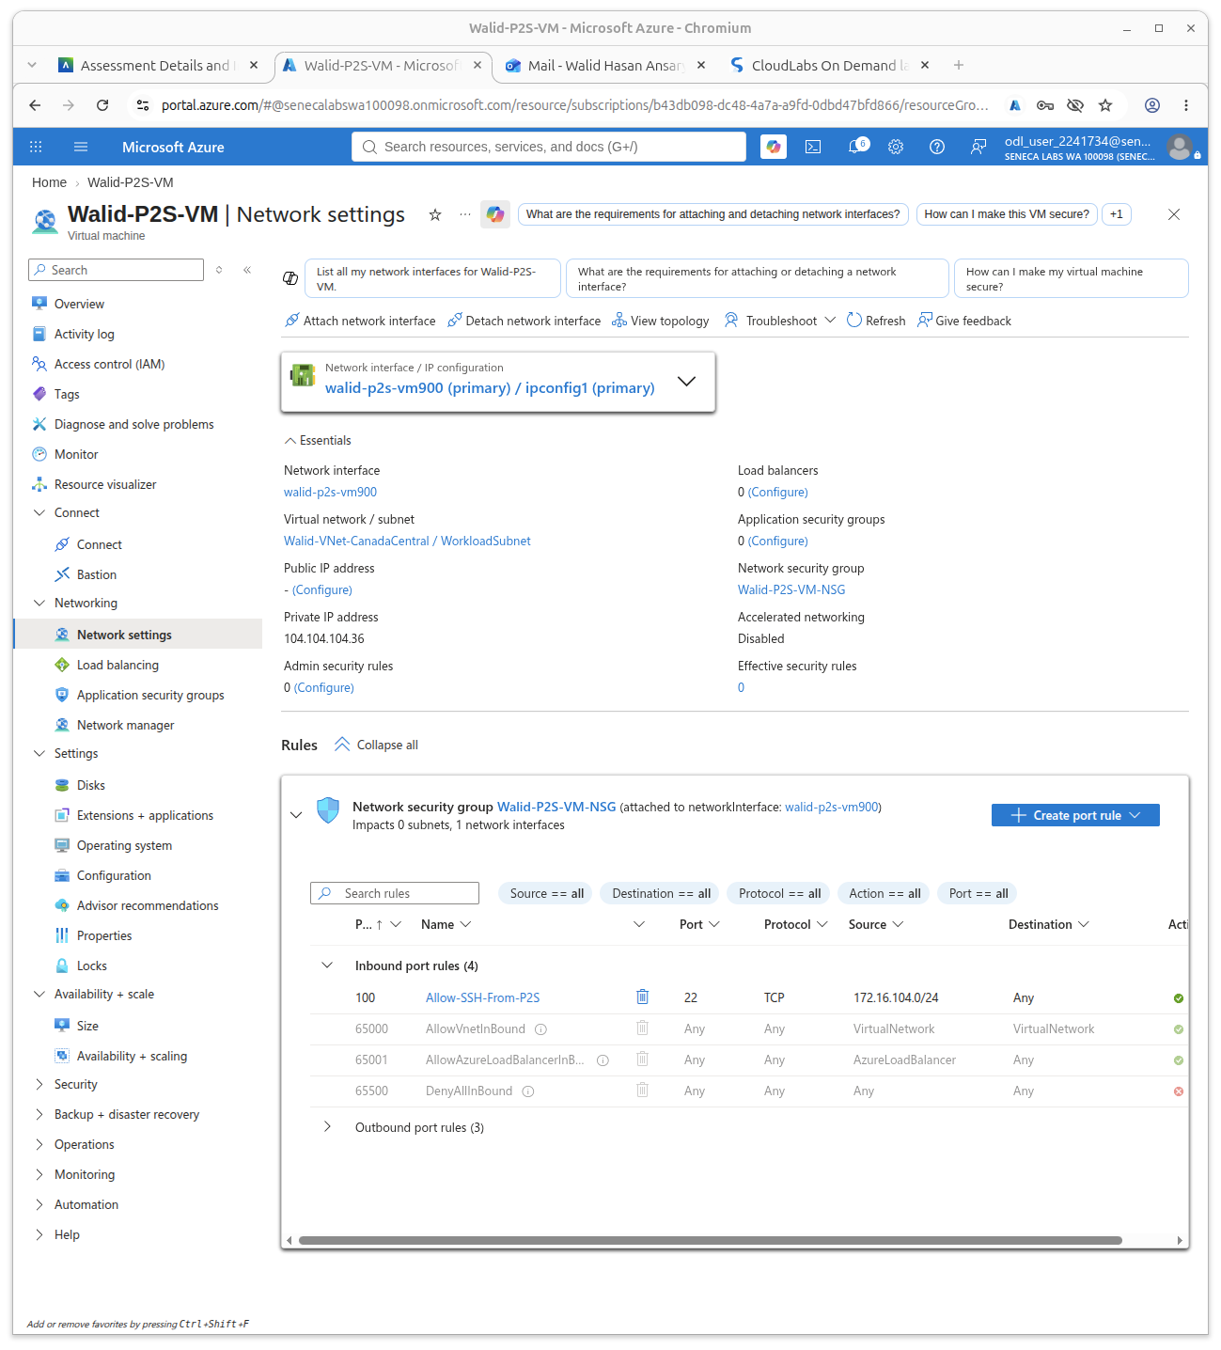
Security Rule
SSH restricted to the VPN client pool
Inbound rule
Allow-SSH-From-P2S
Priority: 100
Source: 172.16.104.0/24
Protocol: TCP
Port: 22
Action: Allow
This NSG is attached to the VM network interface, so the VM accepts SSH only from VPN-assigned client addresses.
MST400 Project 2 | Walid Hasan Ansary | 7

Slide 8
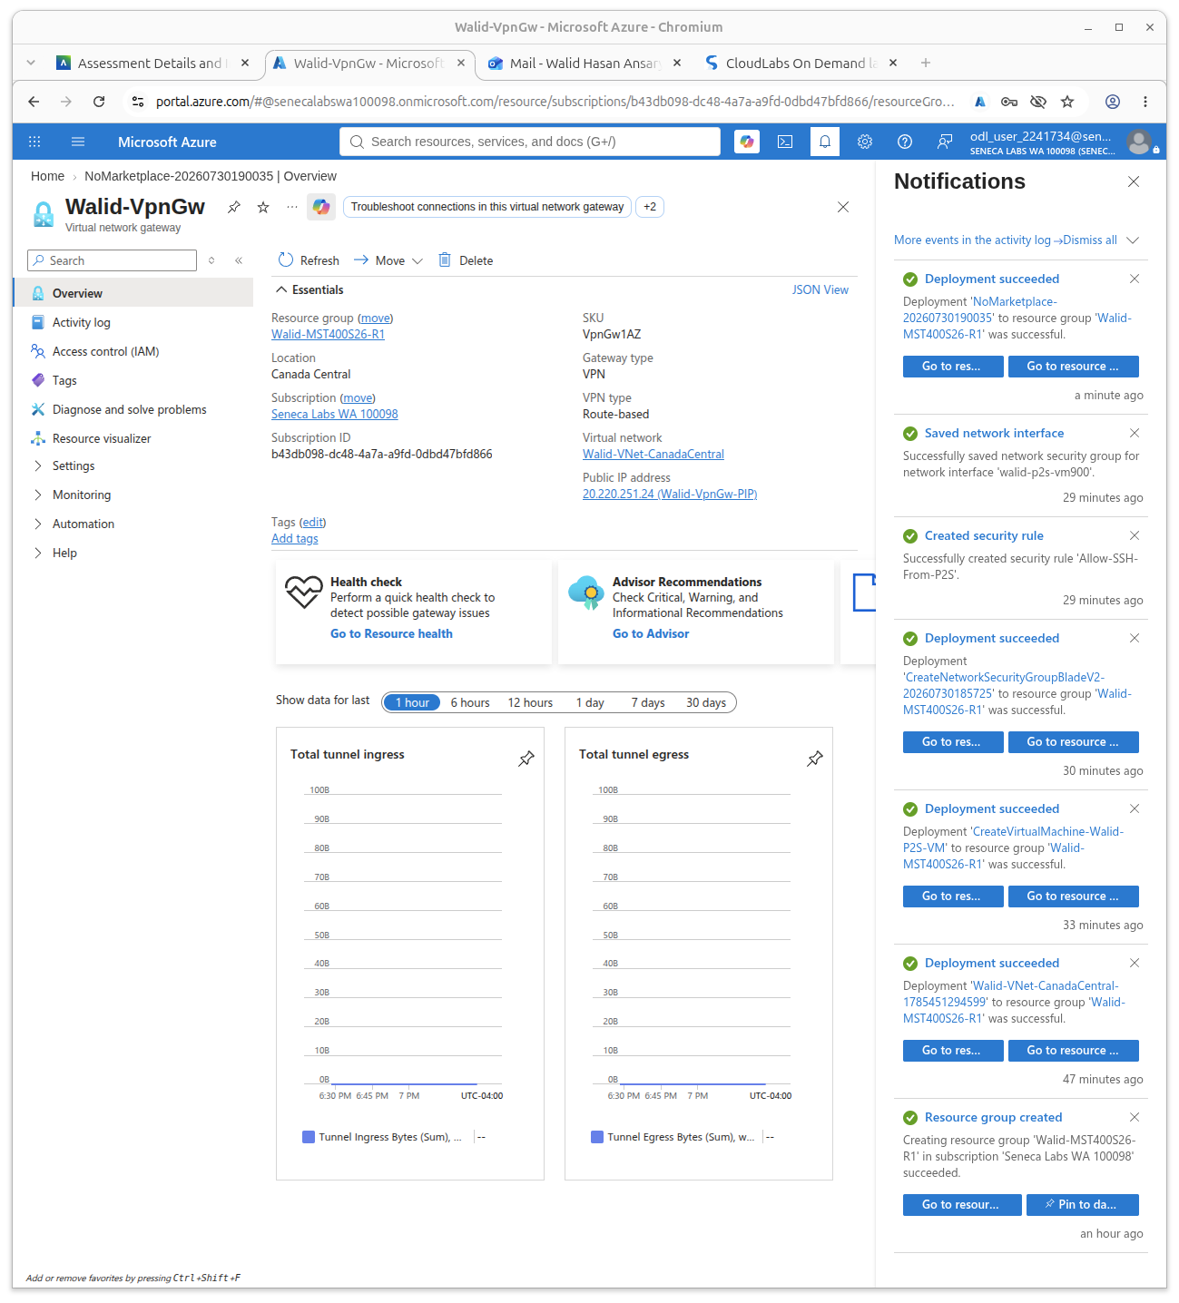
VPN Gateway
Route-based gateway in Canada Central
Gateway configuration
Gateway: Walid-VpnGw
SKU: VpnGw1AZ
Gateway type: VPN
VPN type: Route-based
VNet: Walid-VNet-CanadaCentral
Public IP: Walid-VpnGw-PIP
The VPN Gateway receives the OpenVPN connection and provides a private route into the Azure VNet.
MST400 Project 2 | Walid Hasan Ansary | 8

Slide 9
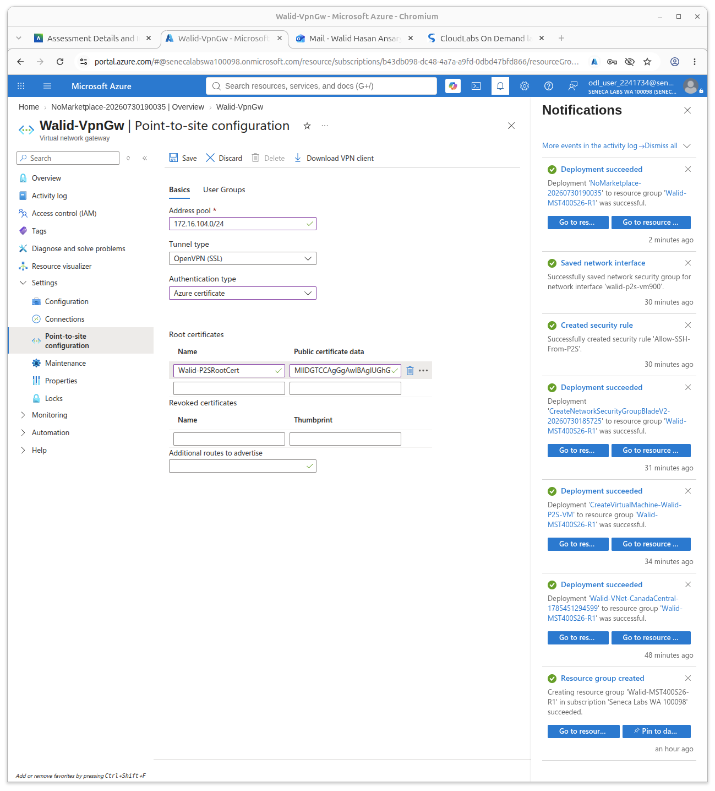
Point-to-Site VPN Configuration
Client address pool, tunnel type, and certificate authentication
P2S settings
Address pool: 172.16.104.0/24
Tunnel: OpenVPN (SSL)
Authentication: Azure certificate
Root cert: Walid-P2SRootCert
Azure uses the uploaded root certificate to trust the client certificate inside the OpenVPN profile.
When connected, my local PC received 172.16.104.2 from this pool.
MST400 Project 2 | Walid Hasan Ansary | 9

Slide 10
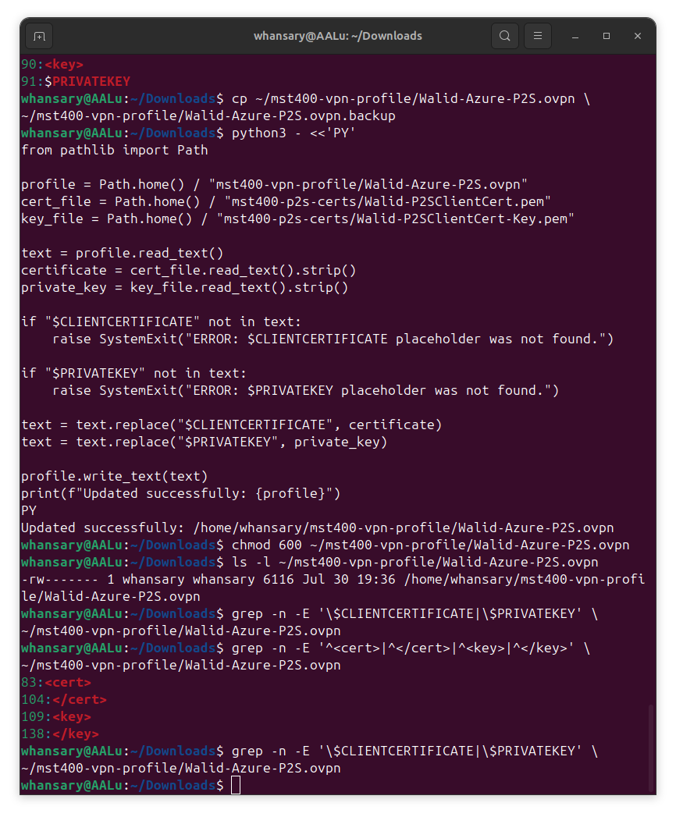
Certificate Setup
Root certificate + client certificate for authentication
Validation evidence
Root certificate created locally
Root public data uploaded to Azure
Client certificate signed by root certificate
Verification result: Walid-P2SClientCert.pem: OK
Private keys were not shared
Only the root public certificate data is uploaded to Azure. The private keys remain on the local computer.
MST400 Project 2 | Walid Hasan Ansary | 10

Slide 11
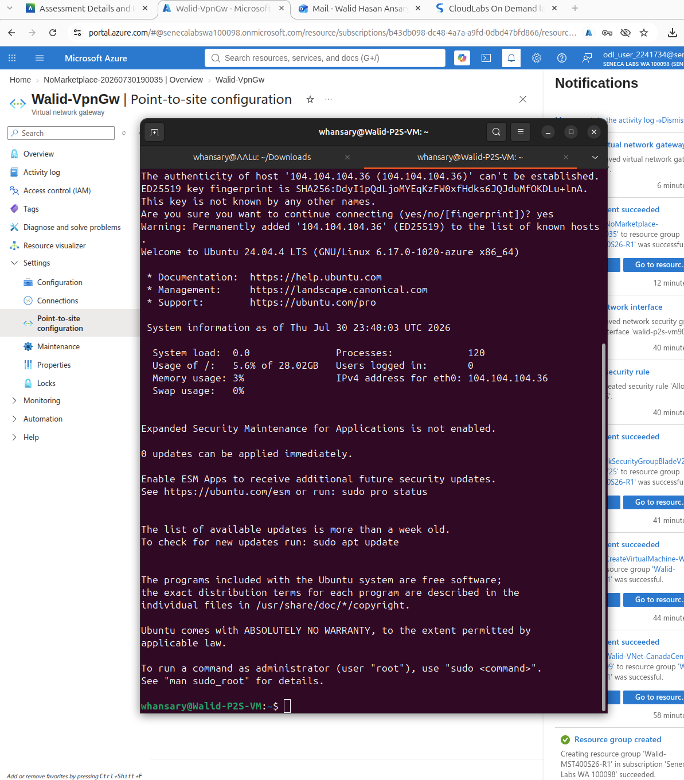
Successful Private-IP SSH
VPN connected → private SSH works
Successful test
ssh -i ~/.ssh/walid-mst400-key \
whansary@104.104.104.36
hostname
whoami
ip addr
hostname -I
The login prompt changed to whansary@Walid-P2S-VM, proving that the SSH session reached the Azure VM by private IP.
MST400 Project 2 | Walid Hasan Ansary | 11

Slide 12
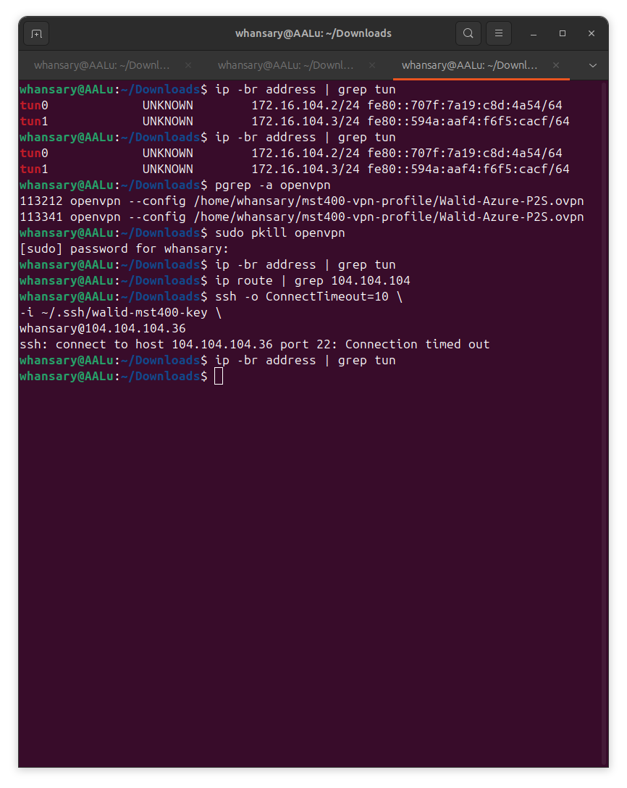
VPN Dependency Test
VPN disconnected → private SSH fails
Failure evidence
sudo pkill openvpn
ip -br address | grep tun
ip route | grep 104.104.104
ssh -o ConnectTimeout=10 \
-i ~/.ssh/walid-mst400-key \
whansary@104.104.104.36
Result: Connection timed out
No tunnel interface + no Azure route = SSH to the private IP times out. This proves access requires the VPN.
MST400 Project 2 | Walid Hasan Ansary | 12

Slide 13
Live Demo Checklist
Use this order during the 5–7 minute recording
Show ODL account and resource group
Show VNet address space and both subnets
Show VM private IP and no public IP
Show NSG rule allowing SSH from 172.16.104.0/24
Show VPN Gateway and P2S settings
Connect OpenVPN and show tun0 with 172.16.104.x
SSH to 104.104.104.36 and run hostname, whoami, ip addr
Disconnect VPN and show SSH timeout
Connect:
sudo openvpn --config ~/mst400-vpn-profile/Walid-Azure-P2S.ovpn
Test:
ssh -i ~/.ssh/walid-mst400-key whansary@104.104.104.36
Disconnect:
sudo pkill openvpn
Say clearly: “This proves the VM is only reachable through the secure Point-to-Site VPN tunnel.”
MST400 Project 2 | Walid Hasan Ansary | 13

Slide 14
Reflection
What I learned and challenges solved
What I learned
Challenge solved
How P2S VPN securely connects a local PC to Azure
How certificate-based VPN authentication works
How to keep Azure VMs private without a public IP
How NSG source ranges restrict SSH access
OpenVPN was accidentally started twice
Two tunnel interfaces appeared: tun0 and tun1
I stopped both with sudo pkill openvpn
Then verified SSH timed out when VPN was disconnected
Final result: successful private-IP SSH when VPN is connected, and failed private-IP SSH when VPN is disconnected.
MST400 Project 2 | Walid Hasan Ansary | 14

