Slide 1

SendMySearch
Timothy Han, William Li, Frank Tian, Dave Wang

Slide 2
Our Idea
Access to Internet crucial to education
More important than ever in modern age
But…
Run out of mobile data
Out of Range
No Access to 3G or 4G LTE

Slide 3
Our Idea
89% of world access to basic texting and voice services
Disproportionately affects the poor or rural
Access to internet increases education
Can decrease poverty across the globe

Slide 4
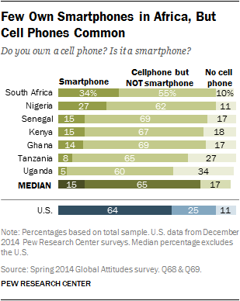
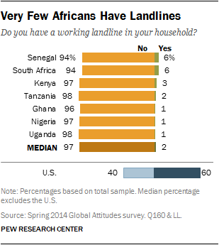

Slide 5
How it Works
Text message to SMS Gateway
SMS Gateway redirects query our server on Director
Server queries Wikipedia and returns JSON output
Returns output through email with mobile carrier
SMS received and parsed client-side
Displays response and plain text

Slide 6
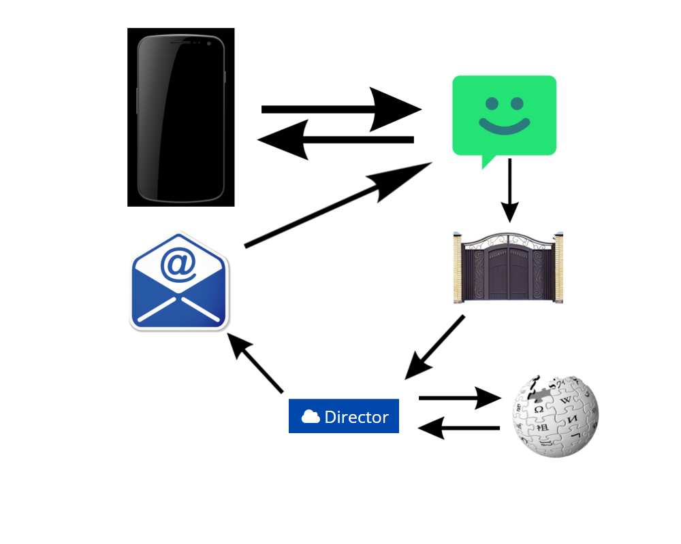
Visual representation

Slide 7
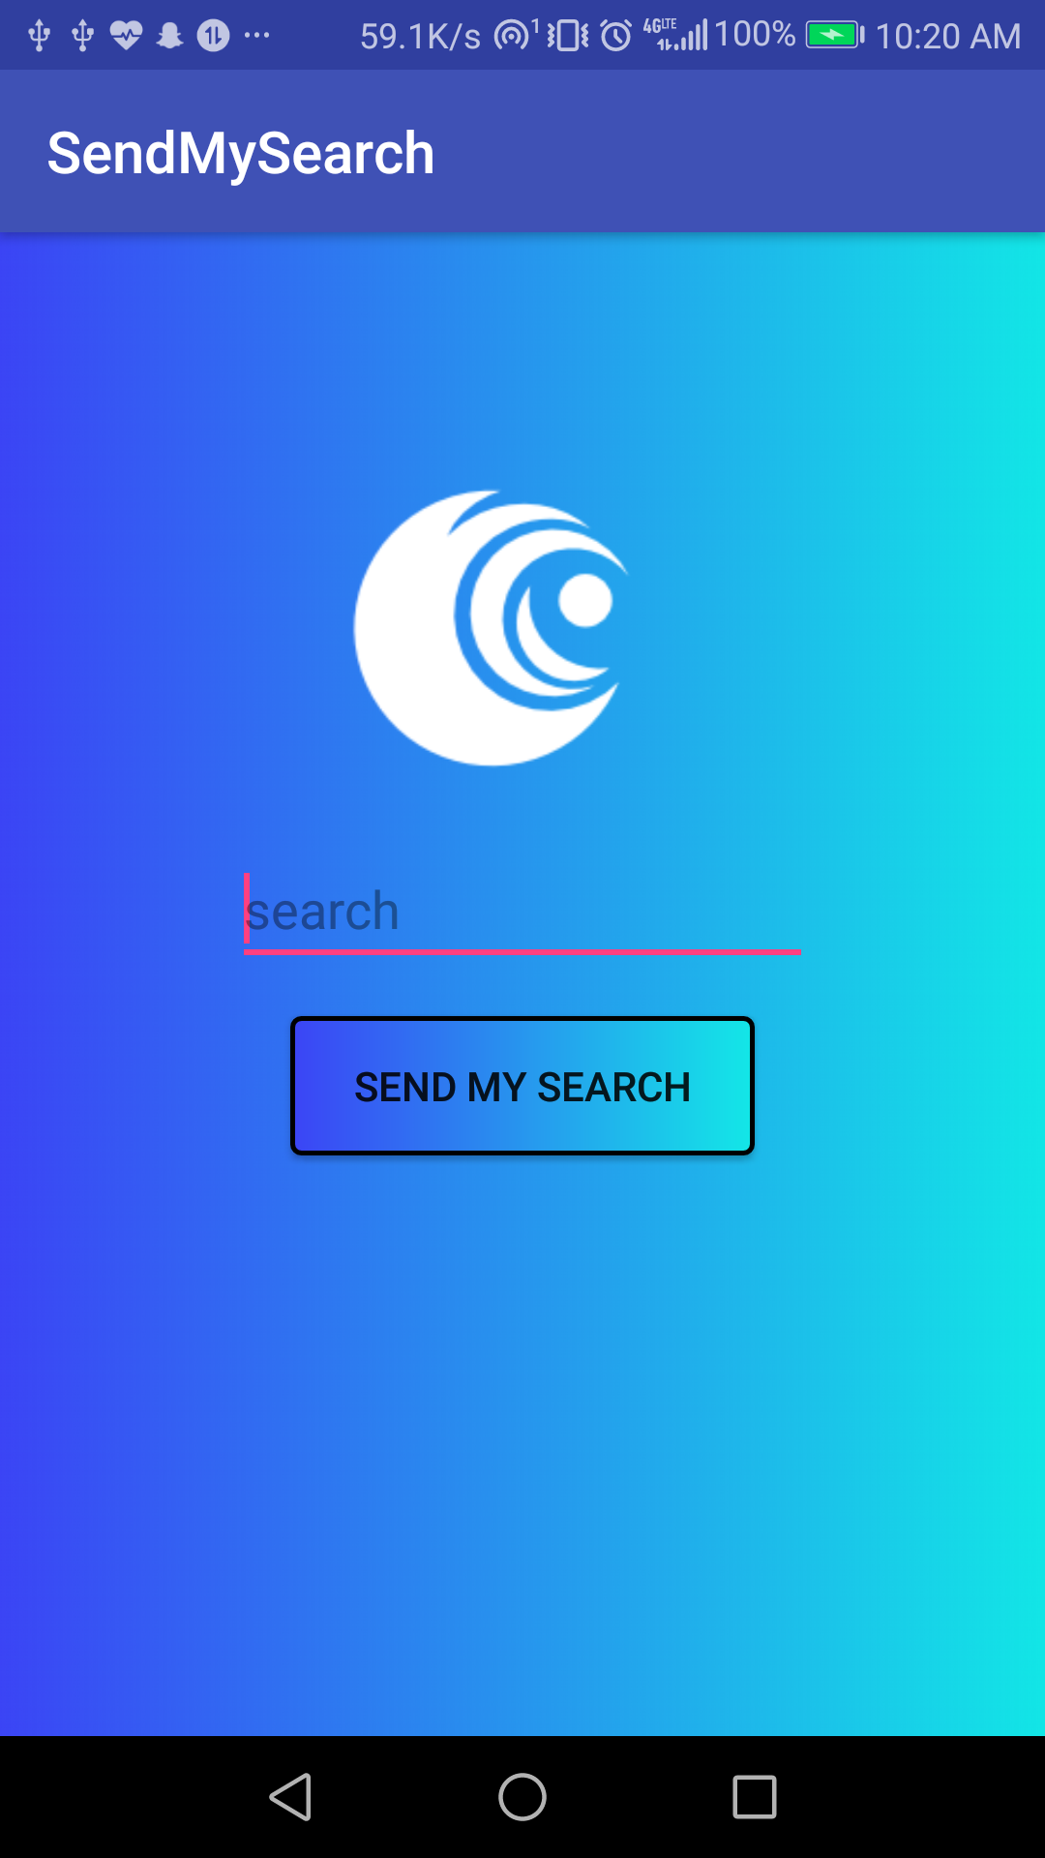
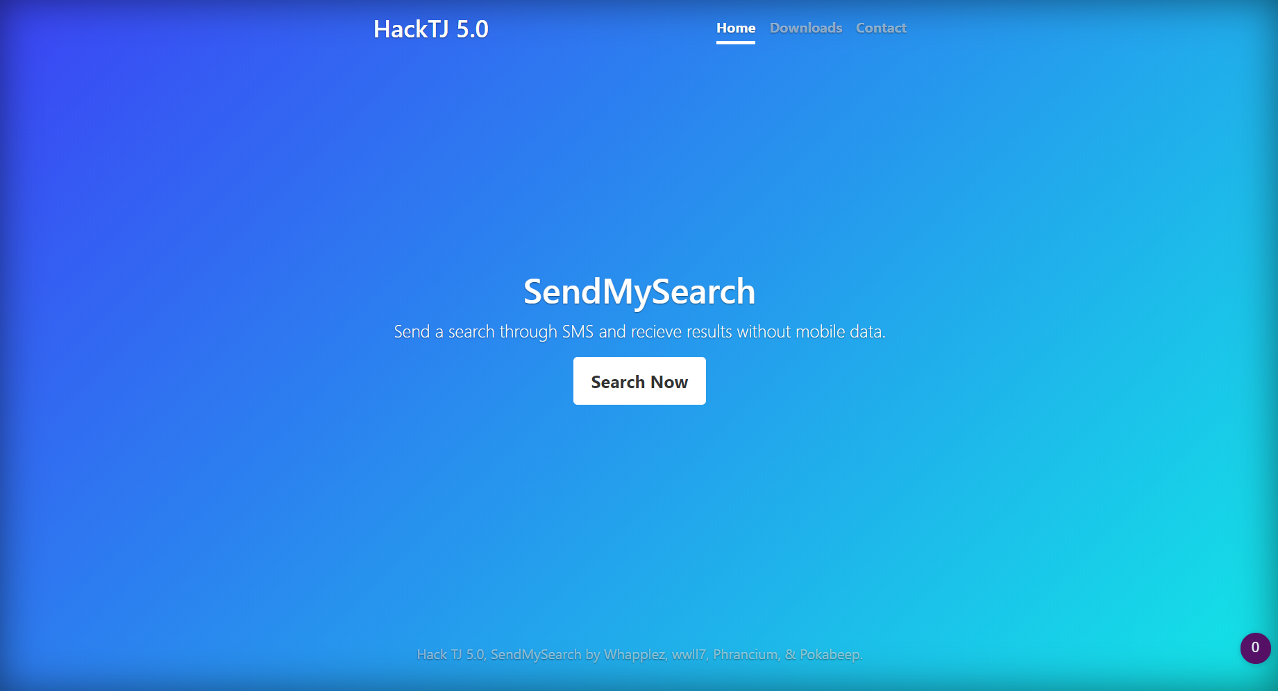
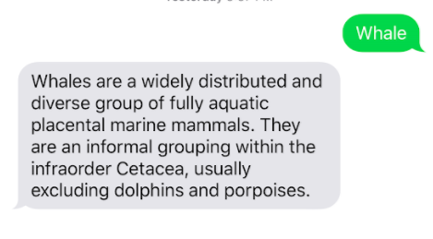
Demo

