Slide 1
Wharton People Analytics Case Competition 2022
William Harkless and Kevin Xu

Slide 2
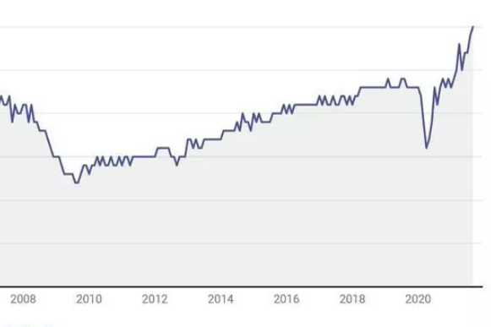
Great Resignation
Marked by large increases in resignation rate among employees beginning March 2021
How has the Great Resignation affected the workforce at Penn?

Slide 3
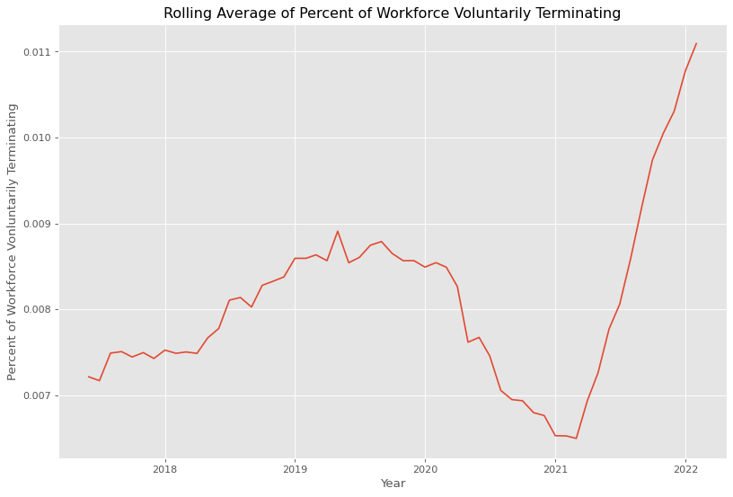
Effect at Penn
Previous high of 0.9% resignation rate averaged over 12 months
Into 2022, resignation rate is 1.1% and climbing
Matches trend of Great Resignation found across the country

Slide 4
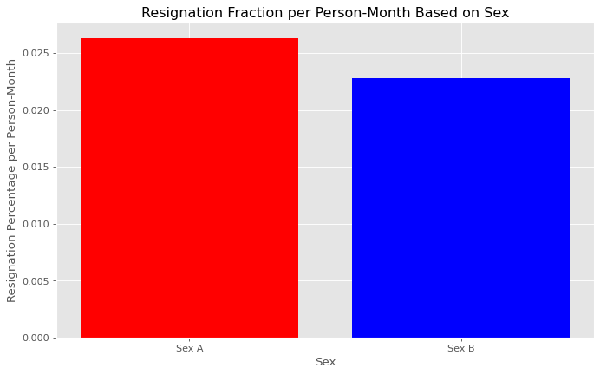
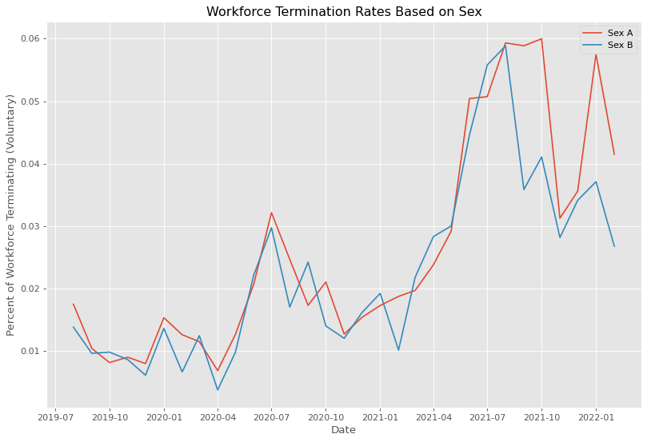
Resignation Rate Grouped by Sex

Slide 5
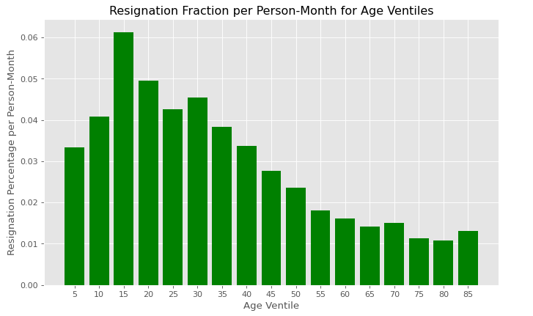
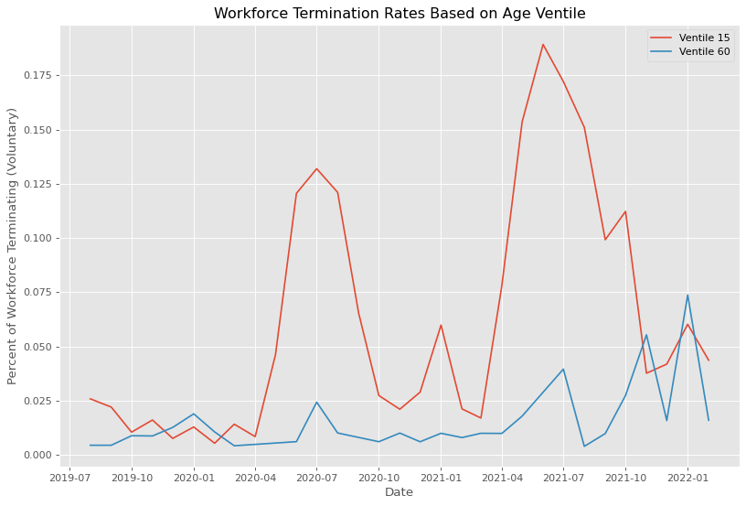
Resignation Rate Grouped by Age

Slide 6
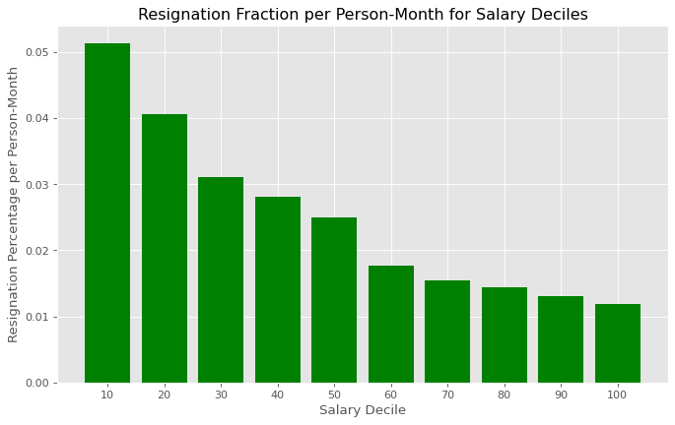
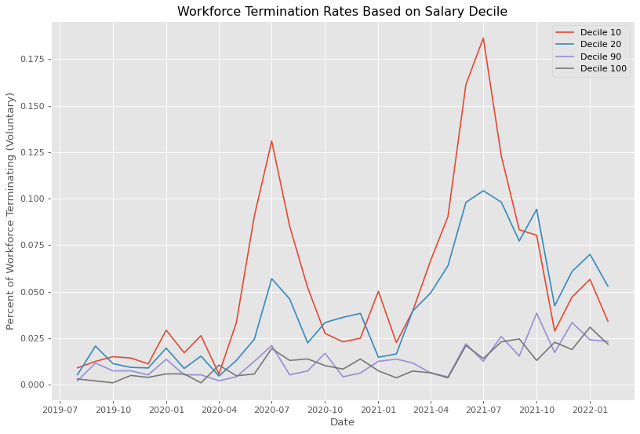
Resignation Rate Grouped by Salary

Slide 7
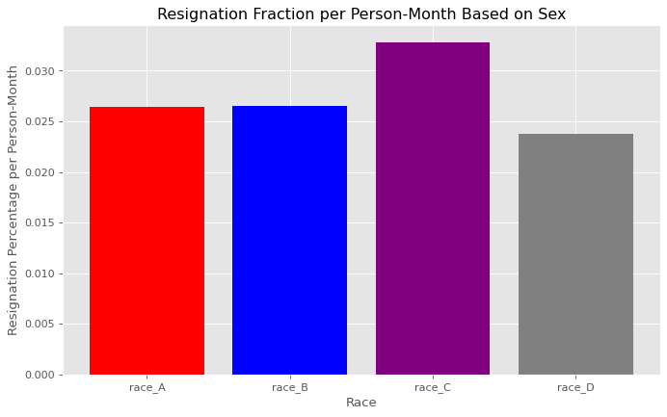
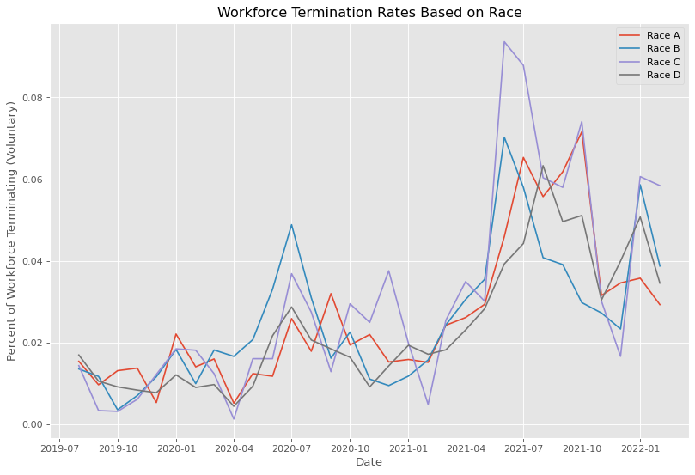
Resignation Rate Grouped by Race

Slide 8
Model Results
Goal: Use employee data to determine whether or not it is likely an employee will resign over the period from late 2019 - 2022
Model Type | Accuracy
Logistic Regression Classifier | 0.643
Random Forest Classifier | 0.832
Gradient Boosting Classifier | 0.817
Support Vector Classifier | 0.624

Slide 9
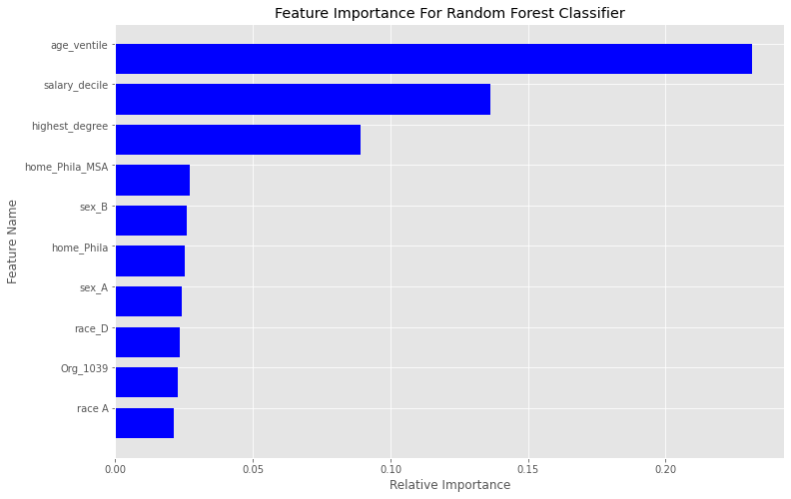
Analyzing Random Forest Model
Out of all individuals who resigned, model was able to accurately predict over 81% of them
Out of all individuals whom the model predicted would resign, over 78% of them did
Age and salary had largest impact on how individuals were classified

Slide 10
Recommendations
Resignation rates highest among young employees and those paid the lowest
Establish clear promotion tracks for those early in the their careers
Provide monetary incentives for employees who stay beyond their first few years
Allow new employees the flexibility to explore other roles at Penn to retain their experience while providing opportunities to explore different careers

