Slide 1
R

Slide 2
資料分析的步驟
觀查資料
猜測原因
整理資料
作圖看相關性

Slide 3
資料整理

Slide 4
天氣和載客量
猜測雨天會增加載客量
天冷會增加載客量

Slide 5
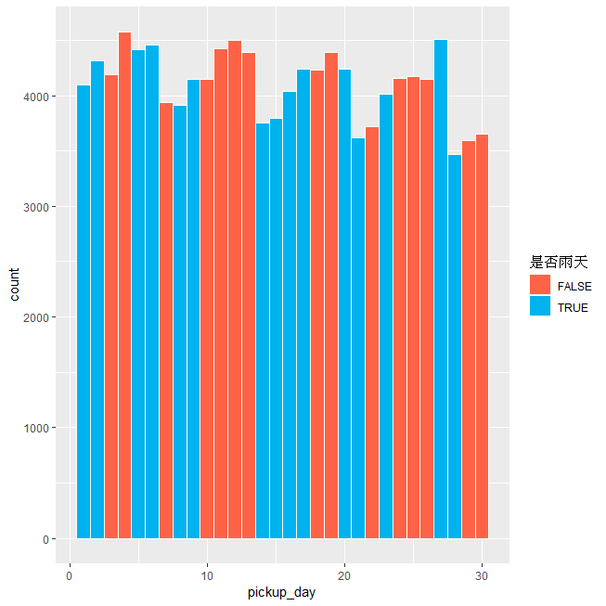
雨天

Slide 6
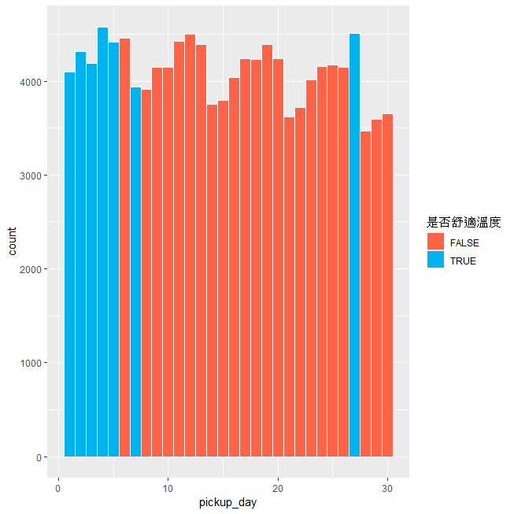
溫度

Slide 7
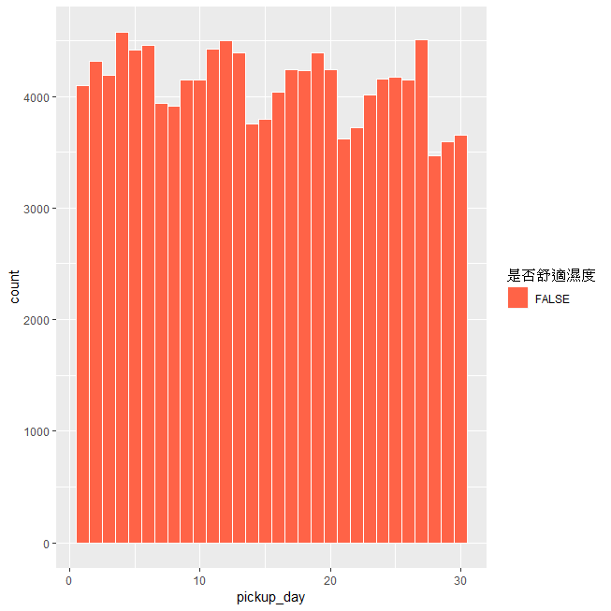
濕度

Slide 8
如何獲得最多的小費
猜乘車人數越多小費愈多
晚班小費較多
乘車距離愈長小費愈多

Slide 9
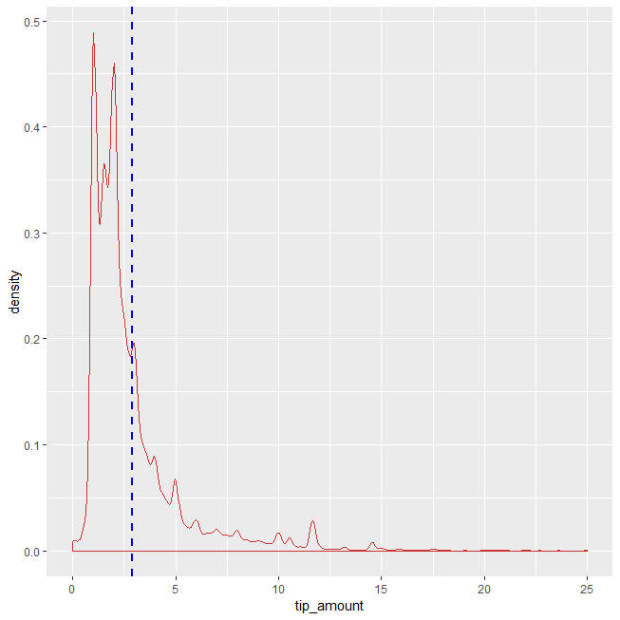
小費分佈
filter(addweatherdata,tip_amount!=0)%>%
ggplot()+
geom_density(aes(x=tip_amount,color=I("brown3")))+
xlim(0,25)+
geom_vline(aes(xintercept=mean(tip_amount)),
color="blue", linetype="dashed", size=1)

Slide 10
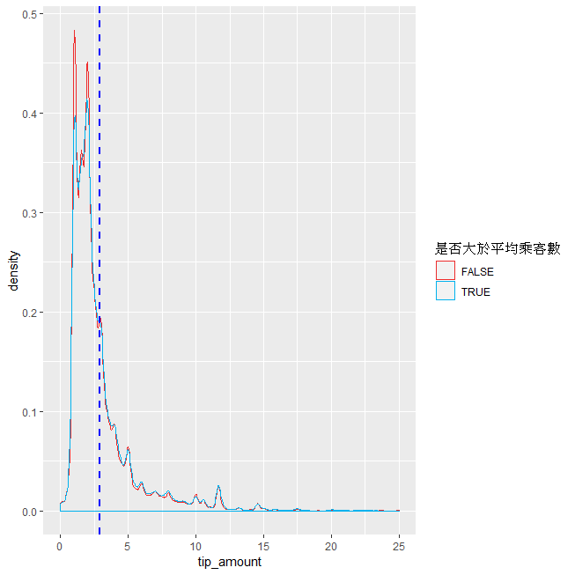
乘車人數與小費
filter(addweatherdata,tip_amount!=0)%>%
ggplot()+
geom_density(aes(x=tip_amount,color=passenger_count>mean(passenger_count)))+
xlim(0,25)+
scale_color_manual(values = c("firebrick2", "deepskyblue2"),name="是否大於平均乘客數")+
geom_vline(aes(xintercept=mean(tip_amount)),
color="blue", linetype="dashed", size=1)

Slide 11
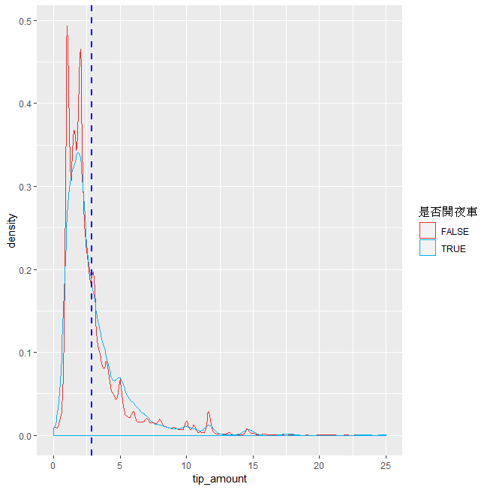
夜車
filter(addweatherdata,tip_amount!=0)%>%
ggplot()+
geom_density(aes(x=tip_amount,color=dropoff_hour==c(0,1,2,3,4,5)))+
xlim(0,25)+
scale_color_manual(values = c("firebrick2", "deepskyblue2"),name="是否開夜車")+
geom_vline(aes(xintercept=mean(tip_amount)),
color="blue", linetype="dashed", size=1)

Slide 12
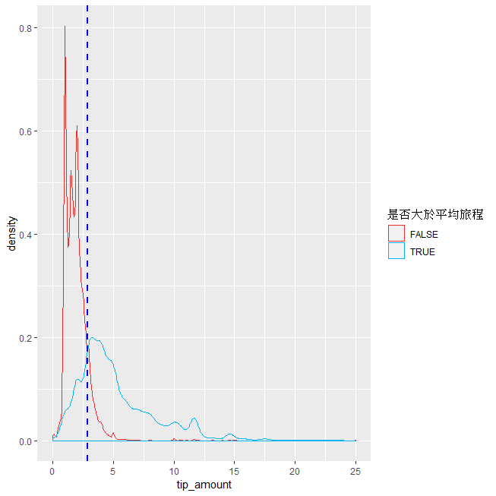
旅程距離和小費
filter(addweatherdata,tip_amount!=0)%>%filter(trip_distance<mean(trip_distance))%>%
ggplot()+
geom_density(aes(x=tip_amount,color=I("springgreen4")))+
xlim(0,25)

Slide 13
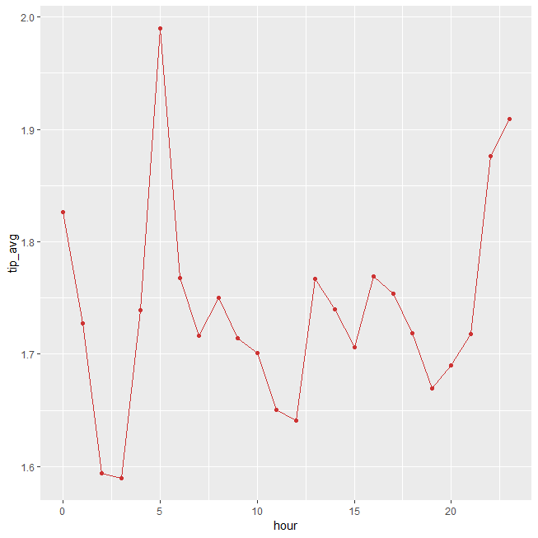
什麼時候小費最多
h <-group_by(addweatherdata,pickup_hour)%>%
summarise(mean(tip_amount, na.rm = TRUE))
names(h)<-c("hour","tip_avg")
ggplot(h,aes(x=hour,y=tip_avg,color=I("brown3")))+
geom_line()+
geom_point()

Slide 14
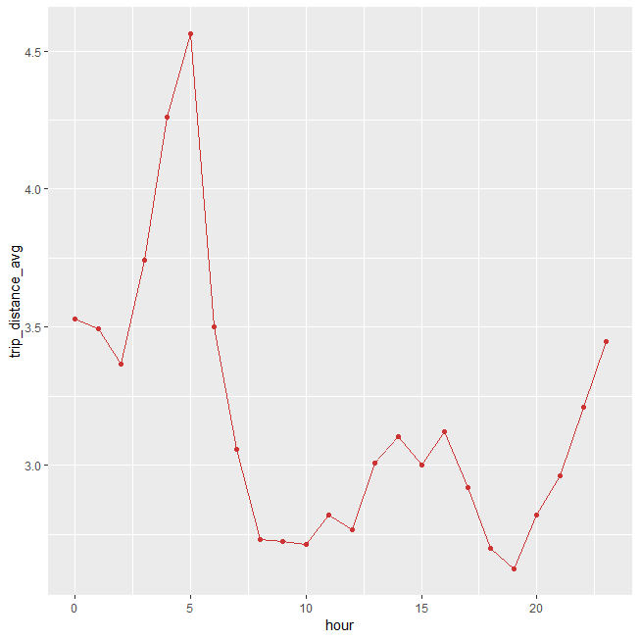
什麼時候開最少
j<-group_by(addweatherdata,pickup_hour)%>%
summarise(mean(trip_distance, na.rm = TRUE))
names(j)<-c("hour","trip_distance_avg")
ggplot(j,aes(x=hour,y=trip_distance_avg,color=I("brown3")))+
geom_line()+
geom_point()

Slide 15
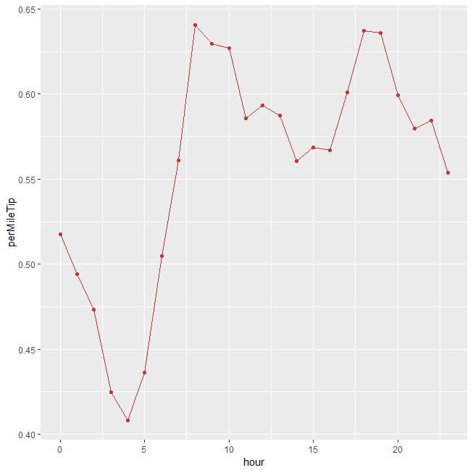
最賺的時間
k<- left_join(h,j)
k<-mutate(k,perMileTip=tip_avg/trip_distance_avg)
ggplot(k,aes(x=hour,y=perMileTip,,color=I("brown3")))+
geom_line()+
geom_point()

