Slide 1
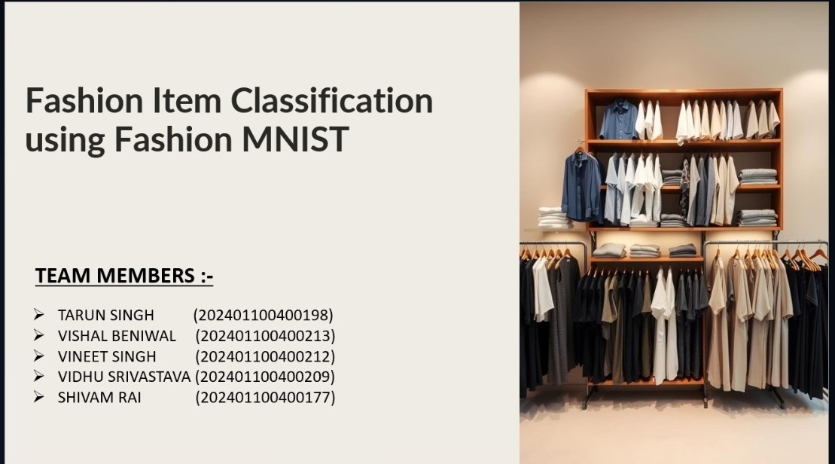

Slide 2
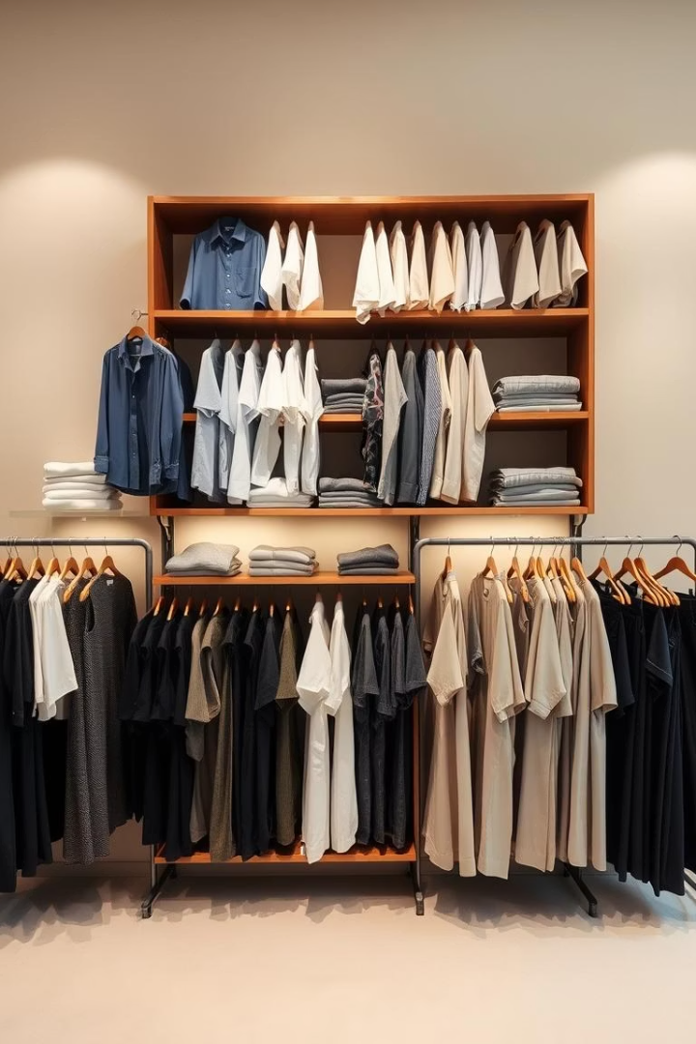
Fashion Item Classification using Fashion MNIST
This project aims to build an image classifier. It will categorize clothing items using the Fashion MNIST dataset. We will visualize the results with a confusion matrix for clear evaluation.

Slide 3
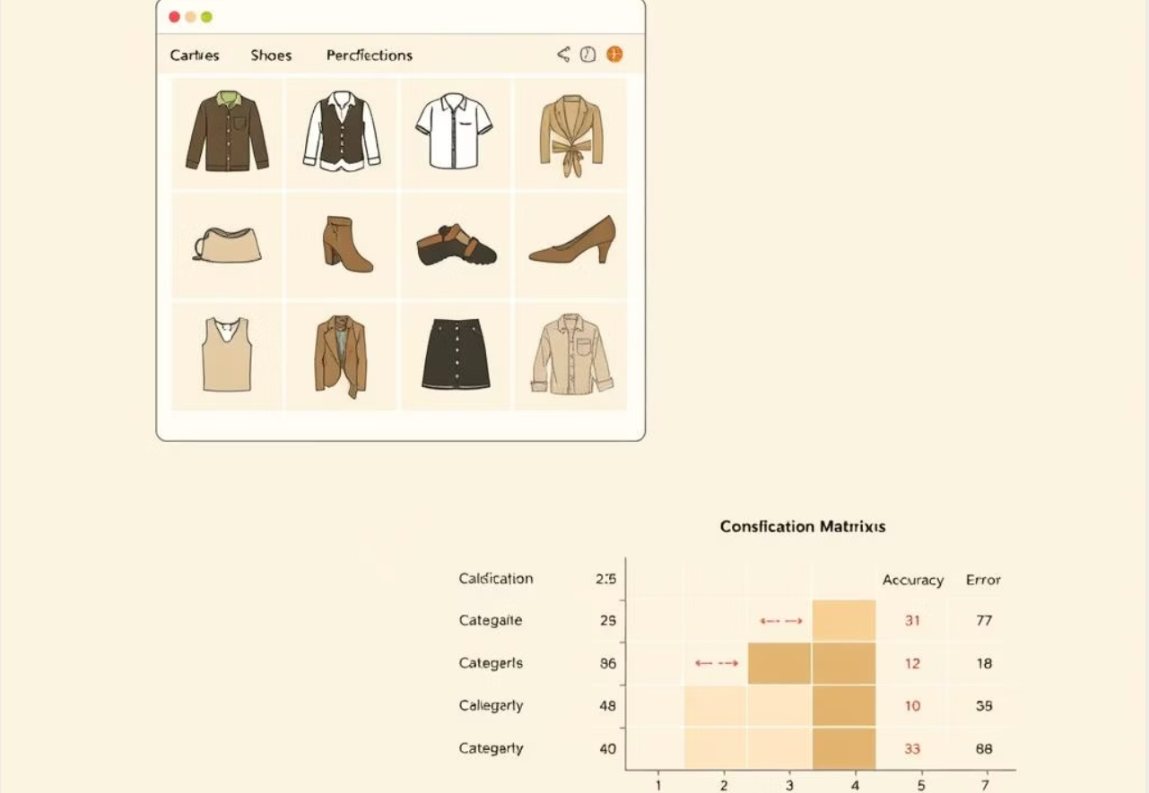
Introduction
This project focuses on classifying clothing items using the Fashion MNIST dataset, which contains 28×28 grayscale images across 10 fashion categories. The data is normalized and fed into a fully connected neural network built with TensorFlow. The model is trained and evaluated using accuracy, confusion matrix, and classification report. Sample predictions are also visualized to understand the model's performance more clearly.

Slide 4
Understanding the Fashion MNIST Dataset
Dataset Overview
10 Distinct Classes
It contains 70,000 images, each 28x28 pixels. There are 60,000 for training and 10,000 for testing. Images are grayscale.
T-shirt/top
Trouser
Pullover
Dress
Coat
Sandal
Shirt
Sneaker
Bag
Ankle boot

Slide 5
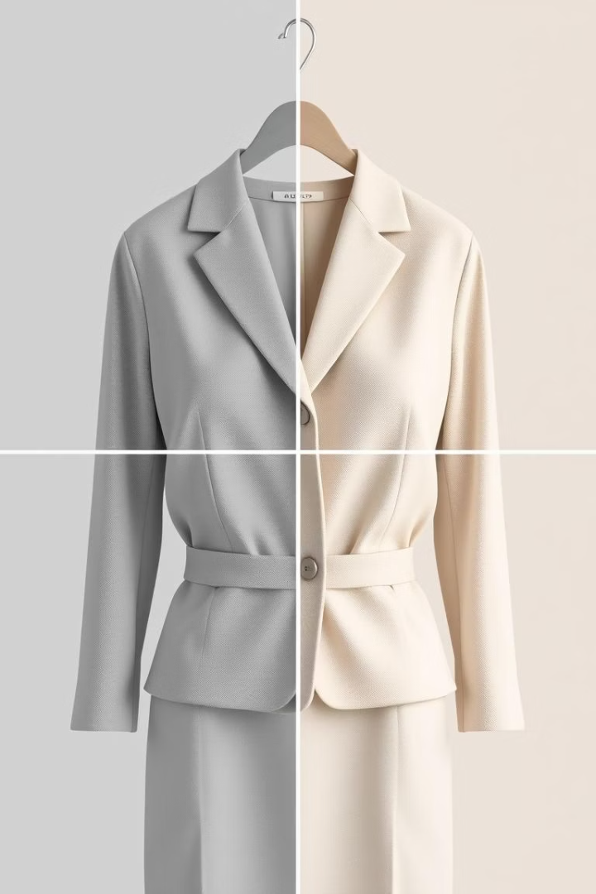



Data Preprocessing and Preparation
Reshape Images
Images are reshaped to 28x28x1 format. This prepares them for the model input.
Normalize Pixels
Pixel values are scaled. They are divided by 255 to be in [0, 1] range.
Split Data
The dataset is split into training and validation sets. A common split is 80/20.

Slide 6
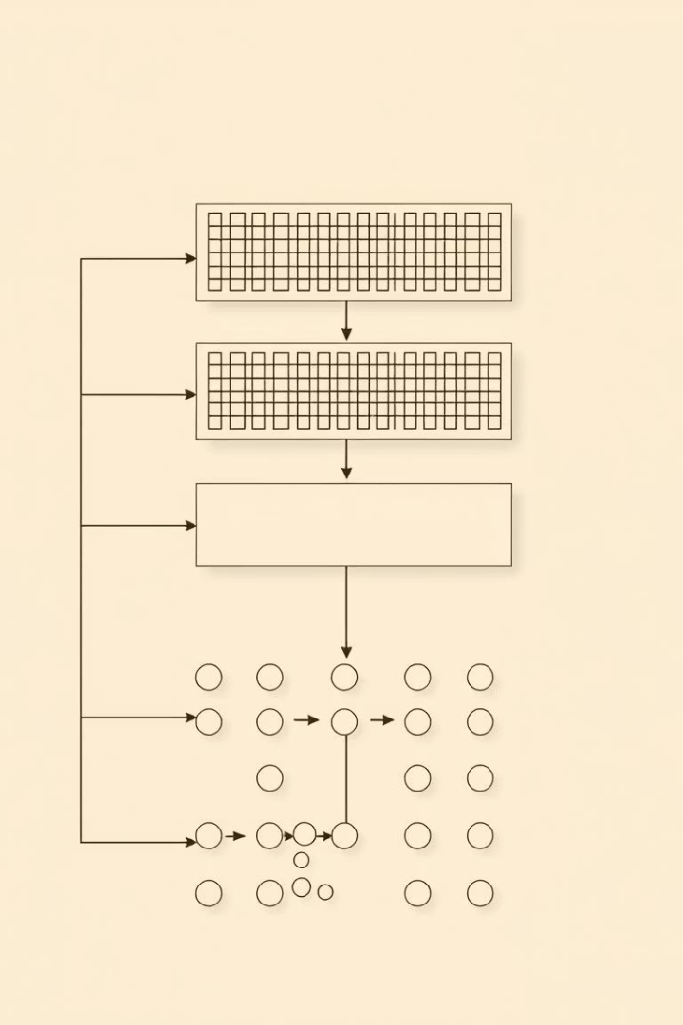
Model Selection and Architecture
Convolutional Layers
Uses 3 layers with 32, 64, and 128 filters. Extracts features from images efficiently.
Pooling & Dropout
MaxPooling reduces dimensions. Dropout (0.25) prevents overfitting by randomly deactivating neurons.
Dense & Output Layers
A dense layer with 128 units processes features. The output layer has 10 units with softmax for classification.
Activation Functions
ReLU is used in hidden layers. Softmax for the output layer. It outputs class probabilities.

Slide 7





Training and Validation
Loss Function
Optimizer
Categorical Crossentropy is selected. It measures prediction error.
Adam optimizer is used with a learning rate of 0.001. It adjusts model weights.
Performance Metrics
Training Parameters
Accuracy, Precision, Recall, and F1-score are monitored. They evaluate model effectiveness.
The model trains for 10-20 epochs. Batch size is set to 32 or 64 samples.

Slide 8

Model Evaluation
Overall Accuracy
91%
T-shirt/top Accuracy
95%
Trouser Accuracy
98%
Pullover Accuracy
87%
Coat Accuracy
89%
Model performance is assessed using the test dataset. Overall accuracy is reported. Class-specific performance is analyzed.

Slide 9








Visualizing Results with Confusion Matrix
Confusion Matrix
Correct Classifications
Rows represent actual classes. Columns represent predicted classes. A visual tool for model errors.
Diagonal elements show correctly classified instances. These are true positives for each class.
Interpretation
Misclassifications
Helps identify which classes are frequently confused. Guides efforts for model improvement.
Off-diagonal elements indicate errors. For example, Pullovers misclassified as Coats.

Slide 10

Conclusion
Future Steps
Key Insights
Next steps involve fine-tuning the model. Exploring different architectures for better performance.
Project Success
The confusion matrix provided valuable insights. It highlighted specific areas for model refinement.
Successfully built and evaluated a fashion item classifier. It achieved high accuracy on Fashion MNIST.

Slide 11
10. References
TensorFlow and Keras documentation
scikit-learn metrics documentation
pandas and matplotlib documentation
Fashion MNIST Dataset
Seaborn visualization library

