Slide 1

Data Science Interview Challenge

Slide 2
Parent Batches
(261)
1
2
1
3
2
3
Those have QC test results
Output Batches
(101)
A
B
C
Those have QC test results and YIELD_VALUE

Slide 3
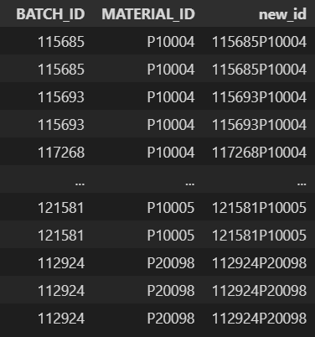
All metrics and raw data inputs are aggregated to the BATCH_ID+MATERIAL_ID level So, I will combine those two column into one ID column. It refers a production unit in process. (new_id)
YIELD_NAME=="activity_coefficient“
173 rows
108 rows without NA
96 of them existing in Batch_Genealogy

Slide 4
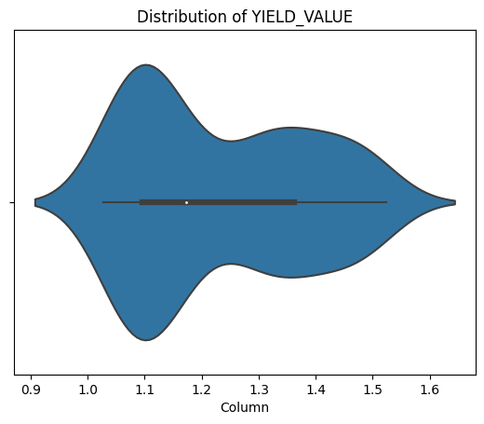
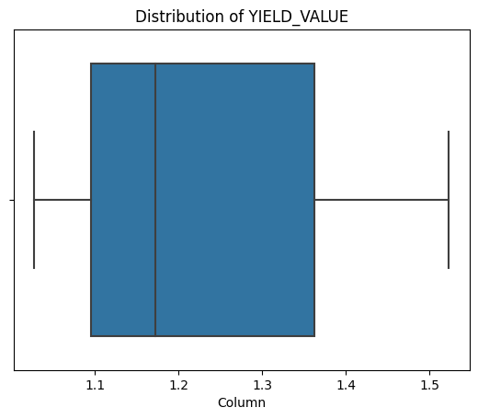
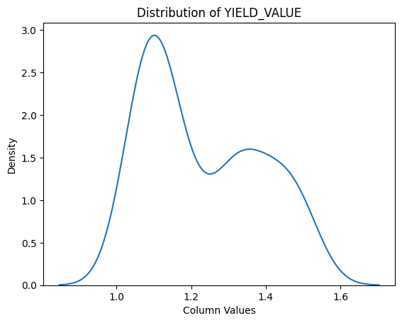
My target variable distribution can give idea about what kind of models that I can build.
It is not a normal distribution. It is a bimodal distribution, it has two peaks
Non-parametric Models: decision trees, random forests, support vector machines, and neural networks. These models can capture complex relationships without explicitly assuming a specific distribution
Generalized Linear Models (GLMs): Logistic Regression
Notes:
Non-parametric models are flexible modeling techniques that do not assume a specific functional form for the relationship between predictors and the response variable. These models make fewer assumptions about the underlying distribution of the data and can be more robust to violations of normality. Non-parametric models include techniques like decision trees, random forests, support vector machines, and neural networks. These models can capture complex relationships without explicitly assuming a specific distribution.
GLMs are an extension of linear regression models that allow for non-normal response variables and account for different types of distributions. GLMs relax the assumption of normally distributed residuals and instead assume a specific distribution from the exponential family, such as binomial, Poisson, or gamma distributions. This allows for modeling various types of response variables, such as binary, count, or skewed continuous variables.

Slide 5
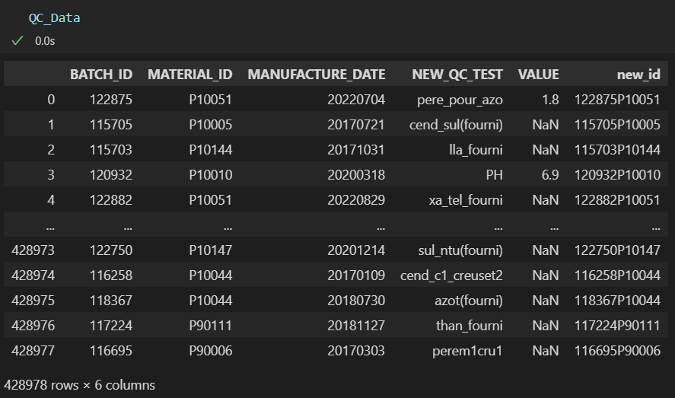
QC_Data
Shape: 428978 rows × 6 columns
# of unique test: 74
# of rows which have value: 56010
It has QC test results for both input and output production unit.
Weighted QC attributes needed for output production units.

Slide 6
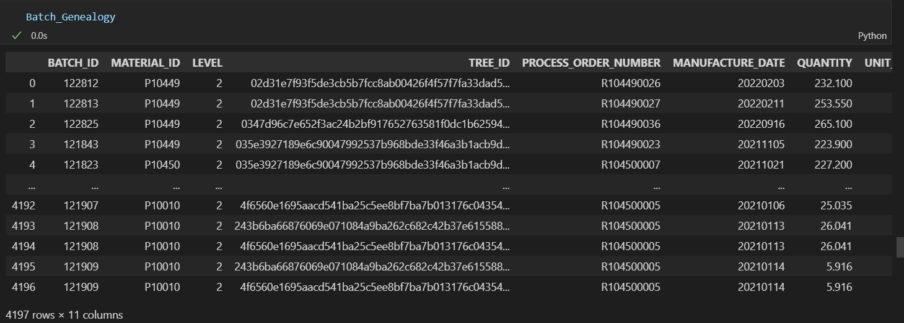
Batch_Genealogy
Shape: 4197 rows × 11 columns
# of total input: 3781
# of total output: 208
# of unique production unit: 983
# of unique input: 886
# of unique output: 97
Length of intersection with Combined_Yields output: 96

Slide 7
Questions
Is time matter? Do Quantity or other features change over time? or is it only for keeping record? I mean I should not apply time series methods, right?
What is TREE_ID? Batch_Genealogy tab has TREE_ID column. I couldn’t understand why it is required. For keeping track on trees, I can use PROCESS_ORDER_NUMBER.

