Slide 1

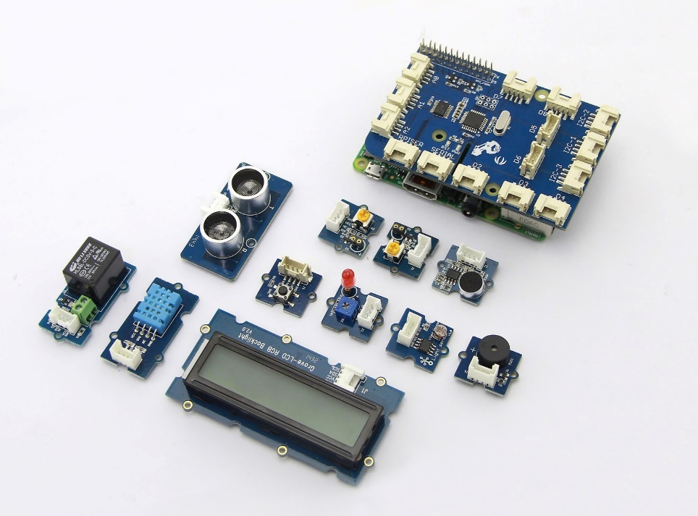

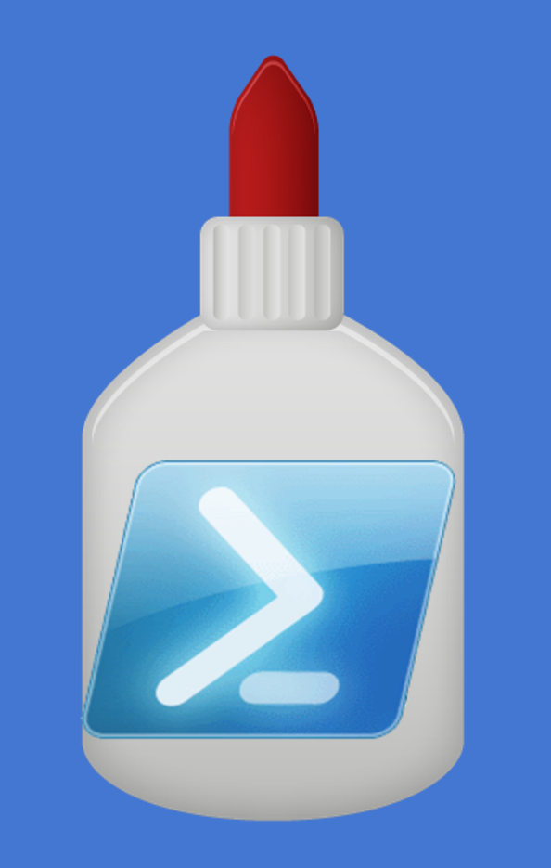

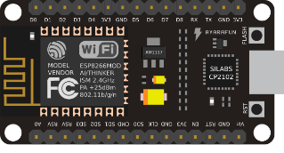
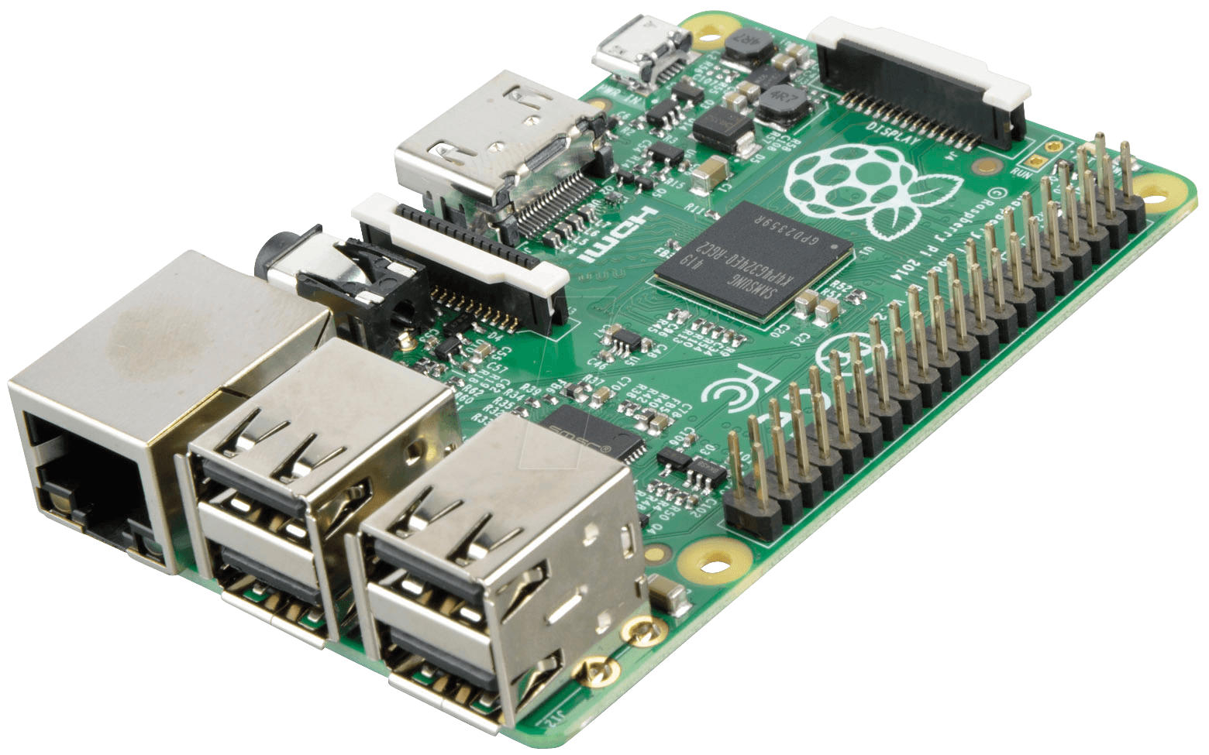
Powershell Invoke-RestMethod
Paul Amazona| Developer

Slide 2
Session Guide
Setup Powershell-Core
Setup Powershell Debugging
Debug Invoke-RestMethod
Demo on Invoke-RestMethod usage with Devices

Slide 3
Setup Powershell-Core
> git clone --recursive https://github.com/PowerShell/PowerShell.git
> Import-Module ./build.psm1
> Start-PSBootstrap
> Start-PSBuild
Reference: https://github.com/PowerShell/PowerShell/blob/master/docs/building/windows-core.md

Slide 4
Installation of Powershell-Core on Linux
Download corresponding package from github:
https://github.com/PowerShell/PowerShell/releases/
2. Install the package
> sudo dpkg -i powershell_6.0.0-alpha.12-1ubuntu1.14.04.1_amd64.deb
> sudo apt-get install -f
3. Type “powershell” in the terminal and hit enter.
Reference: https://github.com/PowerShell/PowerShell/blob/master/docs/installation/linux.md

Slide 5
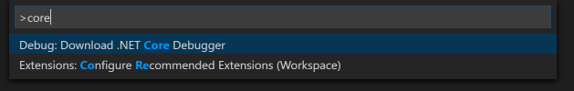
Powershell-Core Debugging
Install VS Code
Install .NET Core Debugger (ctrl+shift+p)

Slide 6
Invoke-RestMethod

Slide 7
Debug Invoke-RestMethod
Install VS Code
Install .NET Core Debugger (ctrl+shift+p)

