Slide 1


Natural Language to Machine Learning
Tigran Ramazyan, Alexander Levin, Leyla Hatbullina,
Kirill Gelvan, Mikhail Kuznetsov, Dmitry Fedorovichev¹
¹ National Research University Higher School of Economics
October 1, 2020

Slide 2
Main Goals and Plan

Slide 3
Goals
To collect a corpus of ML-source code snippets with labelling
To build source code generative models (seq2seq) based on short natural language description

Slide 4
Plan
To collect data for the corpus
To label code snippets of the corpus
To train classification models
To enhance the knowledge graph using the classifiers’ outputs
To build a final version of NL2ML-corpus
To train generative models

Slide 5
Similar Corpora
Code Search Net - https://github.com/github/CodeSearchNet
Python 150k Dataset - https://eth-sri.github.io/py150
CoNaLa - https://conala-corpus.github.io/
StaQC - https://github.com/LittleYUYU/StackOverflow-Question-Code-Dataset

Slide 6
Knowledge Graph

Slide 7
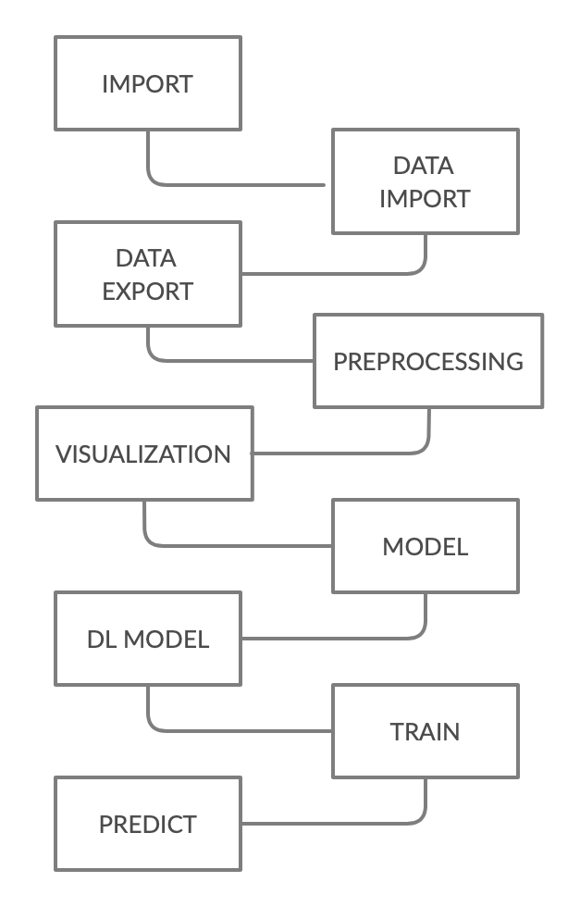
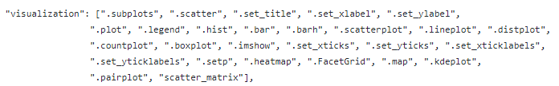
Knowledge Graph (KG)
A graph-description of a ML pipeline:
Each vertex is a high-level part of ML-pipeline
Each vertex has by-hand collected keywords
Keywords are used for regex-labelling
Regex-labelling are used as targets for classification models
Examples:

Slide 8
Data Collection

Slide 9
Preprocessing Dataset
Fully manual collected validation set
Hand-selected methods and algorithms for image, text, speech and table preprocessing, i.e. for one of the KG vertices
Each instance has the following features:
Code
Description
Data format (image/text/speech/table)
Source
Library
Wiki Link
Tags (short description)
Number of instances: 413
Final dataset – nl2ml.csv

Slide 10
Code snippets from Kaggle
Why Kaggle?
Excessive amount of publicly available Python notebooks with ML-code
Kaggle API
Parser pulls out code-description pairs.
Each instance has the following features:
Code
In-code Comments
Number of instances: overall – 254397, unique – 225566
Final dataset – code_blocks_clean.csv

Slide 11
Kaggle Dataset Statistics
Class | Number of Instances | Precentage in the Dataset (%)
import | 28`910 | 12.82
data_import | 17`152 | 7.60
data_export | 4`239 | 1.88
preprocessing | 63`543 | 28.17
visualization | 43`285 | 19.19
model | 6`049 | 2.68
deep_learning_model | 2`946 | 1.31
train | 15`857 | 7.03
predict | 12`993 | 5.76
∑ | <194`974 | <86.44
Reality | 137`424 | 60.92

Slide 12
Code snippets from Github
Parser pulls out code-description pairs.
Each instance has the following features:
User
Repo
File path
Code
In-code Comments
Number of instances: overall – 249542, unique – 167353
Final dataset - github_raw.csv

Slide 13
Golden Set
Ground truth labelling
Validation set labeled by hand based on Kaggle
Number of instances – 884 snippets
Each snippet belongs to only 1 vertex of the KG
100 snippets for every vertex (84 for “data_export”)
Final dataset - golden_884_set.csv

Slide 14
Code Classification (auto-labelling)

Slide 15
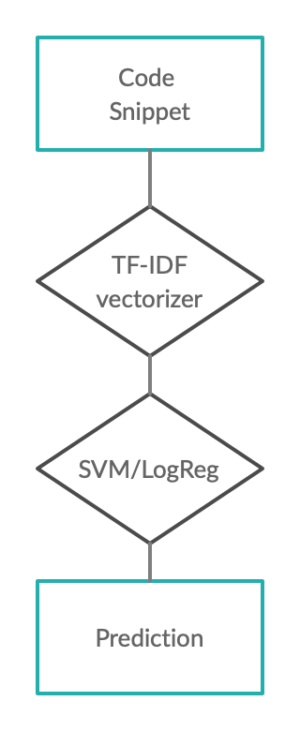
Code Classification (auto-labelling)
Targets – regex-labels
Models: SVM and Logistic Regression
Metric: Accuracy, F1-score (weighted)
Vectorizer: TF-IDF
Scores on the test set (targets – regex-labels)
SVM v6: 0.885
LogReg v6: 0.908
Classification Scores

Slide 16
Models Results

Slide 17
Models Results - Overall
 | Dataset | Number of snippets | Accuracy | F1-score (weighted) | Precision | Recall
Regex_v5 | golden_884_set.csv | 884 | - | 0.757 | 0.926 | 0.678
LogReg_v5 | golden_884_set.csv | 884 | 0.295 | 0.586 | - | -
SVM_v5 | golden_884_set.csv | 884 | 0.316 | 0.586 | - | -
Regex_v6 | golden_884_set.csv | 884 | - | 0.744 | 0.745 | 0.757
LogReg_v6 | golden_884_set.csv | 884 | 0.27 | 0.65 | - | -
SVM_v6 | golden_884_set.csv | 884 | 0.266 | 0.638 | - | -

Slide 18
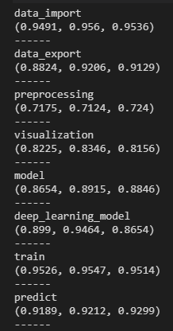
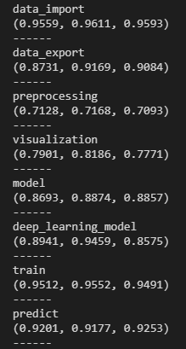
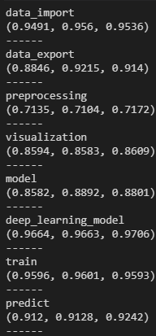
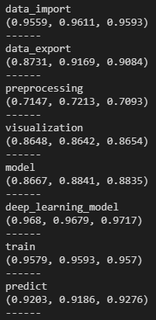
Models Results – Vertices
SVM v5
Log Reg v5
SVM v6
Log Reg v6
F1, Precision, Recall
F1, Precision, Recall
F1, Precision, Recall
F1, Precision, Recall

Slide 19
Future Development
To label more data by hand for deeper evaluation
To continue adding keywords to the KG to increase F1 of classification models
To add vertices to KG for more detailed analysis
To analyze the KG with unsupervised learning models
To use Abstract Syntax Trees (ASTs) which preserve code semantics, hence they might increase prediction quality

Slide 20
Conclusion
Created two datasets with by hand-labelling
Collected the code snippets for the corpus from Kaggle and Github
Labeled code snippets of the corpus with regex (F1 0.744)
Trained SVM (F1 0.885) and Log Reg (F1 0.908) classification models
Enhanced the knowledge graph by hand using the classifiers’ outputs

Slide 21
Final Datasets and Models

Slide 22
Final Data Sets
graph_v{X}.txt - source code semantic knowledge graph vertex with corresponding tags. X is the version of the graph.
kagglenotebooks_list.csv - a list of direct links to Kaggle-notebooks
code_blocks_regex_graph_v{X}.csv - code_blocks_clean.csv, with regex-labelling on the following tags. X is the version of the graph.
nl2ml_preprocessing_full.csv - NL2ML corpus collected by-hand, complete version
chunks_{X}_validate.csv - a dataset containing NL2ML + CoNaLa dataset divided for X rows in a chunk.
github_raw.csv - a dataset containing source code chunks, comments from these chunks and markdowns before the chunks from GitHub.

Slide 23
How does one get these data sets and models?
Clone the repository: https://gitlab.com/lambda-hse/nl2ml
Install DVC from https://dvc.org/doc/install
Do dvc pull or dvc pull data models if you are interested only in the data

Slide 24
Thank you for the attention!

