Slide 1
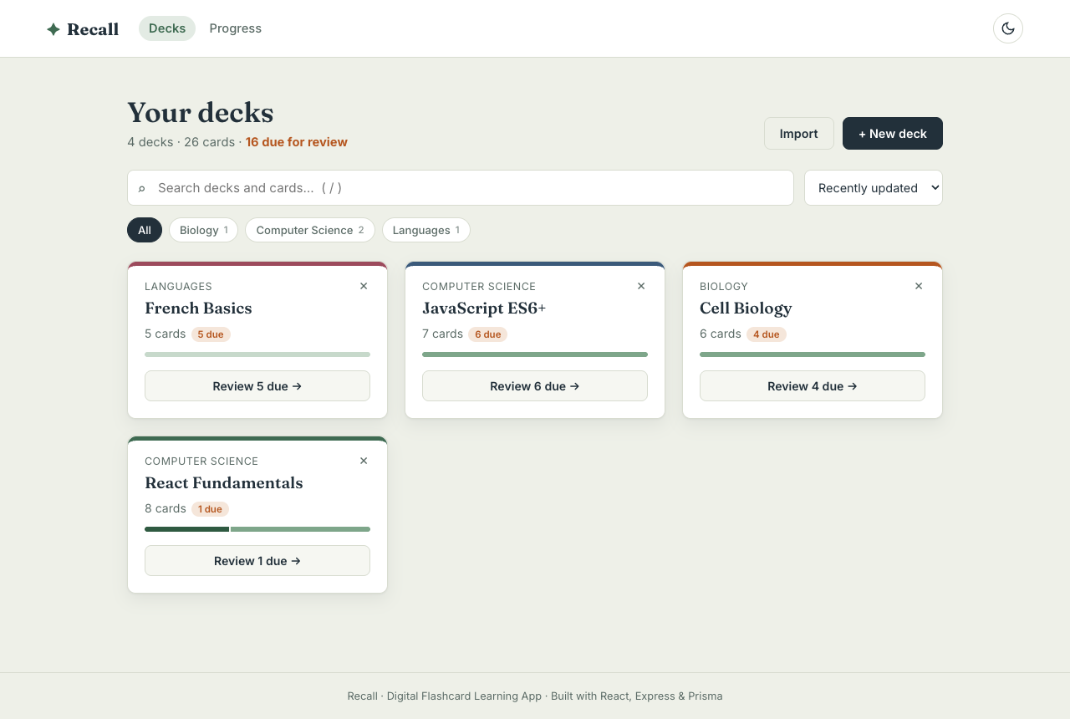
✦ Recall
Digital Flashcard Learning App
with Spaced Repetition
Mini Project — Phase II (FA-2): Advanced Features, Testing & Deployment
Ishita Khandelwal
PRN 125M1H044 · SYMCA · Semester III
Advanced Web Technologies · Dr. Avinash Chormale
PCCoE · Department of MCA · 2026–27

Slide 2
Problem & Objectives
We forget most of what we read within days, unless we review it at the right moment.
The problem
Objectives
Re-reading notes feels productive but is one of the least effective study methods
Flashcards enable active recall, but paper cards give no guidance on what to review when
Existing tools are cluttered, paywalled or hard to use on mobile
Goal: a clean web app that schedules each card just before you would forget it
Full CRUD for decks and cards, stored on a server
Study mode: flip, self-grade (Again/Hard/Good/Easy), keyboard shortcuts
Automatic scheduling with the SM-2 spaced-repetition algorithm
Search, filter and sort; import/export decks as JSON
Progress analytics: streak, recall rate, activity, mastery
Robust validation, error handling, tests and deployment

Slide 3
From Phase I to Phase II
Same design language — new architecture underneath
FA-1 (Phase I)
FA-2 (Phase II) adds
React components, JSX, props
useState, event handling
Conditional rendering, lists & keys
Navigation via a "view" state variable
Data in localStorage (one browser only)
Responsive CSS
Express 5 REST API + Prisma ORM + SQLite (20 endpoints)
React Router: nested layout, params, query strings, 404
useReducer, useContext, useMemo, useCallback, useRef + 7 custom hooks
Validated forms on client (custom) and server (zod)
Search / filter / sort, import / export, SM-2 scheduling
Error boundary, toasts, retry states, offline banner
Lazy routes, memoisation, debouncing, request cancellation
76 automated tests + E2E, CI, deploy configs, dark mode
➜

Slide 4
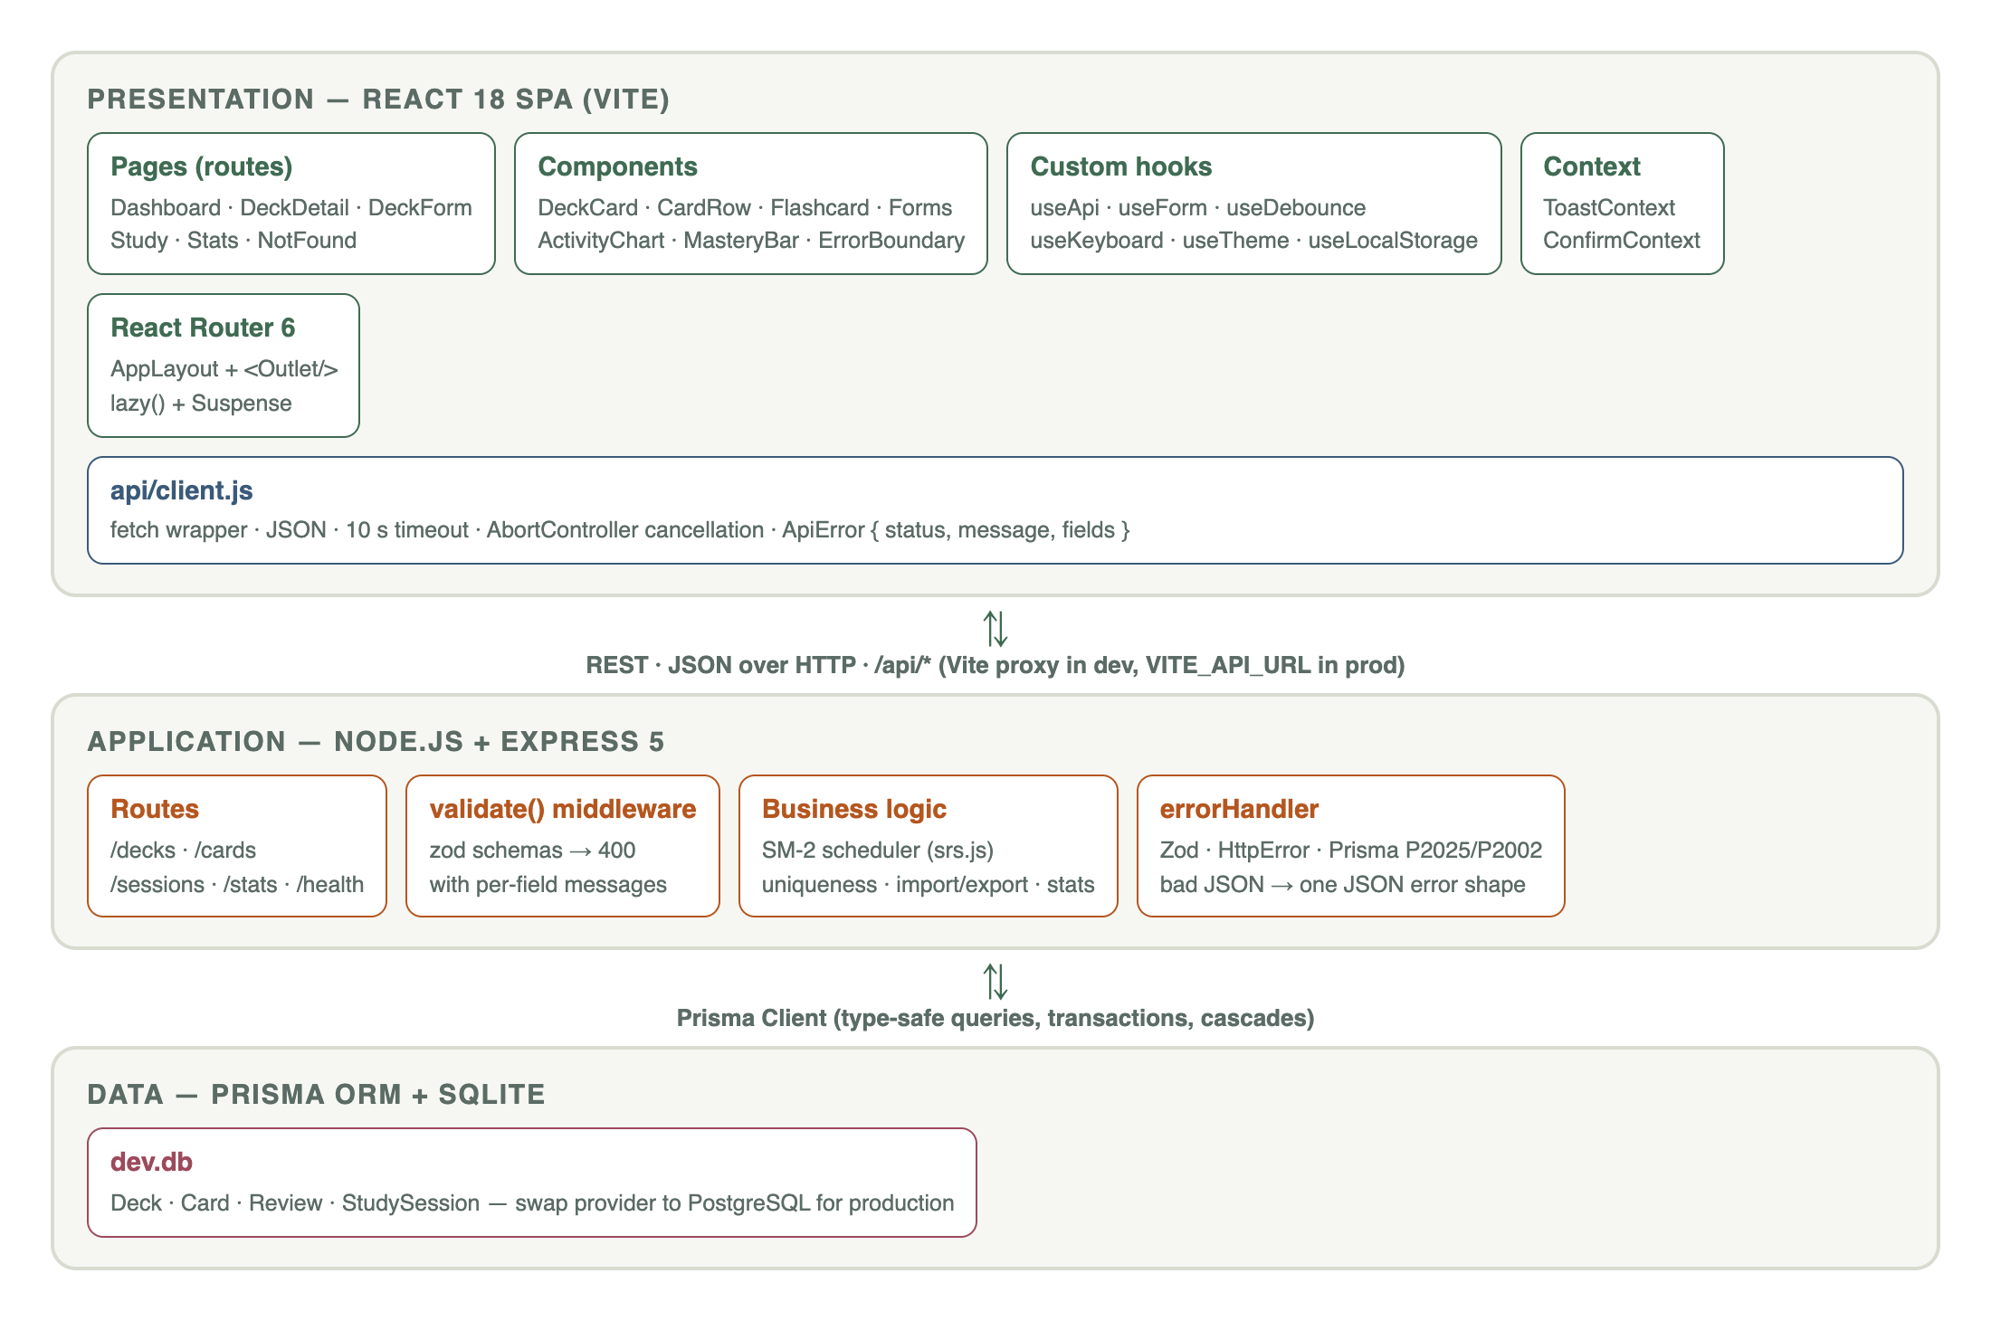
System Architecture
Three tiers: React SPA → Express REST API → Prisma + SQLite
Request flow
Page calls a custom hook (useApi / useForm)
api/client.js: fetch + JSON + 10 s timeout + AbortController
Express route → zod validate() → handler
Handler uses Prisma (transactions, cascades) and SM-2
errorHandler returns { error: { status, message, fields } }
UI shows data, inline field errors or a retry state

Slide 5
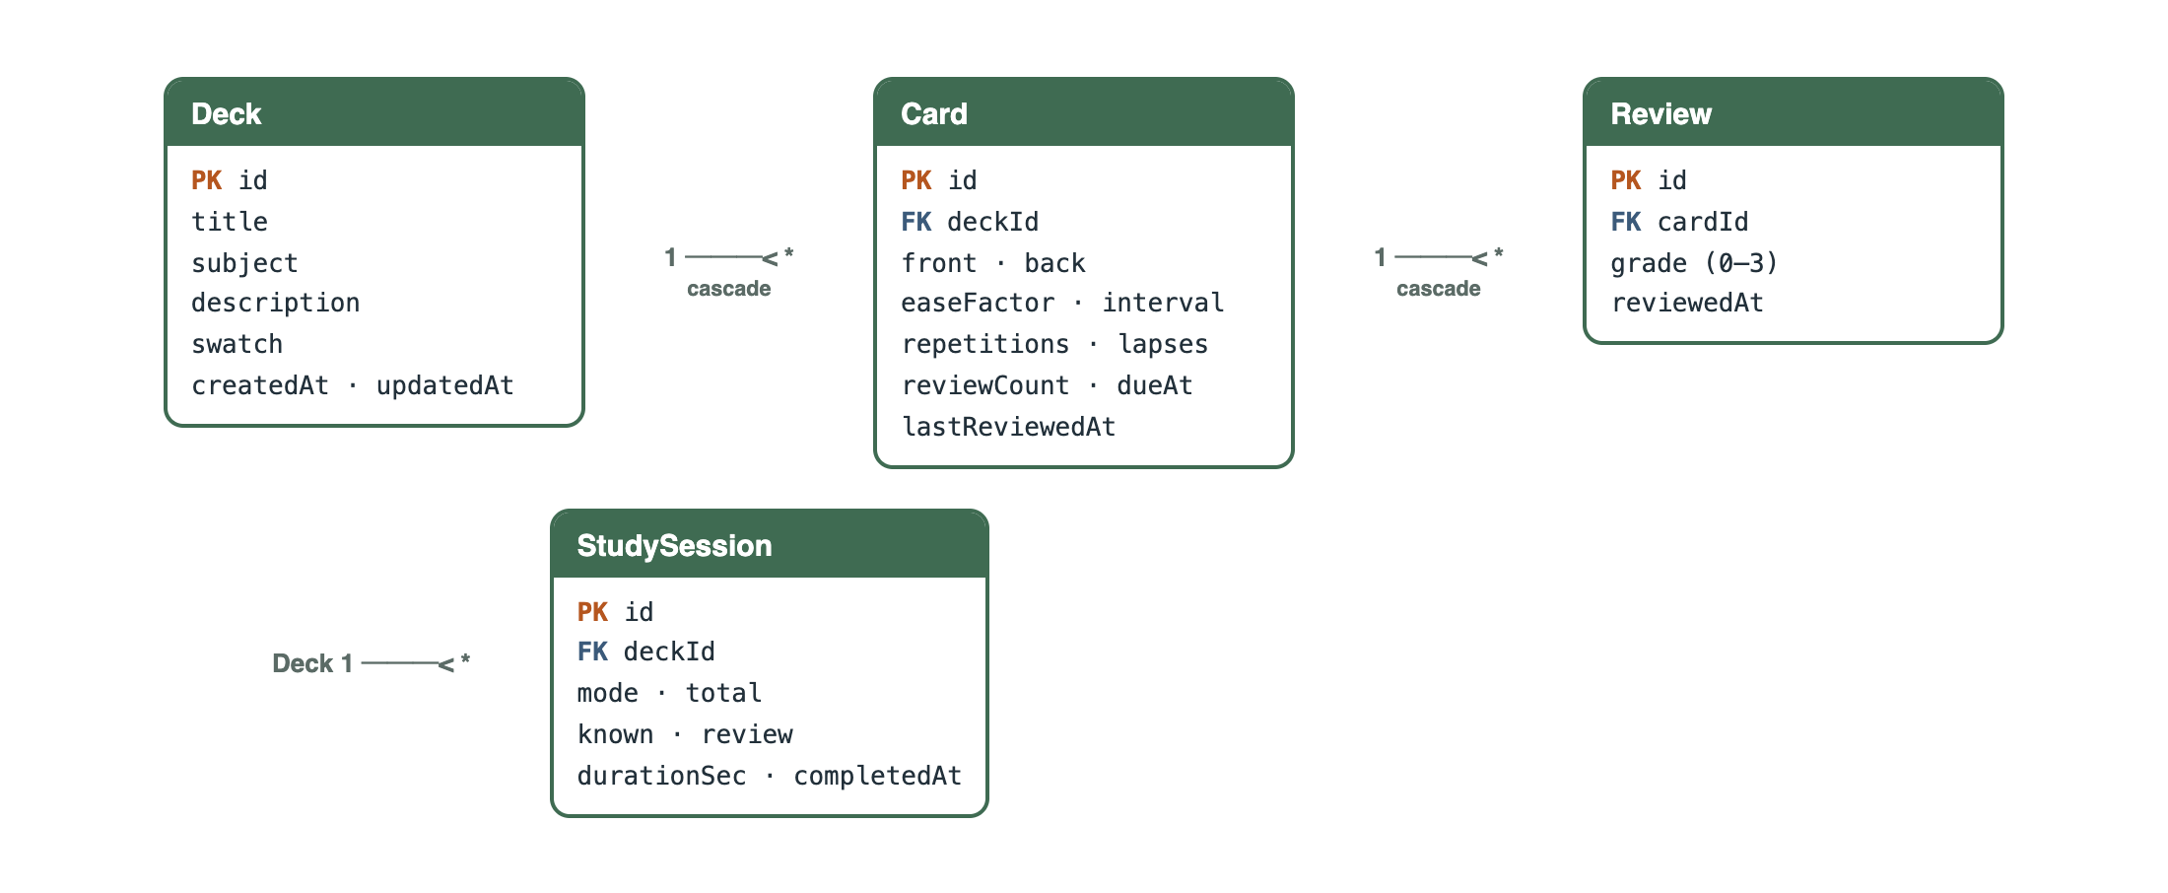
Database Design & Tech Stack
Schema-first with Prisma — swap SQLite for PostgreSQL by changing one line
Layer | Technology
UI | React 18 · React Router 6 · Vite 5
Styling | CSS custom properties (light/dark tokens)
API | Node.js · Express 5 · CORS
Validation | zod (server) + custom validators (client)
Data | Prisma ORM 6 · SQLite
Testing | Vitest · RTL · Supertest · Playwright
DevOps | GitHub Actions · Vercel/Netlify · Render
Deck 1─* Card 1─* Review · Deck 1─* StudySession · all cascade on delete · indexes on deckId, dueAt, reviewedAt

Slide 6
Hooks · Routing · Forms & Validation
React Hooks
Routing (React Router 6)
Forms & Validation
useReducer — study session state machine (start / flip / grade)
useContext — Toasts & promise-based Confirm dialog
useMemo / useCallback — filtered lists, stable handlers
Custom: useApi, useForm, useDebounce, useKeyboard, useLocalStorage, useTheme, useDocumentTitle
/ · /decks/new · /decks/:deckId
/decks/:deckId/edit · /decks/:deckId/study?mode=due&shuffle=1
/stats · * → 404
AppLayout + <Outlet/>, NavLink active states
useNavigate after create/delete; filters synced to the URL
React.lazy + Suspense per route
Reusable useForm: values, touched, errors, submitting
Errors after blur/submit; live character counters
Same rules on server via zod → 400 with field map
DB rules → 409 (duplicate title / question) shown under the field
Ctrl/⌘+Enter to save; fields locked while saving

Slide 7
API Integration · CRUD · Search & Filter · Error Handling
Method | Endpoint | Purpose
GET | /api/decks?q=&subject=&sort= | Search, filter, sort decks
POST · PATCH · DELETE | /api/decks[/:id] | Deck CRUD
POST | /api/decks/:id/cards | Add card
PATCH · DELETE | /api/cards/:id | Edit / delete card
GET | /api/decks/:id/study?mode=due | Study queue
POST | /api/cards/:id/review | Grade → SM-2 reschedule
GET · POST | /api/decks/:id/export · /import | JSON backup
GET | /api/stats | Streak, activity, mastery
Search & filter
Debounced (300 ms) server search — matches card text too
Subject chips + 4 sort orders, state kept in the URL
Card search + status chips (Due/New/Learning/Mastered)
Error handling
Server: zod→400, not found→404, duplicate→409, bad JSON→400
Client: ErrorBoundary, retry states, toasts, 404 page
"Server unreachable" banner via /api/health
Timeouts & cancelled stale requests
20 endpoints in total · consistent JSON errors
Confirm dialogs replace window.confirm · optimistic list updates after every mutation

Slide 8
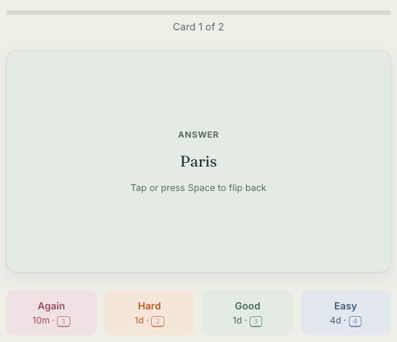
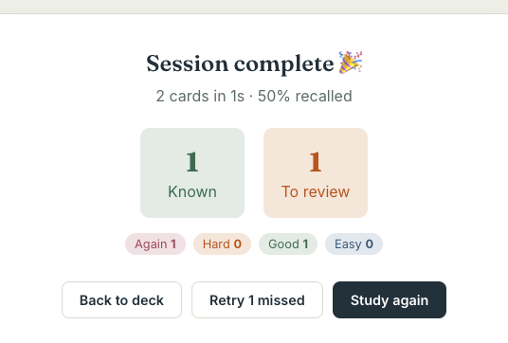
Spaced Repetition (SM-2) & Study Mode
How scheduling works
Grade after flipping: Again · Hard · Good · Easy
Again → streak resets, card returns in 10 minutes
Good → 1 day → 6 days → interval × ease factor
Ease factor starts at 2.5, adapts per card, floor 1.3
Hard ×0.8 · Easy ×1.3
Mastered = interval ≥ 7 days
Next interval previewed on every button
Keys: Space flip · 1–4 grade · Esc exit

Slide 9
Performance Optimisation & Testing
76
17
5
0
automated tests — all passing
E2E steps in a real browser
lazy-loaded route chunks
console errors in E2E run
Performance
Testing strategy
React.lazy + Suspense: pages load on demand (0.5–7.8 kB each)
Vendor chunk (React + Router) cached separately
React.memo on DeckCard / CardRow; useMemo filtering
Debounced search; AbortController drops stale requests
Prisma select + indexes — only needed columns
Backend: SM-2 unit tests + Supertest for every endpoint (isolated test.db)
Frontend: validators, API client, hooks (fake timers), components, pages with mocked API
E2E (Playwright + Chrome): full user journey incl. mobile, dark mode, import
E2E caught & fixed 2 real race-condition bugs
GitHub Actions CI: tests + build on every push

Slide 10
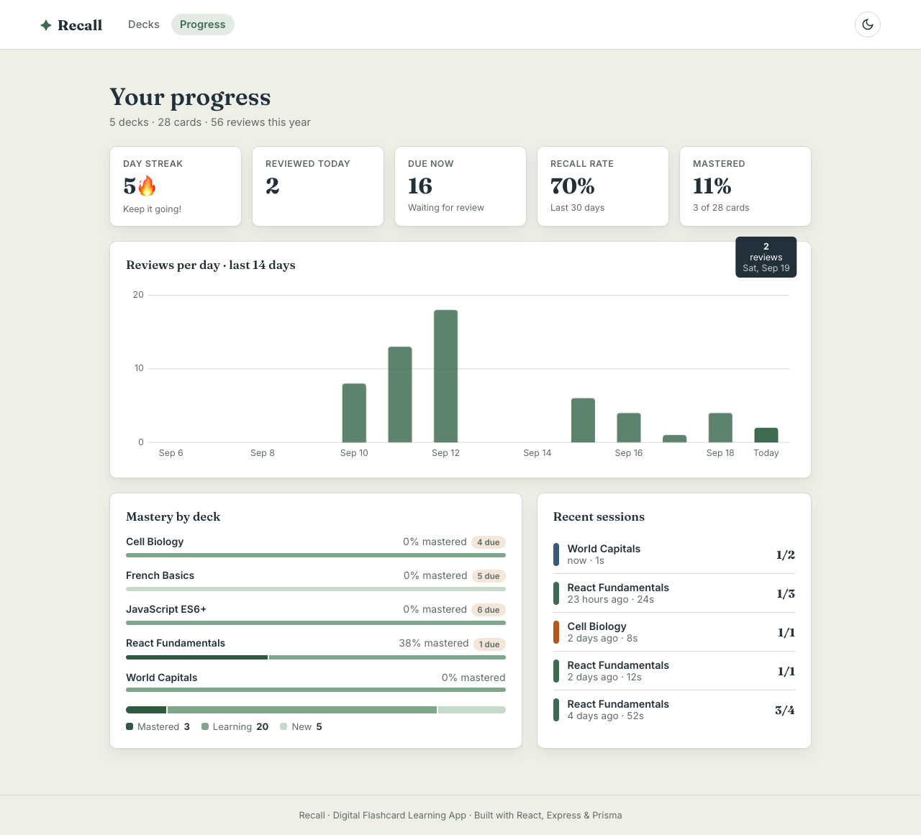
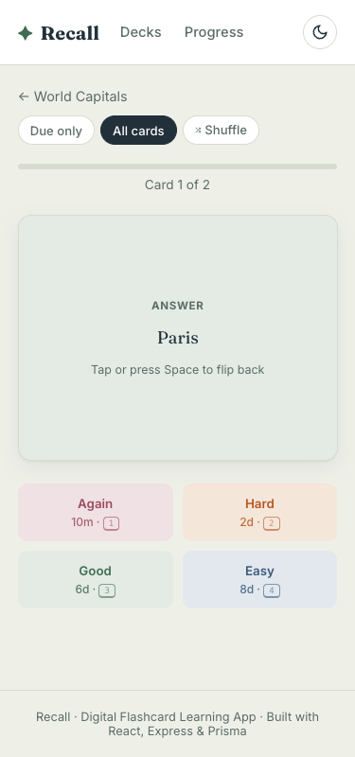
Results · Deployment · Conclusion
Deployment
Frontend: Vercel / Netlify (SPA rewrites included)
Backend: Render blueprint, health check, CORS
One-command setup: npm run setup → dev:all
Conclusion & future scope
All FA-2 scope items delivered, plus SM-2, analytics, dark mode, accessibility
Next: user accounts (JWT), images/audio on cards, PWA offline mode, AI card generation, PostgreSQL

