Slide 1
TSF4G
Nov/2008 jackyai

Slide 2

Agenda
Summary
Basic libraries and services of TSF4G
TSF4G Applications

Slide 3
summary

Slide 4

名词解释-TSF4G
Tencent Service Framework/For Game
Tencent Solution Foundation/For Game

Slide 5
TSF4G-Background
Front End
Back End
Data
接入
逻辑
存储
分析
安全/监控/日志

Slide 6
Vision
产品的服务级别需求SLA（Service Level Agreement ）达到L4或L5
产品的公共代码部分超过60%
减少30%运维人力需求
每万人在线成本降低30%
除了游戏逻辑相关的部分，其他部分应该不需要开发，只需配置一下即可

Slide 7
Design Principle
Data Driven Design
作为网络应用而言，最核心的部分是用户数据，所有的工作都是围绕用户数据进行的
Pattern Oriented
similarity to Generic Programming, 利用元数据(meta data)信息，把数据和逻辑分离, 可以让同一套处理逻辑为不同的数据（应用）服务
hierarchical structure
整个系统划分为不同的层次，功能逐步从业务无关向业务相关过渡，以期提供最大的重用性
高聚合（High cohesion）、低耦合(Low coupling)

Slide 8
Architecture
Solutions
Solution Foundation
BDL
业务相关
Services
Service Framework
Field Related Logic
Components
BIL
业务无关
Messaging
Logging
Managing
Security
Data Represent Layer
Platform Abstract Layer
KnowledgeBase

Slide 9
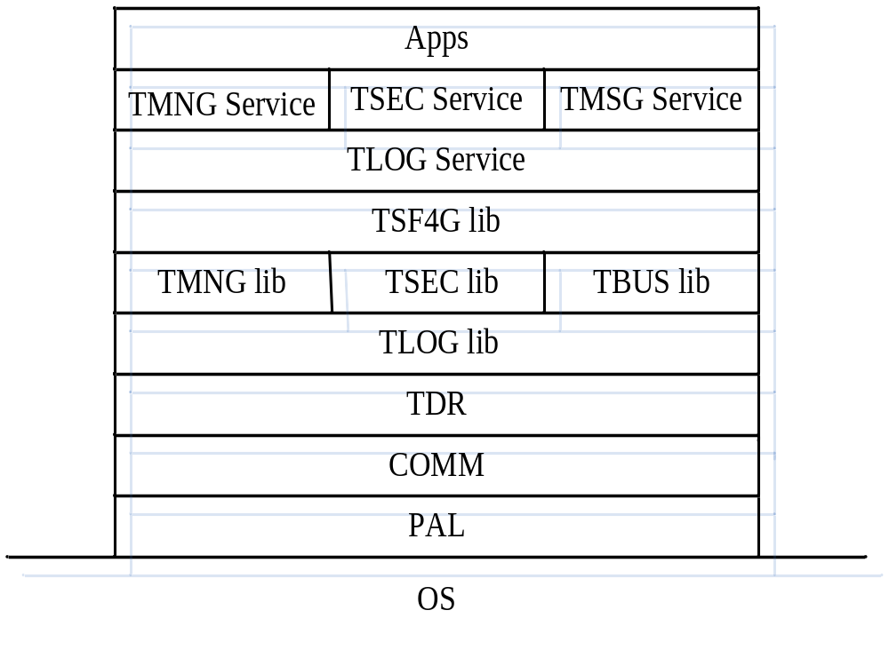
Current Architecture

Slide 10
Basic libraries and services of TSF4G

Slide 11
PAL(Platform Abstract Layer)
平台无关层接口库，主要是隔离操作系统调用的不同，目标是解决可移植性问题。
TSF/G能够同时支持在Windows/类Linux平台上运行
TSF4G后台服务框架，以在Windows平台上模拟Linux平台接口为主
Notes:
PAL：平台无关层接口库，以在Windows平台上模拟Linux平台为主
COMM： 通用数据结构和算法、模块约定（例如ERR 宏的分配）等，
TDR：数据表示层
TLOG lib：日志lib
TMNG lib：管理lib
TSEC lib：安全lib
TBUS lib：进程间通信lib
TSF4G lib：包含下层的3个lib，另外还有一些杂项lib，例如tapp程序通用框架等
TLOG Service：日志服务
TMNG Service：管理服务
TSEC Service：安全服务
TMSG Service：消息服务
Apps：领域应用

Slide 12
PAL接口
数据类型定义： ttypes.h
操作系统相关： tos.h
标准IO库、程序库： tstdio.h tstdlib.h
进程、线程控制： texec.h tfork.h tthread.h twait.h
进程、线程同步与互斥： tlock.h tmutex.h tsemaphore.h tsem.h
进程间通信： tshm.h tmsgque.h tipc.h tmmap.h
信号处理： siginfo.h tsignal.h
网络通信编程： tinet.h tnet.h tsocket.h tpoll.h
文件I/O: tfile.h tfcntl.h tuio.h
文件和目录： tdir.h tdirent.h
字符串处理相关： tstring.h
时间处理相关： ttime.h
命令行选项分析： getopt.h
动态库加载： tdlfcn.h

Slide 13
PAL使用示例
#incldue "pal/pal.h"
tsocket_init(2,0);
iUdpSocket = tsocket_open_udp();
tsocket_set_nonblock(iUdpSocket, 1);
......
tsocket_send();
tsocket_recv();
……
tsocket_close(iUdpSocket);
tsocket_fini();

Slide 14
Organization of PAL in the TSF4G
include file
tsf4g/include/pal
Source code
tsf4g/lib_src/pal

Slide 15
TDR（TSF4G Data Representation ）
TSF4G_DR_user_guild.ppt

Slide 16
TBUS

Slide 17
Tbus-Middle Software for process communication
Supply service for process communication
Shield the deployment of applications, apps exchange data by tbus, change of deployment will not impact the implement of applications
Transmit data Reliably, even process quit, data will not lost
Can Dye and trace message during transmission
provide back-up link for key application
Priority Control to communication channeles

Slide 18
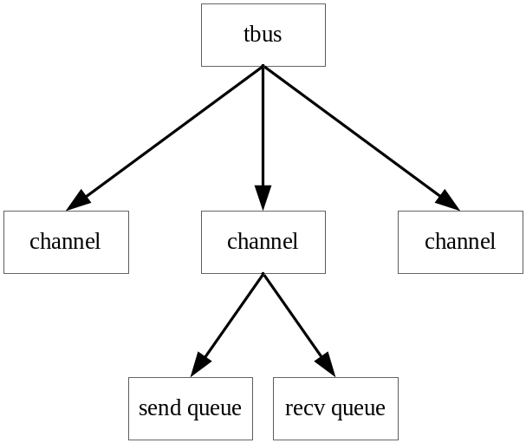
Tbus principle
bus channel was implemented by share memory, each channel has one send queue and recv queue
Each process was distinguished by unique communication address，the address can be represented by dotted decimal notation like as IP address
each channel was distinguished by the interrelated two process’s address

Slide 19
Tbus Address
Tbus Address is stored by 32bit integer in inner implement
the address can be represented by dotted decimal notation
dotted decimal notation templet
  “Segment. Segment…. Segment”
  Segment: description:number of bit
  “world:8.zone:8.func:8.instance:8 ”
  Default templet : “8.8.8.8”
All address represented by dotted decimal notation must match the templet
If templet is “16.8.8”, the address “256.1.1” is valid, but “256.1.256”is invalid

Slide 20
Special tbus address
If one process have more than on tbus channels, we should indicate use which channels to send/recv data By src and dst address
There two specail address that the application cannot use:
0
this address indicate to match the first channel
-1
this address indicate to match any channel

Slide 21
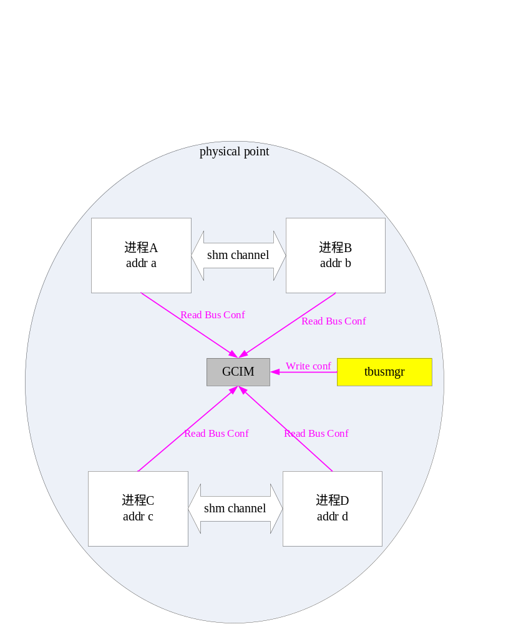
Tbus principle －process communication in the same machine

Slide 22
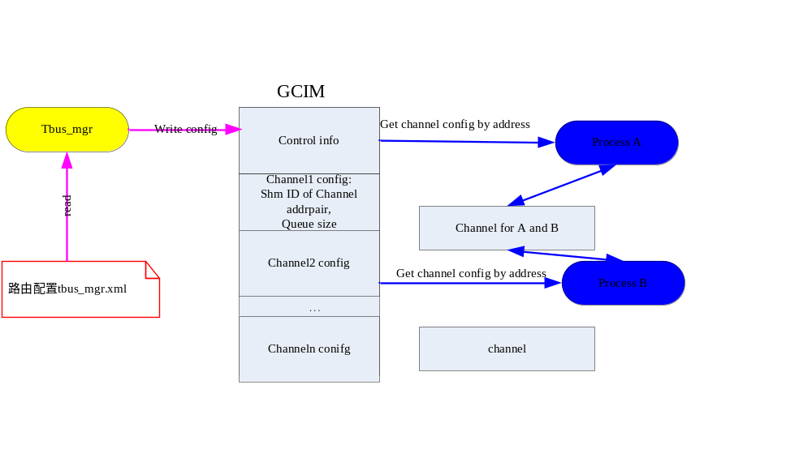
GCIM- Global Channel Information Map
need Only one GCIM in one machine! All process deployed on the machine share the configure in the GCIM

Slide 23
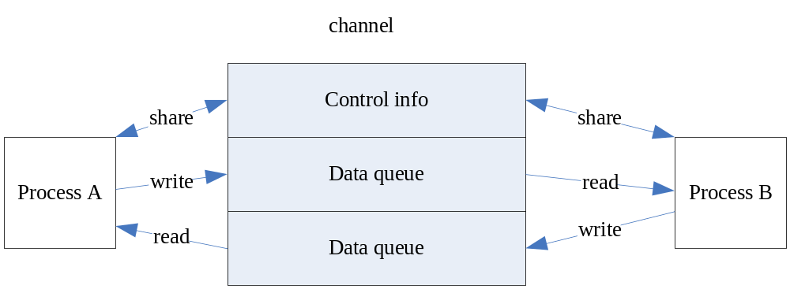
Tbus channels
Supply for full-duplex communication
No lock to queue, if there more than one processes at the same end of queue to read/write data, the processes should use lock. But we recommend to use more than one channels for these
process, each two process use one channels

Slide 24
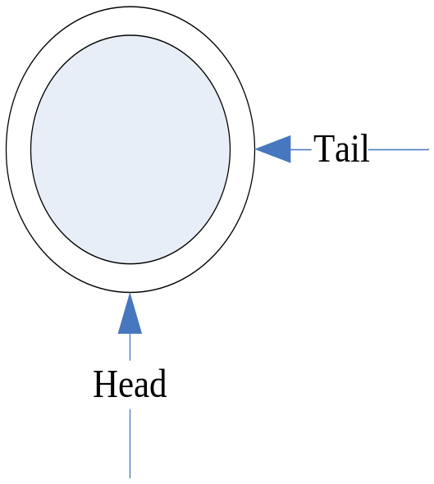
Tbus queue
Tbus Queue is a Cycle queue, queue define by three parameters: head,tail,size
To one tbus queue, one process write data to the queue, and the other read the data
The Writer append data to tail when queue is not full, and only change tail parameter
The Reader read data from head when queue is not empty
The head,tail,size parameters stored by 32 integer, process can read/write by One clock cycle, so need not lock

Slide 25
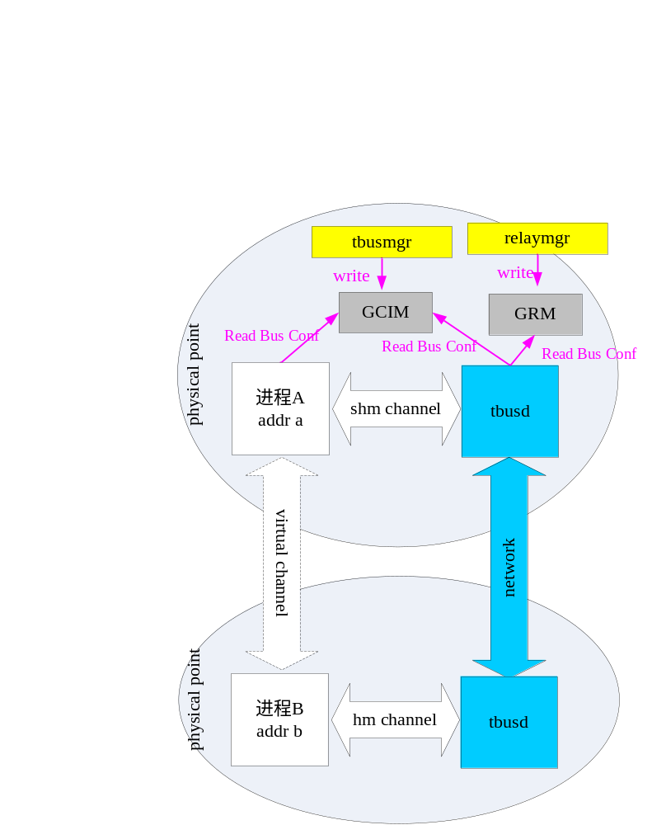
Tbus principle －process communication in the different machines
GRM：Global Relay Map，

Slide 26
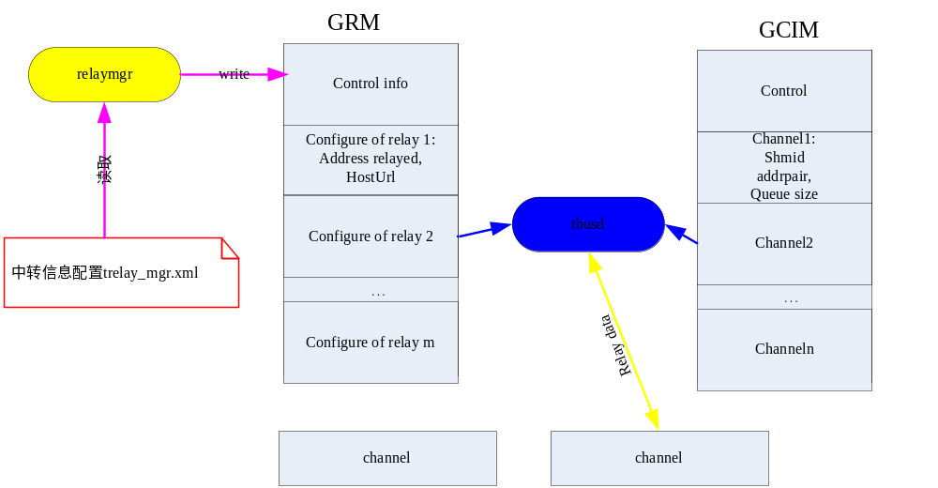
Tbusd- relay server
Tbusd- take charge to reley data, need only one tbusd in one machin
GRM- Golbal Route Map, need only one tbusd in one machin

Slide 27
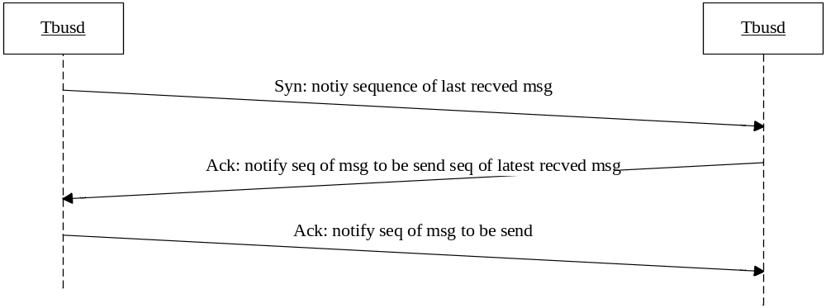
Tbusd - work like as TCP protocol
Every msg in the channels has the unique sequence
Before relaying msg, tbusds will exchange the sequence of recved and rending msg, this process we call as handshake
After handshake, tbusd know the sequence of msg that will be sending at the other side, once recev one msg, tbusd will check the sequence, If the sequence do not match, will discard the msg
Tbusd will notify sequence of receved msg by syn msg by timer or take this info at the sending msg.
In this way, the other side can affirm the msg have receved, If the msg have not be affirmed, tbusd will send again

Slide 28
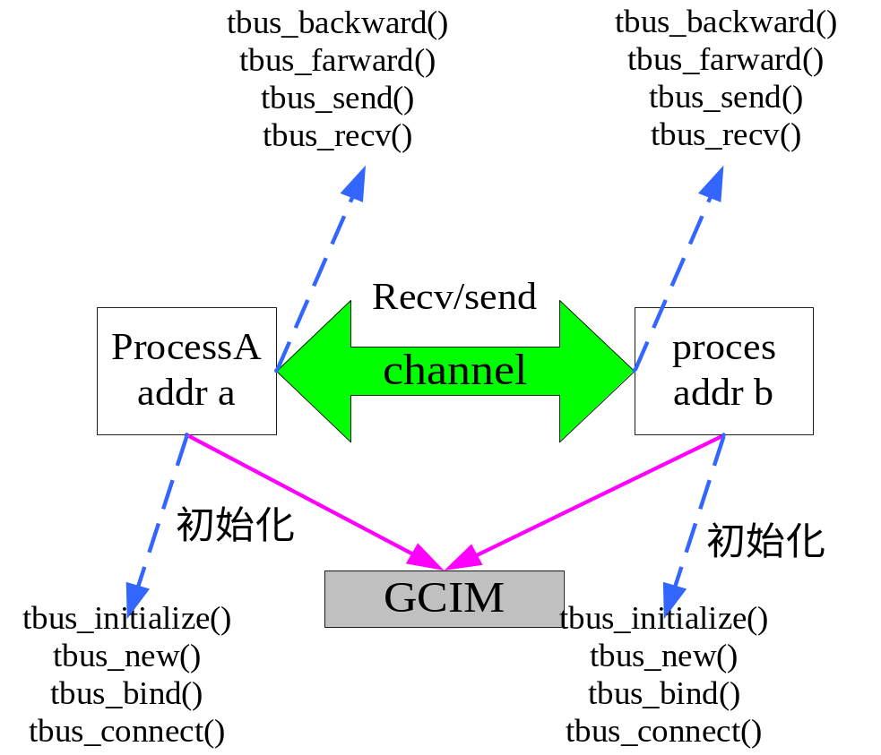
Tbus usage
To get more detail about how to use tbus API by The document ‘TSF-G-TUBS-API.chm’in the directory
Tsf4g/docs/tbus

Slide 29
Tbus usage-forword, backword
TBUS使用-farward,backward
Process A
Process C
Proces D
Process B
Where the msg come from, and the response will go back to there, the process need not record the route of msg
To process C, once recev one msg, and just use tbus_farward to send the msg processD, processD send the response to processC by bus_backward, and then processC backward response to processA if original msg from processA
There a tbusHead added to the msg, when use tbus API to send/recv msg, tbus API can record the route info to the tbusHead, tbus_farward/tbus_backward use the route info in the tbusHead

Slide 30
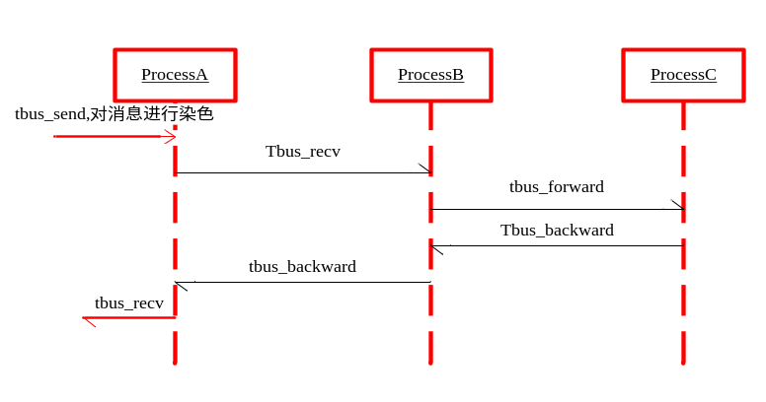
Dye and trace message
If we need to trace the process of one msg, we can dye the msg when sending by tbus API. API of recv/send has one flag parameter to set whether dye msg
If dye the msg, we can get the dyedID, by this id we can trace the msg
Time Operation DyeID src->dst route
T0 Send(start) MsgDyeID A->B` A
T1 Recv MsgDyeID A->B A
T2 Send(forward) MsgDyeID B->C B,A
T3 Recv MsgDyeID B->C B,A
T4 Send(backward) MsgDyeID C->B A
T5 Recv MsgDyeID C->B A
T6 Send(backward) MsgDyeID B->A
T7 Recv MsgDyeID B->A

Slide 31
Tbusmgr/relaymgr
Tbusmgr is a tool to maintain GCIM, we can write,delete or look over the configure of GCIM by this tool
We also can get general picture of msgs in the all channels which belong to one given process.
Relaymgr is a tools to maintain GRM, we can write, delete, or look over the configure of GRM by this tool
To get more detail by document <TSF-G-bus_maintence.doc> in the derectory tsf4g/docs/tbus

Slide 32
Organization of TBUS in the TSF4G
library source codes
tsf4g/include/tbus , tsf4g/lib_src/tbus
Docs
tsf4g/docs/tbus
tools source codes
tsf4g/tools_src/tbus
Tbus service source codes
tsf4g/services_src/tlog_service
Usage sample
tsf4g/lib/example/tbus
tools
tsf4g/tools

Slide 33
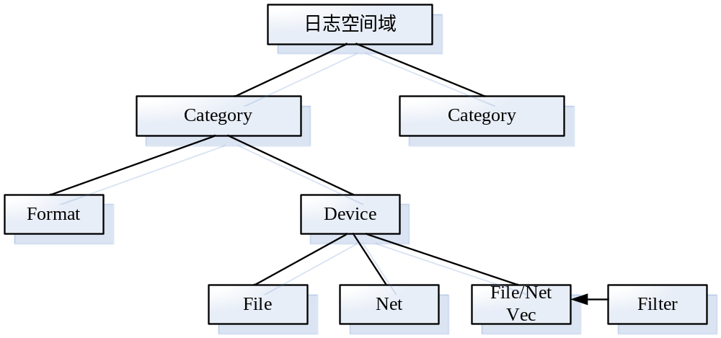
TLOG-component for log
TLOG lib
  起源于log4c
  将日志以各种格式写到磁盘或网络

Slide 34
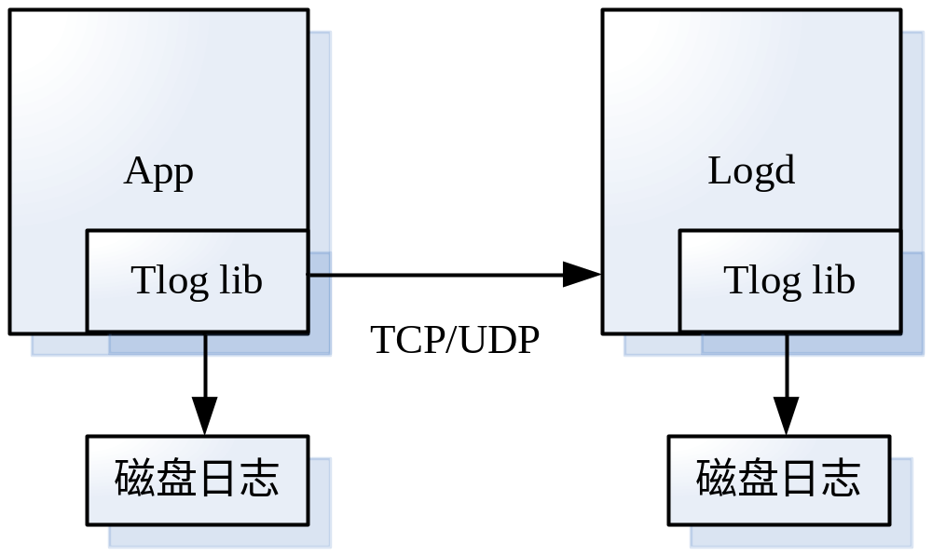
Tlogd-log server
接收网络日志消息
将收到的日志以各种格式写到磁盘或网络

Slide 35
Organization of Tlog in the TSF4G
library source codes
tsf4g/include/tlog , tsf4g/lib_src/tlog
Docs
tsf4g/docs/tlog
tlog service source codes
tsf4g/services_src/tlog_service

Slide 36
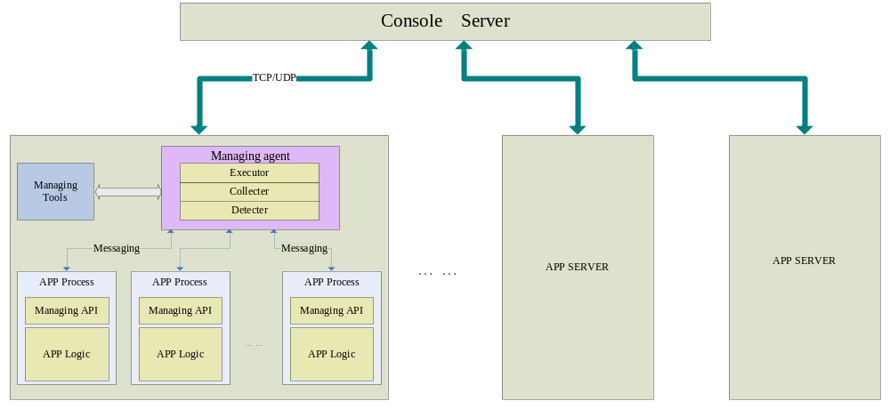
Tmng-component for process management and control

Slide 37
Tmng-manage configure and run data
配置中心
进程
配置数据
Tagent
运行数据
监控中心

Slide 38
Tmng-manage metabase api
Metabase can regard as the database to store the metalibs of data
metalib stored data description information by TDR
There one metabase which is managed by tmng tools in one machine，all process can get the description of data by call API of tmng;
Metabase
Metalibs
进程A
Tmng tools
进程A

Slide 39
Organization of tmng in the TSF4G
library source codes
tsf4g/include/tmng , tsf4g/lib_src/tmng
Tools source codes
tsf4g/tools_src/tmng
Tools
tsf4g/tools

Slide 40
Tapp-template of process framework
总结后台程序处理模式，抽象成服务框架，应用只需设置相应业务处理接口即可
规范进程的起停方式/信号处理/启动参数
int main ( int argc, char ** argv )
{
int iRet;
void *pvArg = &gs_stAppEnv;
gs_stAppCtx.argc = argc;
gs_stAppCtx.argv = argv;
gs_stAppCtx.pfnInit = (PFNTAPPFUNC)app_init;
gs_stAppCtx.pfnFini = (PFNTAPPFUNC)app_fini;
gs_stAppCtx.pfnProc = (PFNTAPPFUNC)app_proc;
gs_stAppCtx.pfnTick = (PFNTAPPFUNC)app_tick;
/*其他初始化系统数据元数据库*/
iRet = tapp_def_init(&gs_stAppCtx, pvArg);
iRet = tapp_def_mainloop(&gs_stAppCtx, pvArg);
tapp_def_fini(&gs_stAppCtx, pvArg);
return iRet;
}

Slide 41
tapp_def_init
Parse command line parameter
Set function to handle signal
Set daemon
Read configure
Initialize bus, log api
Call initialize function of the application
Data about run
stRunData;
tapp
Application
stConfData
Data about configure
DR

Slide 42
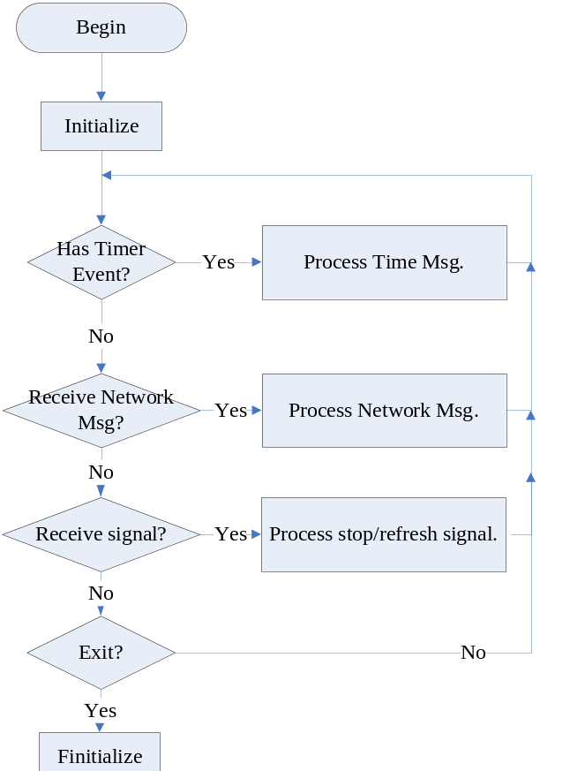
Tapp-framework
Main loop
  process business logic
  Process timer logic
  Refresh configure
  Once recev quit signal，execute logic before process quit

Slide 43
Organization of tapp in the TSF4G
library source codes
tsf4g/include/tapp , tsf4g/lib_src/tapp

Slide 44
TSF4G Applications

Slide 45
Tconnd-connector server
tconnd_user_guide.ppt

Slide 46
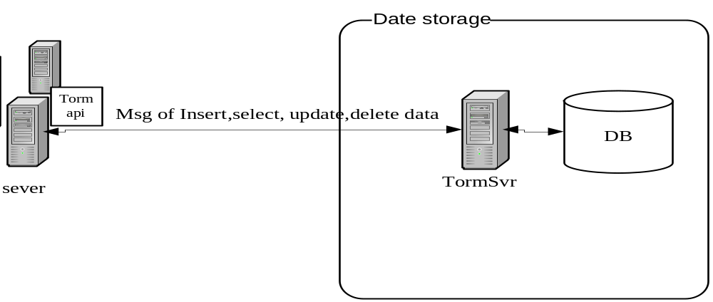
Tormsvr-storage server
Implement the mapping between data in memory and data in DBMS
Shield the conversion detail that generate operation sql for data. So developer need know a liter about DBMS

Slide 47
Implement-Principle
Description the data stored by DR
One logic strut stored by one kinds of table
To the mass data storage, support use several tables to store the data
Define the rules that map the member of struct to the column of table
Define the rules that generate table name by DR description of strut
Use these mapping rules, we can generate sql to create/alter table
$(TSF4G_TOOLS)/meta2tab
Use these mapping rules, we can generate the sql to operate(insert,select,update,delete) the data

Slide 48
Implement-templet of sql
templet of sql generated
  INSERT INTO tbl_name (col_name,...) VALUES (col_val,...)
  UPDATE tbl_name SET col_name1=expr1 [, col_name2=expr2 ...] WHERE where_definition
  SELECT col_name,... FROM tbl_name WHERE where_definition
  DELETE FROM tbl_name WHERE where_definition
WHERE where_definition can be cumtomize, defaultly we will generate the condition by primaykey
According the mapping rules and the sql templet defined, we can implement the interface that generate sql of Insert、Update、Delete and Select data

Slide 49
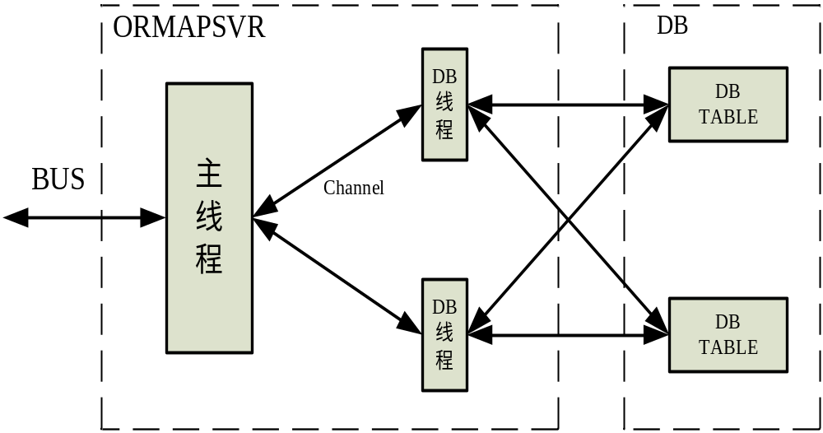
Implement-Build a service
Tormsvr－As a service process, Generate the sql to operate data automatically and execute the sql

Slide 50
implement
Logic server communicate with tormsvr use protocol defined by tormsvr, use this protocol, logic send the insert,update,, select or delete data request to tormsvr, tormsvr generate the sql, execcute, and then send result to logic servr by protocol msg
Request message that contains three main parts：Operation cmd(insert,update,, select or delete ）、description of data operated, the content of data operated
response message that contains three main parts: reuslt, decription of data, the record of data(zoro or more)
One request just operate the all members of part members of the only one strut data
Support cache data if the struct data has primary key

Slide 51
Asynchronous mode
the logic server and tormsvr operate the data by Asynchronous mode
So we need a mechanism to support this asynchronous mode, that means when response come back to logic server, the logic server need match the response to right request
In the protocol of tormsvr and logicsvr, there is a the TORMPkgHeadApp struct in the protocol head, tormsvr will copy this struct to response unchanged.
Also there a AsynCallBackData menber in the head, this information will be copied to response.
The logic server can use these two information to support Asynchronous mode according the Actual needs

Slide 52
Organization of torm in the TSF4G
tormsvr source codes
tsf4g/apps/orm/tormsvr
API for torm client
tsf4g/apps/orm/tormapi
Docs
tsf4g/apps/orm/doc
usage samples
tsf4g/apps/orm/example

Slide 53
Common Login platform’s applications
Version control server
Diretory service server
Tqos servers

Slide 54
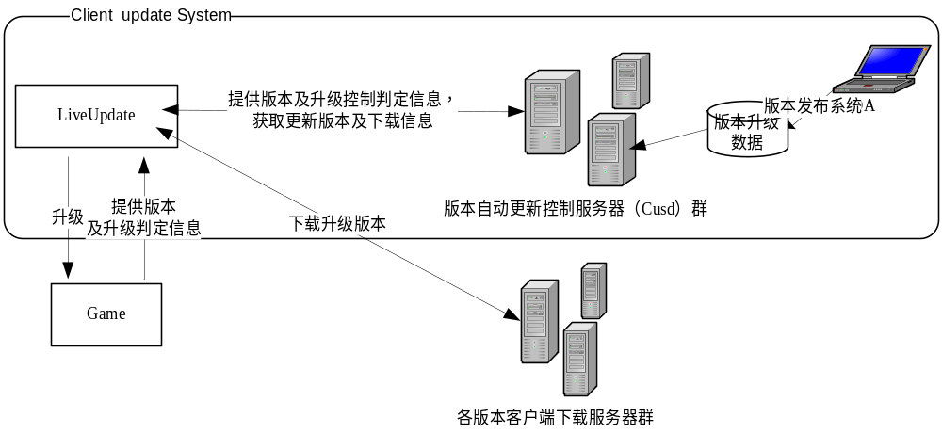
Version server
提供客户端版本升级控制/版本下载信息等
Tenio的相关组件一起提供客户端下载更新服务

Slide 55
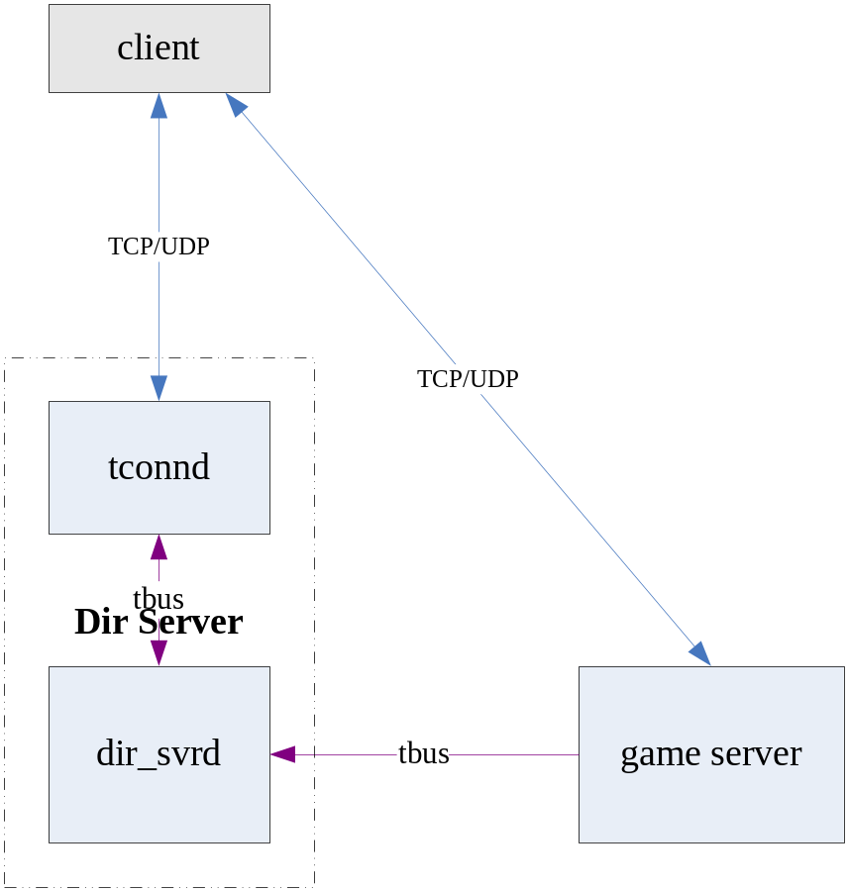
Directory service server
Dir Server 提供给Game Client可用的游戏服务分布信息，引导Client连接相应的Game Server

Slide 56
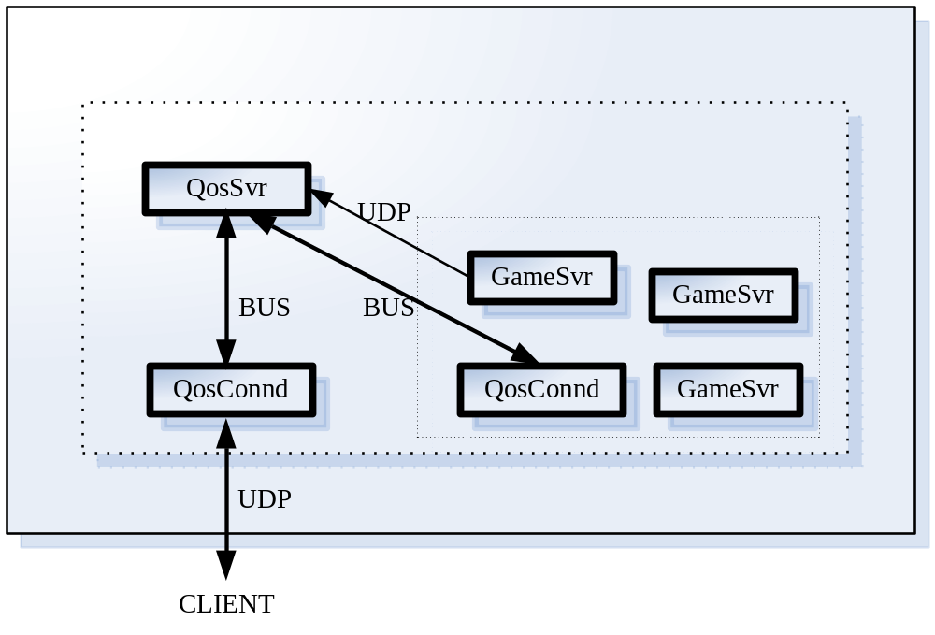
Tqos
TQos组件统一获取QOS（服务质量信息）的方式，包括获取和提供服务接入点网络质量，获取及处理用户体验数据等。

Slide 57
Q&A
Thanks！

