Slide 1
TSF4G_DR_User_Guild
Nov/08 jackyai

Slide 2

Definition
TSF4G
Tencent Solution Foundation/For Game
DR
Data Representation

Slide 3

Agenda
Why we need DR?
Design Principle
Implement
Usage

Slide 4
Why we need DR?

Slide 5
Why we need DR (1)
To network application, User’s data is the key portion
The Generator of the data maybe different from the processor, generally, data may be transfer on network
Some data should be stored to persistent form, such as storing to DBMS
To speed the process , we may change the data’s organization format in memory , such as sorting
For the different of processor, os, and running environment, in order to maintain the semantics of data, the data migration needed to make appropriate arrangements
Sometimes the data required to display by the format that human beings can be read and understood

Slide 6
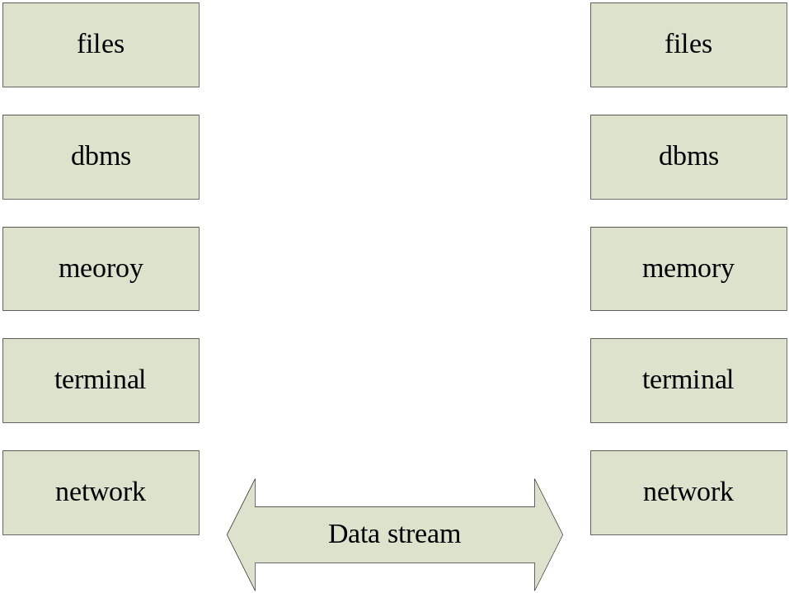
Why we need DR (2)
we need process when data from one status to another

Slide 7
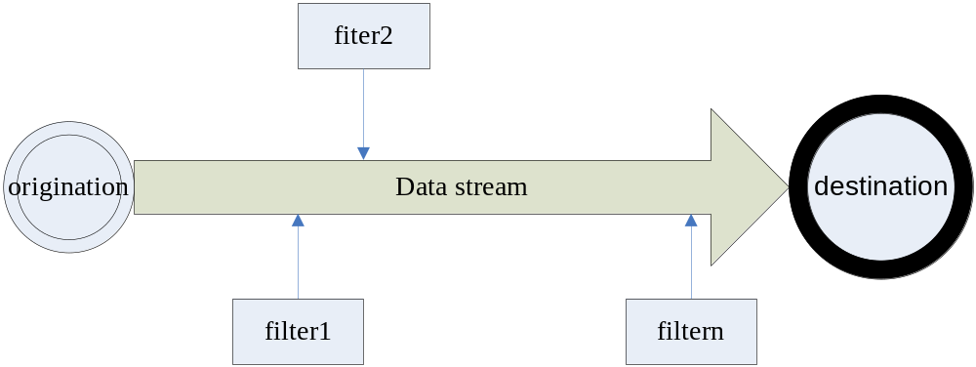
Why we need DR (3)
When the data reach the destination from the origination, we need write code to process

Slide 8
Why we need DR (4)
Once we need to transfer the format of data, although the process is similar, but we must repeat to write the codes
Can we reuse the codes for data Conversion ? Can the data be converted Automatically ?
Yes, we can just by DR
similarity to Generic Programming, DR don not concern to the logic of data, just focus to the common Algorithm of transfer the format of data

Slide 9

Why we need DR (5)
Key point that DR should to resolve:
Understand the semantic of data
semantic: for example, if we store data to META by DR, we should know that use which table to tore data, which entries of data can be the primary key
Supply the Algorithm to Convert the data in in various forms Automatically

Slide 10
Design Principle

Slide 11
Principle(1)
Every data is comprehensive
Every data is describable

Slide 12
Principle(2)
Use metadata to describe the data, all the Conversion process depend on the metadata
Use XML to describe Metadata, each metadata has some nature attributes
Xml Is a universal description of the document (data) content markup language, we can use XML to represent the semantics.

Slide 13
Principle(3)
How combine DR technology with application?
As the C program language can easily combine with the other high-language, so DR provide C program language interface for all format conversion
DR only focus to data self and its conversion , do not care the business logic of the data

Slide 14
Implement

Slide 15
Implement (1)
Use metadata to describe the data, all the Conversion process depend on the metadata
Use XML to describe Metadata, each metadata has some nature attributes
The description info of data include: semantic of data, and info of the memory storage structure following the C program language
In the all lifecycle of the data, we use metadata description info to process conversion
Rules to describe the data by metadata which are described in the ‘document TSF4G-DR -元数据描述.doc’ at tsf4g/dosc/tdr

Slide 16
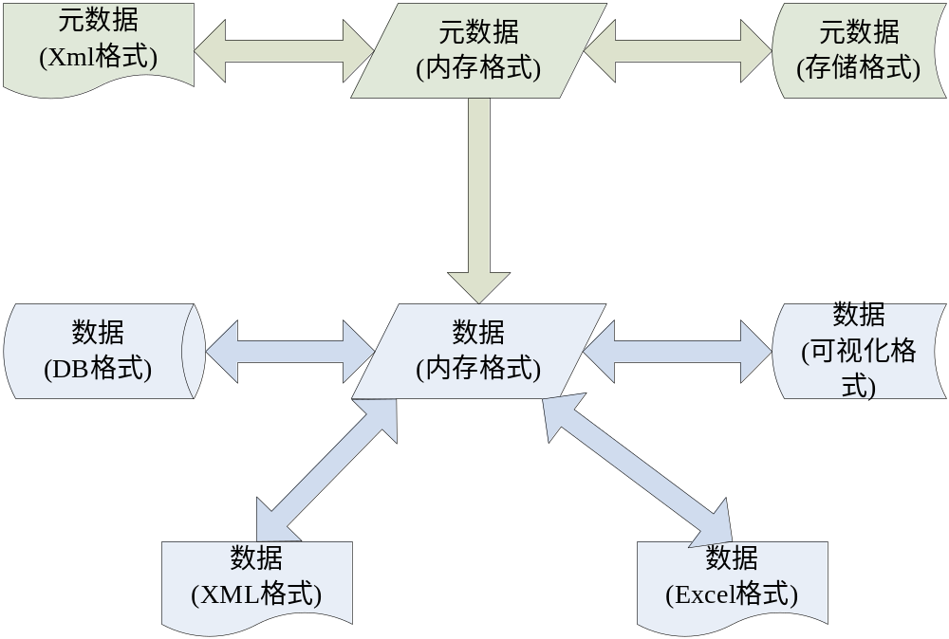
Implement

Slide 17
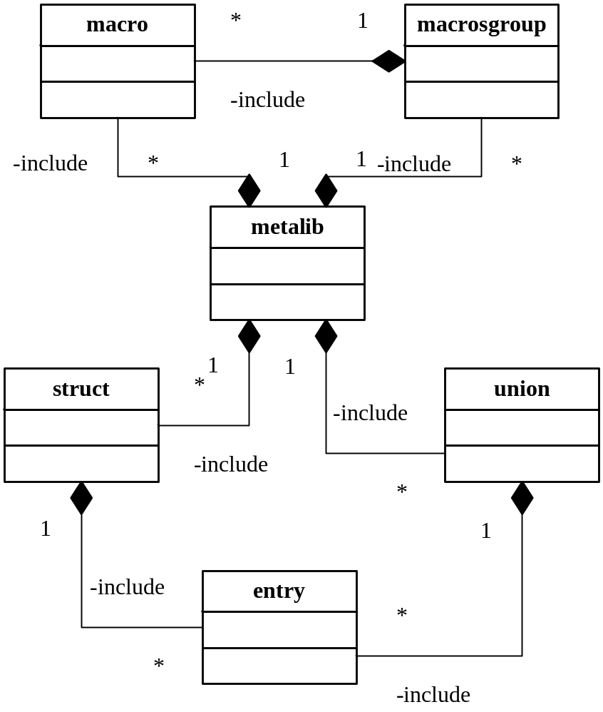
Description rule
Architecture of metalib (Collection of descriptions of data )

Slide 18
Common attribute
  Each element in DR xml can define attributes as following:
  name
  version
  desc
  id
  cname

Slide 19
Restrict of name attribute
Value of name attribute of metalib element is like namespace defined in C++
One metalib can be difined by several DR xml files, the value of name attribute must be same, except that the value is null string
All value of the name of structs and unions in the metalib must be unique
All value of the name of entries in one struct must be unique
The value of the name of entries in one union can be same as long as the value of id is defferent

Slide 20
Restrict of version attribute
metalib,struct and union must have version attribute
The version of metalib used to indicate the change of all data, so once we change the description of data in metalib, we should increment the version value of metalib
The version of struct and union indicate that it was added to metalib at which version of metalib, and its version cannot change
The version of entry in the struct or union indicate that it was added to metalib at which version of metalib. If the entry has not version attribute, that means this entry have the same version value with the struct or union

Slide 21
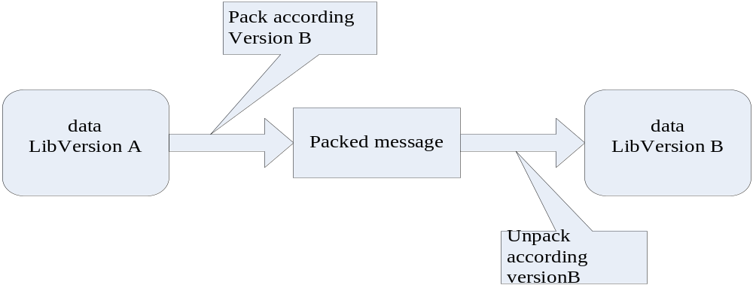
Cutoff Data according to version of metalib
If Version A < Version B, it cannot work
If Version A >=Version B, it’s ok, all the entries whose version is bigger than B will not be packed to msg
So before communication with each other, should exchange the version of data description

Slide 22
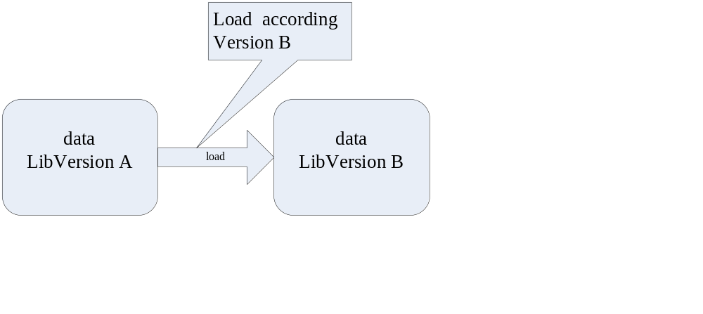
Cutoff Data according to version of metalib
If Version A < Version B, all the entries whose version is bigger than A will be set default value
If Version A >=Version B, all the entries whose version is bigger than B will be ignored
So when we store data, we should record its version

Slide 23
Attributes of metalib
Targetsetversion
At present, its value is 1, this attribute to support the update of metadata self

Slide 24
Attributes of macro
Value
<macro name="MAX_BODY_LEN" value="32000"
desc=“MAX_MSG_BODY_LEN " />

Slide 25
Attribute of struct
size : custom define the memory size for struct
align : corresponding to #pragma pack of compile, default align 1
sortkey : sort array of this struts by which entry
primarykey : when this struct stored to dbms, which entries will be primarkey
splittablefactor，splittablekey，splicttablerule : the datas of one struct can be stored to several tables
sizeinfo : How to record the length of this struct when encode to network msg

Slide 26
Attribtes of entry
type : data type, can be simple data type, and also can be composition data type
count : length of array
refer : indicate the real length of this entry array stored in which entry
defaultvalue : define default value
select : when this entry’s type is union, indicate How get the right entry of union
autoincrement : When this entry is stored to dbms, it has auto-increment characteristic

Slide 27
Usage

Slide 28
Usage
Description by Metadata
XML file
transfer
generate
generate
.h file to define the data
Description by Metadata
Bin file
Description by Metadata
.c file
uesd
Description by Metadata
memory
Data
In memoy
used
application
prces
tranfer
DR API

Slide 29
Tdr tool
Tdr
  --xml2h: create .h file of data by xml description files
  --xml2bin: create binary metalib file by xml files
  --xml2c: create .c metalib file by xml files
Tdr2xml
convert binary metalib file to xml description file
Meta2ab
generate create/alter table sql for one struct by its description
To get more details by document ‘TSF-G-DR-运行控制工具使用说明书.doc’at tsf4g/dosc/tdr

Slide 30
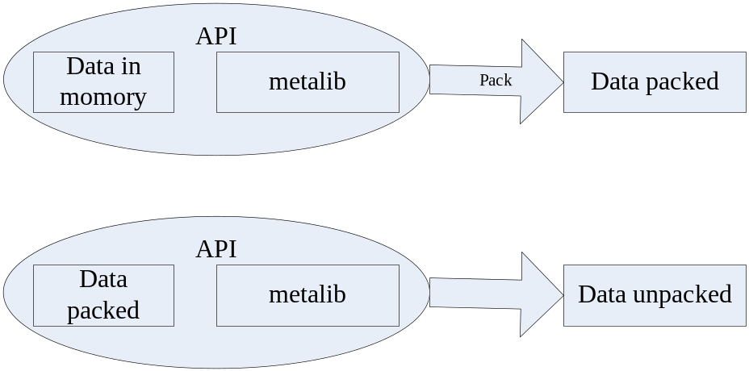
Usage
API: tdr_hotn,tdr_ntoh
Document of API: tsf4g/dosc/tdr/TSF-G-DR-API.chm

Slide 31
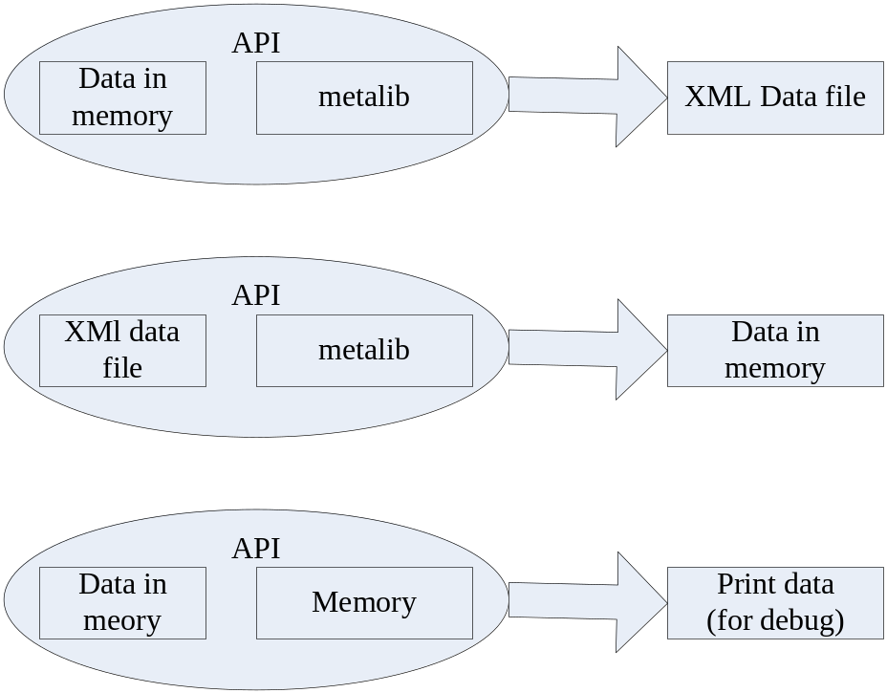
Usage
APIs:
tdr_input,tdr_output
Tdr_fprintf
.

Slide 32
Usage example
At tsf4g/lib/example/tdr, there are several examples to show how t use tdr API

Slide 33
Q&A
Thanks!

